Slide 1
Letters to Corinth
Lessons for us all

Slide 2
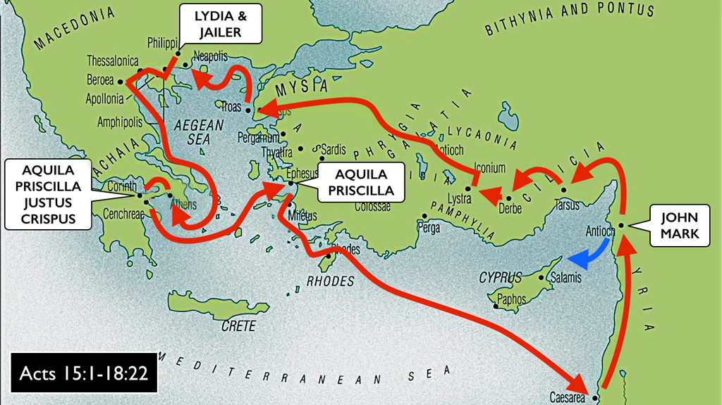
Paul in Corinthians
Acts 18:1-4, 7-16

Slide 3
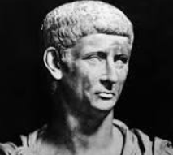
Paul in Corinthians
In Corinth after 49AD Claudius expelled Jews from Rome
Acts 18:7-16

Slide 4
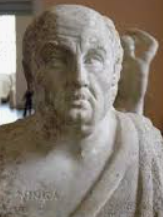
Paul in Corinthians
In Corinth after 49AD Claudius expelled Jews from Rome
Gallio served as proconsul from 51-52AD

Slide 5
Paul in Corinthians
In Corinth after 49AD Claudius expelled Jews from Rome (Acts 18)
Gallio served as proconsul from 51-52AD
1st letter approx. 52-55AD (1 Cor. 5:9)

Slide 6
Paul in Corinthians
In Corinth after 49AD Claudius expelled Jews from Rome (Acts 18)
Gallio served as proconsul from 51-52AD
1st letter approx. 52-55AD (1 Cor. 5:9)
1 Corinthians approx. 55 AD

Slide 7
Paul in Corinthians
In Corinth after 49AD Claudius expelled Jews from Rome (Acts 18)
Gallio served as proconsul from 51-52AD
1st letter approx. 52-55AD (1 Cor. 5:9)
1 Corinthians approx. 55 AD
Another lost letter? (2 Cor. 2:3–4; 7:8, 12)

Slide 8
Paul in Corinthians
In Corinth after 49AD Claudius expelled Jews from Rome (Acts 18)
Gallio served as proconsul from 51-52AD
1st letter approx. 52-55AD (1 Cor. 5:9)
1 Corinthians approx. 55 AD
2 Corinthians approx. 55-57 AD

Slide 9
Paul in Corinthians
Should we be concern with only having 2 of 4 letters?
What is the importance in the number of letters sent to Corinth?

Slide 10
Paul in Corinthians
Should we be concern with only having 2 of 4 letters?
What is the importance in the number of letters sent to Corinth?
No, only thing this tells us is that Paul was consistently contacting the church in Corinth.

Slide 11
Paul in Corinthians
Should we be concerned about the content of the lost letters?

Slide 12
Paul in Corinthians
Should we be concerned about the content of the lost letters?
No.
There will be no uncovered letter that would contradict the rest of the scriptures.

Slide 13
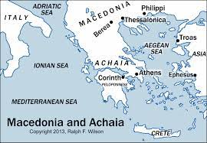
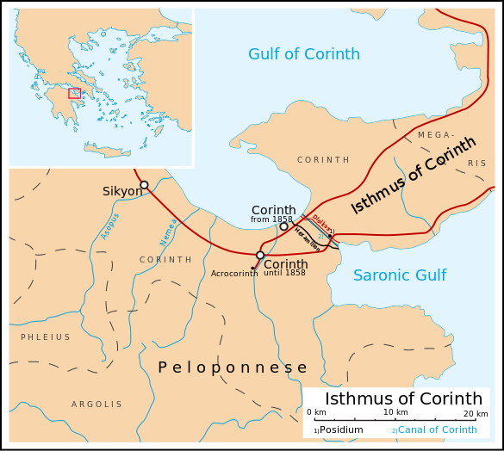
Corinth

Slide 14
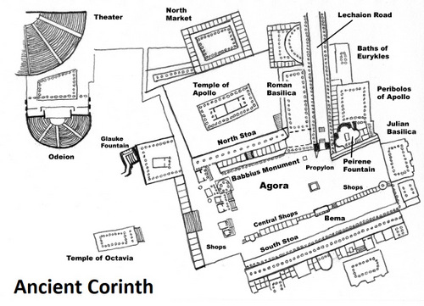
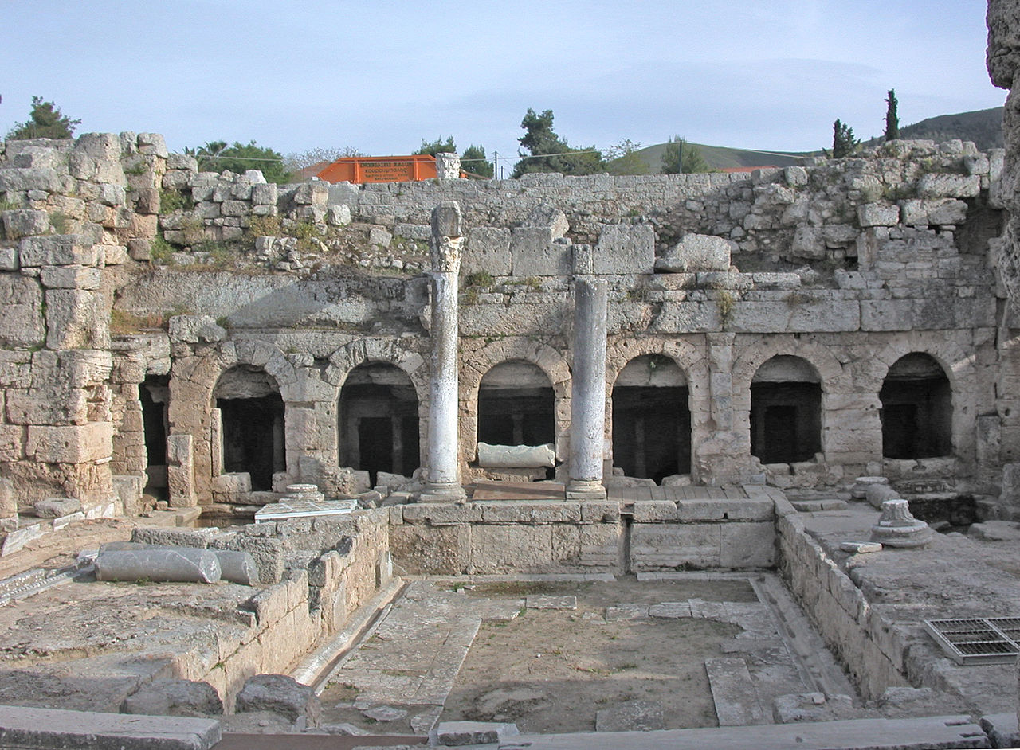
Corinth
Peirene Fountain
It was said to be a favored watering-hole of Pegasus, sacred to the Muses. Poets would travel there to drink and receive inspiration.

Slide 15
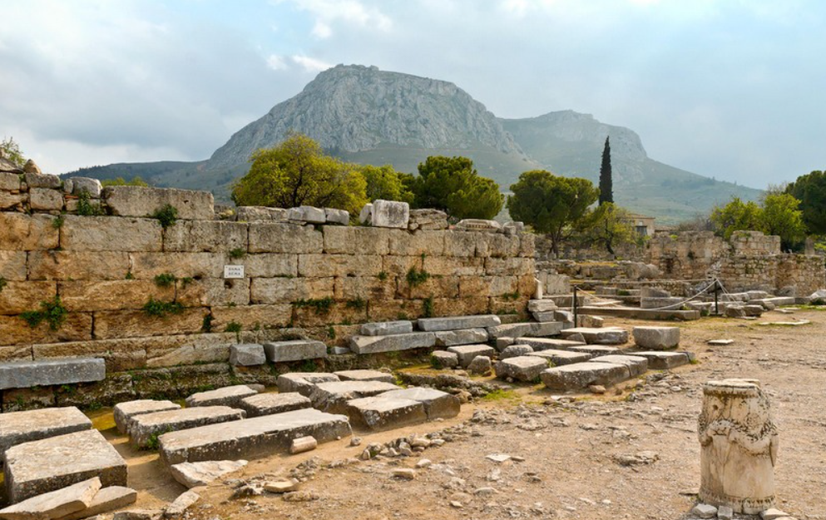
Corinth
“Corinth bema and Acrocorinth.” The bema (also called the “tribunal” or “judicial bench”) is the structure in the left half of the picture. Acts 18:12-17 when Paul was brought before Gallio.

Slide 16
Corinth Korinthiazesthai (Corinthia-zest-hi)
Korinthiazesthai (Corinthia-zest-hi)

Slide 17
Corinth Korinthiazesthai (Corinthia-zest-hi)
Korinthiazesthai (Corinthia-zest-hi)
To live like a Corinthian (to live immorally and drunk)
Worship of many gods; Egyptian, Roman, and Greek

Slide 18
Corinth Korinthiazesthai (Corinthia-zest-hi)
Korinthiazesthai (Corinthia-zest-hi)
To live like a Corinthian (to live immorally and drunk)
Worship of many gods; Egyptian, Roman, and Greek
Aphrodite, goddess of love

Slide 19
Corinth Korinthiazesthai (Corinthia-zest-hi)
Korinthiazesthai (Corinthia-zest-hi)
To live like a Corinthian (to live immorally and drunk)
Worship of many gods; Egyptian, Roman, and Greek
Aphrodite, goddess of love
Asklepios, god of healing

Slide 20
Corinth Korinthiazesthai (Corinthia-zest-hi)
Korinthiazesthai (Corinthia-zest-hi)
To live like a Corinthian (to live immorally and drunk)
Worship of many gods; Egyptian, Roman, and Greek
Aphrodite, goddess of love
Asklepios, god of healing
Peirene, not a goddess, is that she was a nymph who became a spring because of her tears shed in lamentation for her son’s death, who was unintentionally killed by Artemis (Roman Diana).

Slide 21
Corinth Korinthiazesthai (Corinthia-zest-hi)
Korinthiazesthai (Corinthia-zest-hi)
To live like a Corinthian (to live immorally and drunk)
Worship of many gods; Egyptian, Roman, and Greek
Aphrodite, goddess of love
Asklepios, god of healing
Peirene, not a goddess, is that she was a nymph who became a spring because of her tears shed in lamentation for her son’s death, who was unintentionally killed by Artemis (Roman Diana).
Acts 18:4 reveals a Jewish synagogue

Slide 22
Corinth Korinthiazesthai (Corinthia-zest-hi)
Korinthiazesthai (Corinthia-zest-hi)
To live like a Corinthian (to live immorally and drunk)
Worship of many gods; Egyptian, Roman, and Greek
Aphrodite, goddess of love
Asklepios, god of healing
Peirene, not a goddess, is that she was a nymph who became a spring because of her tears shed in lamentation for her son’s death, who was unintentionally killed by Artemis (Roman Diana).
Acts 18:4 reveals a Jewish synagogue
Aelian, If ever a Corinthian was written into a play the actor would play drunk

Slide 23
Corinth Paul’s Inspired Writings
Explain 1 Corinthians 9:24-27.

Slide 24
Corinth Paul’s Inspired Writings (1 Cor. 9:24-27)
Isthmian Games
Chariot races, men only
Pankration, men only
Wrestling, men only
Musical and poetical contests, in which women were allowed to compete.
Boxing, men only
Winners of the games received a crown of wilted vegetables

Slide 25
Corinth Paul’s Inspired Writings
What item is mentioned in 1 Cor. 13:12 and recorded in NKJ/ASV 2 Cor. 3:18?

Slide 26
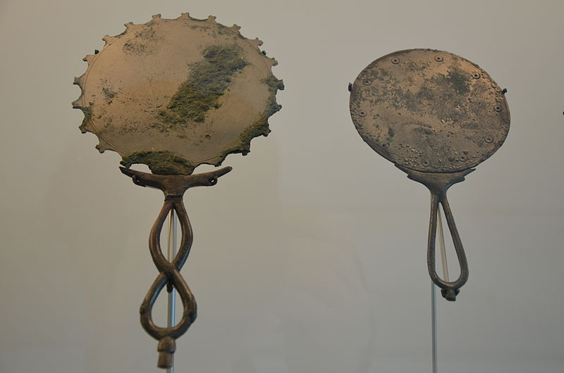
Corinth Paul’s Inspired Writings (1Cor. 13:12; 2Cor. 3:18)
Corinth was highly prized for their bronze manufacturing. To include high valued mirrors.

Slide 27
Corinth Paul’s Inspired Writings
1 Corinthians 12:12-26 Paul speaks of one body with many members.

Slide 28
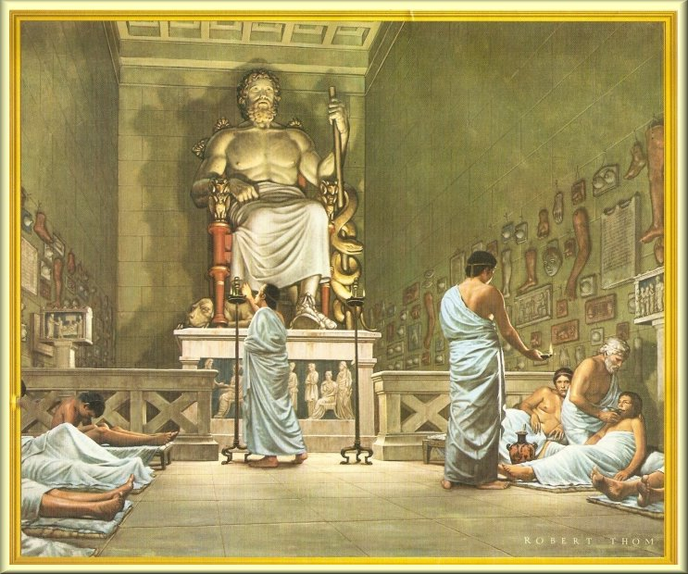
Corinth Paul’s Inspired Writings
Asklepios

Slide 30
Corinth Paul’s Inspired Writings (1Cor.12:12-17)
Asklepios
Clay copies of arms, and other body parts. Petitioners would have casts made of their afflicted parts and that were hung around the temple.

Slide 31
Lesson Schedule for the Corinthian Letters
Lesson 1 Why should Corinthians listen to Paul? (2 Cor. 10-13:10)
Lesson 2 Division in the Church (1 Cor. 1-4)
Lesson 3 Lack of Discipline (1 Cor 5-7)
Lesson 4 Conduct and Idolatry (1 Cor 8-10)
Lesson 5 Humility in Worship (1 Cor. 11)
Lesson 6 Spiritual Gits and Spiritual People (1 Cor. 12-14, 16, 2 Cor. 8-9)
Lesson 7 Resurrection of Believers (1 Cor. 15)
Lesson 8 Paul’s view of the Ministry (2 Cor. 3-6).

