Slide 2
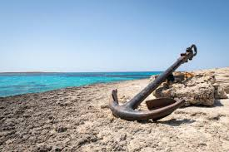
Four Anchors of Life
Hebrews 6:19

Slide 3
1) Faith
“By Faith” – Hebrews 11
Without faith it is IMPOSSIBLE to please
God
Where does our faith come from?
By reading and studying the Word of God (Rom.10:17)
Have your own faith.
What kind of faith do we have?
James 2:26
Working and Living Faith

Slide 4
2) Prayer
Constant Communication
1 Thes. 5:16-18
Phil. 4:6-7
Shows a dependence on God
James 5:16
“Prayer is the Power that leads the hand that moves the world”

Slide 5
3) A Good Conscience
Clean Conscience
1 Tim. 1:16
Rom. 14:23
At Peace
Acts 23:1 – Paul was at peace with God
Walking Worthy
Eph. 4

Slide 6
4) Hope
What is Our Hope?
Col.1:3-5 – Our Hope is Heaven
Titus 1:2 – Our Hope is an eternal life with God
Rom.8:24-25 – Our Hope will be waiting for us
Evidence?
2 Pet.3-8:9 – God answers our prayers and keeps His Promises
Heb. 6:18-19
God DOES NOT lie!

