Slide 1
Deuteronomy
A survey Of the Scriptures

Slide 2
Class Schedule
Lesson 1: Introduction, Chapters 1 & 2
Lesson 2: Chapters 3-5
Lesson 3: Chapters 6-9
Lesson 4: Chapters 10-12
Lesson 5: Chapters 13-15
Lesson 6: Chapters 16-18
Lesson 7: Chapters 19-21
Lesson 8: Chapters 22-25
Lesson 9: Chapters 26-28
Lesson 10: Chapters 29-34

Slide 3
Deuteronomy Chapters 12-16:17 Ceremonial Laws
Israel's Past Reviewed | Exposition of the Law |  |  | Mosaic Covenant | Moses Final Words and Death
 | Chapters 4:44-11
 | Ceremional Laws | Civil Laws | Social Laws
Chapters 1-4:43 | Chapters 12-16:17 | Chapters 16:18-21 | Chapters 22-26 | Chapters 27-30 | Chapters 31-34
PAST- What God has done. | PRESENT - What God expects of Israel |  |  | FUTURE - What God will do for Israel
Ceremonial Laws

Slide 4
Chapter 13 discussion
13:1-5
Moses mentioned three different cases in chapter 13. What is the first source of temptation Moses mentions?

Slide 5
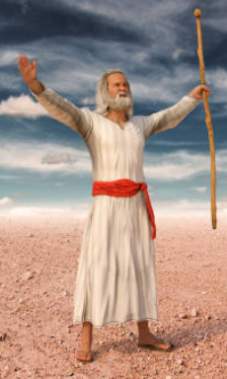
Chapter 13 discussion
13:1-5
Moses mentioned three different cases in chapter 13. What is the first source of temptation Moses mentions?
The Prophet: or receiver of a dream

Slide 6
Chapter 13 discussion
13:6-11
Moses mentioned three different cases in chapter 13.
What is the Second source of temptation Moses mentions?

Slide 7
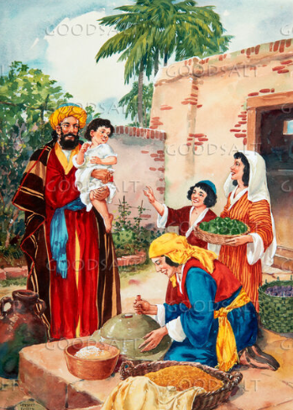
Chapter 13 discussion
13:6-11
Moses mentioned three different cases in chapter 13.
What is the Second source of temptation Moses mentions?
The Relative or Friend

Slide 8
Chapter 13 discussion
13:6-11
Moses mentioned three different cases in chapter 13.
What is the Second source of temptation Moses mentions?
Why do our relationships with people often trump our relationship with God?
The Relative or Friend

Slide 9
Chapter 13 discussion
13:12-18
Moses mentioned three different cases in chapter 13.
What is the third source of temptation Moses mentions?

Slide 10
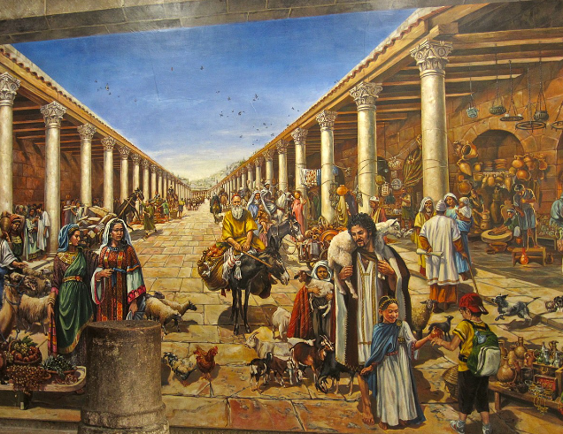
Chapter 13 discussion
13:12-18
Moses mentioned three different cases in chapter 13.
What is the third source of temptation Moses mentions?
The Town

Slide 11
Chapter 13 discussion
13:6-11
Moses mentioned three different cases in chapter 13.
The Prophet: or receiver of a dream
The Relative or Friend
The Town

Slide 12
Chapter 13 discussion
13:15-16
What was the consequence for all guilty parties?

Slide 13
Chapter 13 discussion
13:15-16
What was the consequence for all guilty parties?
What important action comes from verse 14 and what does this action guard against?

Slide 14
Deuteronomy Chapter 14

Slide 15
Chapter 14 discussion
14:1-2
Why was cutting themselves specifically mentioned?

Slide 16
Chapter 14 discussion
14:3-21
Why were certain animals clean and unclean?

Slide 17
Chapter 14 discussion
14:22-29
What was the purpose of tithing?

Slide 18
Chapter 14 discussion
14:22-29
What was the purpose of tithing?
Today our offerings are given freely with an amount purposed in our hearts. (2 Corinthians 9:7) How do you feel about an amount commanded over an amount chosen?

Slide 19
Deuteronomy Chapter 15

Slide 20
Chapter 15 discussion
15:1-11
What do you learn of God’s heart toward the poor?

Slide 21
Chapter 15 discussion
15:1-11
How do we explain the contradiction some see in verses 4 and 11?

Slide 22
Chapter 15 discussion
15:1-11
What responsibilities are recorded for the debtors?

Slide 23
Chapter 15 discussion
15:12-18
How is the slavery in these text different from the slavery we think of today?

Slide 24
Chapter 15 discussion
15:19-23
Why were the Israelites to offer God as near a perfect specimen as possible?

Slide 25
Chapter 15 discussion
15:19-23
Why were the Israelites to offer God as near a perfect specimen as possible?
What are some examples of our first fruit sacrifices?

Slide 26
Deuteronomy Chapter 12
Israel's Past Reviewed | Exposition of the Law |  |  | Mosaic Covenant | Moses Final Words and Death
 | Chapters 4:44-11
 | Ceremional Laws | Civil Laws | Social Laws
Chapters 1-4:43 | Chapters 12-16:17 | Chapters 16:18-21 | Chapters 22-26 | Chapters 27-30 | Chapters 31-34
PAST- What God has done. | PRESENT - What God expects of Israel |  |  | FUTURE - What God will do for Israel
Ceremonial Laws

