Slide 2
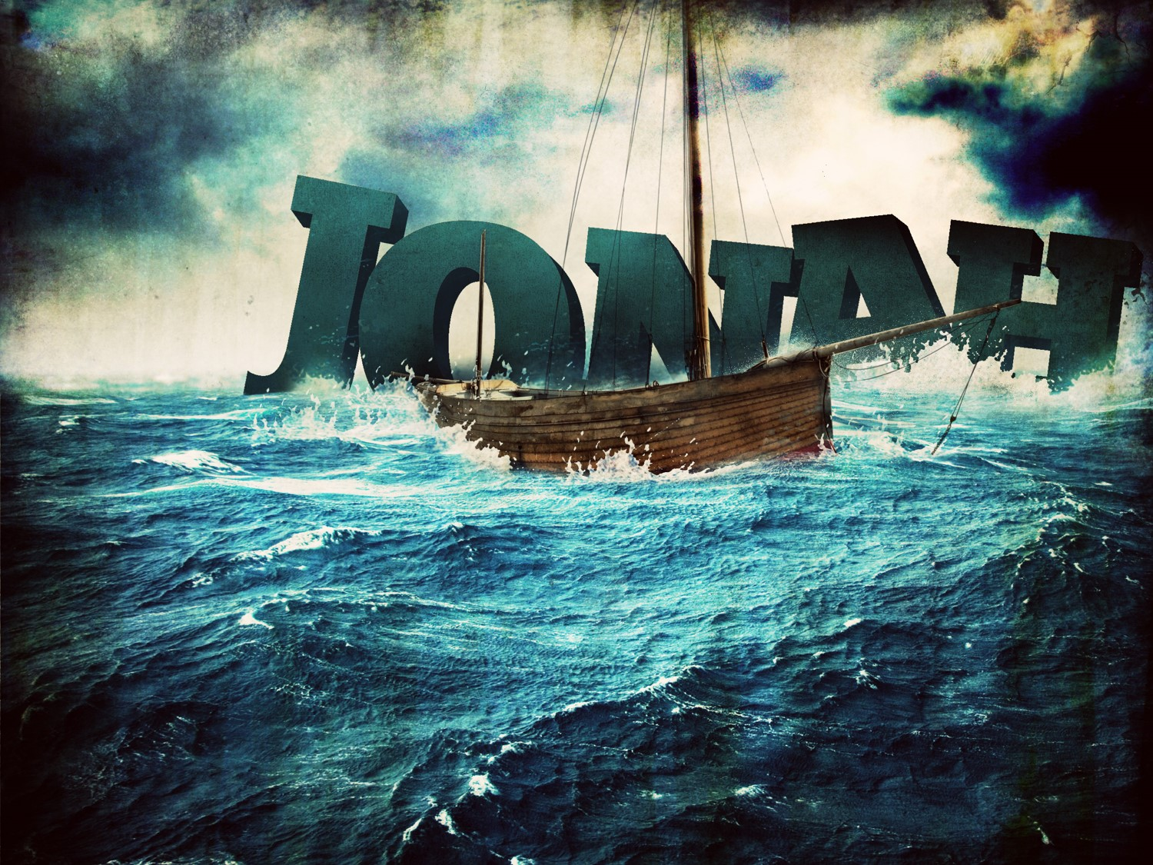
TURNING TO THE LORD

Slide 3
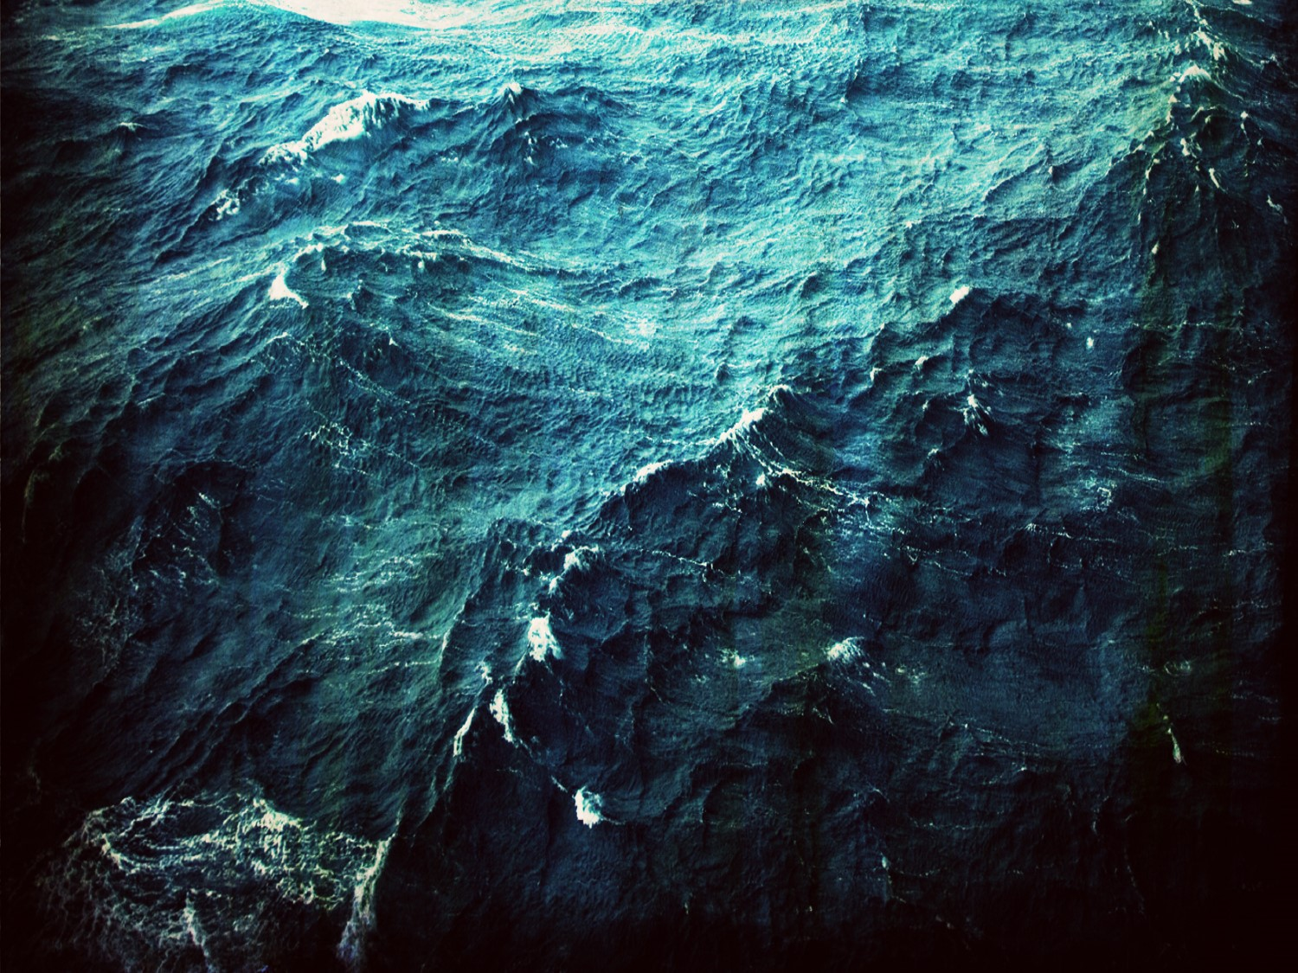
TWO AMAZING EVENTS
And the Lord appointed a great fish to swallow Jonah, and Jonah was in the stomach of the fish three days and three nights. –Jonah 1:17
Then Jonah prayed to the Lord his God from the stomach of the fish... –Jonah 2:1

Slide 4
JONAH’S PRAYER
v.3 – “For You had cast me into the deep, into the heart of the seas, and the current engulfed me. All Your breakers and billows passed over me.”
v.5 – “Water encompassed me to the point of death. The great deep engulfed me, weeds were wrapped around my head.”

Slide 5
JONAH’S PRAYER
v.6 – “I descended to the roots of the mountains. The earth with its bars was around me forever, but You have brought up my life from the pit, O Lord my God.”
v.7 – “While I was fainting away, I remembered the Lord, and my prayer came to You, into Your holy temple.”

Slide 6
3 Lessons Learned from the
Belly of the Great Fish
1. SEEK THE LORD (2:4)
“So I said, ‘I have been expelled from Your sight. Nevertheless I will look again toward Your holy temple.”
2. SALVATION BELONGS TO THE LORD (2:9)
“But I will sacrifice to You with the voice of thanksgiving. That which I have vowed I will pay. Salvation is from the Lord.”

Slide 7
3 Lessons Learned from the
Belly of the Great Fish
3. Death to Deliverance
Then some of the scribes and Pharisees said to Him, “Teacher, we want to see a sign from You.” But He answered and said to them, “An evil and adulterous generation craves for a sign; and yet no sign will be given to it but the sign of Jonah the prophet; for just as Jonah was three days and three nights in the belly of the sea monster, so will the Son of Man be three days and three nights in the heart of the earth.” (Matthew 12:38-40)

Slide 8

According to the Bureau of Standards in Washington, a dense fog covering seven city blocks to a depth of 100 feet is composed of less than one glass of water. That amount of water is divided into about 60 billion tiny droplets. Yet when those minute particles settle over a city or the countryside, they can almost blot out everything from your sight.

Slide 9
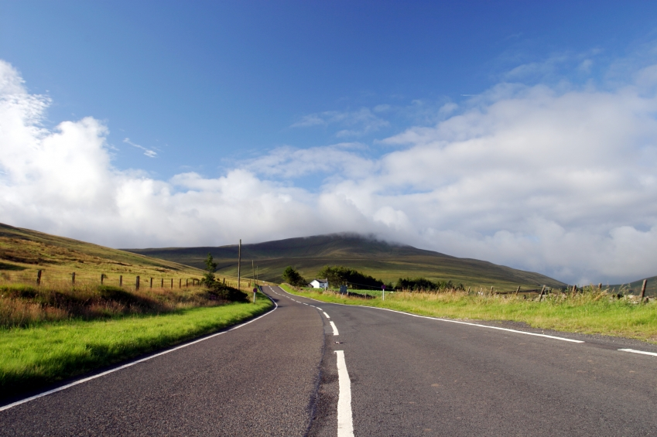
Let us fix our eyes on Jesus, the author and perfecter of our faith, who for the joy set before Him endured the cross, scorning its shame, and sat down at the right hand of the throne of God. Consider Him who endured such opposition from sinful men, so that you will not grow weary and lose heart.” –Heb. 12:2-3
Seek the Lord
Acknowledge Salvation is from the Lord
Maintain a Heavenly Focus

