Slide 2
SECOND CHANCES

Slide 3
TWO POINTS ABOUT HOW
GOD DEALS WITH HIS PEOPLE
God’s Grace Allows For Another Chance (3:1)
“Now the word of the Lord came to Jonah the second time, saying…”

Slide 4
TWO POINTS ABOUT HOW
GOD DEALS WITH HIS PEOPLE
GOD’S GRACE STILL HOLDS US ACCOUNTABLE (3:2-3)
“Arise, go to Nineveh the great city and proclaim to it the proclamation which I am going to tell you. So Jonah arose and went to Nineveh according to the word of the Lord…”

Slide 5
THE MODEL OF REPENTANCE
Then the people of Nineveh believed in God; and they called a fast and put on sackcloth from the greatest to the least of them. (3:5)

Slide 6
THE MODEL OF REPENTANCE
THE PEOPLE ACT OUT THEIR REPENTANCE
“they called a fast and put on sackcloth…” “When the word reached the king of Nineveh, he arose from his throne, laid aside his robe from him, covered himself with sackcloth and sat on the ashes.” (V.6)

Slide 7
THE MODEL OF REPENTANCE
2. THE PEOPLE CALL OUT FOR GOD’S MERCY
“But both man and beast must be covered with sackcloth; and let men call on God earnestly that each may turn from his wicked way and from the violence which is in his hands. Who knows, God may turn and relent and withdraw His burning anger so that we will not perish.” (V.8-9)

Slide 8
THE MODEL OF REPENTANCE
For the grace of God has appeared, bringing salvation to all men, instructing us to deny ungodliness and worldly desires and to live sensibly, righteously and godly in the present age, looking for the blessed hope and the appearing of the glory of our great God and Savior, Christ Jesus, who gave Himself for us to redeem us from every lawless deed, and to purify for Himself a people for His own possession, zealous for good deeds.–Ti. 2:11-14

Slide 9
THE MODEL OF REPENTANCE
2. THE PEOPLE CALL OUT FOR GOD’S MERCY
“But both man and beast must be covered with sackcloth; and let men call on God earnestly that each may turn from his wicked way and from the violence which is in his hands.” (V.8)

Slide 10
THE MODEL OF REPENTANCE
3. GOD’S WARNING OF JUDGMENT IS MERCY!
Then Jonah began to go through the city one day’s walk; and he cried out and said, “Yet forty days and Nineveh will be overthrown.” (V.4)

Slide 11
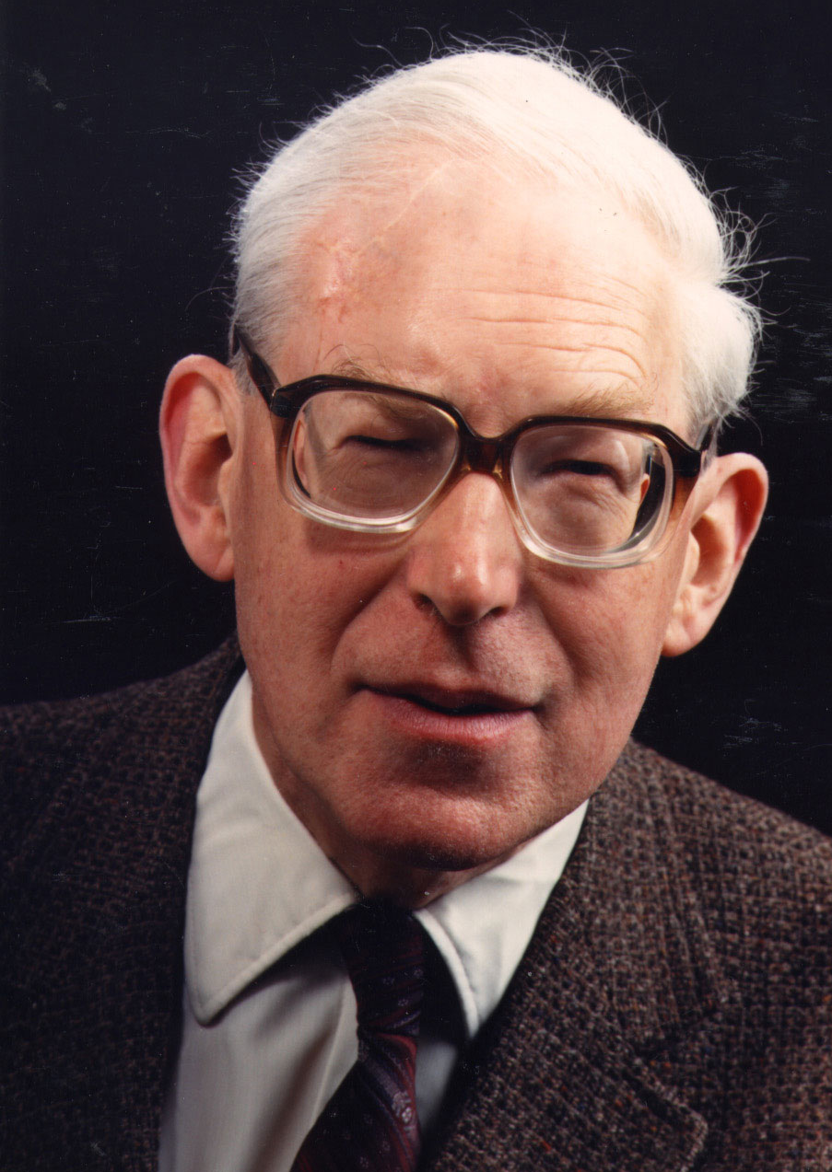
“The faithful servant of God must take care to make clear that what he offers is not his own ideas, but God’s message from God’s book… to let the text talk through him.”
–J.I. Packer
(Professor of Theology at Regent College in Vancouver, British Columbia)

Slide 12
THE MODEL OF REPENTANCE
4. GOD FORGIVES WHEN WE TURN TO HIM
“When God saw their deeds, that they turned from their wicked way, then God relented concerning the calamity which He had declared He would bring upon them. And He did not do it.” (V.10)

Slide 13
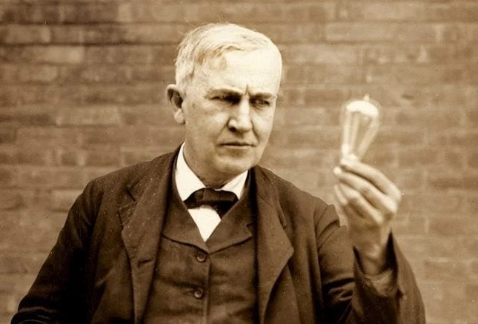

Slide 14
Brethren, I do not regard myself as having laid hold of it yet; but one thing I do: forgetting what lies behind and reaching forward to what lies ahead, I press on toward the goal for the prize of the upward call of God in Christ Jesus.
–Philippians 3:13-14

