Slide 2
GOD’S WORD CHANGES LIVES

Slide 3
JONAH’S ANGER
But it greatly displeased Jonah and he became angry. He prayed to the Lord and said, “Please Lord, was not this what I said while I was still in my own country? Therefore in order to forestall this I fled to Tarshish, for I knew that You are a gracious and compassionate God, slow to anger and abundant in lovingkindness, and one who relents concerning calamity. Therefore now, O Lord, please take my life from me, for death is better to me than life.” The Lord said, “Do you have good reason to be angry?” Then Jonah went out from the city and sat east of it. There he made a shelter for himself and sat under it in the shade until he could see what would happen in the city. –vv.1-5

Slide 4
JONAH’S ANGER
Then the Lord passed by in front of him and proclaimed, “The Lord, the Lord God, compassionate and gracious, slow to anger, and abounding in lovingkindness and truth; who keeps lovingkindness for thousands, who forgives iniquity, transgression and sin; yet He will by no means leave the guilty unpunished, visiting the iniquity of fathers on the children and on the grandchildren to the third and fourth generations.” –Exodus 34:6-7

Slide 5
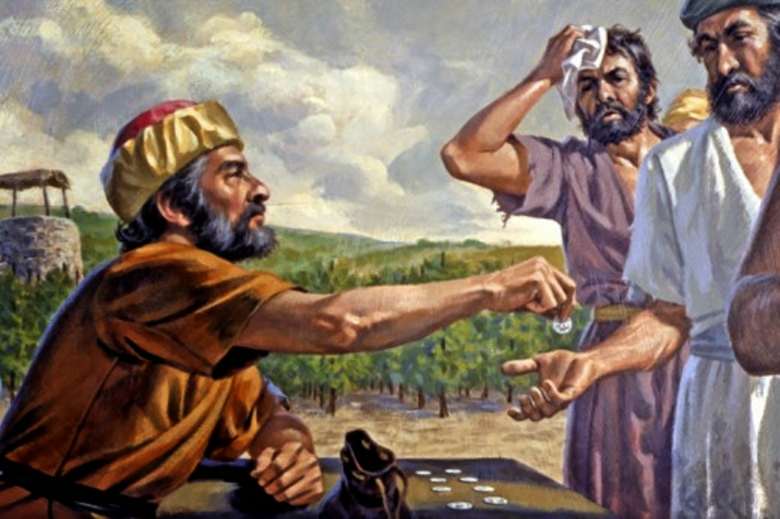
“Is it not lawful for me to do what I wish with what is my own? Or is your eye envious because I am generous?”
–Matthew 20:15
Parable of the Laborer's in the Vineyard

Slide 6
The Lord is not slow about His promise, as some count slowness, but is patient toward you, not wishing for any to perish but for all to come to repentance. –2 Peter 3:9
The Lord said, “Do you have good reason to be angry?”
Then Jonah went out from the city and sat east of it. There he made a shelter for himself and sat under it in the shade until he could see what would happen in the city. (v.4, 5)

Slide 7
JONAH’S COMFORT (4:6-9)
So the Lord God appointed a plant and it grew up over Jonah to be a shade over his head to deliver him from his discomfort. And Jonah was extremely happy about the plant. But God appointed a worm when dawn came the next day and it attacked the plant and it withered. When the sun came up God appointed a scorching east wind, and the sun beat down on Jonah’s head so that he became faint and begged with all his soul to die, saying, “Death is better to me than life.” Then God said to Jonah, “Do you have good reason to be angry about the plant?” And he said, “I have good reason to be angry, even to death.” vv.6-9

Slide 8
JONAH’S COMFORT (4:6-9)
So the Lord God appointed a plant and it grew up over Jonah to be a shade over his head to deliver him from his discomfort. And Jonah was extremely happy about the plant. But God appointed a worm when dawn came the next day and it attacked the plant and it withered. When the sun came up God appointed a scorching east wind, and the sun beat down on Jonah’s head so that he became faint and begged with all his soul to die, saying, “Death is better to me than life.” Then God said to Jonah, “Do you have good reason to be angry about the plant?” And he said, “I have good reason to be angry, even to death.” vv.6-9
For you have need of endurance, so that when you have done the will of God, you may receive what was promised. –Hebrews 10:36

Slide 9
GOD’S Compassion
Then the Lord said, “You had compassion on the plant for which you did not work and which you did not cause to grow, which came up overnight and perished overnight. Should I not have compassion on Nineveh, the great city in which there are more than 120,000 persons who do not know the difference between their right and left hand, as well as many animals?”
vv.10-11
God’s compassion must become our compassion!
God’s mercy must become our mercy!

Slide 10
Lessons learned from Jonah
In our spiritual walk with God…
We must have a yielding attitude towards His will.
We must learn how to cope with our problems.
We need to know it’s possible to start over.
We need to proclaim the Word of God.

