Slide 2
Captivity In 3 Stages
1. 606 B.C. 2 Kings 24:1-2; Daniel 1:1-3. Daniel among the captives. Nebuchadnezzar plundered the temple
2. 597 B.C. 2 Kings 24:10-16. Ezekiel among the 10,000 captives. Nebuchadnezzar plundered the temple.
3. 586 B.C. 2 Kings 25:1-11. Nebuchadnezzar plundered the temple.

Slide 3
Rulers Over Babylon
1. Nebuchadnezzar. 605 B.C. - 562 B.C.
2. Evil-Marduk. 562 B.C. - 560 B.C.
3. Neriglissar. 560 B.C. 556 B.C.
4. Labashi-Mardul. 556 B.C.
5. Nabonidus. 556 B.C. - 539 B.C.

Slide 4
Abuse Of Sacred Things
1. Manasseh. 2 Kings 21:4-5
2. Belshazzar. Daniel 5:1-4, 22-23
3.Days of Jesus. Mark 11:15-17; John 2:16
4. Today: Building not sacred, but devoted for sacred purpose.

Slide 5
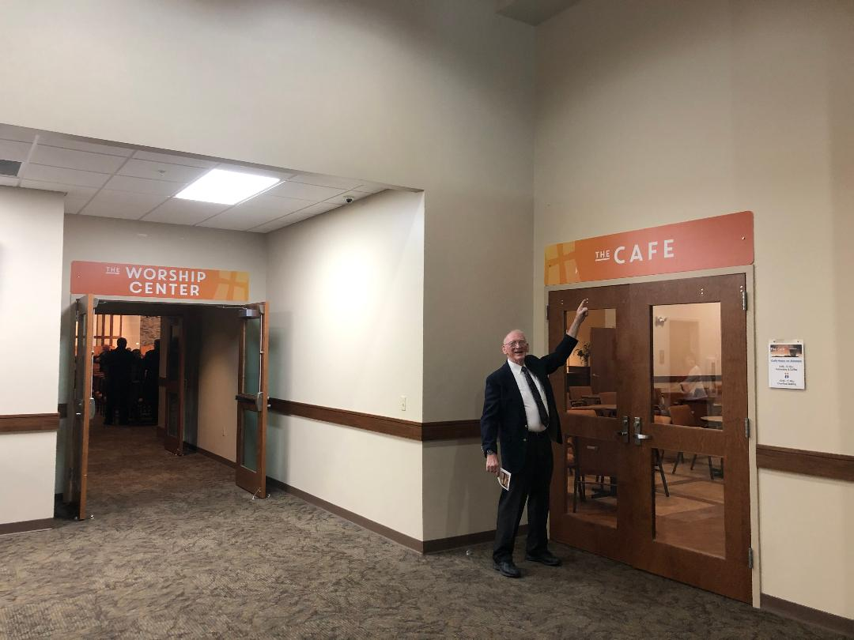

Slide 7
