Slide 1
Individual & Church Are Not The Same
Individual
Church
Member
Care of Own
Individ. Kept Private
Buy & Sell
Christian
Many Members
Church Not Burdened
Individ. Matters to Church
Contribution
“church of Christ”

Slide 2
Blurring The Lines
Personal / private Matters – Spread through the church (Matt. 18:15-17)
Expect church relieve individual responsibility (1 Tim. 5:16)
“Church can do what individual can do” (cf. Jas. 1:27; Gal. 6:10)
Social gospel (1 Cor. 11:22,34)
Social Meals (fellowship halls)
Recreation (Games, entertainment, family life centers)
Ball teams (Gyms)
Making social activities essential to spiritual growth

Slide 3
Blurring The Lines
Personal / private Matters – Spread through the church (Matt. 18:15-17)
Expect church relieve individual responsibility (1 Tim. 5:16)
“Church can do what individual can do” (cf. Jas. 1:27; Gal. 6:10)
Social gospel (1 Cor. 11:22,34)
Calling individual matters – “church function”
Treating individual functions – as essential
Speak of social matters – as spiritual (“Fellowship”)

Slide 4
Blurring The Lines
Weekend Gospel Meeting
July 12 - 14
Speaker: Mr Smith
Time: Friday – Saturday 7:00pm
Sunday 9:30am; 10:30 am
123 Main Street
Our Town, KY 42765
Saturday Fun For Teens
Volleyball, Softball
Pizza & Hamburgers
(3:00 pm at home of Mr Jones427 Maple St.)

Slide 5
Some Brethren – Blurred Lines
Summer Lectures
Saturday July 13
Speaker: John Doe
Time: 10:00 am; 11:00am
Break Lunch to be provided
1:00 pm
123 Main Street
Somewhere, KY 11111

Slide 6
Why Does it Matter?
Lines become blurred – in our own mind
Lines will be gone – to world & next generation
Confused on what is “Church matters” – “Individual”
Give birth to social gospel & youth ministries
Think individual function – equal to assembling (essential)

Slide 7
Make a Distinction
Keep Biblical teaching on distinction before us (II Pet. 1:12)
Don’t refer to individual & social matters as “church functions”
Don’t make people feel they have neglected the Lord if they don’t make every individual / social function.
Don’t equate social matters with spiritual matters
Don’t talk about “church group” when speaking of social & recreational matters

Slide 8
WORK OF THE CHURCH
Evangelism - I Thes 1:3-8; Phil 1:3-5
Philippi – Phil 4:15-17
Thessalonica – I Thes 1:3-8
Macedonia – II Cor 11:7-9
Edification – Eph 4:11-16, I Cor 12:14-27, Gal 6:1-2
Worship – Eph 5:19, Col 3:16
Teaching – Col 1:28; Rom 12:6-7, Acts 11:22-23
Benevolence – Acts 2:44-45; Acts 4:32-35
Antioch – Acts 11:29-30
Macedonia – II Cor 8:1-4
Corinth – II Cor 9:10-12

Slide 9
Command, Example, Logical Conclusion
Command: Paraggello - Order, charge, declare
II Thes 3:10 – 12: 10 For even when we were with you, we commanded you this: If anyone will not work, neither shall he eat. 11 For we hear that there are some who walk among you in a disorderly manner, not working at all, but are busybodies. 12 Now those who are such we command and [c]exhort through our Lord Jesus Christ that they work in quietness and eat their own bread.
Example: Tupos – model, pattern, manner
Phil 3:17 Brethren, join in following my example, and note those who so walk, as you have us for a pattern
I Cor 11:1 Be ye followers (mimetes; imitate) of me, even as I also am of Christ.
Inference: Krino - determine, be of opinion, deem, think
Acts 15:19 Therefore I judge that we should not trouble those from among the Gentiles who are turning to God,

Slide 10
Specific Authority
Limited to the specifications
Exclusive – excludes anything not specified
Acts 20:7 And upon the first day of the week, when the disciples came together to break bread, Paul preached unto them, ready to depart on the morrow; and continued his speech until midnight.
Specific or limited to first day of the week (Sunday)
Excludes all other days (Mon – Sat)

Slide 11
General Authority
Not specified
Inclusive – includes everything falling into a class or order
Acts 20:7 And upon the first day of the week, when the disciples came together to break bread, Paul preached unto them, ready to depart on the morrow; and continued his speech until midnight.
Time of day not specified – All hours in Sunday included
Location not specified – anywhere

Slide 12
Expediency
Sumphero - to be an advantage, profitable, expedient
John 16:7 Nevertheless I tell you the truth; It is expedient for you that I go away: for if I go not away, the Comforter will not come unto you; but if I depart, I will send him unto you.

Slide 13
Expediency
Must be lawful
Generic – not specified
Aid vs Addition
Edify

Slide 14
General | Aid/Expedient | Specified | Addition/Substitution
Build Ark | Tools - Hammer, Saw | Gopher Wood (Gen 6:14) | Pine, Oak, Maple
Baptism Acts 2:38 | River, Lake, Pool, Baptistry | Burial (Immersion) Rom 6:4; Col 2:12 | Pouring, Sprinkling
Lords Supper | Trays, cups, container | Unleavened Bread Fruit of the vine Luke 22:15-20 | Muffins, cookies Coffee, Tea, Soda
Lord’s Supper | Location, time, seats, lights | First day Acts 20:7 | Mon-Sat, “special” days, yearly
Speak in psalms, hymns, spiritual songs Teach & admonish… | Sheet music, harmony, unison | Sing Eph 5:19; Col 3:16 | Piano, organ, guitar
Go Preach / Teach | Walk, Ride, Sail, Fly | Observe what I commanded, Gospel Matt 28:19, 29; Mark 16:15 | Law of Moses, circumcision, another gospel Gal 1:8

Slide 15
History of the Social Gospel Movement
Started in America
Roots in Modernism
Years following the Civil War
Social Gospel Concept

Slide 16
A Great Shift
Spiritual
Social

Slide 17
History of the Social Gospel Movement
Started in America
Roots in Modernism
Years following the Civil War
Social Gospel Concept
Impact on Denominations
Impact on the Church

Slide 18
Christians Have Spiritual Needs
Grow (2 Pet. 3:18)
Edified (1 Cor. 14:26)
Faith Increased (2 Thess. 1:3)
How?
Regular attendance?
Acts of worship?
Preaching?
Study of word?
Fellowship?
Some Think:
Social Activities
Eat
Be together
Games
Activities

Slide 19
Edify
Edify
NT:3619
1. (the act of) building, building up, 2. equivalent to oikodomeema, a building (i. e., thing built, edifice): Mark 13:1 f
(Thayer)

Slide 20
Edification
Come together – I Cor 14:26; Acts 2:42
Worship – Heb 10:25
Teaching – Acts 16:5
Good Works – Phil 4:15-17; II Cor 9:1-8
Love – Eph 4:2-4; I Cor 12:22-26
Discipline – II Thes 3:6; Rom 16:16

Slide 21
Don’t Confuse Edification with That Which You Enjoy
Based Upon Revelation – Not Enjoyment or Excitement
Edified by Worship
Singing (Eph 5:19; Col 3:16)
Assembling (Heb 10:24,25)
Preaching (Eph 4:11,12)
Prayer (I Cor 14:17)
Good speaker
Funny stories
Exciting class
Feeling good
Eating good meal
Playing games together
Good conversation (secular)
Social activities

Slide 23
Fellowship
Koinonia – association, sharing, participation, communication
Worship (Doctrine, Lord Supper, prayer) – Acts 2:42
Ministering needy saints – II Cor 8:4
Lord’s Supper I Cor 10
Evangelism – Phil 1:5; Gal 2:9

Slide 24
Social Gospel based on Feelings
The evidence that we have faith is based on feelings of emotion.
We are edified because we feel good
We are growing to be a stronger Christian because we feel closer to God

Slide 25
Feelings Are Result of our Spiritual Growth
Feelings are based on knowledge
Luke 10:20 rejoice that your names are written in heaven
Job 19:25,26 For I know that my redeemer liveth, and that he shall stand at the latter day upon the earth, And though after my skin worms destroy this body, yet in my flesh shall I see God
We feel good because we have been edified
I Pet 1:4-6 kept by the power of God through faith unto salvation… wherein ye greatly rejoice
We feel good because we are growing to be a stronger Christian
II Pet 3:18 Grow in the grace and knowledge of our Lord and Savior Jesus Christ

Slide 26
Dangers Among Us
Forget How Apostasy Works (Heb 2:1-3)
Forget The Issues That Divided the Church
Fail To Distinguish- Individual & Church
Focus on Social Is More Important

Slide 27
Youth Group – Youth Activity Center
Helping Hands Clothing Room
School Supplies
Mother’s Day Out

Slide 29
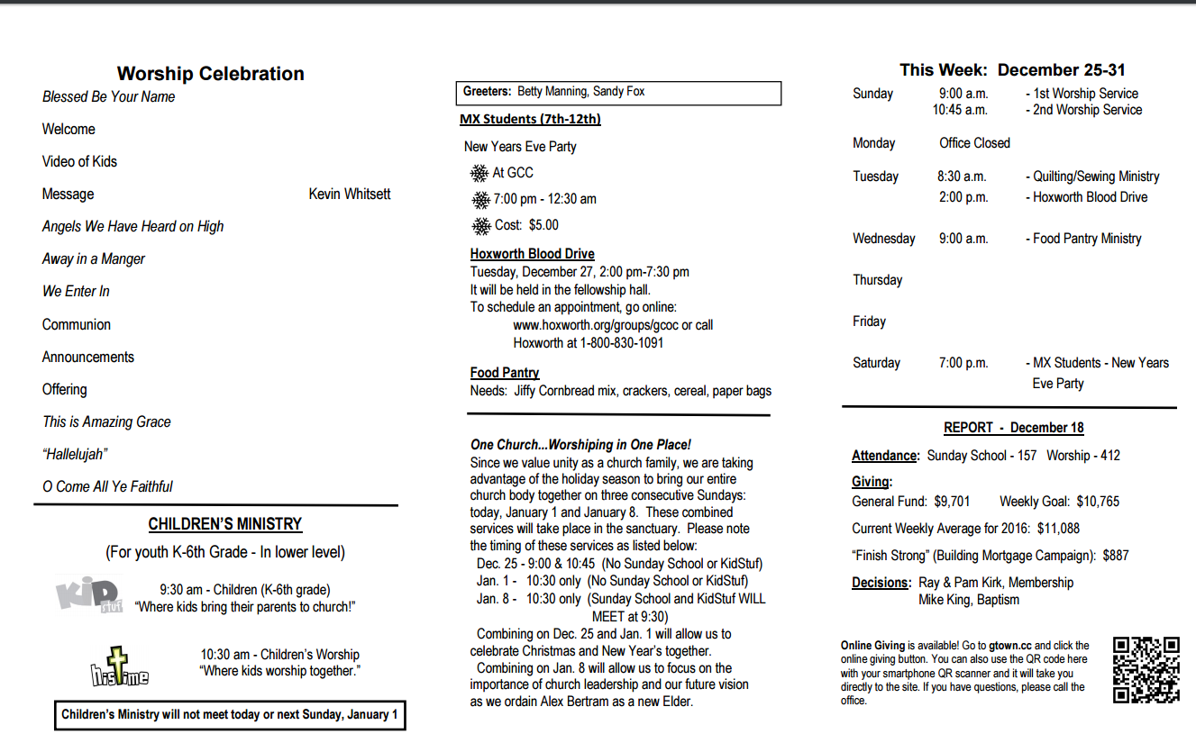

Slide 30
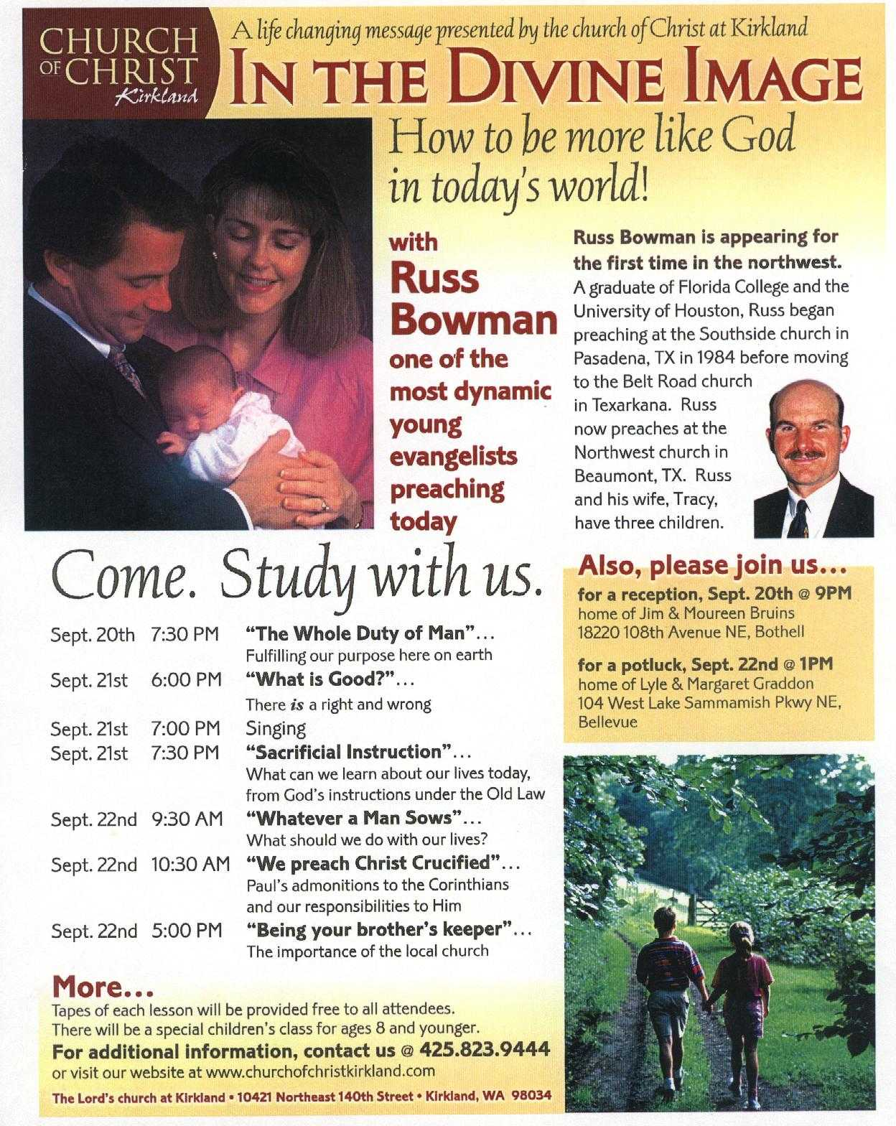

Slide 31
Dangers Among Us
Forget How Apostasy Works (Heb 2:1-3)
Forget The Issues That Divided the Church
Fail To Distinguish- Individual & Church
Focus on Social Is More Important
Argue That Social Builds Faith
Overreaction In Either Direction

Slide 32
Lessons Today
Beware and be steadfast (II Pet 3:17)
Grow in the Grace and Knowledge of Christ (II Pet 3:18)
Remember the old paths (Jer 6:16)

Slide 33
The Institutional Question

Slide 34
Early Church Issues & Problems
Is circumcision essential to salvation (Acts 15)?
From among “yourselves” – perverse things (Acts 20:30)
Doctrine of no resurrection (1 Cor. 15:12)
Some will depart giving heed to error (1 Tim. 4:1-3)
Judaism (Hebrews, etc.)

Slide 35
History of Institutional Support
1800’s Restoration Movement:
Pointing men back to the Bible: “Where the Bible speaks, we speak; where it is silent, we are silent.”
Called for men to lay aside opinions and unite upon the Scriptures
Soon two different mindsets developed:
Church can do only what is positively authorized
Church can do anything not specifically forbidden

Slide 36
History of Institutional Support
1800’s Restoration Movement
1850’s Missionary Society
1860 Instrumental Music
1906 Disciples of Christ / Christian Church
1950 Institutionalism

Slide 37
Institutionalism
Sponsoring Church for evangelism efforts (missionary societies)
Institutions to fulfill social outreach
Benevolent organizations, Orphan home, Bible colleges, nursing homes
Church assumes responsibility of individual Christians

Slide 38
WORK OF THE CHURCH
Evangelism - I Thes 1:3-8; Phil 1:3-5
Philippi – Phil 4:15-17
Thessalonica – I Thes 1:3-8
Macedonia – II Cor 11:7-9
Edification – Eph 4:11-16, I Cor 12:14-27, Gal 6:1-2
Worship – Eph 5:19, Col 3:16
Teaching – Col 1:28; Rom 12:6-7, Acts 11:22-23
Benevolence – Acts 2:44-45; Acts 4:32-35
Antioch – Acts 11:29-30
Macedonia – II Cor 8:1-4
Corinth – II Cor 9:10-12

Slide 39
The Missionary Society
Local
Church
$
Local
Church
Missionary
Society
$
Support
Preachers
$
Local
Church
$
A Separate Organization Between
The Church And The Work
Local
Church

Slide 40
New Testament Example
Antioch
Paul
Barnabas
John Mark
Silas
$
Philippi
$
$
Paul
Thessa lonica
$
Berea

Slide 41
This
Collegeview
Mill Street
Eastside
Hebron Lane
Evangelist

Slide 42
Not This
Collegeview
KY Missionary Society
Eastside
Hebron Lane
Evangelist
Notes:
Clearly it is not authorized
What are the dangers of a support structure like this?
Argument:
Missionary Society is just an expedient therefore, it is authorized.
Not scriptural; it is a substitution – therefore false teaching
Why?
Influence the evangelist on what to teach
Society may declare where to go rather than the congregation
Autonomy of the church to support the individual; If teaching error, has no control.

Slide 43
The Bible College
Local
Church
$
Local
Church
“Christian
School” /
Bible College
$
Teach
Bible
$
Local
Church
$
Local
Church
A Separate Organization Between
The Church And The Work

Slide 44
Biblical Teaching (Edification)
Local
Church
Bible Class
Local
Church
Preacher Training
Local
Church
Bible Studies
Local
Church
Lecture Series/ Gospel Meeting
Notes:
What is the Pattern:
Teaching:
Eph 4: 11-16 Paul indicates that one of the ways that we can be edified is through teaching. It is through teaching God’s word that man can be perfected or “complete” that he can come to the knowledge of the Son of God.
Eph 4:11 And he gave some, apostles; and some, prophets; and some, evangelists; and some, pastors and teachers;
12 For the perfecting of the saints, for the work of the ministry, for the edifying of the body of Christ:
13 Till we all come in the unity of the faith, and of the knowledge of the Son of God, unto a perfect man, unto the measure of the stature of the fulness of Christ:
14 That we henceforth be no more children, tossed to and fro, and carried about with every wind of doctrine, by the sleight of men, and cunning craftiness, whereby they lie in wait to deceive;
15 But speaking the truth in love, may grow up into him in all things, which is the head, even Christ:
16 From whom the whole body fitly joined together and compacted by that which every joint supplieth, according to the effectual working in the measure of every part, maketh increase of the body unto the edifying of itself in love.
Individually:
Acts 18:24 And a certain Jew named Apollos, born at Alexandria, an eloquent man, and mighty in the scriptures, came to Ephesus.
25 This man was instructed in the way of the Lord; and being fervent in the spirit, he spake and taught diligently the things of the Lord, knowing only the baptism of John.
26 And he began to speak boldly in the synagogue: whom when Aquila and Priscilla had heard, they took him unto them, and expounded unto him the way of God more perfectly.
Barnabas taught Saul:
Acts 11:25 Then departed Barnabas to Tarsus, for to seek Saul:
26 And when he had found him, he brought him unto Antioch. And it came to pass, that a whole year they assembled themselves with the church, and taught much people. And the disciples were called Christians first in Antioch.
Study (Acts 20:32; II Tim 3:15-17; I Peter 2:2)
Paul when he was talking to the Ephesian elders in Acts 20:32 said “And now brethren, I commend you to God, and to the word of his grace, which is able to build you up, and give you an inheritance among all them which are sanctified”
Paul said God’s word is able to build you up. We must give attention to the word of God in order that we may grow.
II Tim 3:15 when Paul was writing to Timothy he said in verse 15 “And that from a child thou has known the holy scriptures, which are able to make thee wise unto salvation, through faith in Christ Jesus. All scripture is given by inspiration of God and is profitable for doctrine, for reproof, for correction, for instruction in righteousness: That the man of God may be perfect, thoroughly furnished unto all good works” From the time he was a child Timothy was studying God’s word.
Back in chapter 2:15 Paul says to “study to show thyself approved unto God, a workman that needeth not be ashamed, rightly dividing the word of truth.

Slide 45
The Benevolent Society
Local
Church
$
Local
Church
Benevolent
Society
“Orphan Home”
$
Care of
Needy
$
Local
Church
$
A Separate Organization Between
The Church And The Work
Local
Church

Slide 46
Benevolence
Local
Church
$
Local
Church
Judea (Jerusalem)
$
Care of
brethren
$
Local
Church
$
Local
Church

Slide 47
This
Collegeview
Mill Street
Eastside
Hebron Lane
Dallas Church

Slide 48
Not This
Collegeview
Potter Children’s Home
Eastside
Hebron Lane
Feed the Children

Slide 49
Problems
Ties of Fellowship
Independency / Autonomy
Oversight of Elders
Contrary to New Testament Example

