Slide 2
Examining Our Ways
II Cor 13:5-10

Slide 3
Joshua’s Challenge
Josh 24:14;15
Serve the Lord
Sincerity
Truth
Make a choice

Slide 4
Josiah’s Reform
II Kings 23:1-3
Humbled himself
Committed to keep commandments
Removed Idolatry
Turned to the Lord

Slide 5
Hiel
In the days of Ahab (1 Kings 16:29 – 33)
Idolatry
Pagan worship (Baal)
More evil than all before him
More to provoke God than all before him
In these days Hiel rebuilt Jericho

Slide 6
Excuses
He didn’t know
He knew but didn’t believe
He believed but didn’t care

Slide 7
No Excuses
Ignorance is no excuse
Acts 17:30
Disbelief or rejecting God’s Word
Rom 14:11,12; II Cor 5:10

Slide 8
Watch for Warnings
Reap what is sown
Beware in departing from God

Slide 9
God’s Word is Certain
2 Pet 3:3-14
He gave the warnings
He accepts no excuses
He keeps His promises

Slide 10
Examining Our Ways
Specifics:
Words
Thoughts & Feelings
Conduct
Where are we headed?
Keep His word

Slide 11
Follow God’s Command
Fear, Love, Serve the Lord Your God (Deut 10:12)
Keep His commandments (I John 5:3)

Slide 12
Three Excuses of Hiel
He didn’t know
He knew but didn’t believe
He believed but didn’t care

Slide 13
Conclusion
God has also told us how to be prepared for judgment day
You can count on His promise of judgment
You can count on His promise of forgiveness
Have you examined your ways?

Slide 15
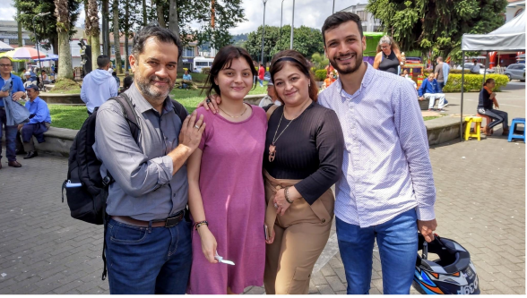
Oscar Arias
Evangelist – 24 Yrs
Villamaria, Columbia
Tabatinga & Umariacu Brazil
Galapagos Ecuador (Brother Sanchez)
$300 month

Slide 16
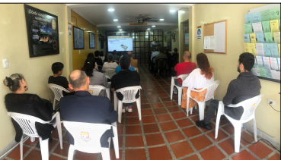
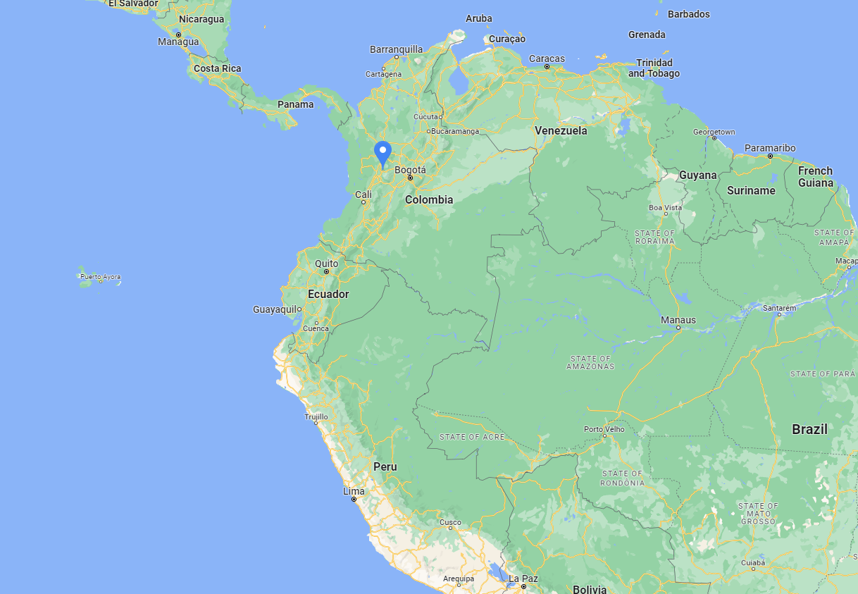
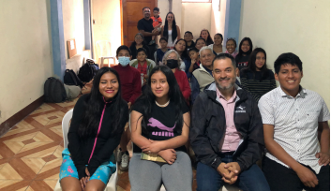
Villamaria
Tabatinga
Umariacu
Galapagos

