Slide 1
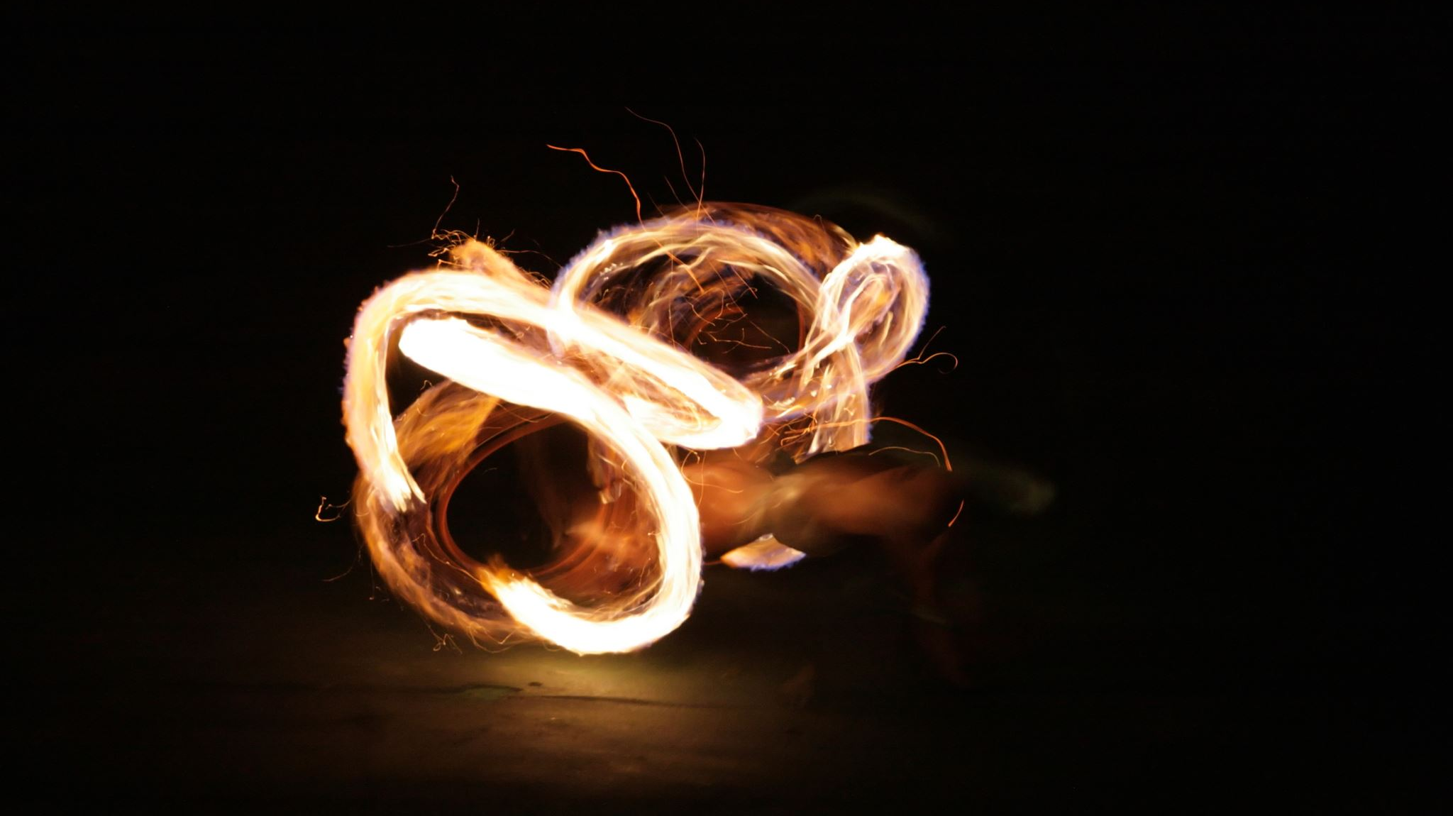
Lighting the Fire
Fire Extinguishers

Slide 2
Extinguisher #1: Satan Blows It Out
The darkness is immediate when this happens.
Media
We follow the direction of our eyes (Matthew 6:22-23).
What we listen to impacts our thoughts and words (Philippians 4:8).
How many unwholesome things do we interact with of social media each day?

Slide 3
Extinguisher #1: Satan Blows It Out
The darkness is immediate when this happens.
Media
Peer pressure
Part of living in the world is being around sin and learning how to not be influenced by it.
Not only that, but we face tremendous pressure to accept sinful lifestyles.
1 Corinthians 15:33 – “Do not be deceived”

Slide 4
Extinguisher #1: Satan Blows It Out
The darkness is immediate when this happens.
Media
Peer pressure
Attitudes
When the going gets rough, when we are in a stressful situation, how do we act?
People will always remember the poor attitudes we show, no matter how many good things we do.

Slide 5
Extinguisher #2: Slowly Burns Out
Maybe the biggest reason for this is that we turn our attention to other things.
Our flame slowly burns out because our focus gets off Jesus and God.
How can we make the most of our time?
Hebrews 12:1-2
Ephesians 5:15-16
Luke 8:7, 14
Hebrews 3:12-13

