Slide 1
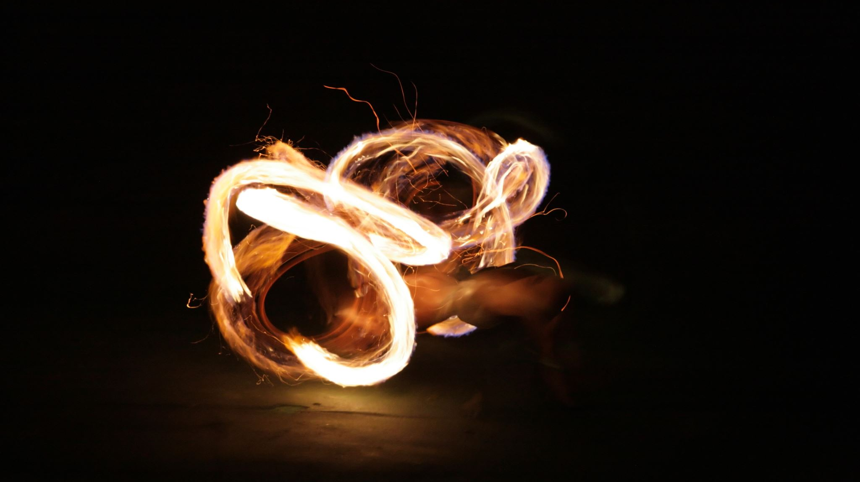
Lighting the Fire

Slide 2
Taking It For Granted
If we grow up in a Christian family, we will battle our fire dimming and going out.
By the time we are 16, we have been to well over 1,000 services and Bible studies!
This means it can be very easy to take the gift of growing up in a Christian family for granted.

Slide 3
The Christians In Laodicea
Revelation 3:14-22
What does lukewarm look like?
We only focus on spiritual things when we have to.
We only think about worship at the church building.
We rush through or don’t even complete our Bible lesson.
We focus on worldly things.
Verse 17 shows us what took their focus off God: luxuries and riches. Does this sound like our country?
Fires need to be hot, not lukewarm!

Slide 4
The Christians In Ephesus
Revelation 2:1-7
These Christians were still doing the right things, but something was missing: their heart wasn’t in it.
Look at all the great things we can do for the Lord, but still be rebuked because we have lost our spark for Him.
When we become lukewarm, we eventually lose our first love.

Slide 5
Lighting the Fire
“Light the fire in my weary soul”
Create in me a clean heart, O God, And renew a steadfast spirit within me.
Psalm 51:10

Slide 6
Lighting the Fire
“Light the fire in my weary soul”
“Fan the flame, make me whole”
And let endurance have its perfect result, so that you may be perfect and complete, lacking in nothing. But if any of you lacks wisdom, let him ask of God, who gives to all generously and without reproach, and it will be given to him.
James 1:4-5

Slide 7
Lighting the Fire
“Light the fire in my weary soul”
“Fan the flame, make me whole”
“Lord you know just where I’ve been”
Would not God find this out? For He knows the secrets of the heart.
Psalm 44:21

Slide 8
Keeping the Flame Lit
Daniel 1:8-17
These young me decided they wanted to live for God, not for the King.
Keeping the flame lit means…
We “make up our mind” (verse 8) to stay true to our faith.
We trust that God’s way works (verses 12-13).
We stick to our guns (verse 14).
When new, enticing things come our way, we must go to God and have Him keep our flame lit.

Slide 10
Light the Fire
Verse 1
I stand to praise you(All)
but I fall on my knees(All)
My spirit is willing(All)
but my flesh is so weak(All)

Slide 11
Chorus
(Men) (Women)
So light the fire Light the fire
In my soul In my weary soul
Fan the flame Fan the flame
Make me whole Make my spirit whole
Lord you know Lord you know
Just where I've been Where I've been
So, light the fire in my heart again

Slide 12
Verse 2
I feel your arms around me (All)
as the power of your healing begins (All)
You breathe new life right through me (All)
like a mighty rushing wind (All)
*Repeat Chorus 2 times*

Slide 13
Chorus
(Men) (Women)
So light the fire Light the fire
In my soul In my weary soul
Fan the flame Fan the flame
Make me whole Make my spirit whole
Lord you know Lord you know
Just where I've been Where I've been
So, light the fire in my heart again

