Slide 1
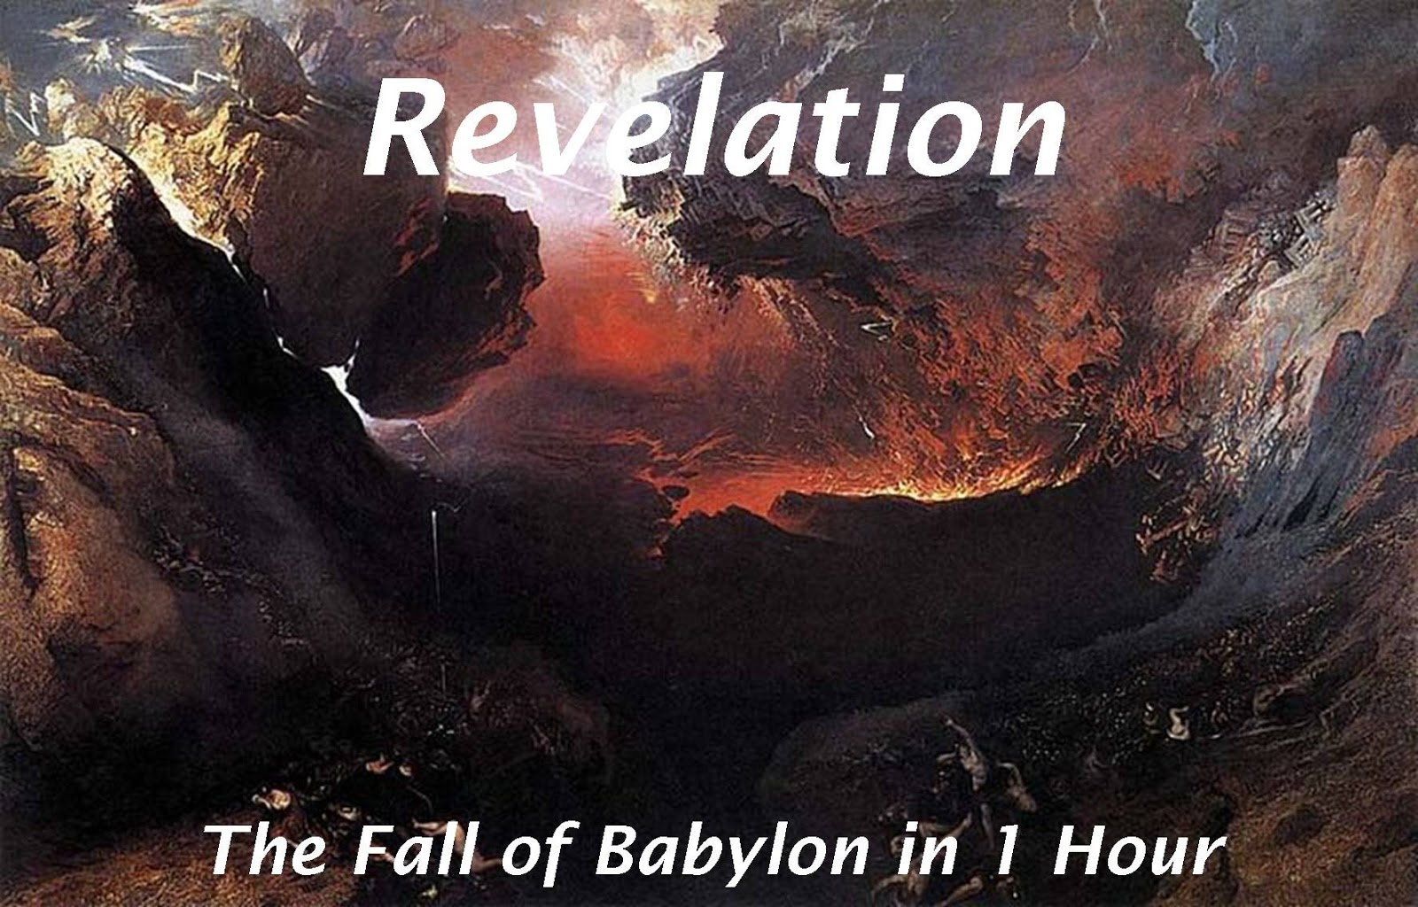
18
ROME WILL FALL
It shall be sudden and violent and none of Rome’s friends will help them in their worst hour of need.
And so it begins!

Slide 2
18 After these things I saw another angel coming down from heaven, having great authority, and the earth was illuminated with his glory
The greatness of the angel and of his mission is here told and described by John as “the earth was lightened with his glory.”

Slide 3
² And he cried mightily with a loud voice, saying, “Babylon the great is fallen, is fallen, and has become a dwelling place of demons, a prison for every foul spirit, and a cage for every unclean and hated bird!
The wording is as if it has already occurred.
Isaiah 21:9 – This prophecy was made a century and half BEFORE it occurred.
And look, here comes a chariot of men with a pair of horsemen!” Then he answered and said, “Babylon is fallen, is fallen! And all the carved images of her gods He has broken to the ground.”

Slide 4
³ For all the nations have drunk of the wine of the wrath of her fornication, the kings of the earth have committed fornication with her, and the merchants of the earth have become rich through the abundance of her luxury.”
The worldliness of Rome is appealing to many in the world
This verse sets up a point that Jesus wants to make to His people in the next verse.
A comparison and contrast is being made for the Christians in the first century and us today.

Slide 5
⁴ And I heard another voice from heaven saying, “Come out of her, my people, lest you share in her sins, and lest you receive of her plagues.
Christians are not to physically leave Rome, but they are not to partake of their sins like the kings of the earth had
Ephesians 5:11
What does say to Christians today?
¹¹ And have no fellowship with the unfruitful works of darkness, but rather expose them.

Slide 6
⁴ And I heard another voice from heaven saying, “Come out of her, my people, lest you share in her sins, and lest you receive of her plagues.
Who do we associate with?
Our TV Viewing?
Our books we read?
Our visits on the internet?
Our Free time?
Who do we spend more time with, the world or Christians?

Slide 7
⁵ For her sins have reached to heaven, and God has remembered her iniquities.
Why we come out of her and not partake of that which the world offers.
God will allow sin (Nationally) to continue for a while, but will end the country.
Think about Abraham going through the promised land and what God told Abraham

Slide 8
⁶ Render to her just as she rendered to you, and repay her double according to her works; in the cup which she has mixed, mix double for her.
Another lesson as to why need to come out Babylon/the world??
This is a lesson that is true to not only individuals but also to nations

Slide 9
⁷ In the measure that she glorified herself and lived luxuriously, in the same measure give her torment and sorrow; for she says in her heart, ‘I sit as queen, and am no widow, and will not see sorrow.’
Pride goeth before the fall!
Isaiah 47:7 said to Babylon of old as well.
And you said, ‘I shall be a lady forever,’ So that you did not take these things to heart, Nor remember the latter end of them.

Slide 10
⁷ In the measure that she glorified herself and lived luxuriously, in the same measure give her torment and sorrow; for she says in her heart, ‘I sit as queen, and am no widow, and will not see sorrow.’
The attitude here is the same as the rich farmer when he wanted to tear down the smaller barns and build bigger!
We must NOT get comfortable in this life – feel as if we have “arrived” in this life but always realize we are pilgrims passing through. This world, as we sing, truly is NOT our home.
End Result for the farmer and Rome?
They died

Slide 11
⁸ Therefore her plagues will come in one day—death and mourning and famine. And she will be utterly burned with fire, for strong is the Lord God who judges her.
The “therefore” indicates the consequences of the boast from the verse before
One day (quickly) is emphasized over and over in this chapter
How often falls of nations and people occur like it was in one day or overnight?

Slide 12
⁹ “The kings of the earth who committed fornication and lived luxuriously with her will weep and lament for her, when they see the smoke of her burning,
The kings are not crying for Rome, but what they lost!
Two points of emphasis: (1) quick destruction and (2) No one cares for Rome
World is NOT concerned for you when push comes to shove
What good friends the world makes

Slide 13
¹⁰ standing at a distance for fear of her torment, saying, ‘Alas, alas, that great city Babylon, that mighty city! For in one hour your judgment has come.’
One hour indicates the briefness and suddenness of the destruction of Rome
When problems occur (think Covid) they hit with swiftness and seem as if one day all was great and the next the world falls apart (depression of the 30s)
Again, the “one hour” comes up and will come up again and again

Slide 14
¹¹ “And the merchants of the earth will weep and mourn over her, for no one buys their merchandise anymore:
The merchants laments were like that of the kings – not for Rome, but for what THEY LOST
It is all about financial loss and NOT any esteem or concern for Rome

Slide 15
¹¹ “And the merchants of the earth will weep and mourn over her, for no one buys their merchandise anymore: ¹² merchandise of gold and silver, precious stones and pearls, fine linen and purple, silk and scarlet, every kind of citron wood, every kind of object of ivory, every kind of object of most precious wood, bronze, iron, and marble; ¹³ and cinnamon and incense, fragrant oil and frankincense, wine and oil, fine flour and wheat, cattle and sheep, horses and chariots, and bodies and souls of men. ¹⁴ The fruit that your soul longed for has gone from you, and all the things which are rich and splendid have gone from you, and you shall find them no more at all.
Look at the emphasis in these verses – all that is materially could be found in Rome!
Worldly does NOT last!

Slide 16
¹⁵ The merchants of these things, who became rich by her, will stand at a distance for fear of her torment, weeping and wailing, ¹⁶ and saying, ‘Alas, alas, that great city that was clothed in fine linen, purple, and scarlet, and adorned with gold and precious stones and pearls! ¹⁷ For in one hour such great riches came to nothing.’ Every shipmaster, all who travel by ship, sailors, and as many as trade on the sea, stood at a distance
The list of cargoes and merchandise consist primarily of the luxuries and comforts of life!
Minerals – Gold and silver
Plants – linen and silk
Animal – cattle
Man
Note – no one wants to get close to her

Slide 17
¹⁵ The merchants of these things, who became rich by her, will stand at a distance for fear of her torment, weeping and wailing, ¹⁶ and saying, ‘Alas, alas, that great city that was clothed in fine linen, purple, and scarlet, and adorned with gold and precious stones and pearls! ¹⁷ For in one hour such great riches came to nothing.’ Every shipmaster, all who travel by ship, sailors, and as many as trade on the sea, stood at a distance
Think of all the material things listed here. Rome had it all. It did truly have all of the world’s material things found in her.
Can you think of a country today that is similar with Rome that has everything materially, all the comforts that the world has to offer, a person could ever want?
Emphasis is on APPEARANCE

Slide 18
¹⁸ and cried out when they saw the smoke of her burning, saying, ‘What is like this great city?’ ¹⁹ “They threw dust on their heads and cried out, weeping and wailing, and saying, ‘Alas, alas, that great city, in which all who had ships on the sea became rich by her wealth! For in one hour she is made desolate.’
The casting of dust is an oriental form of mourning
Again, the mourning is because of THEIR loss of wealth for the merchants, sailors and captains – not for Rome
Material things do NOT last!!

Slide 19
²⁰ “Rejoice over her, O heaven, and you holy apostles and prophets, for God has avenged you on her!”
THIS IS THE POINT OF THE CHAPTER!
Here is the reason for Rome’s fall
Justice is the reason to rejoice, not the death of so many, but God’s justice reigns and will always reign

Slide 20
²¹ Then a mighty angel took up a stone like a great millstone and threw it into the sea, saying, “Thus with violence the great city Babylon shall be thrown down, and shall not be found anymore.
⁶¹ And Jeremiah said to Seraiah, “When you arrive in Babylon and see it, and read all these words, ⁶² then you shall say, ‘O Lord, You have spoken against this place to cut it off, so that none shall remain in it, neither man nor beast, but it shall be desolate forever.’ ⁶³ Now it shall be, when you have finished reading this book, that you shall tie a stone to it and throw it out into the Euphrates. ⁶⁴ Then you shall say, ‘Thus Babylon shall sink and not rise from the catastrophe that I will bring upon her. And they shall be weary.’ ”
It will be a violent judgment
Compare to Jeremiah 51:61-64

Slide 21
²² The sound of harpists, musicians, flutists, and trumpeters shall not be heard in you anymore. No craftsman of any craft shall be found in you anymore, and the sound of a millstone shall not be heard in you anymore.
Five live come to an end in Rome:
Musical Instruments (Amusement)
Mill – (Food, needed to survive)
Craftsmen – (Business/economical)
Lights – (Luxury, no more luxuries)
Bride – (Merriment and partying atmosphere)

Slide 22
²³ The light of a lamp shall not shine in you anymore, and the voice of bridegroom and bride shall not be heard in you anymore. For your merchants were the great men of the earth, for by your sorcery all the nations were deceived. ²⁴ And in her was found the blood of prophets and saints, and of all who were slain on the earth.”
Two reasons for Rome’s destruction are here pictured:
They deceived the nations
Innocent blood shed by Rome. Not only had they shed the blood of prophets and saints, but all who were slain on the earth.

