Slide 1
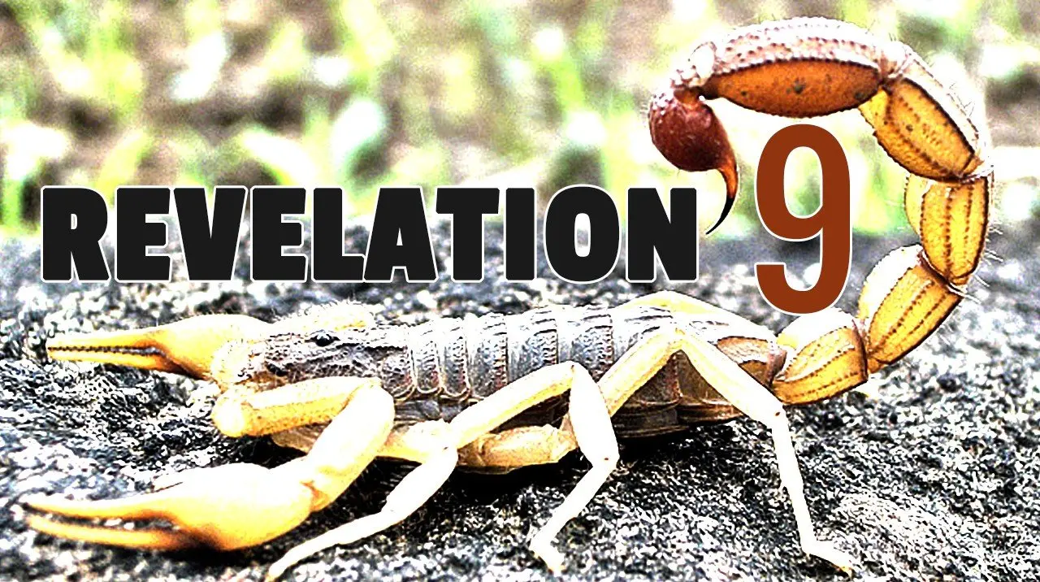

Slide 2
9 Then the fifth angel sounded: And I saw a star fallen from heaven to the earth. To him was given the key to the bottomless pit. ² And he opened the bottomless pit, and smoke arose out of the pit like the smoke of a great furnace. So the sun and the air were darkened because of the smoke of the pit.
Star = Satan (Luke 10:18)
Key = Symbol of Power
Christ has the keys of death and Hades (1:18)
Satan has the key here, but they had to be given to him by Christ. He is PERMITTED to open the abyss
¹⁸ And He said to them, “I saw Satan fall like lightning from heaven.
¹⁸ I am He who lives, and was dead, and behold, I am alive forevermore. Amen. And I have the keys of ^{[j]}Hades and of Death.

Slide 3
9 Then the fifth angel sounded: And I saw a star fallen from heaven to the earth. To him was given the key to the bottomless pit. ² And he opened the bottomless pit, and smoke arose out of the pit like the smoke of a great furnace. So the sun and the air were darkened because of the smoke of the pit.
Satan will begin to have a more prominent place in the message from here on out.
In Daniel, we find that Satan has an influence on the nations
John 12:31
Ephesians 2:2
³¹ Now is the judgment of this world; now the ruler of this world will be cast out.
² in which you once walked according to the course of this world, according to the prince of the power of the air, the spirit who now works in the sons of disobedience,

Slide 4
9 Then the fifth angel sounded: And I saw a star fallen from heaven to the earth. To him was given the key to the bottomless pit. ² And he opened the bottomless pit, and smoke arose out of the pit like the smoke of a great furnace. So the sun and the air were darkened because of the smoke of the pit.
2 Corinthians 4:4
The phrase “god of this world” (or “god of this age”) indicates that Satan is the major influence on the ideals, opinions, goals, hopes and views of the majority of people. His influence also encompasses the world’s philosophies, education, and commerce and so much more. The thoughts, ideas, speculations and false religions of the world are under his control and have sprung from his lies and deceptions.
⁴ whose minds the god of this age has blinded, who do not believe, lest the light of the gospel of the glory of Christ, who is the image of God, should shine on them.

Slide 5
³ Then out of the smoke locusts came upon the earth. And to them was given power, as the scorpions of the earth have power. ⁴ They were commanded not to harm the grass of the earth, or any green thing, or any tree, but only those men who do not have the seal of God on their foreheads.
Smoke = Gloom and Despair
The Abyss = the infernal regions to which the demons have been assigned (Luke 8:31)
Satan is case there when bound (Rev 20:1,3)
It is NOT Ghenna/Lake of Fire, but the present abode of the devil and his angels
³¹ And they begged Him that He would not command them to go out into the abyss.

Slide 6
³ Then out of the smoke locusts came upon the earth. And to them was given power, as the scorpions of the earth have power. ⁴ They were commanded not to harm the grass of the earth, or any green thing, or any tree, but only those men who do not have the seal of God on their foreheads.
Seal of God on their foreheads?
Is this a TRUE knowledge of God?
If so, how is it obtained?
Importance of reading (daily), study (daily) and meditation on God’s word (all day and night long)?
False teaching of chapters 2 and 3 with some of the churches coming into play here?

Slide 7
⁵ And they were not given authority to kill them, but to torment them for five months. Their torment was like the torment of a scorpion when it strikes a man. ⁶ In those days men will seek death and will not find it; they will desire to die, and death will flee from them.
These were NOT normal locust; they did not eat vegetation
These were locust from the Abyss
Power to not kill but torment sinners
BUT still no repentance (Vs 20,21)
Men sought death but could not find it

Slide 8
⁷ The shape of the locusts was like horses prepared for battle. On their heads were crowns of something like gold, and their faces were like the faces of men. ⁸ They had hair like women’s hair, and their teeth were like lions’ teeth. ⁹ And they had breastplates like breastplates of iron, and the sound of their wings was like the sound of chariots with many horses running into battle.
Pictured as:
Horses
Strong
Crowns (Mission Victorious)
Hair as women (beautiful)
Teeth as lions
Breastplates (invincible)
Wings
Multitudes (MANY)
TOTALLY SYMBOLIC!!!!

Slide 9
¹⁰ They had tails like scorpions, and there were stings in their tails. Their power was to hurt men five months. ¹¹ And they had as king over them the angel of the bottomless pit, whose name in Hebrew is Abaddon, but in Greek he has the name Apollyon. ¹² One woe is past. Behold, still two more woes are coming after these things.
The sting of a scorpion does NOT normally kill, but it is VERY painful
Just the FIRST woe is passed!! Two more to come.
God is allowing worldly man to see how much Satan cares for man. God gave His Son to die. Satan ONLY gives pain and torment and suffering.

Slide 10
¹³ Then the sixth angel sounded: And I heard a voice from the four horns of the golden altar which is before God, ¹⁴ saying to the sixth angel who had the trumpet, “Release the four angels who are bound at the great river Euphrates.”
Euphrates – God’s forces of vengeance were held in restraint at their border until a time determined by God.
Border of the Parthian and Roman Empires
The forces of vengeance were held in restraint at the border until God Himself determined to release them. HE IS IN CONTROL!!!

Slide 11
¹⁵ So the four angels, who had been prepared for the hour and day and month and year, were released to kill a third of mankind.
Four angels probably represent judgment on a world wide proportion (N S E W)
Time has been prepared by God
Only God prepares time of judgment (Acts 1:7)
Locust did NOT kill men, so now it gets worse!
1/3 part – Not all, again, God trying to get mankind to repent!
⁷ And He said to them, “It is not for you to know times or seasons which the Father has put in His own authority.

Slide 12
¹⁶ Now the number of the army of the horsemen was two hundred million; I heard the number of them.
A MIGHTY host!!
Regular formation of this cavalry would have been one mile wide, and 84 miles long
SYMBOLIC!!
Could we be seeing another reference to feared Parthians and their mighty cavalry??

Slide 13
¹⁷ And thus I saw the horses in the vision: those who sat on them had breastplates of fiery red, hyacinth blue, and sulfur yellow; and the heads of the horses were like the heads of lions; and out of their mouths came fire, smoke, and brimstone. ¹⁸ By these three plagues a third of mankind was killed—by the fire and the smoke and the brimstone which came out of their mouths. ¹⁹ For their power is in their mouth and in their tails; for their tails are like serpents, having heads; and with them they do harm.
The whole picture is given to symbolize external invasion which would serve as an instrument in God’s hands to punish the oppressor of his people.
First judgment on man, more to come!

Slide 14
²⁰ But the rest of mankind, who were not killed by these plagues, did not repent of the works of their hands, that they should not worship demons, and idols of gold, silver, brass, stone, and wood, which can neither see nor hear nor walk.
This is the WHOLE point of the book.
This is given as a sign to the rest of unrepentant man, but they ignored the sign.
God will give more time, but time is running out and soon final judgment will fall.

Slide 15
²¹ And they did not repent of their murders or their sorceries or their sexual immorality or their thefts.
This completes the three instruments symbolized in Revelation by God to get unrepentant man to repent.
Natural Calamities
Internal Rottenness
External invasion
All of which caused the down fall of Rome
America
Today?

Slide 16
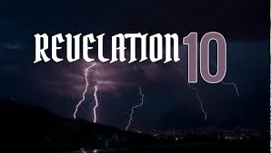

Slide 17
Chapters 10 and 11 Overview
Scene now shifts to another area that is taking place at the same time as the seals, trumpets and bowls are occurring.
Chapter 9 ends with worldly refusing to repent
God’s people are being directly attacked in these two chapters
But we also see things from a heavenly view which shows God expects His people to remain faithful, no matter what

Slide 18
10 I saw still another mighty angel coming down from heaven, clothed with a cloud. And a rainbow was on his head, his face was like the sun, and his feet like pillars of fire.
Cloud is used 25 times in the NT and only three times does it not mean or symbolize some sort of divine appearance of judgment
So this angel has some sort of divine appearance in judgment
Rainbow = God keeps His promises (Emphasized many times in this book)
Pillar of fire led = God led Israelites out of Egypt

Slide 19
² He had a little book open in his hand. And he set his right foot on the sea and his left foot on the land,
Little book – contrast that with the “big scroll” of chapter 5
This then must only be a portion of God’s total purpose
It is open = not a mystery
Feet would indicate the far reaching, all inclusiveness of his mission

