Slide 1
Notes:
Welcome visitors, ask you to follow along. Verses will be on screen for those dealing with small children.

Slide 2
Is Your Light Hidden Under A Basket?
Adapted from Jesse Flowers’ The Silent Christian
Notes:
Attended a gospel meeting 2 months ago and one of the closing slides was “Is Your Light Hidden Under a Basket?” quoting from Matt. 5:15.
"Nor do they light a lamp and put it under a basket, but on a lampstand, and it gives light to all who are in the house.”
With our theme this year being on Letting Our Lights Shine and this being my last time in the preacher rotation for this year. I thought I’d preach on this using many of the points from Bro. Flowers sermon.

Slide 3
John 19:38
“After this, Joseph of Arimathea, being a disciple of Jesus, but secretly, for fear of the Jews, asked Pilate that he might take away the body of Jesus; and Pilate gave him permission. So he came and took the body of Jesus.”
Notes:
In the scripture reading we read of Joseph of Arimathea. It says here, he was a disciple of Jesus but was one secretly. Other parallel passages such as Mk. 15, add that he was a prominent council member and he had to gather up the courage to ask Pilate. But I want to focus on that fact that he was a secret disciple…

Slide 4
Study: What Americans Really Think
axios.com
"Self-silencing" — people saying what they think others want to hear rather than what they truly feel — is skewing our understanding of how Americans really feel about abortion, COVID-19 precautions, what children are taught in school and other hot-button issues, a new study finds (8/17/22).
Notes:
Study done by axios in August of this year (2022)….
What more of a hot-button issue than what the Bible says on things?

Slide 5
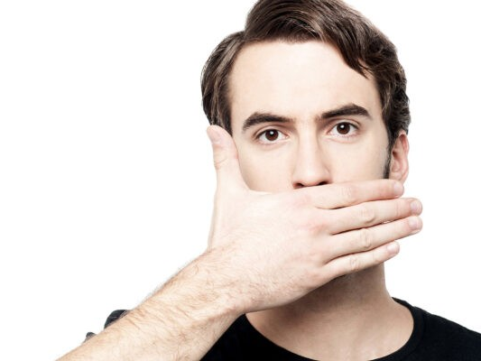
What Causes Our Silence?
Notes:
It certainly has happened in the past, where followers of Christ have silenced themselves – like Joseph of Arimathea for fear of the Jews. But sadly, it is also true too often in present day, that children of God are guilty of self-silencing.

Slide 6
What Causes our Silence?
Fear Of Men
Proverbs 29:25
Notes:
Our silence can be caused by fear of men, just as we saw with Joseph of Arimathea.

Slide 7
Proverbs 29:25
“The fear of man brings a snare, but whoever trusts in the Lord shall be safe.”
Notes:
We should not fear but have trust in the Lord.

Slide 8
What Causes our Silence?
Fear Of Men
Proverbs 29:25
Matthew 10:28

Slide 9
Matthew 10:28
“And do not fear those who kill the body but cannot kill the soul. But rather fear Him who is able to destroy both soul and body in hell.”
Notes:
Again we read that we should not fear men who can only kill the body but fear God who is able to destroy both soul & body in hell.

Slide 10
What Causes our Silence?
Fear Of Men
Proverbs 29:25
Matthew 10:28
Revelation 21:8

Slide 11
Revelation 21:8
“But the cowardly, unbelieving, abominable, murderers, sexually immoral, sorcerers, idolaters, and all liars shall have their part in the lake which burns with fire and brimstone, which is the second death.”
Notes:
The first one in this list that the inspired apostle John writes is the COWARDLY…those who for fear, who cower and flee from their faith in God.

Slide 12
What Causes our Silence?
Fear Of Men
Proverbs 29:25
Matthew 10:28
Revelation 21:8
2 Timothy 1:7

Slide 13
2 Timothy 1:7
“For God has not given us a spirit of fear, but of power and of love and of a sound mind.”
Notes:
We need to focus on our faith in God to overcome fear.

Slide 14
What Causes our Silence?
Fear Of Men
Proverbs 29:25
Matthew 10:28
Revelation 21:8
2 Timothy 1:7
Notes:
Also not listed: Matthew 25:25 – Parable of talents: unprofitable servant was afraid and hid his talent in the ground

Slide 15
What Causes our Silence?
Fear Of Men
We are afraid of how others will react to the truth.
We are afraid of offending others.
We fear confrontation and hostility.
Notes:
So why/how could we fear men today?

Slide 16
Acts 18:9-10
“Now the Lord spoke to Paul in the night by a vision, “Do not be afraid, but speak, and do not keep silent; for I am with you, and no one will attack you to hurt you; for I have many people in this city.”
Notes:
In Acts 18, Paul was encouraged to not be afraid but speak. The Jews had rejected him & blasphemed and Paul asserts that “From now on, I will go to the Gentiles” but evidently Paul needed to be encouraged to NOT be afraid but to continue speaking.

Slide 17
What Causes our Silence?
Ashamed Of The Gospel
Luke 9:26
Notes:
Secondly, the fear of men will lead us to acting ashamed of Christ and His teachings.

Slide 18
Luke 9:26
“For whoever is ashamed of Me and My words, of him the Son of Man will be ashamed when He comes in His own glory, and in His Father’s, and of the holy angels.”
Notes:
We can clearly see here that we must not be ashamed of Christ OR His Words. By inference, knowing that Christ sent the Holy Spirit to guide the apostles in their teaching and He only spoke the things He heard from Christ (Jn. 16:13), we can know that we must not be ashamed of any of the Bible.

Slide 19
What Causes our Silence?
Ashamed Of The Gospel
Luke 9:26
Matthew 10:32-33

Slide 20
Matthew 10:32-33
“Therefore whoever confesses Me before men, him I will also confess before My Father who is in heaven. But whoever denies Me before men, him I will also deny before My Father who is in heaven.”
Notes:
In these verses we see what will happen if we are ashamed or deny Christ, He will deny us before the Father.

Slide 21
What Causes our Silence?
Ashamed Of The Gospel
Luke 9:26
Matthew 10:32-33
Romans 1:16-17

Slide 22
Romans 1:16-17
“For I am not ashamed of the gospel of Christ, for it is the power of God to salvation for everyone who believes, for the Jew first and also for the Greek. For in it the righteousness of God is revealed from faith to faith; as it is written, “The just shall live by faith.”
Notes:
By studying His word, we can boldly say as Paul that we are not ashamed of the gospel.

Slide 23
What Causes our Silence?
Ashamed Of The Gospel
Luke 9:26
Matthew 10:32-33
Romans 1:16-17
2 Timothy 1:7-8

Slide 24
2 Timothy 1:7-8
“For God has not given us a spirit of fear, but of power and of love and of a sound mind.
Therefore do not be ashamed of the testimony of our Lord, nor of me His prisoner, but share with me in the sufferings for the gospel according to the power of God,”
Notes:
We read vs 7 earlier talking about our fear of men, but let’s continue the context in v. 8. We should not fear or be ashamed of the testimony of our Lord.

Slide 25
What Causes our Silence?
Ashamed Of The Gospel
Luke 9:26
Matthew 10:32-33
Romans 1:16-17
2 Timothy 1:7-8
Notes:
Now that we have seen what the Bible says about being ashamed of the gospel, let’s take a look at how can we be ashamed of the gospel…

Slide 26
What Causes our Silence?
Ashamed Of The Gospel
We are ashamed of how narrow the way is.
We are ashamed of the one true Church.
We are ashamed of Bible baptism & its necessity.
We are ashamed of New Testament worship (music).
We are ashamed of the role of women.
Notes:
When talking to our friends and neighbors, are we silent because we are….ashamed of the narrowness of truth?

Slide 27
Mark 8:38
“For whoever is ashamed of Me and My words in this adulterous and sinful generation, of him the Son of Man also will be ashamed when He comes in the glory of His Father with the holy angels.”
Notes:
We read earlier from Matt. 10 but now let’s read the parallel verse in Mark 8:38.

Slide 28
What Causes our Silence?
We Seek The Approval Of Men
John 12:42-43
Notes:
A third aspect that can cause our silence is that we seek the approval of men.

Slide 29
John 12:42-43
“Nevertheless even among the rulers many believed in Him, but because of the Pharisees they did not confess Him, lest they should be put out of the synagogue; for they loved the praise of men more than the praise of God.”
Notes:
Many of the rulers believed in Christ but because of the Pharisees they didn’t confess him (there’s that fear of men), because they loved the praise of men MORE than the praise of God.

Slide 30
What Causes our Silence?
We Seek The Approval Of Men
John 12:42-43
John 5:41, 44

Slide 31
John 5:41,44
“I do not receive honor from men…How can you believe, who receive honor from one another, and do not seek the honor that comes from the only God?”
Notes:
Jesus came not to receive approval or honor from men but to seek the honor that comes from God. This is another one of those areas where we are to imitate Christ, and solely seek the honor that comes from God.

Slide 32
What Causes our Silence?
We Seek The Approval Of Men
John 12:42-43
John 5:41, 44
Galatians 1:10

Slide 33
Galatians 1:10
“For do I now persuade men, or God? Or do I seek to please men? For if I still pleased men, I would not be a bondservant of Christ.”
Notes:
Paul states that he is not trying to seek the approval of man but of God and if it was his mission to please men, he would not be a bondservant of Christ.

Slide 34
What Causes our Silence?
We Seek The Approval Of Men
John 12:42-43
John 5:41, 44
Galatians 1:10
1 Thessalonians 2:4

Slide 35
1 Thessalonians 2:4
“But as we have been approved by God to be entrusted with the gospel, even so we speak, not as pleasing men, but God who tests our hearts.”
Notes:
Paul tells the Thessalonians that we are entrusted with the gospel and we speak pleasing God, not man.

Slide 36
What Causes our Silence?
We Seek The Approval Of Men
John 12:42-43
John 5:41, 44
Galatians 1:10
1 Thessalonians 2:4
Notes:
We see in these verses who we should be seeking approval from and that is God, however in this life….

Slide 37
What Causes our Silence?
We Seek The Approval Of Men
We naturally want others to like us.
We want to fit in at school, work, and in our community.
We want to be accepted and receive the approval of our peers and the world.
Notes:
We want to be approved but the Bible warns us:
“For we have spent enough of our past lifetime in doing the will of the Gentiles--when we walked in lewdness, lusts, drunkenness, revelries, drinking parties, and abominable idolatries. In regard to these, they think it strange that you do not run with them in the same flood of dissipation, speaking evil of you” (1 Peter 4:3-4).
“Woe to you when all men speak well of you, for so did their fathers to the false prophets” (Luke 6:26).
And in James…

Slide 38
James 4:4
“Adulterers and adulteresses! Do you not know that friendship with the world is enmity with God? Whoever therefore wants to be a friend of the world makes himself an enemy of God.”
Notes:
We are not to seek approval from the world as they are the enemies of God but we should strive to always be seeking God’s approval in all that we do.

Slide 39
We are not Saved to be Silent
Ezek. 3:17-19
“Son of man, I have made you a watchman for the house of Israel; therefore hear a word from My mouth, and give them warning from Me: When I say to the wicked, 'You shall surely die,' and you give him no warning, nor speak to warn the wicked from his wicked way, to save his life, that same wicked man shall die in his iniquity; but his blood I will require at your hand. Yet, if you warn the wicked, and he does not turn from his wickedness, nor from his wicked way, he shall die in his iniquity; but you have delivered your soul.”

Slide 40
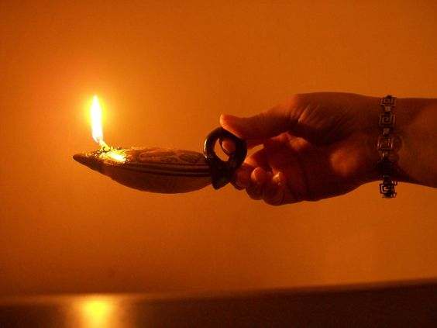
Do NOT Keep Silent
Confess Christ before Men (Matt. 10:32)
Speak the Truth in Love (Eph. 4:15)
Open Your Mouth Boldly to Make Known the Gospel (Eph. 6:19)
Let your Speech be with Grace & Seasoned with Salt (Col. 4:6)
With Humility Correct those who are in Opposition (2 Tim. 2:25)
Give a Defense to Everyone who Asks with Meekness and Fear (1 Pet. 3:15)

Slide 41
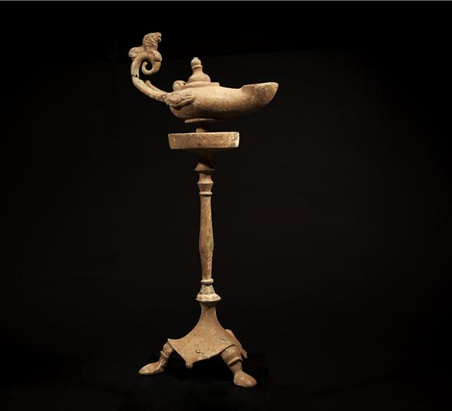
Will you put your lamp under a basket or will you put it on a lampstand? (Matthew 5:14-16)
Notes:
“You are the light of the world. A city that is set on a hill cannot be hidden. Nor do they light a lamp and put it under a basket, but on a lampstand, and it gives light to all who are in the house. Let your light so shine before men, that they may see your good works and glorify your Father in heaven.”

Slide 42
Notes:
If you are Christian and have hidden your lamp, make changes today
or
If you haven’t become a Christian and let your light shine, you have the opportunity to come now confessing your faith in Christ, repenting of your sins and being baptized for the remission of your sins.
If you have either of these needs, we ask that you come forward now as we stand & sing.

