Slide 2
Adam versus Christ
1. One offense - many died. Grace by one abounds to many. 5:15
2. One offense - condemnation. Free gift: many justified. 5:16
3. One offense - death reigned. Gift of grace: many reign. 5:17
4. One offense - judgment to all. One man’s act: life to all 5:18
5. One man’s act - Many made sinners. One man’s obedience: many made righteous. 5:19

Slide 3
Can We Continue In Sin?
6:2. We died to sin.
6:6. We crucified the old man.
6:7-8. We are now free from sin.
6:10-11. Christ died and lives before God. We die to sin and now live before God.
6:12-14. Sin no longer reigns over us.
6:18-19. We are now slaves to righteousness.
6:23. The wages of sin is death.

Slide 4
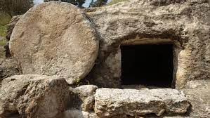
New Life

Slide 5
How does one get into Christ Jesus
where the spiritual blessings are found?
Every Spiritual Blessing in heavenly places in Christ Jesus

