Slide 2
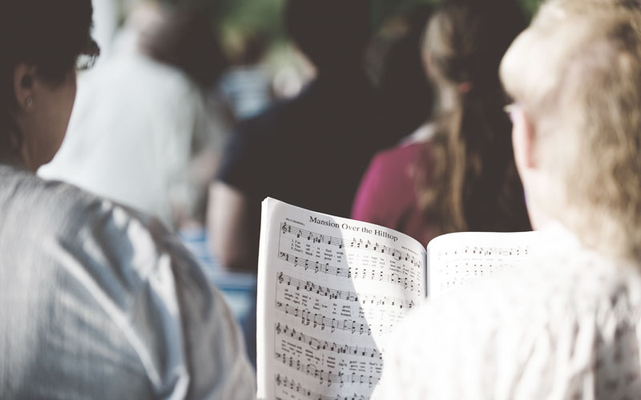
Sing to the Lord!

Slide 3
The Practice of Singing Praises
Age old practice of God’s people which existed and was done long before the New Testament Church was established.
Moses and Israel (Ex. 15:1-2)
Deborah (Jud. 5:3)
David (assorted Psalms)
Isaiah (Isa. 12:1-4)
Jeremiah (Jer. 20:13)
Jesus (Matt. 26:30)
The apostles taught the early church to accomplish this in two ways:
Congregationally (1 Cor. 14:15)
Individually (Acts 16:25)

Slide 4
Why do we sing?
Commanded (Eph. 5:19)
Multiple things can and are accomplished through singing:
Praise to God
Emotions are expressed
Teaching and admonishing of brethren and non-believers
We speak to ourselves

Slide 5
Requirements for Singing
Must have a song
Psalms, Hymns, Spiritual Songs
Memorized or written
Must have a melody/tune
No melody/tune= chant which is NOT a song
Often poems set to music
Must have a pitch
Must have a leader in worship for orderly accomplishment of command to sing
1 Cor. 14:40

Slide 6
New Testament Teaching on Music in Worship
Found multiple times in the New Testament
Restricted to 3 types of music in this regard:
Psalms: songs devoted to praise of God
Hymns: songs of praise, thanksgiving and supplication
Spiritual Songs: originally knows as an “ode”
God as specified that this must be done with the heart!
Col. 3:16
Eph. 5:19
How do we sing?
John 4:23-24- this must be done in SPIRIT and TRUTH

