Slide 2
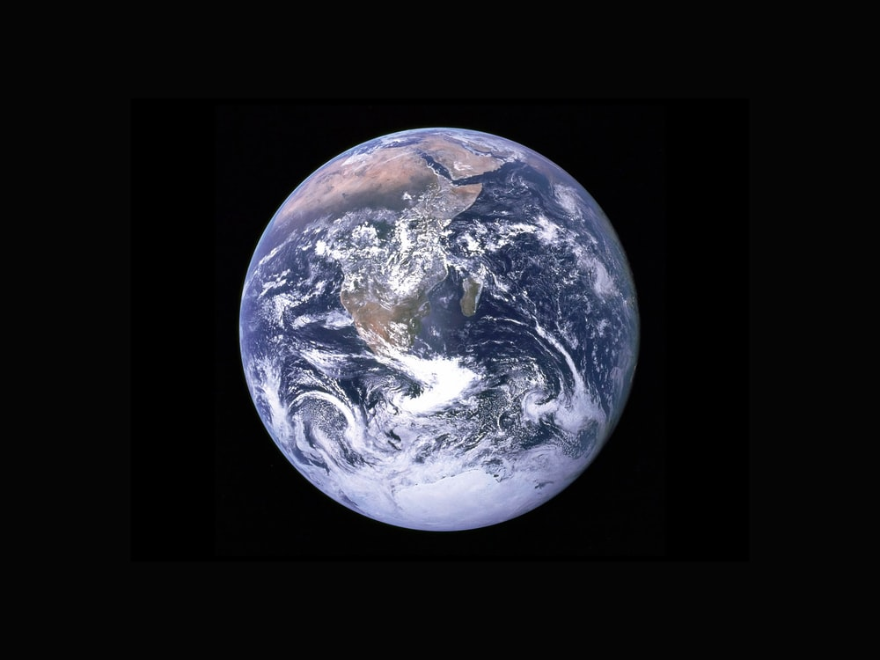
At some time, known only to the
mind of God, the world as we know it will come an end

Slide 3
A Judgement For All Mankind
1. ALL that are in the tombs. John 5:28-29
2. We must ALL be manifested. 2 Corinthians 5:10
3. There will be a separation. Matthew 25:41,46
THINK! This will include your family, your relatives, your neighbors, your friends, your co-workers.

Slide 4
The Great Commission
1. The apostles were to GO.
2. The baptized believers are under consideration in verse 20.
3. What had Jesus commanded? GO!
4. We either go and teach, or we disobey Jesus!

Slide 5
Paul’s Command To Timothy
1. Timothy was to teach others.
2. These were to teach MORE people.
3. Question: How obedient are we in carrying out these two commands?

Slide 6
Will We Always be Successful?
1. Jesus faced rejection. John 6:66-67
2. Paul faced rejection. Acts 24:24-26
3. Agrippa did not obey. Acts 26:27-28
Yet, Paul was not ashamed. Romans 1:15-17

