Slide 2
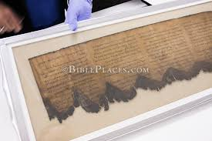

Slide 4
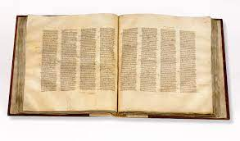

Slide 5
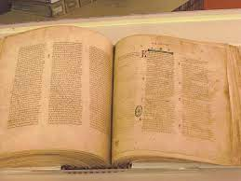

Slide 6
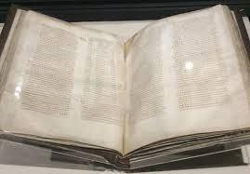

Slide 10
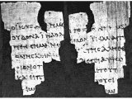

Slide 12
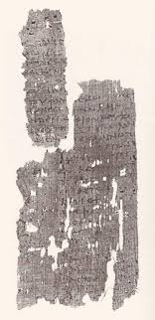

Slide 13
INTHERBEGINNINGWASTHEWORDANDTHEWORDW
ASWITHGODANDTHEWORDWASGODTHESAMEWAS
INTHEBEGINNINGWITHGOD

