Slide 1
DEFEATING YOUR
GOLIATH
1 Samuel 17

Slide 2
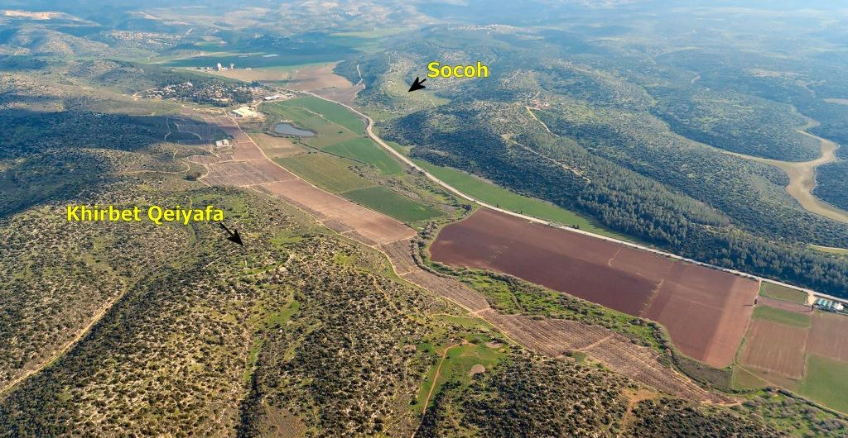
Elah Valley
Philistine Camp
Elah Stream
Israelite Camp
Azekah
Gath

Slide 3
1 SAMUEL 17:5-7
He had a bronze helmet on his head, and he was clothed with scale-armor which weighed five thousand shekels of bronze. He also had bronze greaves on his legs and a bronze javelin slung between his shoulders. The shaft of his spear was like a weaver’s beam, and the head of his spear weighed six hundred shekels of iron; his shield-carrier also walked before him.

Slide 4
1 SAMUEL 17:8
He stood and shouted to the ranks of Israel and said to them, “Why do you come out to draw up in battle array? Am I not the Philistine and you servants of Saul? Choose a man for yourselves and let him come down to me.

Slide 5
1 SAMUEL 17:10-11
Again the Philistine said, “I defy the ranks of Israel this day; give me a man that we may fight together.” When Saul and all Israel heard these words of the Philistine, they were dismayed and greatly afraid.

Slide 6
1 SAMUEL 17:24
When all the men of Israel saw the man, they fled from him and were greatly afraid.

Slide 7
1 SAMUEL 17:32
David said to Saul, “Let no man’s heart fail on account of him; your servant will go and fight with this Philistine.”
1 SAMUEL 17:33
Then Saul said to David, “You are not able to go against this Philistine to fight with him; for you are but a youth while he has been a warrior from his youth.”

Slide 8
1 SAMUEL 17:43-44
The Philistine said to David, “Am I a dog, that you come to me with sticks?” And the Philistine cursed David by his gods. The Philistine also said to David, “Come to me, and I will give your flesh to the birds of the sky and the beasts of the field.”

Slide 9
1 SAMUEL 17:45-50
Then David said to the Philistine, “You come to me with a sword, a spear, and a javelin, but I come to you in the name of the Lord of hosts, the God of the armies of Israel, whom you have taunted. This day the Lord will deliver you up into my hands, and I will strike you down and remove your head from you. And I will give the dead bodies of the army of the Philistines this day to the birds of the sky and the wild beasts of the earth, that all the earth may know that there is a God in Israel and that all this assembly may know that the Lord does not deliver by sword or by spear;…

Slide 10
1 SAMUEL 17:45-50
…for the battle is the Lord’s and He will give you into our hands.” Then it happened when the Philistine rose and came and drew near to meet David, that David ran quickly toward the battle line to meet the Philistine. And David put his hand into his bag and took from it a stone and slung it, and struck the Philistine on his forehead. And the stone sank into his forehead, so that he fell on his face to the ground. Thus David prevailed over the Philistine with a sling and a stone, and he struck the Philistine and killed him; but there was no sword in David’s hand.

Slide 11
PRIDE
FAILURE
INSECURITY
ENVY
ADDICTION
LONELINESS
LAZINESS
GREED
Anxiety
UNRULY TONGUE
LUST
DISCOURAGEMENT
DOUBT
SELFISHNESS
FEAR
GOLIATH

Slide 12
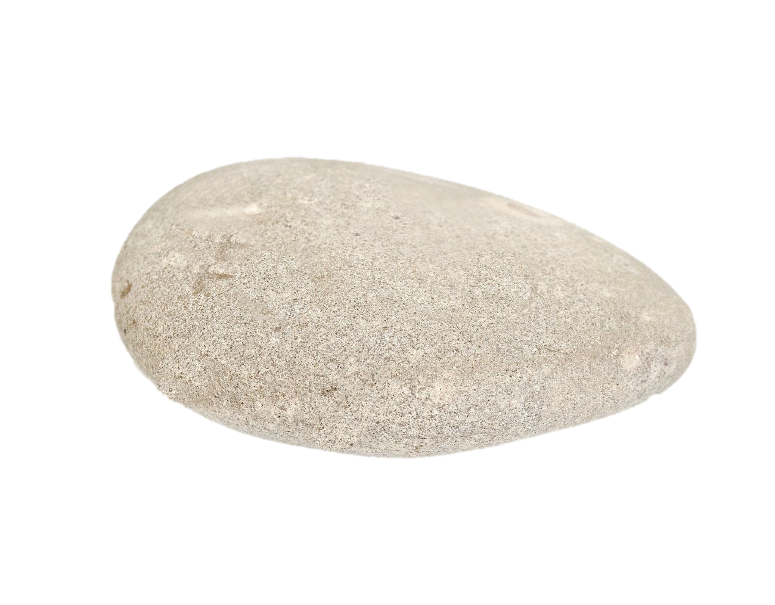
COURAGE – “Let no man’s heart fail on account of him; your servant will go and fight with this Philistine.” (v.32)

Slide 13
CONFIDENCE – “The Lord who delivered me from the paw of the lion and from the paw of the bear, He will deliver me from the hand of this Philistine.” And Saul said to David, “Go, and may the Lord be with you.” (v.37)

Slide 14
PREPARATION – “He took his stick in his hand and chose for himself five smooth stones from the brook, and put them in the shepherd’s bag which he had, even in his pouch, and his sling was in his hand; and he approached the Philistine.” (v.40)

Slide 15
TRUST – “You come to me with a sword, a spear, and a javelin, but I come to you in the name of the Lord of hosts, the God of the armies of Israel, whom you have taunted.” (v.45)

Slide 16
VICTORY – “Thus David prevailed over the Philistine with a sling and a stone, and he struck the Philistine and killed him; but there was no sword in David’s hand.” (v.50)

Slide 17
Psalm 23:1, 4
The Lord is my shepherd, I shall not want…
Even though I walk through the valley of the shadow of death, I fear no evil, for You are with me; Your rod and Your staff, they comfort me.

