Slide 1
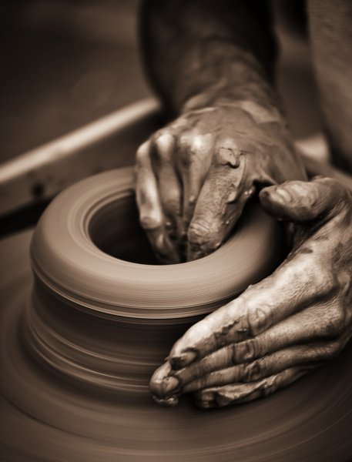
Developing Positive Christian Character
Workbook by Roger Hillis

Slide 2
Developing Positive Christian Character
HUMILITY
RESPECT
MATURITY
KINDNESS
DILIGENCE
PERSEVERANCE
FAITHFULNESS
CONTENTMENT
COURAGE
INTEGRITY
COMPASSION
MORAL PURITY

Slide 3
MATURITY
Walking in His footsteps (1 Pet. 2:19-25)
What does it meant to “follow His steps”?
Ways to follow Christ’s example?
By following His example we grow & mature
“no longer I who live” (Gal. 2:20)
“until Christ is formed in you” (Gal. 4:19)
“till we all come” / “till we attain” (Eph. 4:13-14)
“that we may present EVERY man perfect/mature” (Col. 1:28)
Be committed to meditation on God’s word so progress is evident to all...Persevere/persist (1 Tim. 4:15-16)
Ought to walk as Jesus did. (1 Jn. 2:6)
“example”?
HUMILITY
RESPECT
KINDNESS
DILIGENCE
PERSEVERANCE
FAITHFULNESS
CONTENTMENT
COURAGE
INTEGRITY
COMPASSION
MORAL PURITY

Slide 4
MATURITY
On to Maturity (Heb. 5:12-6:3)
Why did writer think they should be able to teach others?
What is milk & what is solid food?
What is meant by the phrase “by reason of use”?
What does it mean to discern good & evil?
Col. 2:6-10
What does it mean to “walk in Him”?
What does it mean to be “rooted & built up in Him and established in the faith”?
How can we “beware” things in v. 8 don’t happen to us?
HUMILITY
RESPECT
KINDNESS
DILIGENCE
PERSEVERANCE
FAITHFULNESS
CONTENTMENT
COURAGE
INTEGRITY
COMPASSION
MORAL PURITY

Slide 5
Developing Positive Christian Character
MATURITY
Immature Corinthians (1 Cor. 3:1-3; 2 Cor. 12:20)
Where is growth/maturity needed in your life?
Carnal
Envy/jealousies
Strife/contentions
Divisions
Outbursts of wrath
Selfish ambition
Backbitings
Whisperings
Conceits
Tumults
Faithfulness
Contentment
Courage
Integrity
Compassion
Moral Purity
Humility
Respect
HUMILITY
RESPECT
KINDNESS
DILIGENCE
PERSEVERANCE
FAITHFULNESS
CONTENTMENT
COURAGE
INTEGRITY
COMPASSION
MORAL PURITY

Slide 6
Developing Positive Christian Character
HUMILITY
RESPECT
MATURITY
KINDNESS
DILIGENCE
PERSEVERANCE
FAITHFULNESS
CONTENTMENT
COURAGE
INTEGRITY
COMPASSION
MORAL PURITY

Slide 7
KINDNESS
The Parable of the Good Samaritan (Luke 10:30-37)
The Lord wants us to be kind, considerate & helpful
God’s desire is for Christians to be considered “nice” & “kind”
Christians should do nice things for other people and not just think about themselves
“Random acts of kindness”/ “Pay it forward” – kindness begets kindness
1 Cor. 13 – “Love suffers long and is kind”
Mk. 12:31 – Love your neighbor as yourself
Matt. 11:29 – Jesus is “gentle & lowly in heart”
HUMILITY
RESPECT
MATURITY
DILIGENCE
PERSEVERANCE
FAITHFULNESS
CONTENTMENT
COURAGE
INTEGRITY
COMPASSION
MORAL PURITY

Slide 8
KINDNESS
Fruit of Spirit of kindness (Gal. 5:22)
Opposites: Selfishness, harshness, stinginess, rudeness, arrogance, being inconsiderate, unthoughtfulness
If people were to describe you in a single word, would they use the word KIND?
HUMILITY
RESPECT
MATURITY
DILIGENCE
PERSEVERANCE
FAITHFULNESS
CONTENTMENT
COURAGE
INTEGRITY
COMPASSION
MORAL PURITY

Slide 9
KINDNESS
Ephesians 4:31-32
What negative qualities/attitudes should we eliminate?
What does it mean to be tenderhearted?
What is the final reminder in this passage?
Colossians 3:12-14
Which of these qualities is your biggest weakness?
Which of these qualities is your greatest strength?
Why is love called the “bond of perfection”?
HUMILITY
RESPECT
MATURITY
DILIGENCE
PERSEVERANCE
FAITHFULNESS
CONTENTMENT
COURAGE
INTEGRITY
COMPASSION
MORAL PURITY

Slide 10
KINDNESS
Bible Examples
Gen. 24 (v. 10-20)
2 Kings 4:8-17
What do we learn about kindness in:
1 Pet. 3:8
Gal. 5:22
Eph. 2:7
Acts 27:3
HUMILITY
RESPECT
MATURITY
DILIGENCE
PERSEVERANCE
FAITHFULNESS
CONTENTMENT
COURAGE
INTEGRITY
COMPASSION
MORAL PURITY

Slide 11
Developing Positive Christian Character
KINDNESS
“Kindness is the ability to love people more than they deserve.”
Loving your enemies
Aren’t we glad that God is kind to us?
Bullying
Why is bullying prevalent these days?
Is there a difference between bullying and teasing?
How does being bullied make one feel?
Have you bullied?
HUMILITY
RESPECT
MATURITY
DILIGENCE
PERSEVERANCE
FAITHFULNESS
CONTENTMENT
COURAGE
INTEGRITY
COMPASSION
MORAL PURITY

Slide 12
Developing Positive Christian Character
HUMILITY
RESPECT
MATURITY
KINDNESS
DILIGENCE
PERSEVERANCE
FAITHFULNESS
CONTENTMENT
COURAGE
INTEGRITY
COMPASSION
MORAL PURITY

