Slide 1
Church History
Apostasy, Reformation, and Restoration

Slide 2
Reformation
the action or process of reforming an institution or practice.

Slide 3
Reformation (15th - 16th Century)
Lesson 8: Reformation
John Wessel
Desiderius Erasmus
Ulrich Zwingli
John Knox
Marin Luther
John Calvin

Slide 4
Martin Luther 1483-1546
Born 1483 in Eisleben Germany
1501 University of Erfurt
Lightning-fast life change
1505 Monk
1507 Priest
1508 Professor of Philosophy at the University of Wittenberg
1510-1511 Change of heart for Catholic Church
1512 Doctorate of Divinity

Slide 5
Martin Luther’s Church
Translations included teachings of his opinions
Watered down Catholic Church organization
German Mass
Consubstantiation
Faith only doctrine
Forgiveness of Sins
Infant baptism

Slide 6
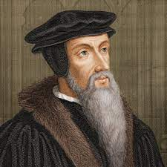
John Calvin (1509-1564)
Born 1509 in Noyon, France
1523 University of Paris
1529 University of Bourges
1534 adopted ideas of Reform
1536-1559 The Institutes of the Christian Religion
1536 Geneva, Switzerland
1538 Thrown out of Switzerland
1541 Invited back to preach in Switzerland

Slide 7
What is the number one teaching most Christians know about John Calvin?

Slide 8
What is the number one teaching most Christians know about John Calvin?
T.u.l.i.p.

Slide 9
John Calvin’ System of theology (T.U.L.I.P.)
Total Hereditary Depravity
Unconditional Election
Limited Atonement
Irresistible Grace
Perseverance of the Saints

Slide 10
John Calvin’s Complete Uniformity Plan
Rulers that deny God will lose power
Church and State are separate but must work together
The magistrates must expel or execute dangerous heretics
No one can be forced to be a Protestant

Slide 11
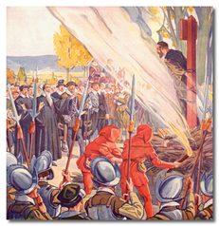
John Calvin’s Complete Uniformity Plan
1542-1546
57 Executed
76 Banished from Geneva

Slide 12
Your Thoughts

Slide 13
Restoration (18th - 19th Century)
Lesson 9: Early Restoration Influences
Causes of the Restoration Movement
Principles of the Restoration Movement
James O’Kelly
Dr. Abner Jones
Barton W. Stone

Slide 14
Restoration
the action of returning something to a former owner, place, or condition.

Slide 15
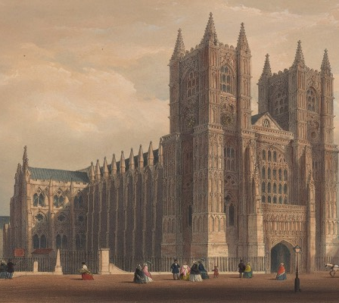
Briefly Mentioned Religious Groups
The Church of England 1534

Slide 16
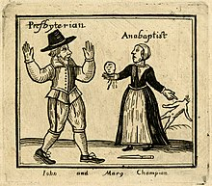
Briefly Mentioned Religious Groups
The Church of England 1534
Anabaptist 1611

Slide 17
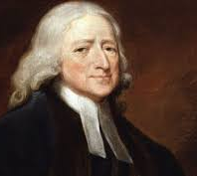
Briefly Mentioned Religious Groups
The Church of England 1534
Anabaptist 1611
Methodist 1739

Slide 19
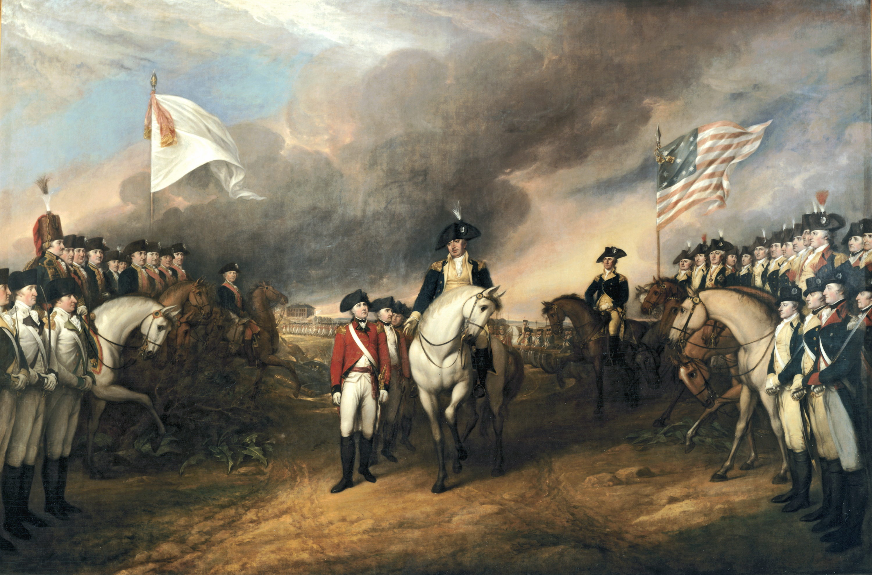
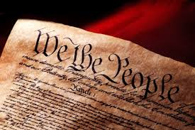
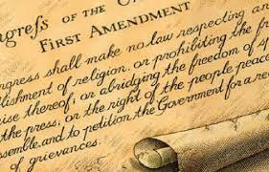
Revolutionary War

Slide 20
Causes of the Restoration Movement
The word of God over human creeds

Slide 21
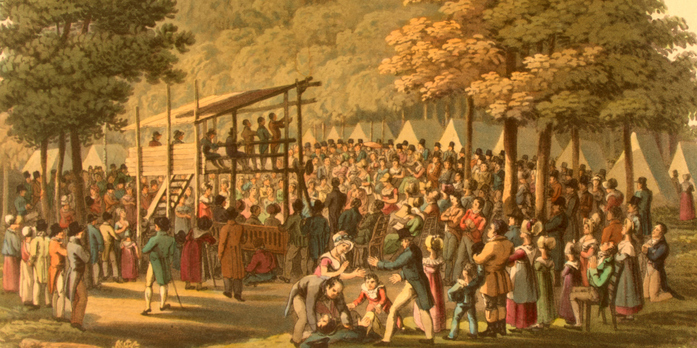
Causes of the Restoration Movement
The word of God over human creeds
Growing religious denominations

Slide 22
Causes of the Restoration Movement
The word of God over human creeds
Growing religious denominations
Strong divisions of faith

Slide 23
Causes of the Restoration Movement
The word of God over human creeds
Growing religious denominations
Strong divisions of faith
Ignorant and arrogant clergy

Slide 24
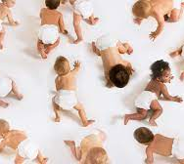
Causes of the Restoration Movement
The word of God over human creeds
Growing religious denominations
Strong divisions of faith
Ignorant and arrogant clergy
Calvinistic disputes

Slide 25
The Principles for the Restoration Movement
Recognition of Christ as supreme authority in religion and the New Testament as the only rule of faith and practice. This would automatically do away with creeds and human authority
A proper distinction between the Old and New Testament
Recognition of the New Testament pattern of the church
The autonomy of the local church
The unity of all Christians

Slide 26
Are you a Campbellite?
Alexander Campbell 1786-1866

Slide 27
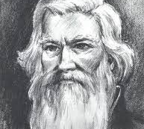
James O’Kelly 1735-1826
Methodist preacher in North Carolina
Opposed the episcopal form of government in the Methodist Church.
He insisted on local church autonomy
1794 He and those that agreed with him left the Methodist Church and started a group in Surry County, Virginia.

Slide 28
James O’Kelly 1735-1826
Use the name Christian and no other
Christ is the only head of the Church
The Bible is the only creed
The right of private judgment and liberty of conscience

Slide 29
Dr. Abner Jones 1772-1841
Baptist minister in Vermont
Distressed over sectarianism
1800 broke away from the Baptist religion
Established a group that endeavored to worship as it was in the New Testament
His group wore the name Christian.
Dr. Jones had not heard of O’Kelly nor his teaching at the start.

Slide 30
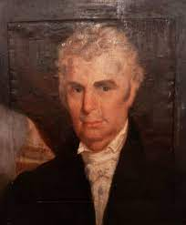
Barton W. Stone 1772-1844
1791 Minister for Presbyterian Church
Preached in North Carolina, Tennessee and eventually Bourbon County. Kentucky.
1801 Cane Ridge Revival near Paris, Kentucky. 20,000-30,000 people
Preached on unity and the God loves all men and Jesus died for all men.
Rejected Calvinism, he and four Presbyterian leaders broke away from the Presbyterian Church.
1803 Springfield Presbyterian Church but that name would only last a year.
In 1804 the Springfield Presbyterian Church wrote “The Last Will and Testament of the Springfield Presbyterian Church”

Slide 31
The Last Will and Testament of the Springfield Presbyterian Church (highlights)
We will that this body die, be dissolved, and sink into union with the body of Christ at large; for there is but one body and one Spirit, even as we are called in one hope of Our Calling.
We will that our name of distinction, with its reverend title, be forgotten that there be but one Lord over God's heritage and His name one.
We will that our power of making laws for the government of the church, and executing them by delegated authority, forever cease; that the people may have free course to the Bible, and adopt the law of the spirit of life in Christ Jesus.

Slide 32
The Last Will and Testament of the Springfield Presbyterian Church (highlights)
We will that each particular church as a body, actuated by the same spirit, choose her own preacher, and support him by free will offering, without a written call or subscription, admit members, remove offenses; and never henceforth delegate her right of government to any man or set of men whatever.
We will that people henceforth take the Bible as the only sure guide to heaven; and as many as are offended with other books which stand in competition with it, may cast them into the fire if they choose, for it is better to enter into life having one book, than having many to be cast into hell.

Slide 33
Are You a Campbellite?
Campbell Movement started 1811
James O’Kelly 1794
Dr. Abner Jones 1800
Barton W. Stone 1804

Slide 34
Your Thoughts

