Slide 1
Church History
Apostasy, Reformation, and Restoration

Slide 2
Reformation (12th - 13th Century)
Lesson 6: Birth of Reformation
Petrobrusians
Henricians
Waldensians

Slide 3
What were some reasons Christianity continued to grow during these times of persecutions?
Salvation
The Idea of a witnessed Human/God that Lived and died for the People
Salvation by Baptism over pain or expense initiation rites
The offer of a personal relationship with God
The idea that people would help each other simply by Loving each other
Colossians 3:10-11 A since of belonging

Slide 4
False Teaching in the Catholic Church
Infant Baptism
The veneration of the Cross
Transubstantiation
Prayers for the Dead

Slide 5
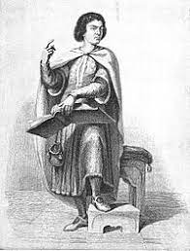
Petrobrusians (approx. 1120 AD)
Peter of Bruys
Medieval French religious teacher
He was called a heresiarch (leader of a heretical movement) by the Roman Catholic Church
He opposed infant baptism, the erecting of churches and the veneration of crosses, the doctrine of transubstantiation and prayers for the dead.

Slide 6
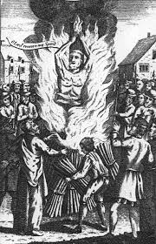
Petrobrusians (1131 AD)
Peter of Bruys
Crosses became for the Petrobrusians objects of desecration and were destroyed in bonfires.
In 1131 AD, Peter was publicly burning crosses in St Gilles, near Nîmes. The local populace, angered by Peter's destruction of the crosses, cast him into the flames of his own bonfire

Slide 7
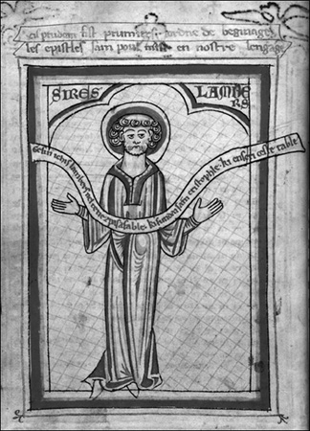
Henricians (approx. 1135 AD)
Henry of Lausanne
A former Cluniac monk
Adopted the Petrobrusians' teachings about 1135
Modified form of Peter of Bruy’s teaching, opposing all worship involving the church clergy.

Slide 8
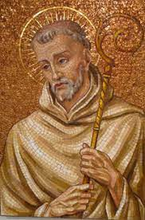
Henricians (approx. 1135 AD)
Henry of Lausanne
Bernard of Clairvaux, in writing to a nobleman and inviting him to put down the heretics.
“The churches are without flocks, the flocks without priests, the priests are nowhere treated with due reverence, the churches are leveled down to synagogues, the sacraments are not esteemed holy, the festivals are no longer celebrated.”

Slide 9
Henricians (approx. 1135 AD)
Henry of Lausanne
Arrested sent to prison for life in 1148 AD but died within a year.
Both the Petrobrusians and Henrician sects died out by 1151 AD

Slide 10
Your Thoughts

Slide 11
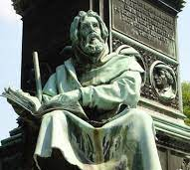
Waldensians (approx. 1170 AD)
‘Peter’ Waldo
A wealthy merchant who gave away his property around 1170 AD, preaching apostolic poverty as the way to perfection.

Slide 12
Waldensians (approx. 1170 AD)
‘Peter’ Waldo
In the spring of 1179, Waldo and his followers were forbidden by the church to preach unless explicitly invited by a priest.
Several years later, around 1183, Waldo was banned from the city by the archbishop of Lyons.
When he was warned to stop preaching, Waldo responded with the words of the Apostle Peter in Acts 4:19: “Do you think God wants us to obey you rather than him?”
Some historians believe this episode was the catalyst for Waldo being referred to as “Peter Waldo” by future Waldensians.

Slide 13
Waldensians (approx. 1170 AD)
Temporal offices and dignities were not meant for preachers of the Gospel
Relics were no different from any other bones and should not be regarded as special or holy
Holy water was no more valuable than rainwater
Prayer was just as effectual if offered in a church or a barn
Catholic Church as the harlot of the Apocalypse.
They rejected what they perceived as the idolatry of the Catholic Church and considered the Papacy as the Antichrist of Rome.

Slide 14
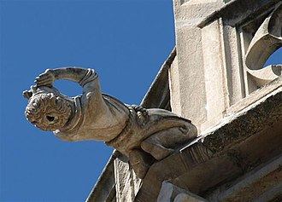
Waldensians (approx. 1170 AD)
Saw themselves as part of the Roman Catholic Church until the time of the Reformation.
Many took communion at least once a year and baptized their children.
Waldo depicted as a gargoyle on Lyon Cathedral: he is depicted with a hollow head, like a madman, preaching towards the sky, instead of prostrating himself before God.

Slide 15
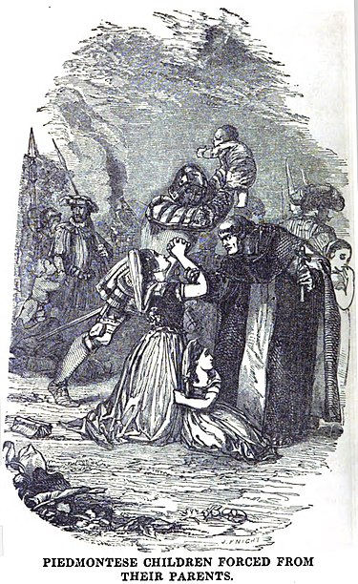
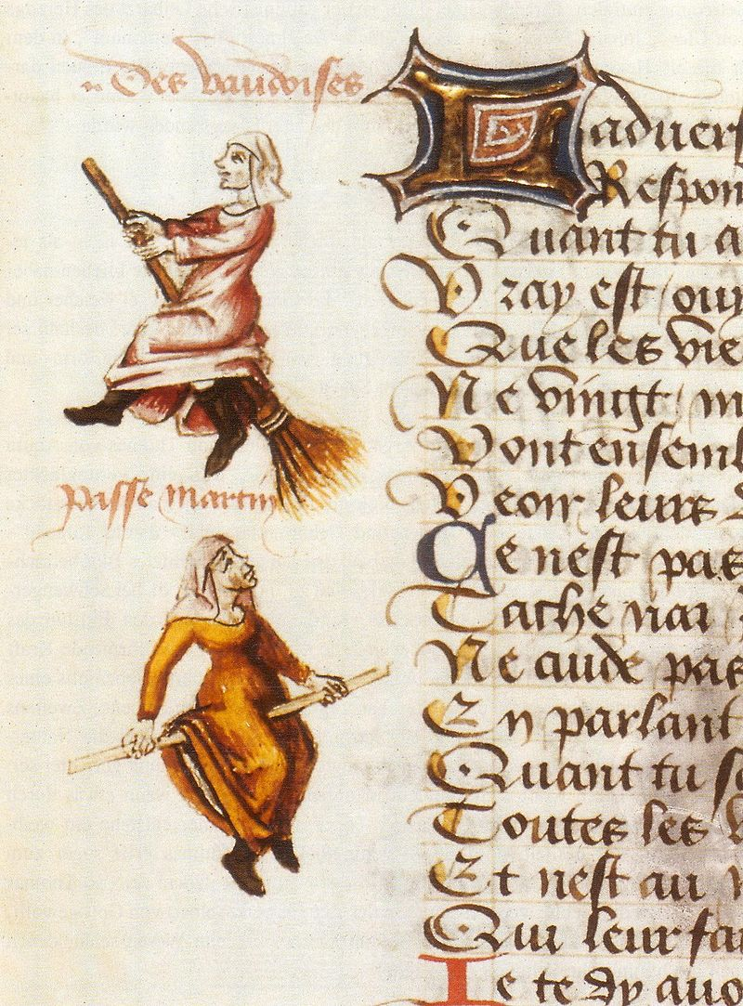
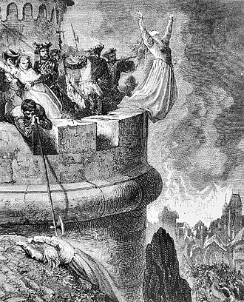
Waldensians (approx. 1170 AD)
Centuries of persecutions

Slide 16
Your Thoughts

Slide 17
Reformation
the action or process of reforming an institution or practice.

Slide 18
Reformation (14th - 15th Century)
Lesson 7: Birth of Reformation
John Wycliffe
First English translation of New and Old Testament
Jan Hus

Slide 19
John Wycliffe (1330-1384)
Born Yorkshire, England
Student at Oxford 1345
Survived the Black Death 1346-1353
Bachelor’s Degree 1369
Appointed Master of Balliol College at Oxford
Doctorate in Theology 1372

Slide 20
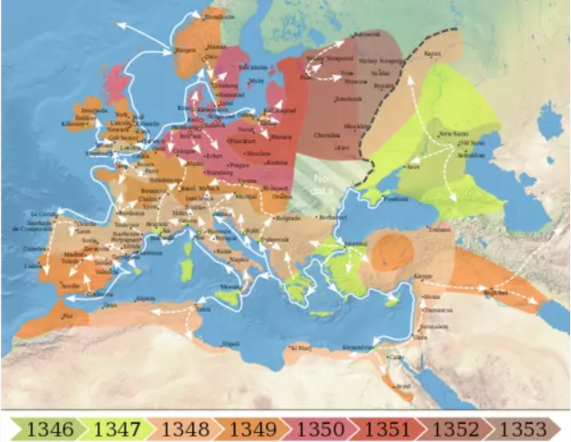
How the Black Death inspired Reformation 1346-1353

Slide 21
How the Black Death inspired Reformation 1346-1353
The plague was a punishment from God for humanity's sins
“Bad Air”,
Witchcraft and Sorcery,
Individual life choices including one's piety or lack of it.

Slide 22
How the Black Death inspired Reformation 1346-1353
Penitential processions, attending mass, fasting, prayer, use of amulets and charms
The Flagellant Movement
Attempted to make cures and fumigation of “bad air”
Flight from infected areas
Persecution of marginalized communities, especially the Jews

Slide 23
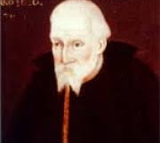
How the Black Death inspired Reformation 1346-1353
Death of Thomas Bradwardine

Slide 24
How the Black Death inspired Reformation 1346-1353
Death of Thomas Bradwardine
Church’s Aid had no effect

Slide 25
How the Black Death inspired Reformation 1346-1353
Death of Thomas Bradwardine
Church’s Aid had no effect
Wycliffe turned to scripture over church ordinances

Slide 26
John Wycliffe’s First Arguments
Festivity of the Lord’s Supper
Powers the church had over sins

Slide 27
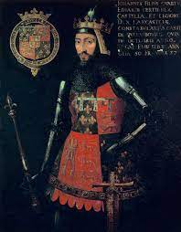
John Wycliffe losing favor with the church
In 1374 Wycliffe caught the attention of John of Gant, one of the sons of King Edward III.
Wycliffe was sent as part of a delegation to Pope Gregory XI to settle disputes over the king's rights vs. the pope's in land ownership.
Wycliffe took the king's side in this dispute, gaining him the favor of the royal house.

Slide 28
John Wycliffe’s Growing Arguments
Festivity of the Lord’s Supper
Powers the church had over sins
Hierarchy
Land-Greed

Slide 29
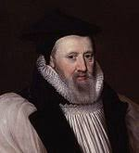
John Wycliffe called to London
William Courtney, Archbishop of Canterbury

Slide 30
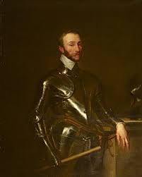
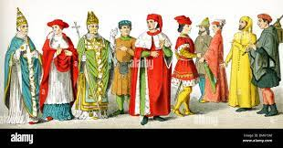
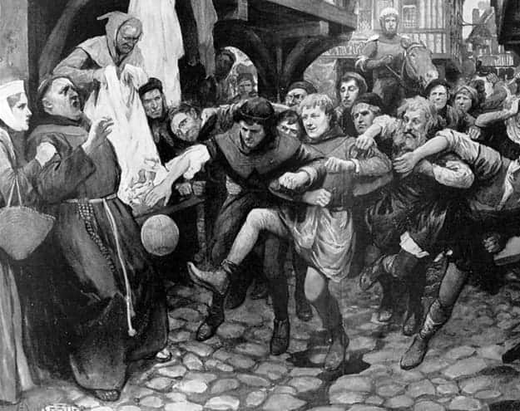
John Wycliffe called to London

Slide 31
John Wycliffe called to London
Courtenay could not condemn Wycliff without risking a riot and possibly incurring the wrath of the nobility but could not dismiss the charges without compromising the authority of the Church.
He was left with no option but to warn Wycliffe against preaching unorthodox doctrines and then letting him go.

Slide 32
First English Translation of the Bible

Slide 33
First English Translation of the Bible
Old Testament 1382
New Testament 1384
Xylography
Wycliffe’s Lollards

Slide 34
John Wycliffe’s Death and Exhumation
Died in good standing with the church in 1384

Slide 35
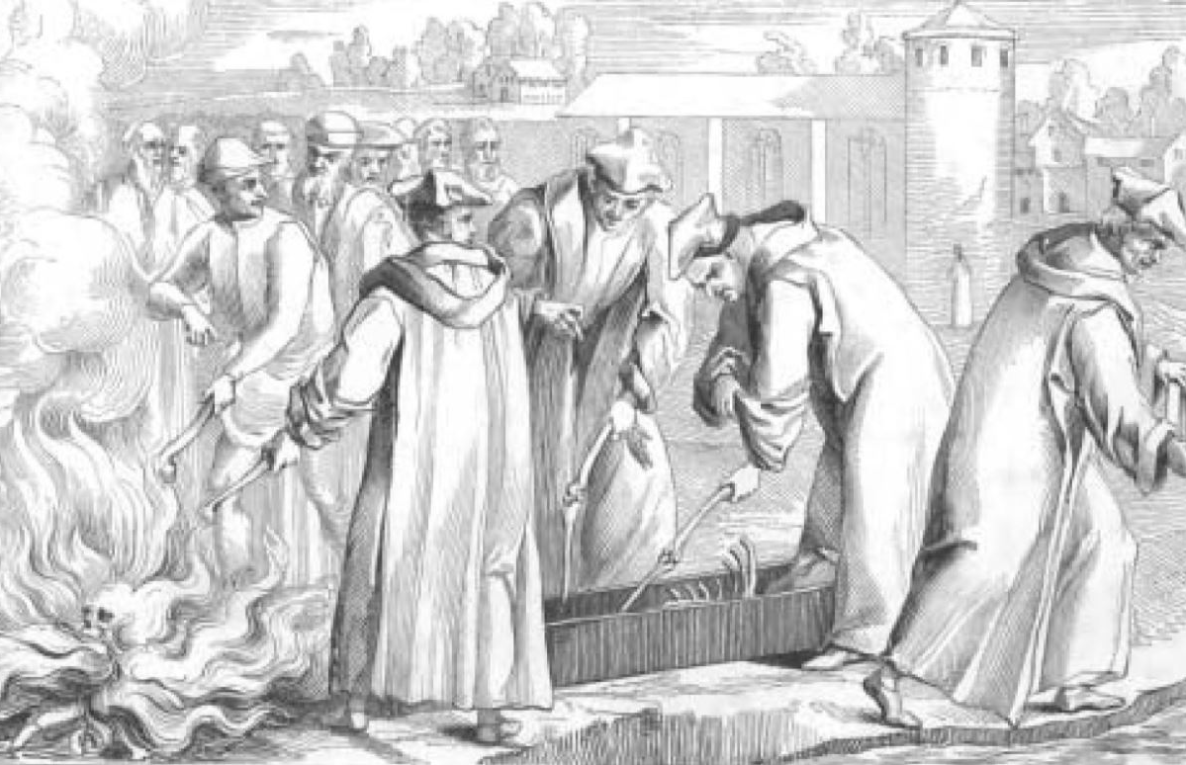
John Wycliffe’s Death and Exhumation
Died in good standing with the church in 1384
Council of Constance in 1415
Wycliffe was condemned as a heretic, his remains dug up burned and poured into River Swift.

Slide 36
Your Thoughts

Slide 37
Jan Hus 1369-1415
Czech philosopher, priest, and theologian
Inspired by the work of John Wycliffe.

Slide 38
Jan Hus 1369-1415
Introduced to the works of John Wycliffe in 1402 by his friend Jerome of Prague
Also in 1402, Hus was appointed rector of the University of Prague and priest of the Bethlehem Chapel

Slide 39
Jan Hus Against the Church
Hierarchy Corruption
Condemned the sale of indulgences
Taught Wycliffe’s views but only by scripture

Slide 40
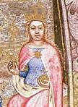
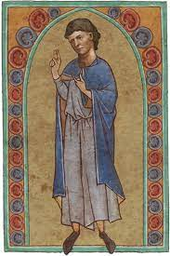
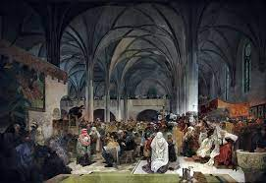
Jan Hus drew a crowd
Preached Twice on Sunday to large crowds
Archbishop Zbyněk Zajíc of Hazmburk
King Wenceslaus IV and Queen Sophia supported Hus’ teachings.
In 1413, Hus finished his famous work De Ecclesia (The Church)

Slide 41
Jan Hus
Sigismund of Hungary 'King of the Romans', convened the Council of Constance 1414
Hus was given a promise of safe conduct by Sigismund

Slide 42
Jan Hus
Sigismund of Hungary 'King of the Romans', convened the Council of Constance 1414
Hus was given a promise of safe conduct by Sigismund
November 1414 and, while waiting for the conference to begin, Hus preached to the people of the city.
Catholic officials cited this as a violation of his safe-conduct pass and had him arrested.

Slide 43
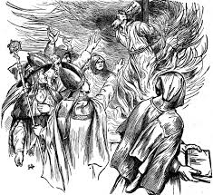
Jan Hus
Burned at the stake on 6 July 1415
His ashes were cast into the Rhine River afterwards to prevent his followers from housing them for veneration, and his works were condemned and ordered destroyed as heresies.
Hussite Wars 1419 - 1434

Slide 44
Your Thoughts

