Slide 2
The God who loves the weak

Slide 3
Society Versus Our God
Our society adores and worships strength, success, and winners.
As saints, we need to move towards maturity, but we should never forget the weak saints, all of us, are moving towards maturity and need our love and patience.
Romans 5:6
⁶ For when we were still without strength, in due time Christ
died for the ungodly.

Slide 4
How does God view the weak?
God loves the weak and gave His Son for the weak
God labors to free us from spiritual weakness, moral and spiritual and tries to help us towards maturity
Colossians 1:28; Hebrews 13:20-21
²⁸ Him we preach, warning every man and teaching every man in all
wisdom, that we may present every man perfect in Christ Jesus.
²⁰ Now may the God of peace who brought up our Lord Jesus from the
dead, that great Shepherd of the sheep, through the blood of the everlasting covenant, ²¹ make you complete in every good work to do His will, working
in ^{[g]}you what is well pleasing in His sight, through Jesus Christ, to whom be
glory forever and ever. Amen

Slide 5
How does God view the weak?
While God views weakness with love
UNDERSTAND
A refusal to move toward maturity is REBELLION and God is against REBELLION (sin) without reservation.
Finding out how God views the weak, will help us understand how He feels towards US, as all of us are weak in many ways at any stage of our spiritual development.
Let’s start with Isaiah 42:1-4 this morning

Slide 6
“Behold! My Servant whom I uphold, My Elect One in whom My soul delights! I have put My Spirit upon Him; He will bring forth justice to the Gentiles. ² He will not cry out, nor raise His voice, Nor cause His voice to be heard in the street. ³ A bruised reed He will not break, And smoking flax He will not quench; He will bring forth justice for truth. ⁴ He will not fail nor be discouraged, Till He has established justice in the earth; And the coastlands shall wait for His law.”

Slide 7
Our Lord and Master
² He will not cry out, nor raise His voice, Nor cause His voice to be heard in the street.”
³ A bruised reed He will not break, . . .”
³ . . . And smoking flax He will not quench;”
While God loves the weak, He doesn’t extol (praise) it.
BUT
He will not put a burden on us that is too strong for us to bear – Matthew 11:28-30

Slide 8
Our Lord and Master
²⁸ Come to Me, all you who labor and are heavy laden, and I will give
you rest. ²⁹ Take My yoke upon you and learn from Me, for I am gentle
and lowly in heart, and you will find rest for your souls. ³⁰ For My yoke
is easy and My burden is light.”
Lyon Phelps
Words like “weak” and “weakness” occur some 87 times in the NT
In all 87 times, the word “weak” or “weakness” occur in the NT there is NOT a word of condemnation in a single one of the references.
There is NO promoting it, but no condemnation.

Slide 9
Our Lord and Master
He has made the strong to help the weak – Romans 15:1
Isaiah 40:9-11
We then who are strong ought to bear with the scruples of the
weak, and not to please ourselves.
O Zion, You who bring good tidings, Get up into the high mountain; O Jerusalem, You who bring good tidings, Lift up your voice with strength, Lift it up, be not afraid; Say to the cities of Judah, “Behold your God!”
¹⁰ Behold, the Lord God shall come with a strong hand, And His arm shall
rule for Him; Behold, His reward is with Him, And His work before Him. ¹¹ He will feed His flock like a shepherd; He will gather the lambs with
His arm, And carry them in His bosom, And gently lead those who are
with young.

Slide 10
Ezekiel 34:1-10
And the word of the Lord came to me, saying, ² “Son of man, prophesy against the shepherds of Israel, prophesy and say to them, ‘Thus says the Lord God to the shepherds: “Woe to the shepherds of Israel who feed themselves! Should not the shepherds feed the flocks? ³ You eat the fat and clothe yourselves with the wool; you slaughter the fatlings, but you do not feed the flock. ⁴ The weak you have not strengthened, nor have you healed those who were sick, nor bound up the broken, nor brought back what was driven away, nor sought what was lost; but with force and ^{[a]}cruelty you have ruled them. ⁵ So they were scattered because there was no shepherd; and they became food for all the beasts of the field when they were scattered. ⁶ My sheep wandered through all the mountains, and on every high hill; yes, My flock was scattered over the whole face of the earth, and no one was seeking or searching for them.” ⁷ ‘Therefore, you shepherds, hear the word of the Lord: ⁸ “As I live,” says the Lord God, “surely because My flock became a prey, and My flock became food for every beast of the field, because there was no shepherd, nor did My shepherds search for My flock, but the shepherds fed themselves and did not feed My flock”— ⁹ therefore, O shepherds, hear the word of the Lord! ¹⁰ Thus says the Lord God: “Behold, I am against the shepherds, and I will require My flock at their hand; I will cause them to cease feeding the sheep, and the shepherds shall feed themselves no more; for I will deliver My flock from their mouths, that they may no longer be food for them.”

Slide 11
Our Lord and Master
John 16:12
Our God has made a total commitment to the weak
He has worked with them from the beginning of His ministry!
This should help comfort us, if we are weak and encourage us to lift our heads up and see the “fields white for harvest”, no matter who they are or where they are from and go and teach them.
¹² “I still have many things to say to you, but you cannot bear them
now.

Slide 14
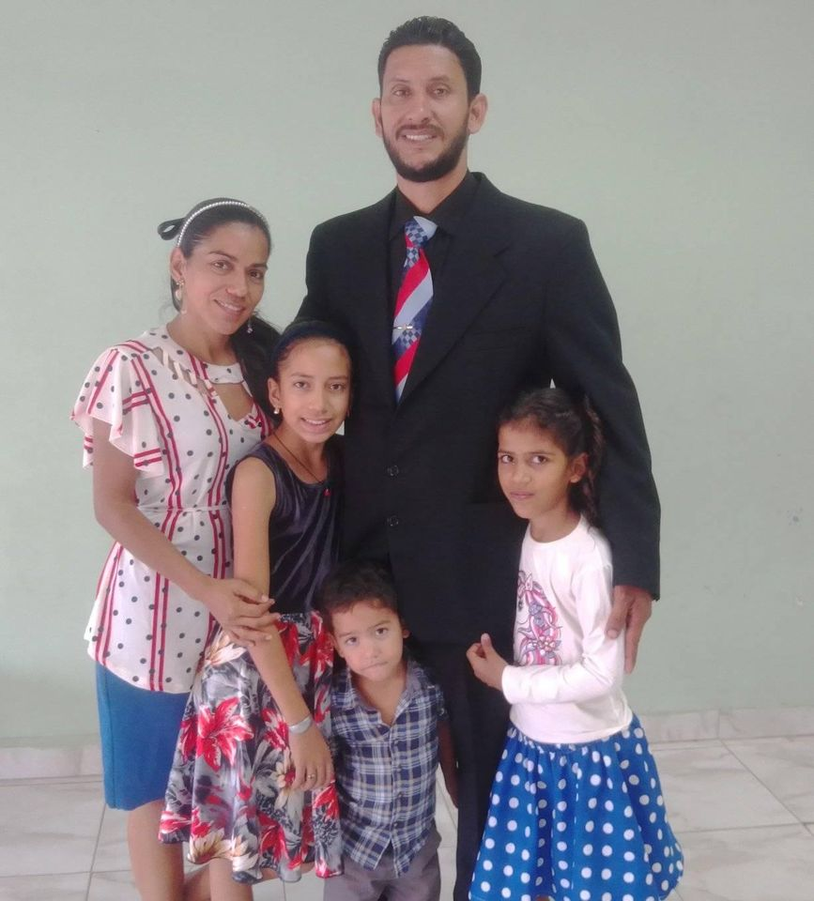
Jesus Marsella

Slide 16
