Slide 1
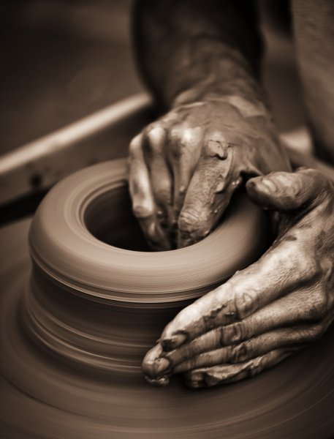
Developing Positive Christian Character
Workbook by Roger Hillis

Slide 2
Developing Positive Christian Character
HUMILITY
RESPECT
MATURITY
KINDNESS
DILIGENCE
PERSEVERANCE
FAITHFULNESS
CONTENTMENT
COURAGE
INTEGRITY
COMPASSION
MORAL PURITY

Slide 3
MORAL PURITY
Genesis 39:1-20
How old was Joseph?
Who would have known if Joseph had laid with Potiphar’s wife?
How does v. 9 describe why Joseph’s refused her advances?
What does account ending with Joseph in jail teach us about consequences of doing the right thing?
What do we learn from verse 5?
HUMILITY
RESPECT
MATURITY
KINDNESS
DILIGENCE
PERSEVERANCE
FAITHFULNESS
CONTENTMENT
COURAGE
INTEGRITY
COMPASSION

Slide 4
MORAL PURITY
Romans 13:13-14
What does it mean to walk properly, as in the day?
What is involved in making “no provision” for the flesh?
Define these words & find verses where used.
Holiness
Godliness
Sanctification
Virtue
HUMILITY
RESPECT
MATURITY
KINDNESS
DILIGENCE
PERSEVERANCE
FAITHFULNESS
CONTENTMENT
COURAGE
INTEGRITY
COMPASSION

Slide 5
Developing Positive Christian Character
MORAL PURITY
List specific examples of things people do that compromise their moral purity.
Are you different morally from your friends in the world?
What do you need to change about your life or your habits or your thoughts to be more pure?
HUMILITY
RESPECT
MATURITY
KINDNESS
DILIGENCE
PERSEVERANCE
FAITHFULNESS
CONTENTMENT
COURAGE
INTEGRITY
COMPASSION

Slide 6
Developing Positive Christian Character
HUMILITY
RESPECT
MATURITY
KINDNESS
DILIGENCE
PERSEVERANCE
FAITHFULNESS
CONTENTMENT
COURAGE
INTEGRITY
COMPASSION
MORAL PURITY

Slide 7
HUMILITY
Not being conceited
Involves esteeming others above & before self
Opposite of pride, arrogance & self-righteousness
“Let nothing be done through selfish ambition or conceit, but in lowliness of mind let each esteem others better than himself. Let each of you look out not only for his own interests, but also for the interests of others.” (Phil. 2:3-4)
RESPECT
MATURITY
KINDNESS
DILIGENCE
PERSEVERANCE
FAITHFULNESS
CONTENTMENT
COURAGE
INTEGRITY
COMPASSION
MORAL PURITY

Slide 8
HUMILITY
A person with humility (humble)
Is Not Stubborn
Doesn’t Believe His/Her Ideas or Ways Are Best
Not Afraid to Admit When They Are Wrong
Not thinking you are worthless/doormat
Remember: You are created in image of God, Christ died for you and you are valuable & matter to God & His family.
Not to think more highly than we ought (Rom. 12:3)
We are to be clothed with humility. (1 Pet. 5:5-6)
RESPECT
MATURITY
KINDNESS
DILIGENCE
PERSEVERANCE
FAITHFULNESS
CONTENTMENT
COURAGE
INTEGRITY
COMPASSION
MORAL PURITY

Slide 9
HUMILITY
The Banquet Feast (Luke 14:7-11)
Why would people choose “the best places?”
What did Jesus say they should choose?
Why is it true that one who exalts himself will be humbled?
What does Jesus tell us to do in verse 12?
Have you ever done this in similar situations?
RESPECT
MATURITY
KINDNESS
DILIGENCE
PERSEVERANCE
FAITHFULNESS
CONTENTMENT
COURAGE
INTEGRITY
COMPASSION
MORAL PURITY

Slide 10
HUMILITY
The Pharisee & Tax Collector (Luke 18:9-14)
To whom did Lord speak this parable?
Who were the Pharisees?
Who were the tax collectors?
How did the Pharisee pray wrong?
How did the tax collector pray right?
RESPECT
MATURITY
KINDNESS
DILIGENCE
PERSEVERANCE
FAITHFULNESS
CONTENTMENT
COURAGE
INTEGRITY
COMPASSION
MORAL PURITY

Slide 11
HUMILITY
Pride in Proverbs
List type of pride & how seen these proverbs come true.
6:16-17
8:13
11:2
13:10
14:3
15:25
15:33
16:5
16:18
RESPECT
MATURITY
KINDNESS
DILIGENCE
PERSEVERANCE
FAITHFULNESS
CONTENTMENT
COURAGE
INTEGRITY
COMPASSION
MORAL PURITY

