Slide 1
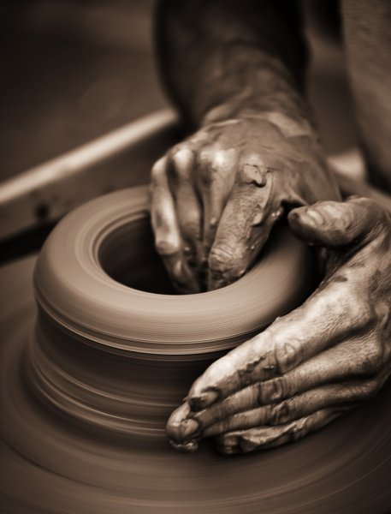
Developing Positive Christian Character
Workbook by Roger Hillis

Slide 2
Developing Positive Christian Character
HUMILITY
RESPECT
MATURITY
KINDNESS
DILIGENCE
PERSEVERANCE
FAITHFULNESS
CONTENTMENT
COURAGE
INTEGRITY
COMPASSION
MORAL PURITY

Slide 3
COURAGE
Josh. 1:1-9
What was Joshua’s job?
How many times did God tell Joshua to be courageous?
What was the key to Joshua’s success?
Who told Joshua to be courageous in v.18?
What was the military strategy against Jericho?
Why did the strategy take courage?
HUMILITY
RESPECT
MATURITY
KINDNESS
DILIGENCE
PERSEVERANCE
FAITHFULNESS
CONTENTMENT
INTEGRITY
COMPASSION
MORAL PURITY

Slide 4
COURAGE
Esther
Who was Esther?
Why would Mordecai not bow to Haman (3:2-5)?
What was Haman’s plan for the Jews (3:6)?
What does it mean that Esther had “come to the kingdom for such a time as this” (4:14)?
How did Esther show tremendous courage (4:11,16)?
HUMILITY
RESPECT
MATURITY
KINDNESS
DILIGENCE
PERSEVERANCE
FAITHFULNESS
CONTENTMENT
INTEGRITY
COMPASSION
MORAL PURITY

Slide 5
COURAGE
John the Baptist (Matt. 14:1-12)
What had John said that required great courage?
What happened to John because he told the truth?
Was there some other way he might have approached the situation and saved his life?
Self-reflection: Would you be willing to die if you told the truth or would you be tempted to lie?
HUMILITY
RESPECT
MATURITY
KINDNESS
DILIGENCE
PERSEVERANCE
FAITHFULNESS
CONTENTMENT
INTEGRITY
COMPASSION
MORAL PURITY

Slide 6
COURAGE
Stephen (Acts 7- esp. 51-60)
What had Stephen said that made the crowd so hostile?
Crowd’s first reaction?
Crowd’s second reaction?
Why didn’t Stephen soften the message?
HUMILITY
RESPECT
MATURITY
KINDNESS
DILIGENCE
PERSEVERANCE
FAITHFULNESS
CONTENTMENT
INTEGRITY
COMPASSION
MORAL PURITY

Slide 7
Developing Positive Christian Character
COURAGE
Other examples of courage in the Bible?
Examples of courage not in Bible?
Self-reflection: Can you tell of one instance in your own life when you have shown courage?
HUMILITY
RESPECT
MATURITY
KINDNESS
DILIGENCE
PERSEVERANCE
FAITHFULNESS
CONTENTMENT
INTEGRITY
COMPASSION
MORAL PURITY

Slide 8
Developing Positive Christian Character
HUMILITY
RESPECT
MATURITY
KINDNESS
DILIGENCE
PERSEVERANCE
FAITHFULNESS
CONTENTMENT
COURAGE
INTEGRITY
COMPASSION
MORAL PURITY

Slide 9
INTEGRITY
Psa. 25:11 – “Let integrity and uprightness preserve me, For I wait for You”
Integrity
Honesty in words & actions
Psa. 15:4; Matt. 5:37; Prov. 12:19
“No one has a good enough memory to make a successful liar” -Lincoln
“Beware of the half truth. You may have gotten hold of the wrong half”
Examples of dishonesty:
Cheating
Stealing
Not paying debts
Lying
Other examples?
HUMILITY
RESPECT
MATURITY
KINDNESS
DILIGENCE
PERSEVERANCE
FAITHFULNESS
CONTENTMENT
COURAGE
COMPASSION
MORAL PURITY

Slide 10
INTEGRITY
Psa. 25:11 – “Let integrity and uprightness preserve me, For I wait for You”
Integrity
Honesty in words & actions
Moral purity
Security (Pro. 10:9)
HUMILITY
RESPECT
MATURITY
KINDNESS
DILIGENCE
PERSEVERANCE
FAITHFULNESS
CONTENTMENT
COURAGE
COMPASSION
MORAL PURITY

Slide 11
INTEGRITY
Ananias & Sapphira (Acts 5:1-11)
How does this show God hates lying?
What was their lie?
In what sense were they testing the Lord (v. 9)?
HUMILITY
RESPECT
MATURITY
KINDNESS
DILIGENCE
PERSEVERANCE
FAITHFULNESS
CONTENTMENT
COURAGE
COMPASSION
MORAL PURITY

Slide 12
INTEGRITY
Different kinds of lies
Half-truth (Gen. 12:11-13)
Exaggeration (Exo. 32:22-24)
HUMILITY
RESPECT
MATURITY
KINDNESS
DILIGENCE
PERSEVERANCE
FAITHFULNESS
CONTENTMENT
COURAGE
COMPASSION
MORAL PURITY

