Slide 1
Church History
Apostasy, Reformation, and Restoration

Slide 2
Why should we study Church History?
Gives us a perspective on our future
Strengthens our identity as Christians and our purpose toward God
Helps us to avoid mistakes
Helps us resist popular or political changes
Develops courageous Christians

Slide 3
Apostasy (1st Century)
Lesson 1: Early Church Apostasy
1 Corinthians

Slide 4
New Testament Church
1. All authority is given to Christ Matthew 28:18-20

Slide 5
New Testament Church
1. All authority is given to Christ Matthew 28:18-20
2. There is no deviation from the foundation laid by Christ. 1 Cor 3:11

Slide 6
New Testament Church
1. All authority is given to Christ Matthew 28:18-20
2. There is no deviation from the foundation laid by Christ. 1 Cor 3:11
3. Worship will be on the first day of the week Acts 20:7

Slide 7
New Testament Church
1. All authority is given to Christ Matthew 28:18-20
2. There is no deviation from the foundation laid by Christ. 1 Cor 3:11
3. Worship will be on the first day of the week Acts 20:7
4. Christians will worship in “spirit and in truth” John 4:24 meaning worship is directed to God and the mind is spiritually connected to Him. All actions will be conducted in accordance with the truth.

Slide 8
New Testament Church
5. These true acts of worship will be:
Proclaiming Christ at the Table 1 Cor 11:26;
Teaching the Word of God Acts 2:42;
Prayer Acts 2:42;
Singing Col 3:16, Eph 5:19;
Giving of our means 1 cor 16:2.

Slide 9
New Testament Church
5. These true acts of worship will be: Proclaiming Christ at the Table 1 Cor 11:26; Teaching the Word of God Acts 2:42; Prayer Acts 2:42; Singing Col 3:16, Eph 5:19; Giving of our means 1 cor 16:2.
6. The organization of the church consist of Elders, Deacons, and Saints. Acts 14:23, 20:17; Phil 1:1

Slide 10
New Testament Church
5. These true acts of worship will be: Proclaiming Christ at the Table 1 Cor 11:26; Teaching the Word of God Acts 2:42; Prayer Acts 2:42; Singing Col 3:16, Eph 5:19; Giving of our means 1 cor 16:2.
6. The organization of the church consist of Elders, Deacons, and Saints. Acts 14:23, 20:17; Phil 1:1
7. Membership into the body of Christ is only done by baptism Matt 28:18-20

Slide 11
New Testament Church
5. These true acts of worship will be: Proclaiming Christ at the Table 1 Cor 11:26; Teaching the Word of God Acts 2:42; Prayer Acts 2:42; Singing Col 3:16, Eph 5:19; Giving of our means 1 cor 16:2.
6. The organization of the church consist of Elders, Deacons, and Saints. Acts 14:23, 20:17; Phil 1:1
7. Membership into the body of Christ is only done by baptism Matt 28:18-20
8. All saints are one in Christ. John 17:20-21; Eph 4:4-6

Slide 12
Apostasy
1 : an act of refusing to continue to follow, obey, or recognize a religious faith. 2 : abandonment of a previous loyalty : defection.

Slide 13
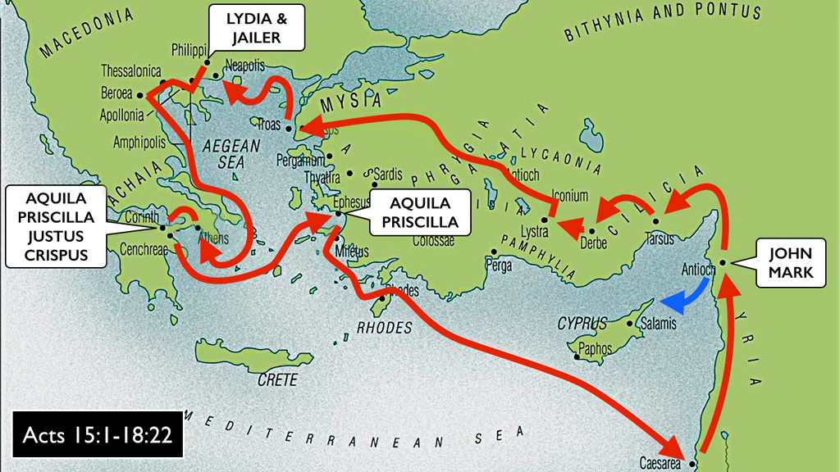
Paul in Corinthians
Acts 18:1-4, 7-16

Slide 14
Paul in Corinthians
In Corinth after 49AD Claudius expelled Jews from Rome
Acts 18:7-16

Slide 15
Paul in Corinthians
In Corinth after 49AD Claudius expelled Jews from Rome
Gallio served as proconsul from 51-52AD

Slide 16
Paul in Corinthians
In Corinth after 49AD Claudius expelled Jews from Rome (Acts 18)
Gallio served as proconsul from 51-52AD
1st letter approx. 52-55AD (1 Cor. 5:9)

Slide 17
Paul in Corinthians
In Corinth after 49AD Claudius expelled Jews from Rome (Acts 18)
Gallio served as proconsul from 51-52AD
1st letter approx. 52-55AD (1 Cor. 5:9)
1 Corinthians approx. 55 AD

Slide 18
Paul in Corinthians
In Corinth after 49AD Claudius expelled Jews from Rome (Acts 18)
Gallio served as proconsul from 51-52AD
1st letter approx. 52-55AD (1 Cor. 5:9)
1 Corinthians approx. 55 AD
Another lost letter? (2 Cor. 2:3–4; 7:8, 12)

Slide 19
Paul in Corinthians
In Corinth after 49AD Claudius expelled Jews from Rome (Acts 18)
Gallio served as proconsul from 51-52AD
1st letter approx. 52-55AD (1 Cor. 5:9)
1 Corinthians approx. 55 AD
2 Corinthians approx. 55-57 AD

Slide 20
Paul in Corinthians
What is the importance in the number of letters sent to Corinth?

Slide 21
Paul in Corinthians
What is the importance in the number of letters sent to Corinth?
None, only thing this tells us is that Paul was consistently contacting the church in Corinth.

Slide 22
Paul in Corinthians
What is the importance given to the content of the lost letters?

Slide 23
Paul in Corinthians
What is the importance given to the content of the lost letters?
None.
There will be no uncovered letter that would contradict the rest of the scriptures.

Slide 24
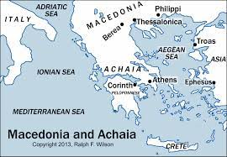
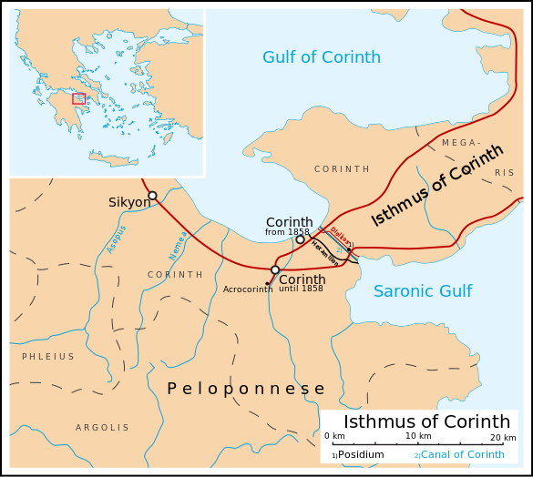
Corinth

Slide 25
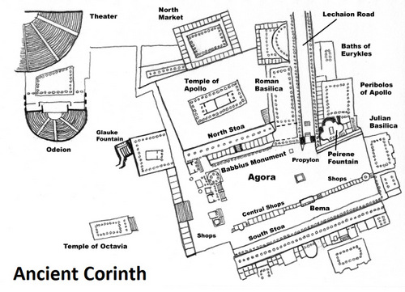
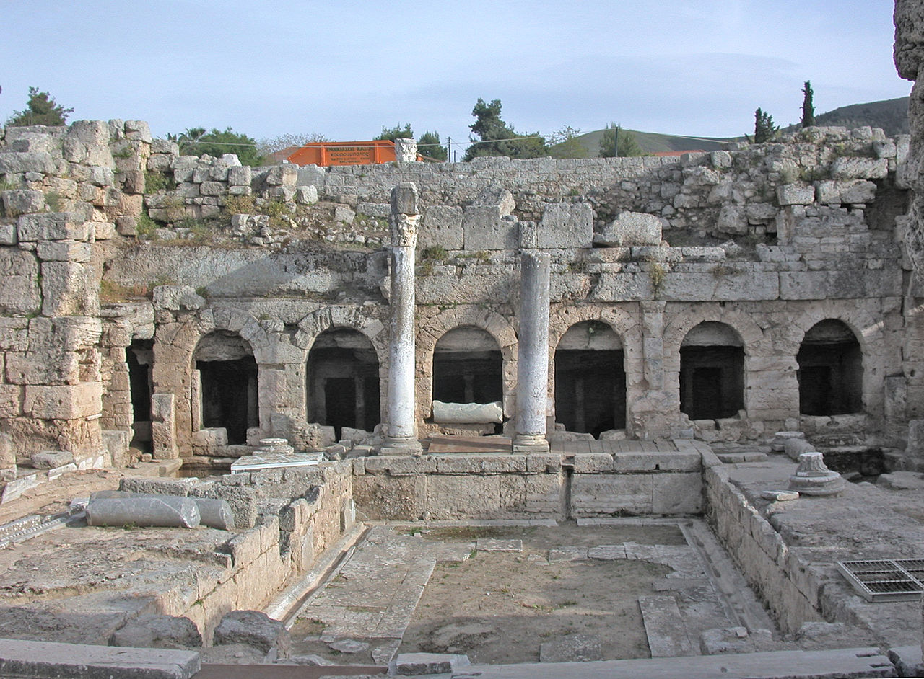
Corinth
Peirene Fountain
It was said to be a favored watering-hole of Pegasus, sacred to the Muses. Poets would travel there to drink and receive inspiration.

Slide 26
Corinth Korinthiazesthai (Corinthia-zest-hi)
Korinthiazesthai (Corinthia-zest-hi)

Slide 27
Corinth Korinthiazesthai (Corinthia-zest-hi)
Korinthiazesthai (Corinthia-zest-hi)
To live like a Corinthian (to live immorally and drunk)
Worship of many gods; Egyptian, Roman, and Greek

Slide 28
Corinth Korinthiazesthai (Corinthia-zest-hi)
Korinthiazesthai (Corinthia-zest-hi)
To live like a Corinthian (to live immorally and drunk)
Worship of many gods; Egyptian, Roman, and Greek
Aphrodite, goddess of love

Slide 29
Corinth Korinthiazesthai (Corinthia-zest-hi)
Korinthiazesthai (Corinthia-zest-hi)
To live like a Corinthian (to live immorally and drunk)
Worship of many gods; Egyptian, Roman, and Greek
Aphrodite, goddess of love
Asklepios, god of healing

Slide 30
Corinth Korinthiazesthai (Corinthia-zest-hi)
Korinthiazesthai (Corinthia-zest-hi)
To live like a Corinthian (to live immorally and drunk)
Worship of many gods; Egyptian, Roman, and Greek
Aphrodite, goddess of love
Asklepios, god of healing
Peirene, not a goddess, is that she was a nymph who became a spring because of her tears shed in lamentation for her son’s death, who was unintentionally killed by Artemis (Roman Diana).

Slide 31
Corinth Korinthiazesthai (Corinthia-zest-hi)
Korinthiazesthai (Corinthia-zest-hi)
To live like a Corinthian (to live immorally and drunk)
Worship of many gods; Egyptian, Roman, and Greek
Aphrodite, goddess of love
Asklepios, god of healing
Peirene, not a goddess, is that she was a nymph who became a spring because of her tears shed in lamentation for her son’s death, who was unintentionally killed by Artemis (Roman Diana).
Acts 18:4 reveals a Jewish synagogue

Slide 32
Corinth Korinthiazesthai (Corinthia-zest-hi)
Korinthiazesthai (Corinthia-zest-hi)
To live like a Corinthian (to live immorally and drunk)
Worship of many gods; Egyptian, Roman, and Greek
Aphrodite, goddess of love
Asklepios, god of healing
Peirene, not a goddess, is that she was a nymph who became a spring because of her tears shed in lamentation for her son’s death, who was unintentionally killed by Artemis (Roman Diana).
Acts 18:4 reveals a Jewish synagogue
Aelian, If ever a Corinthian was written into a play the actor would play drunk

Slide 33
Apostasy in 1 Corinthians
Chapters 1-4:
1 Cor 1:10-17
1 Cor 3:1-9
1 Cor 4:6,15

Slide 34
Apostasy in 1 Corinthians
Chapters 1-4: Division
1 Cor 1:10-17
1 Cor 3:1-9
1 Cor 4:6,15

Slide 35
Apostasy in 1 Corinthians
Chapters 1-4: Division
1 Cor 1:10-17
1 Cor 3:1-9
1 Cor 4:6,15
Chapters 5-7:
1 Cor 5:1-5
1 Cor 6:12-20
1 Cor 7:1-3

Slide 36
Apostasy in 1 Corinthians
Chapters 1-4: Division
1 Cor 1:10-17
1 Cor 3:1-9
1 Cor 4:6,15
Chapters 5-7: Fornication
1 Cor 5:1-5
1 Cor 6:12-20
1 Cor 7:1-3

Slide 37
Apostasy in 1 Corinthians
Chapters 1-4: Division
1 Cor 1:10-17
1 Cor 3:1-9
1 Cor 4:6,15
Chapters 5-7: Fornication
1 Cor 5:1-5
1 Cor 6:12-20
1 Cor 7:1-3
Chapters 8-10:
1 Cor 8-9 Do not be a stumbling block to others
1 Cor 10:14-17

Slide 38
Apostasy in 1 Corinthians
Chapters 1-4: Division
1 Cor 1:10-17
1 Cor 3:1-9
1 Cor 4:6,15
Chapters 5-7: Fornication
1 Cor 5:1-5
1 Cor 6:12-20
1 Cor 7:1-3
Chapters 8-10: Conduct and Idolatry
1 Cor 8-9 Do not be a stumbling block to others
1 Cor 10:14-17

Slide 39
Apostasy in 1 Corinthians
Chapters 11: Lord’s Supper
1 Cor 11:17-22

Slide 40
Apostasy in 1 Corinthians
Chapters 11: Lord’s Supper
1 Cor 11:17-22
Chapters 12-14:
1 Cor 12:1-11
1 Cor 13:1-3
1 Cor 14:23-24

Slide 41
Apostasy in 1 Corinthians
Chapters 11: Lord’s Supper
1 Cor 11:17-22
Chapters 12-14: Spiritual Gifts
1 Cor 12:1-11
1 Cor 13:1-3
1 Cor 14:23-24

Slide 42
Apostasy in 1 Corinthians
Chapters 11: Lord’s Supper
1 Cor 11:17-22
Chapters 12-14: Spiritual Gifts
1 Cor 12:1-11
1 Cor 13:1-3
1 Cor 14:23-24
Chapter 15:
1 Cor 15:12-17

Slide 43
Apostasy in 1 Corinthians
Chapters 11: Lord’s Supper
1 Cor 11:17-22
Chapters 12-14: Spiritual Gifts
1 Cor 12:1-11
1 Cor 13:1-3
1 Cor 14:23-24
Chapter 15: Resurrection
1 Cor 15:12-17

Slide 44
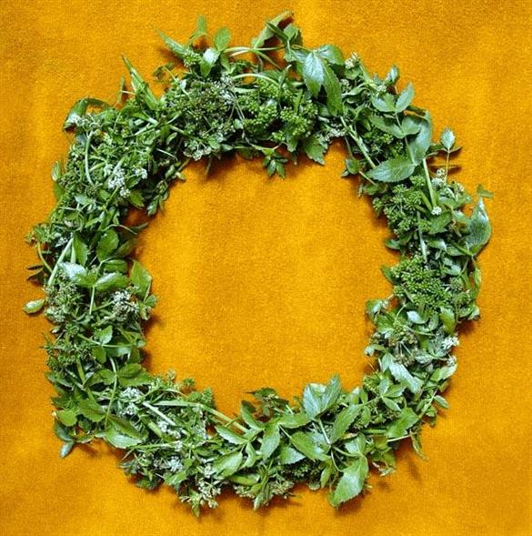
Corinth Paul’s Inspired Writings
Isthmian Games
Chariot races, men only
Pankration, men only
Wrestling, men only
Musical and poetical contests, in which women were allowed to compete.
Boxing, men only
Winners of the games received a crown of wilted vegetables

Slide 45
Corinth Paul’s Inspired Writings (1 Cor. 9:24-27)
Isthmian Games
Chariot races, men only
Pankration, men only
Wrestling, men only
Musical and poetical contests, in which women were allowed to compete.
Boxing, men only
Winners of the games received a crown of wilted vegetables

Slide 46
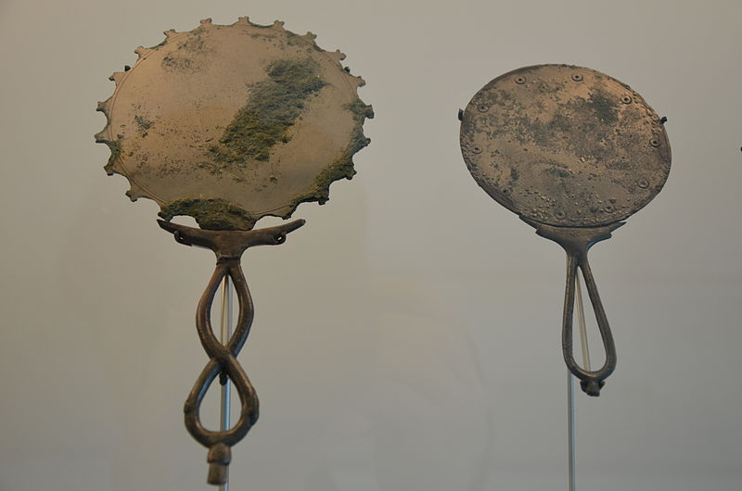
Corinth Paul’s Inspired Writings
Corinth was highly prized for their bronze manufacturing. To include high valued mirrors.

Slide 47
Corinth Paul’s Inspired Writings (1Cor. 13:12; 2Cor. 3:18)
Corinth was highly prized for their bronze manufacturing. To include high valued mirrors.

Slide 48
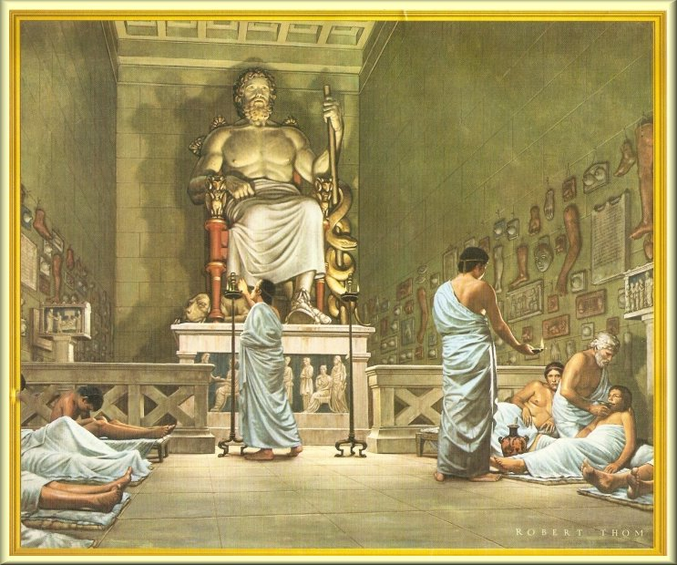
Corinth Paul’s Inspired Writings
Asklepios (uh-skel-pe-ohs)

Slide 50
Corinth Paul’s Inspired Writings
Asklepios (uh-skel-pe-ohs)
Clay copies of arms, and other body parts. Petitioners would have casts made of their afflicted parts and that were hung around the temple.

Slide 51
Corinth Paul’s Inspired Writings (1Cor.12:12-17)
Asklepios (uh-skel-pe-ohs)
Clay copies of arms, and other body parts. Petitioners would have casts made of their afflicted parts and that were hung around the temple.

Slide 52
Paul in Corinthians
Acts 18:11
49-50.5AD
First letter
51-55AD

