Slide 1
Scripture Reading
Luke 14:26-27

Slide 2
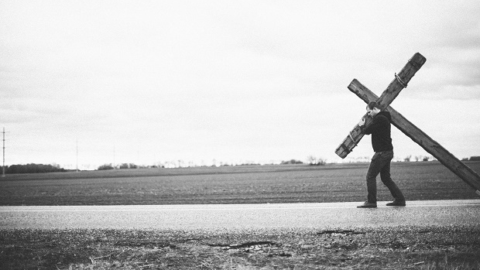
Leaving Everything for Jesus

Slide 3
“They left everything”
Who left everything to follow Jesus?
Peter, Andrew, James, John, and their companions (Luke 5:11)
Matthew (Luke 5:27-28)
Jesus’ disciples (Mark 10:28)
These people left behind their livelihood, wealth reputation, comfort, and lives for Jesus.
No matter our background, our upbringing, or our spiritual age, this is the conversion we must have in order to enter the kingdom of heaven!

Slide 4
What does this mean?
Be willing to give up our comforts and earthly connections (Luke 9:57-62).
Do not let anything get in the way of our devotion to Christ (Matthew 10:32-39; Luke 14:26-27).
Be willing to give up our lives (Luke 9:23-24).
Store up treasure in heaven and seek His kingdom first (Matthew 6:24, 33).

Slide 5
What holds us back?
I am afraid American Christians don’t want to go to heaven as bad as we should because we think we have paradise right here already!
Let us not be like the Laodiceans (Revelation 3:14-22) or the rich young ruler (Luke 18:18-23), who were too attached to the world’s comforts to truly follow Christ.
We cannot make this world our home and leave everything behind at the same time!

Slide 6
What holds us back?
Don’t be like Pilate: so worried about our own lives that we are okay with giving up Jesus!
I am afraid American Christians don’t want to go to heaven as bad as we should because we think we have paradise right here already!
Let us not be like the Laodiceans (Revelation 3:14-22) or the rich young ruler (Luke 18:18-23), who were too attached to the world’s comforts to truly follow Christ.
We cannot make this world our home and leave everything behind at the same time!

