Slide 2
FOUND!
Those found by Christ, find others and bring them to Christ.
John 1:35-51

Slide 3
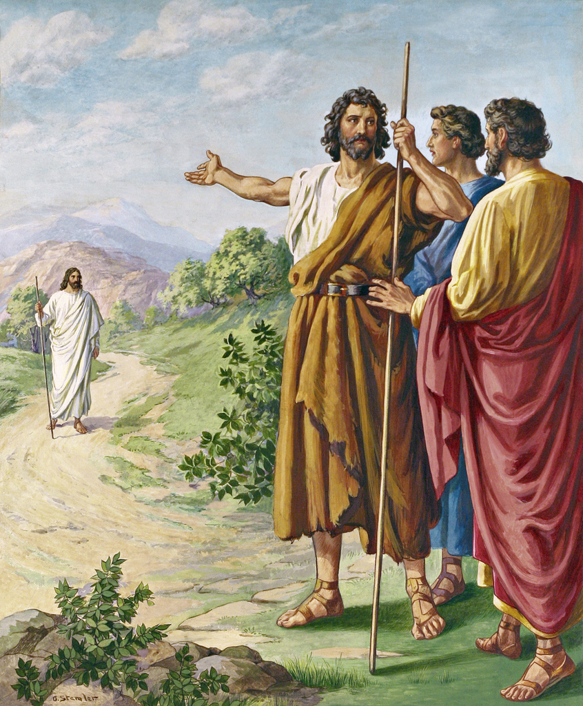
The First Disciples John 1:36-51
Found

Slide 4
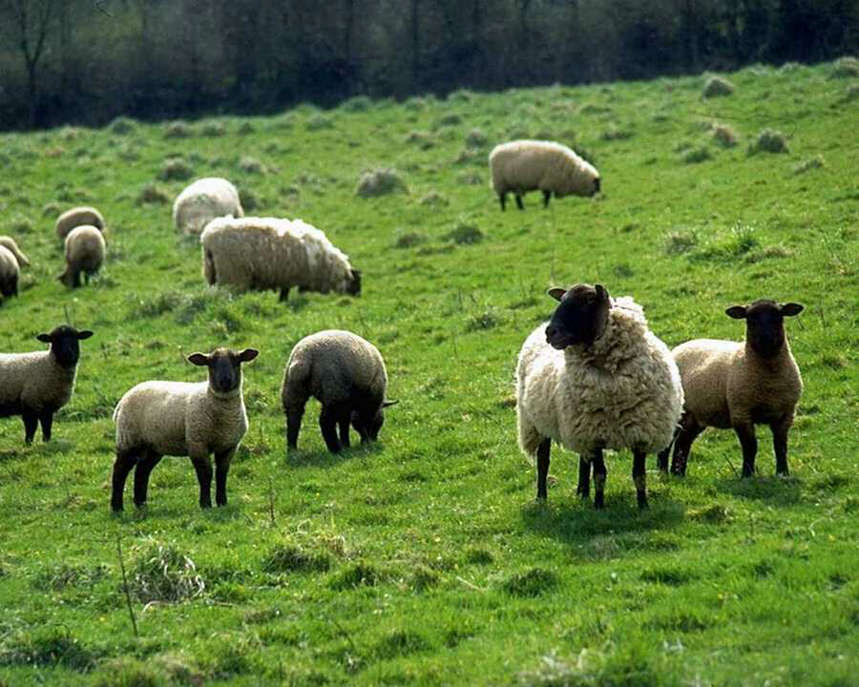
Found
John is standing with 2 disciples (John 1:35)
“Behold, the Lamb of God!” (1:36)
They follow Jesus. (1:37)
(One was Andrew)
He finds first his own brother. (John 1:41)
(Simon)
“We have found the Christ” (1:41)
He brought him to Jesus. (1:42)
Jesus changes his name. (1:42b)
(Cephas/Peter)
Jesus found Philip, “follow Me” (John 1:43)
Philip finds Nathanael. (1:45-46)
“We have found Him…come and see”

Slide 5
Mark 5:18-20
As He was getting into the boat, the man who had been demon-possessed was imploring Him that he might accompany Him.¹⁹And He did not let him, but He said to him, “Go home to your people and report to them what great things the Lord has done for you, and how He had mercy on you.”
²⁰And he went away and began to proclaim in Decapolis what great things Jesus had done for him; and everyone was amazed.

Slide 6
Mark 6:53-56
When they had crossed over they came to land at Gennesaret, and moored to the shore. ⁵⁴When they got out of the boat, immediately the people recognized Him, ⁵⁵and ran about that whole country and began to carry here and there on their pallets those who were sick, to the place they heard He was. ⁵⁶Wherever He entered villages, or cities, or countryside, they were laying the sick in the market places, and imploring Him that they might just touch the fringe of His cloak; and as many as touched it were being cured.

Slide 7
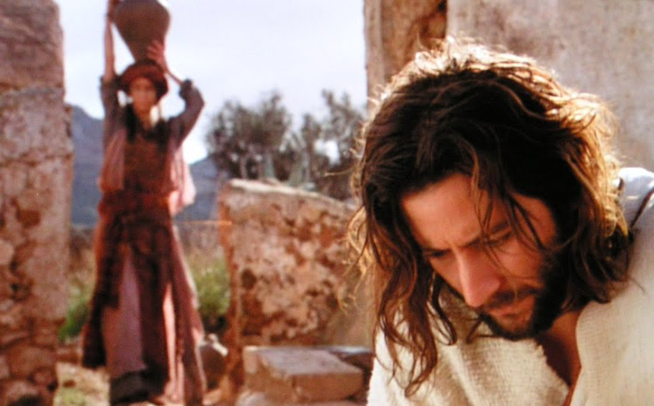
The Samaritan Woman John 4:1-45
Found

Slide 8
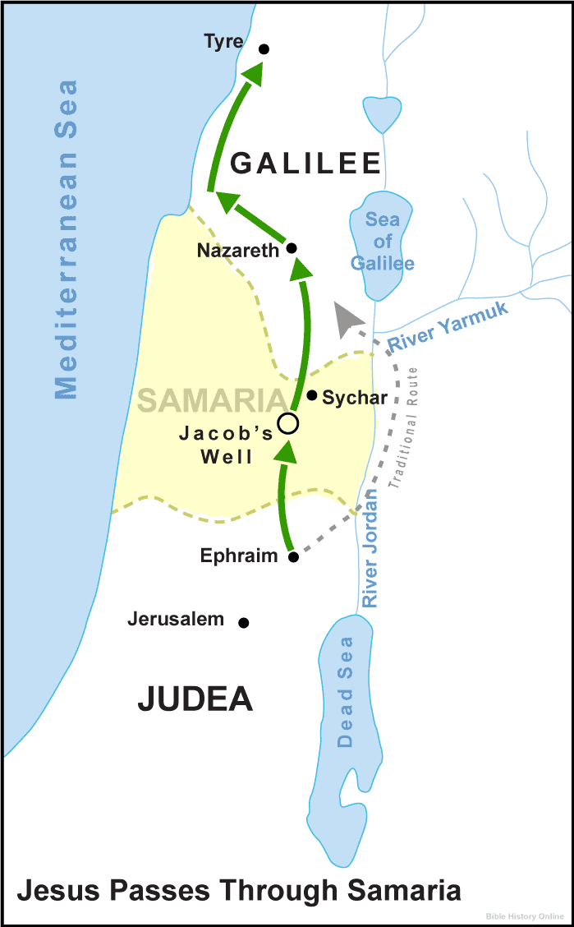
The Samaritan Woman John 4:1-45
John 4:3-6
He left Judea and went away again into Galilee. ⁴And He had to pass through Samaria. ⁵So He came to a city of Samaria called Sychar, near the parcel of ground that Jacob gave to his son Joseph; ⁶and Jacob’s well was there. So Jesus, being wearied from His journey, was sitting thus by the well. It was about the sixth hour.
The Samaritans occupied the country formerly belonging to the tribe of Ephraim and the half-tribe of Manasseh.

Slide 9
When the ten tribes were carried away into captivity to Assyria, the king of Assyria sent people from Cutha, Ava, Hamath, and Sepharvaim to inhabit Samaria (2 Kings 17:24).
These foreigners intermarried with the Israelite population that was still in and around Samaria.
Because the Samaritans adopted the idolatrous religion, they were generally considered “half-breeds” and were universally despised by the Jews.
Who Were The Samaritans?

Slide 10
Samaria became a place of refuge for all the outlaws of Judea (Joshua 20:6-7; 21:21)—a sanctuary city.
The Samaritans willingly received Jewish criminals and refugees from justice.
The violators of the Jewish laws, and those who had been excommunicated, found safety for themselves in Samaria, greatly increasing the hatred which existed between the two nations.
Who Were The Samaritans?

Slide 11
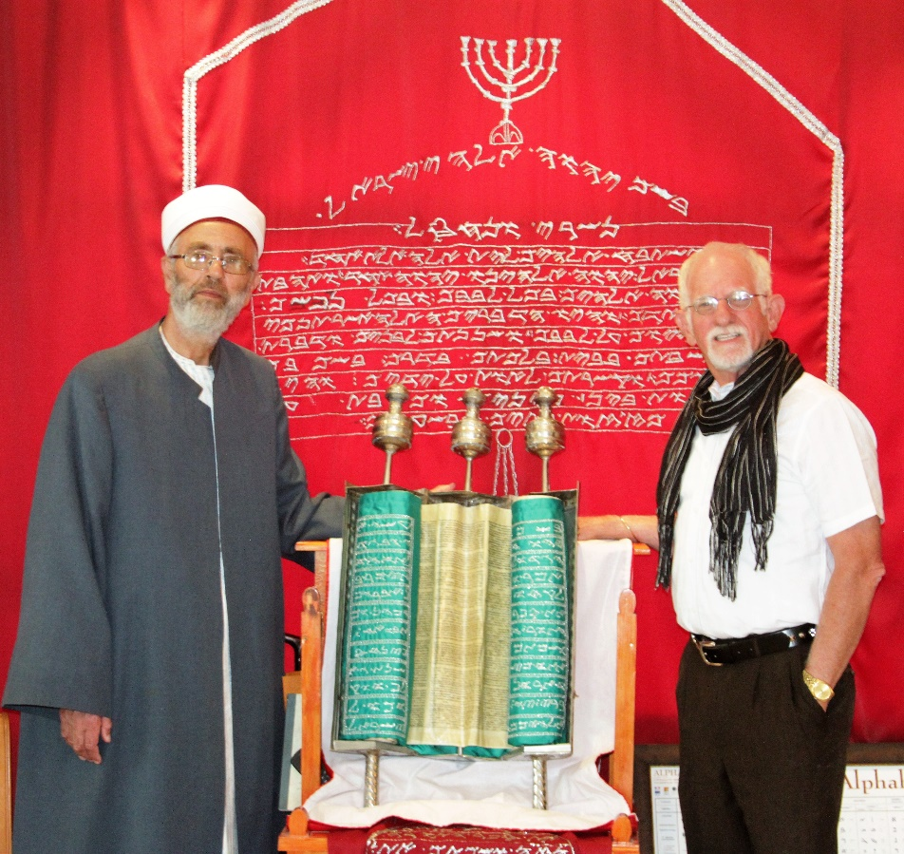
Who Were The Samaritans?
The Samaritans embraced a religion that was a mixture of Judaism and idolatry (2 Kings 17:26-28).
The Samaritans accepted only the five books of Moses and rejected the writings of the prophets and all the Jewish traditions.
Even down to this age, the Samaritans argue that they are the only true followers of God’s Law.

Slide 12
“Let no Israelite eat one mouthful of any thing that is a Samaritan’s; for if he eat but a little mouthful, he is as if he ate swine’s flesh”
(J. B. Lightfoot, pg. 275).

Slide 13
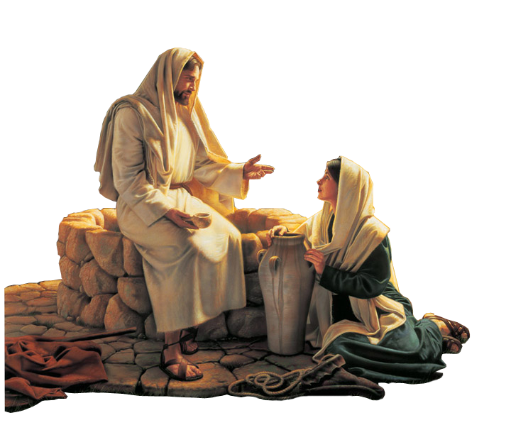
Jesus speaks first
(John 4:7)
He requests water – “Give me a drink” (4:7)
She questions Him – “How is it that you, a Jew, ask for a drink from me, a woman of Samaria?” (4:9)
He challenges her – “If you knew the gift of God, and who it is that is saying to you, ‘Give me a drink,’ you would have asked him, and he would have given you living water. (4:10)

Slide 14
She questions Him again – “Sir, you have nothing to draw water with, and the well is deep. Where do you get that living water? Are you greater than our father Jacob? He gave us the well and drank from it himself, as did his sons and his livestock” (4:11-12)
He answers her – “Everyone who drinks of this water will be thirsty again, but whoever drinks of the water that I will give him will never be thirsty again. The water that I will give him will become in him a spring of water welling up to eternal life” (4:13-14)

Slide 15
Found
She requests water – “Sir, give me this water, so that I will not be thirsty or have to come here to draw water” (4:15)

Slide 16
Found
Jesus speaks again (4:16)
Jesus said to her, “Go, call your husband, and come here.”
The woman answered him, “I have no husband.”
Jesus said to her, “You are right in saying, ‘I have no husband’; ¹⁸for you have had five husbands, and the one you now have is not your husband. What you have said is true” (4:17b-18)
The woman said to him, “Sir, I perceive that you are a prophet.”
She replies and Jesus answers (4:17-18)
She replies and Jesus answers (4:19)

Slide 17
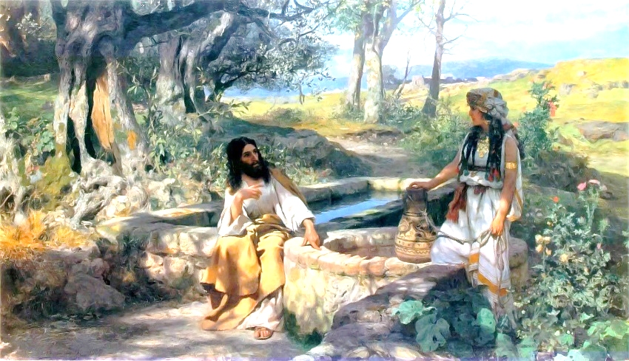
Found
She finds others (4:28)
“Come, see….this is not the Christ is it?” (4:29)
They come to Him (4:30)
They become believers (4:39)
First because of her words (4:39)
Finally because of Christ’s words (4:41-42)

Slide 18
All Christians are introduced to Christ
Christians find others
Those found, find others
“Come and see.”
x

Slide 19
FOUND!
Those found by Christ, find others and bring them to Christ.

