Slide 2
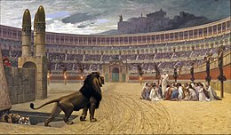
Suffering as a Christian
1 Peter 4:12-19

Slide 3
Suffering as a Christian
Expect Suffering
1 Peter 4:12
1 Peter 2:11-12
1 Peter 2:21-24; 4:1-2
1 Peter 3:13-16
FOUR TRUTHS

Slide 4
Suffering as a Christian
Rejoice in Suffering
1 Peter 4:13
1 Peter 4:14
1 Peter 1:6-9
1 Peter 1:7
1 Peter 1:7, 9
FOUR TRUTHS

