Slide 2
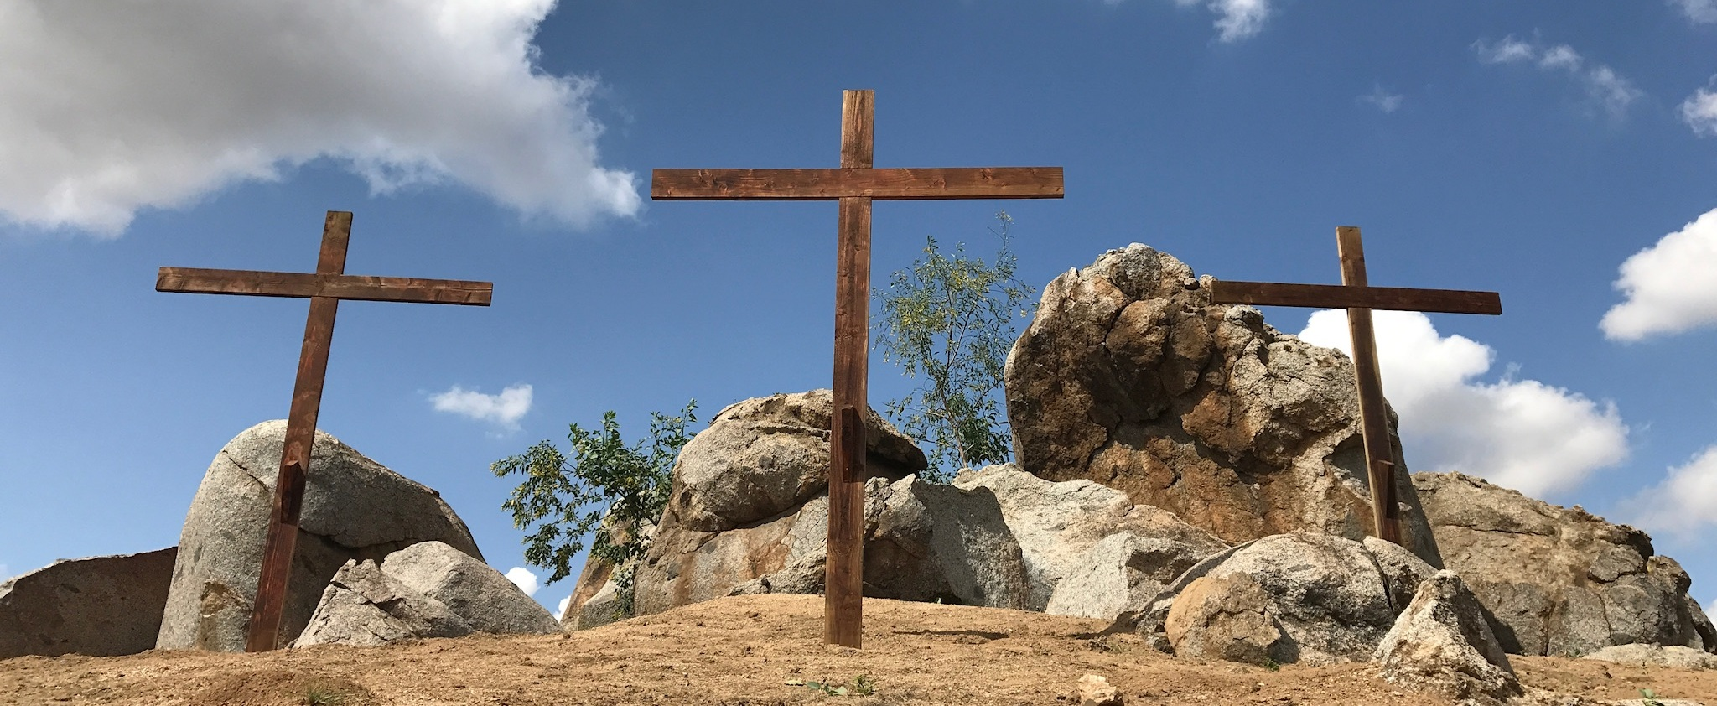
Lead Me to Calvary

Slide 3
FOUR Garments
Psalm 22:18
John 19:23-25
Acts 3:18
Lead Me to Calvary

Slide 4
FIVE Wounds
“And when they had crucified Him” (Mt. 27:35)
“And they crucified Him” (Mk. 15:24)
“There they crucified Him” (Lk. 23:33; Jn. 19:18)
Lead Me to Calvary

Slide 5
FIVE Wounds
John 19:34
John 20:20, 25, 27
Isaiah 53:5
Lead Me to Calvary

Slide 6
SIX Hours
Mark 15:25, 33-37
Hebrews 12:2
Lead Me to Calvary

Slide 7
SEVEN Statements
“My God, My God, why have You forsaken Me?”
“Father, forgive them; for they know not what they do.”
“Truly I say to you, today you shall be with Me in paradise.”
Lead Me to Calvary

Slide 8
SEVEN Statements
Woman, behold, your son! Behold, your mother!”
“I am thirsty.”
“It is finished!”
“Father, into Your hands I commit My spirit.”
Lead Me to Calvary

