Slide 2
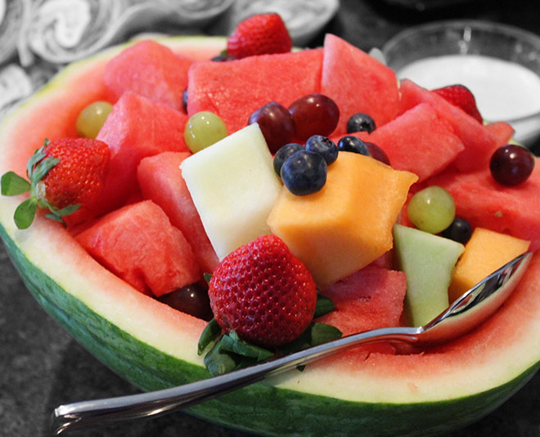
“O Taste and See That the Lord Is Good”
Psalm 34

Slide 3
“O Taste and See That the Lord Is Good”
“I will bless the Lord at all times” (vv. 1-3)

Slide 4
“O Taste and See That the Lord Is Good”
“I will bless the Lord at all times” (vv. 1-3)
“I sought the Lord and He answered me” (vv. 4-7)

Slide 5
“O Taste and See That the Lord Is Good”
“I will bless the Lord at all times” (vv. 1-3)
“I sought the Lord and He answered me” (vv. 4-7)
“O taste and see that the Lord is good” (vv. 8-14)

Slide 6
“O Taste and See That the Lord Is Good”
“I will bless the Lord at all times” (vv. 1-3)
“I sought the Lord and He answered me” (vv. 4-7)
“O taste and see that the Lord is good” (vv. 8-14)
“The eyes of the Lord are toward the righteous” (vv. 15-18)

Slide 7
“O Taste and See That the Lord Is Good”
“I will bless the Lord at all times” (vv. 1-3)
“I sought the Lord and He answered me” (vv. 4-7)
“O taste and see that the Lord is good” (vv. 8-14)
“The eyes of the Lord are toward the righteous” (vv. 15-18)
“Many are the afflictions of the righteous, but the Lord delivers him out of them all” (vv. 19-22)

Slide 8
“O Taste and See That the Lord Is Good”
HAVE YOU?

