Slide 2
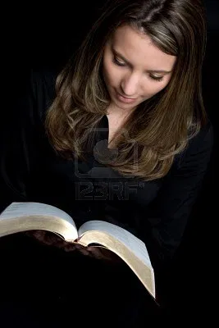
Praising Excellent Women
Proverbs 31:10-31

Slide 3
Praise-Worthy Qualities
An Excellent Woman
vv. 10-12

Slide 4
Praise-Worthy Qualities
An Excellent Woman
Plans and Provides for Others
vv. 13-21, 24, 27

Slide 5
Praise-Worthy Qualities
An Excellent Woman
Plans and Provides for Others
Teaches Others
v. 26

Slide 6
Praise-Worthy Qualities
An Excellent Woman
Plans and Provides for Others
Teaches Others
Fears the Lord
vv. 25, 30

Slide 7
Her Reward
Praise from Others
vv. 28-31

