Slide 2
OR
Galatians 5:13-26

Slide 3
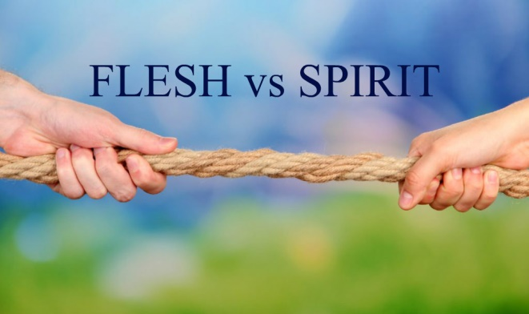
The Fruit of the Spirit
Patience
Forbearance, longsuffering, especially when wronged or experiencing trials
Long-tempered
Endurance, perseverance
2 Peter 3:9, 15
1 Thessalonians 5:14

Slide 4
The Fruit of the Spirit
Kindness
Doing what is useful, beneficial, good for others
Luke 6:35; Titus 3:4-7
Ephesians 4:32

Slide 5
The Fruit of the Spirit
Goodness
Useful; pleasant; excellent; upright; benevolent, kind, generous; what is acceptable to God
Psalm 119:68; 86:5
Romans 15:14

Slide 6
The Fruit of the Spirit
Faithfulness
Reliable; dependable; trustworthy; loyal
1 Corinthians 1:9; 10:13
Matthew 25:21, 23

Slide 7
The Fruit of the Spirit
Gentleness
Mildness; humility
Not weakness, but strength, emotions, passions under control
Matthew 11:28-30
Galatians 6:1; 1 Peter 3:15

Slide 8
The Fruit of the Spirit
Self-control
“The virtue of one who masters his desires and passions, especially his sensual appetites” (Thayer’s)
Self-control is GOD-control (Galatians 5:16, 24)!
1 Peter 2:21-23
2 Peter 1:5-11

Slide 9
“Seeds” We Can Sow
True love for God and others
Humility
Compassion
Forgiveness
Trust
Obedience

Slide 10
“Seeds” We Can Sow
Various trials/tests of our faith – living our faith
Self-denial
Seeing people as God sees people

