Slide 2
OR
Galatians 5:13-26

Slide 3
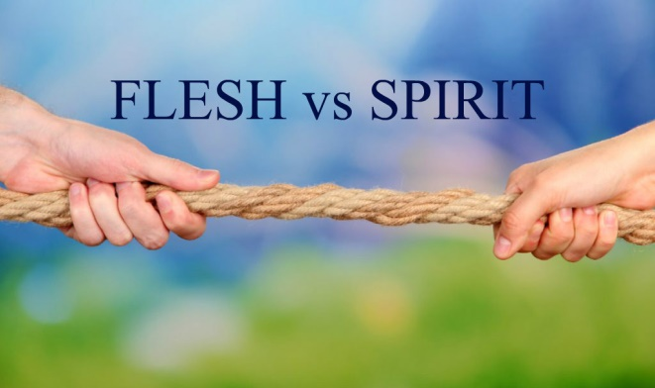
The “Seeds” of Love
1 Corinthians 13:4-7
Patience
Kindness
Contentment
Honor
Humility
Decency

Slide 4
The “Seeds” of Love
1 Corinthians 13:4-7
Preference
Restraint
Forgets wrongs
Sadness and joy
Trust
Support

Slide 5
The Fruit of the Spirit
Joy
Cheerfulness; gladness; a calm delight

Slide 6
The Fruit of the Spirit
Peace
Harmony; a calm tranquility; prosperity
“The tranquil state of a soul assured of its salvation through Christ, and so fearing nothing from God and content with its earthly lot.” (Thayer)

Slide 7
The Fruit of the Spirit
Joy and Peace
More than the absolute absence of sadness or strife
An inner calm, regardless of one’s outer circumstances
Come from being in a right relationship with God
Can exist on at least three levels: God, others, self

Slide 8
Real Joy and Peace
Romans 16:19-20
Ephesians 2:14-18
Philippians 4:4-9
2 Thessalonians 3:16

Slide 9
Real Joy and Peace
God is THE source of real, lasting joy and peace
Joy is found in Jesus (Phil. 4:4)
Jesus is our peace (Rom. 5:1-2; Eph. 2:14-18)
God is “the God of peace” (Rom. 15:33; 16:20; Phil. 4:9; 2 Thess. 3:16)
He fills us with joy and peace (Rom. 15:13; 16:20; Phil. 4:7; 2 Thess. 3:16)

Slide 10
“Seeds” of Joy and Peace
Contentment
Obedience
Patience
Prayer
Dwelling on God’s good, positive Word

