Slide 2
OR
Galatians 5:13-26

Slide 3
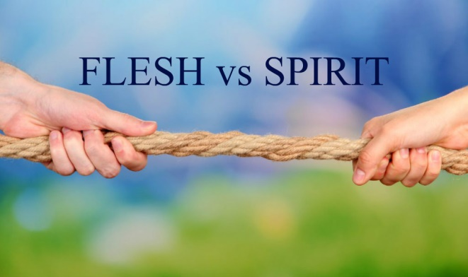
The Flesh’s Field and the Spirit’s Garden
Galatians 6:6-11
EVERY person sows and reaps, whether he/she acknowledges it, realizes it or not (v. 7)
Satan can deceive us about the reality of God’s truth of sowing/reaping, and about its reality for each of us individually (v. 7)

Slide 4
The Flesh’s Field and the Spirit’s Garden
Galatians 6:6-11
What we sow is what we reap (v. 8)
It takes a steadfastness, a patient endurance to “sow to the Spirit” (v. 9)
I choose which life to live, which seed to sow, which harvest to reap!

Slide 5
The Source of True Love
Love – an active good-will toward others
This word appears throughout Scripture to describe God’s love for man, man’s love for God, and man’s love for man
This kind of love humbly seeks the best interest of others, and puts their best interest ahead of its own (Philippians 2:3-4)

Slide 6
The Source of True Love
John 3:16
God took the initiative to love us first (“God so loved the world” NOT “the world so loved God”)
This text shows us the DEPTH of God’s love for us and what real love looks like

Slide 7
The Source of True Love
1 John 4:7-21
“God IS love” (vv. 8, 16)
“Love is FROM God” (v. 7)

Slide 8
The “Seeds” of Love
1 Corinthians 13:4-7
Patience
Kindness
Contentment
Honor
Humility
Decency

Slide 9
The “Seeds” of Love
1 Corinthians 13:4-7
Preference
Restraint
Forgets wrongs
Sadness and joy
Trust
Support

