Slide 2
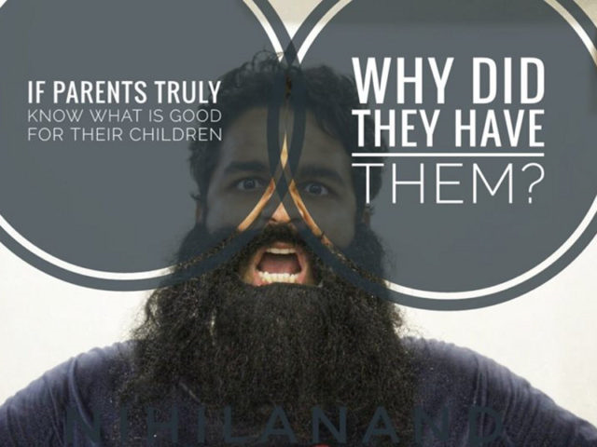
Antinatalism

Slide 3
Anti-natalism
Natalism-promotes birth of sentient life
Natalism is from the Latin word-natalis-relating to birth
Anti-natalism promotes the idea of not giving life
Raphael Samuel is suing his parents because he says he didn’t give his consent to be born

Slide 4
What Does The Bible Say?
“Be fruitful and multiply…” Ge. 1:22; 9:1
“Behold, children are a heritage…” Ps. 127:3,4
“Grandchildren are the crown of the aged…” Pr. 17:6
“Children obey your parents…” Eph. 6:1-2

Slide 5
Is Life Hard Sometimes?
Absolutely
Sometimes our difficulties are self imposed Pr.13:15
Life has its ups and downs
We see Job who suffered much and had a perspective on his life that wasn’t favorable Job 3:1
Life isn’t always problematic

