Slide 2
OR
Galatians 5:13-26

Slide 3
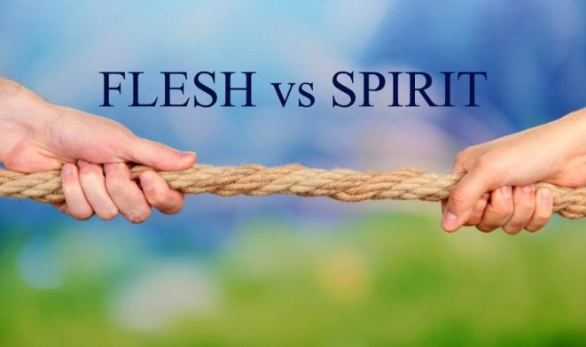
Out-of-Control Sins
Drunkenness
Intoxication from alcoholic drinks
“Excessive use of strong drink” (Bible Knowledge Commentary)

Slide 4
Out-of-Control Sins
Carousing
A wild, uncontrolled, late-night feast or party with drinking intoxicating drinks, music, dancing, etc. to a false “god”

Slide 5
Examining Similar Biblical Texts
Proverbs 23:29-35
Negative results: woe, sorrow, contentions, complaining, needless injuries, red eyes
Who suffers these consequences?
Possibly those that hesitate to decide
Those that look, but perhaps don’t drink
Those that taste it

Slide 6
Examining Similar Biblical Texts
Proverbs 23:29-35
More bad consequences: pain, blurry vision, hallucinations, stupid/dangerous behavior, unconscious, can’t feel pain, addiction
This text is a STRONG warning against desiring alcoholic drinks, and certainly against drinking them!

Slide 7
Examining Similar Biblical Texts
Romans 13:11-14
Drunkenness and carousing appear in the context of putting off “deeds of darkness” and putting on the Lord and His “armor of light”
Behavior that befits a Christian CANNOT include these sins!
We have come too far in our walk with Christ to turn back to the world now!

Slide 8
Examining Similar Biblical Texts
Ephesians 5:15-21
We must walk “wisely”, not “foolishly” as the world does
Part of the wise walk is to NOT get “drunk with wine”, but to be “FILLED with the Spirit”!
This is “the will of the Lord”!

Slide 9
Examining Similar Biblical Texts
1 Peter 4:3-5
We wasted enough time before becoming Christians living like the world; now we must live a new life in Christ!
That new life includes abstaining from “drunkenness, carousing, drinking parties”

Slide 10
Examining Similar Biblical Texts
1 Peter 4:3-5
Our friends, family, co-workers, classmates, neighbors will think we’re weird and will speak evil of us
Remember that they will one day answer to God for their wild, excessive, sinful lives!

Slide 11
Examples In Our World
Bars
Parties with alcohol, drugs, sexual/sensual activity
Some concerts
Some celebrations for championship sports teams

