Slide 2
War With The Amalekites
1. David fought the Amalekites. 1 Sam.27:8
2. Amalekites attacked Judah. 1 Sam.30
3. An Amalekite brought Saul’s crown and bracelet to David. 2 Sam.1:8
4. David fought the Amalekites. 2 Sam.8:11-12
5. Even in the days of Hezekiah. 1 Chron.4:41-43

Slide 3
Who Were The Amakelites?
1. They attacked Israel. Ex.17:8-16; Deut.25:17-18
2. The type of warriors they were. 1 Sam.30:1-2.14.16
3. “From generation to generation” Ex.17:16

Slide 4
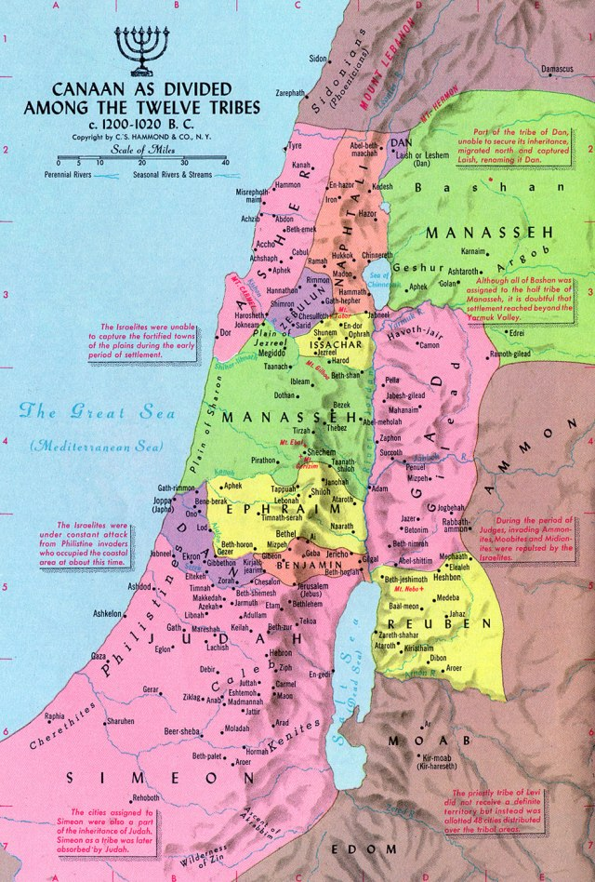

Slide 5
Saul Had A Better Idea
1. “I”, “They”, “We”. 1 Sam.15:13-15
2. When rebuked by Samuel. 1 Sam.15:20-21
3. MARK THESE VERSES! 1 sam15:22-23
4. Second statement of rejection. 1 Sam.15:23
4. NOW Saul admitted his guilt. 1 Sam.15:24

