Slide 2
Mizpeh
1. Mizpah in Judah. Josh.15:33,38
2. Mizpah in Benjamin. Josh.18:21,26
3. Mizpah in Gilead. Jud.11:29
4. Mizpah in Moab. 1 Sam.22:3
Mizpah means “Watch Tower”.

Slide 3
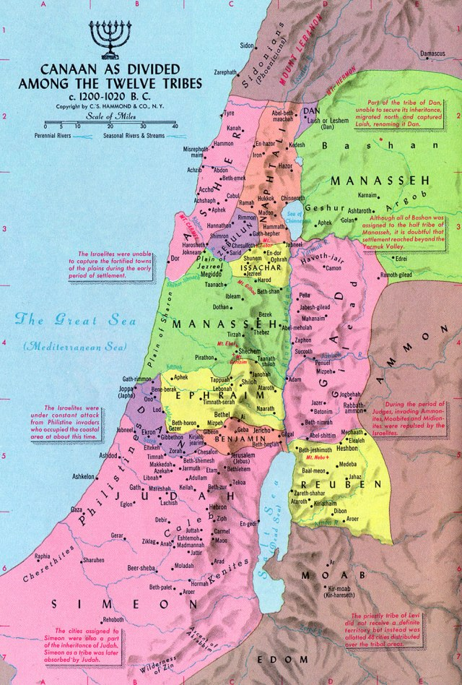

Slide 4
Why Israel Wanted A King
1. Samuel was an old man. 1 Sam.8:5
2. His sons walked not on his ways. 1 Sam.8:5
3. Make a king to judge us like the nations. 1 Sam.8:5 (verse 20)
4. Give us a king to fight our battles. 1 Sam.8:20
5. That they might be like other nations. 1 Sam.8:20

