Slide 2
OR
Galatians 5:13-26

Slide 3
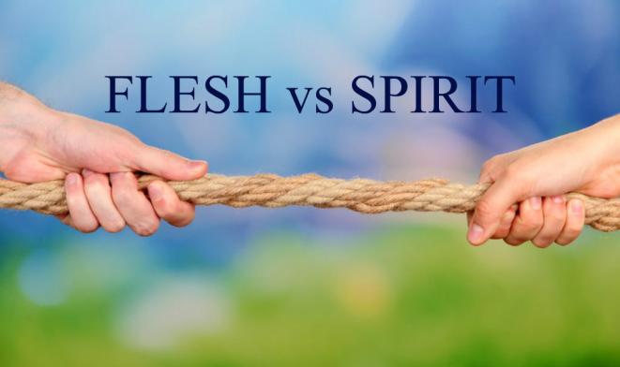
Introduction
“He who is slow to anger is better than the mighty,
And he who rules his spirit, than he who captures a city.”
- Proverbs 16:32
“Like a city that is broken into and without walls
Is a man who has no control over his spirit.”
- Proverbs 25:28

Slide 4
Our Key Text
Galatians 5:13-26
Paul wrote this book to “the churches of Galatia” (1:2)
A common threat: Judaizing teachers (5:7-12; 6:12-13)
Paul is afraid that they would believe these false teachers, renounce and reject Christ, and return to Judaism (1:6-9; 4:8-11; 5:7)

Slide 5
Our Key Text
Galatians 5:13-26
If they returned to Judaism, they would be cut off from Christ, fall from grace, and be eternally lost (5:2-6; 6:15)
They could be justified by walking by faith in Jesus Christ (2:15-16; 3:6-9, 23-26; 5:1, 5-6)

Slide 6
Our Key Text
Galatians 5:13-26
Keeping the Old Law = walking according to the flesh (3:1-3; 4:29; 6:13)
Living by faith in Jesus Christ = walking according to the Spirit (5:16-18, 24-25)

Slide 7
Our Key Text
Galatians 5:13-26
A REAL choice today:
Living according to the flesh or living according to the Spirit!
Galatians 2:20
Galatians 5:13
Galatians 6:7-8, 14

Slide 8
A Brief Preview
Take an in-depth look at “the works of the flesh” and “the fruit of the Spirit”
See how the fruit of the Spirit guards against, protects us from the works of the flesh
Make applications to the culture and circumstances in which we live

Slide 9
A Brief Preview
My goal is that by the end of this quarter, we will be…
Better informed as to what the works of the flesh and the fruit of the Spirit really are
Better equipped to shun the works of the flesh and be filled with the fruit of the Spirit
Be more like Jesus Christ, more fit for His service now and more fit for dwelling with Him forever!

