Slide 2
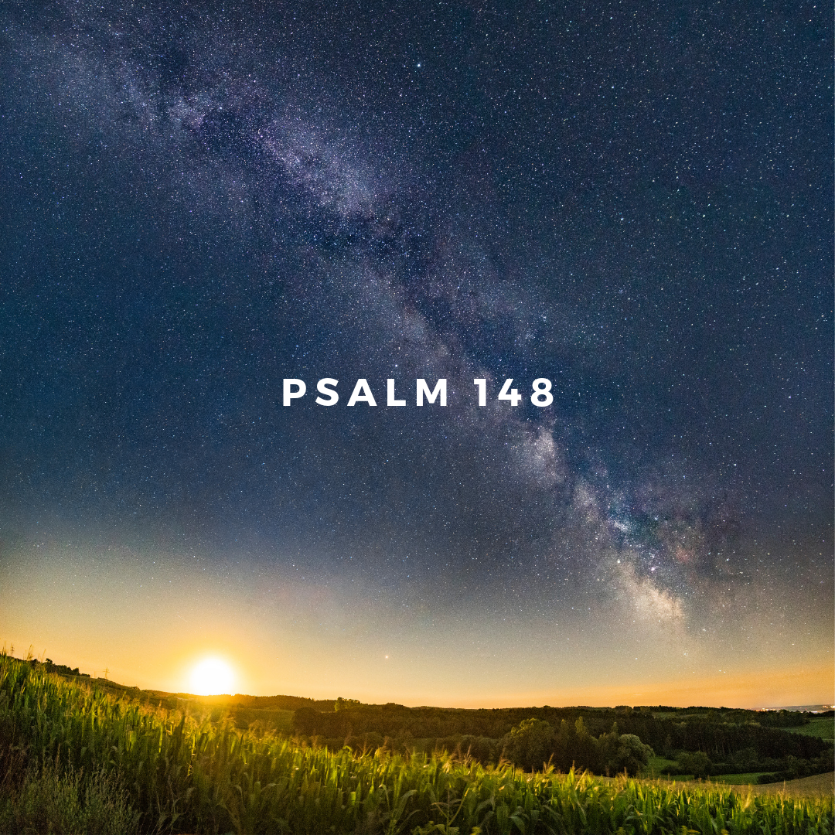
Creation’s Chorus of Praise

Slide 3
Why does the heavenly creation praise the Lord?
Creation’s Chorus of Praise
He created them by His command
Psalm 33:6, 9
Heavenly Creation’s Praise
vv. 1-6

Slide 4
Why does the heavenly creation praise the Lord?
Creation’s Chorus of Praise
He created them by His command
He established them
Heavenly Creation’s Praise
vv. 1-6

Slide 5
Why does the heavenly creation praise the Lord?
Creation’s Chorus of Praise
He created them by His command
He established them
He made a decree concerning them
Heavenly Creation’s Praise
vv. 1-6

Slide 6
How does the heavenly and earthly creation praise the Lord?
Creation’s Chorus of Praise
Psalm 19:1-6
Romans 1:20
Earthly Creation’s Praise
vv. 7-13

Slide 7
As the Lord’s people today…
Creation’s Chorus of Praise
…we owe Him much praise, for He has not only physically created and sustained us, He has also made us a new creation in Christ!
Luke 1:69
Spiritual Creation’s Praise
v. 14

