Slide 2
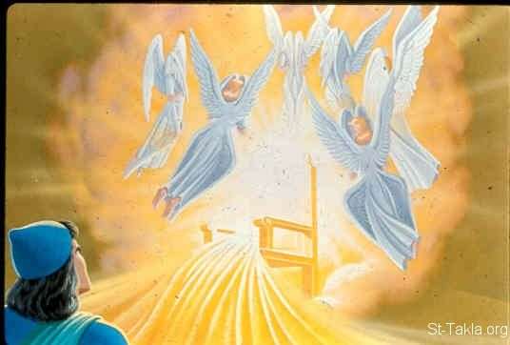
Imitating Isaiah’s Evangelistic Spirit
Isaiah 6

Slide 3
Four Ways to Imitate Isaiah’s Evangelistic Spirit
Experience God’s glory and holiness before teaching others (vv. 1-4)
John 1:14
1 John 1:1-3
2 Peter 1:16-18
Acts 22:6-10, 14-15
Acts 9:19b-22, 28

Slide 4
Four Ways to Imitate Isaiah’s Evangelistic Spirit
Realize we’re saved sinners teaching lost sinners God’s way (vv. 5-7)
Isaiah 59:1-3
Luke 5:8
1 Timothy 1:12-16
1 Corinthians 15:9-11
Ephesians 3:8-9

Slide 6
Imitating Isaiah’s Evangelistic Spirit
Isaiah 6

Slide 7
Four Ways to Imitate Isaiah’s Evangelistic Spirit
Experience God’s glory and holiness before teaching others (vv. 1-4)

Slide 8
Four Ways to Imitate Isaiah’s Evangelistic Spirit
Experience God’s glory and holiness before teaching others (vv. 1-4)
Realize we’re saved sinners teaching lost sinners God’s way (vv. 5-7)

Slide 9
Four Ways to Imitate Isaiah’s Evangelistic Spirit
Be ready and willing to go teach others (v. 8)
Acts 26:16-23
Romans 1:14-15
1 Corinthians 9:16-18
Matthew 28:18-20

Slide 10
Four Ways to Imitate Isaiah’s Evangelistic Spirit
Keep teaching God’s word as long as we live (vv. 9-13)
Matthew 13:11-15
Isaiah 11:1
Isaiah 55:10-11
Acts 28:23-31

