Slide 2
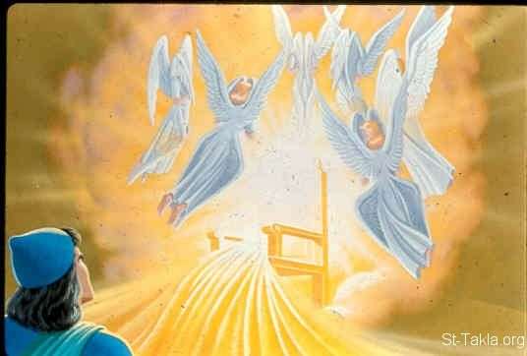
Imitating Isaiah’s Evangelistic Spirit
Isaiah 6

Slide 3
Four Ways to Imitate Isaiah’s Evangelistic Spirit
Experience God’s glory and holiness before teaching others (vv. 1-4)
John 1:14
1 John 1:1-3
2 Peter 1:16-18
Acts 22:6-10, 14-15
Acts 9:19b-22, 28

Slide 4
Four Ways to Imitate Isaiah’s Evangelistic Spirit
Realize we’re saved sinners teaching lost sinners God’s way (vv. 5-7)
Isaiah 59:1-3
Luke 5:8
1 Timothy 1:12-16
1 Corinthians 15:9-11
Ephesians 3:8-9

