Slide 2
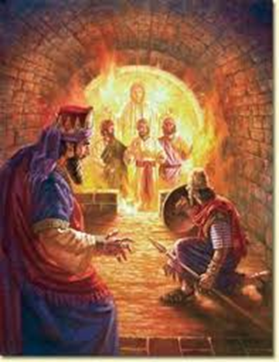
Three Friends and a Fiery Furnace
Daniel 3

Slide 3
The king’s decree (1-7)
THE TEXT

Slide 4
The king’s decree (1-7)
The Chaldeans’ complaint (8-12)
THE TEXT

Slide 5
The king’s decree (1-7)
The Chaldeans’ complaint (8-12)
Shadrach, Meshach and Abed-nego appear before the king (13-18)
THE TEXT

Slide 6
The king’s decree (1-7)
The Chaldeans’ complaint (8-12)
Shadrach, Meshach and Abed-nego appear before the king (13-18)
Three friends are thrown into a fiery furnace (19-23)
THE TEXT

Slide 7
The king’s decree (1-7)
The Chaldeans’ complaint (8-12)
Shadrach, Meshach and Abed-nego appear before the king (13-18)
Three friends are thrown into a fiery furnace (19-23)
Shadrach, Meshach and Abed-nego emerge unharmed (24-27)
THE TEXT

Slide 8
The king’s decree (1-7)
The Chaldeans’ complaint (8-12)
Shadrach, Meshach and Abed-nego appear before the king (13-18)
Three friends are thrown into a fiery furnace (19-23)
Shadrach, Meshach and Abed-nego emerge unharmed (24-27)
Nebuchadnezzar blesses God (28-30)
THE TEXT

Slide 9
Our faith will be tested
Daniel 1:8-13
Daniel 2:13-14
2 Timothy 3:10-12
1 Peter 4:12-13
Three
Faith
Lessons

Slide 10
Our faith will be tested
We can pass tests of our faith
Daniel 1:14-21
Daniel 2:17-18
Daniel 3:16-18, 28
Hebrews 11:34
Daniel 3:27
Three
Faith
Lessons

Slide 11
Our faith will be tested
We can pass tests of our faith
When we pass, we will influence others
Daniel 3:15
Daniel 3:29
Three
Faith
Lessons

