Slide 2
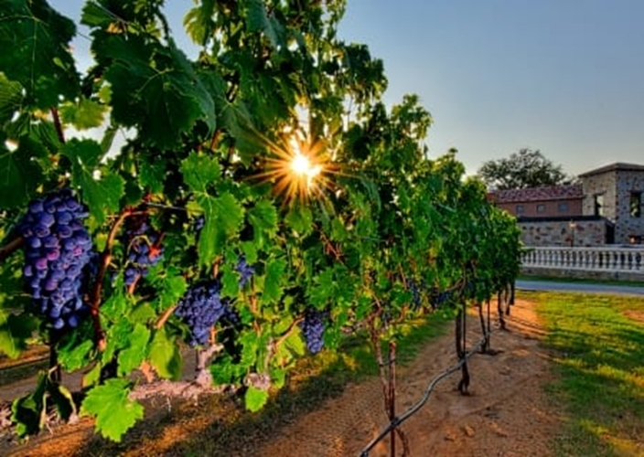
Staying Connected to the Vine
John 15:1-11

Slide 3
Four Key Words
Vine – Jesus Christ
Vinedresser – The Father
Branch – Each apostle/disciple
Fruit – Spiritual produce
Staying Connected to the Vine

Slide 4
The Purpose of the Branches
Love Christ and keep His commandments
John 14:15, 21, 23; 15:10
Matthew 22:37
John 15:12, 17
John 15:9-10
John 15:3, 7
Staying Connected to the Vine

Slide 5
The Purpose of the Branches
Bear spiritual fruit
John 15:2, 8
John 15:4-6
Galatians 5:22-26
Romans 15:26-28
Philippians 4:15-17
Staying Connected to the Vine

Slide 6
The Purpose of the Branches
Glorify God
John 15:8
John 17:4
Staying Connected to the Vine

Slide 7
Disconnected from the Vine: One Warning
John 15:2, 6
Don’t get disconnected from Christ!
Staying Connected to the Vine

Slide 8
Staying Connected to the Vine: Two Blessings
Answered prayers
John 15:7
1 John 3:21-22
1 John 5:13-15
Staying Connected to the Vine

Slide 9
Staying Connected to the Vine: Two Blessings
Answered prayers
Fullness of joy
John 15:11
Staying Connected to the Vine

