Slide 1
Kevin’s Philippine Report
Feb. 4 – Feb. 18, 2020

Slide 2
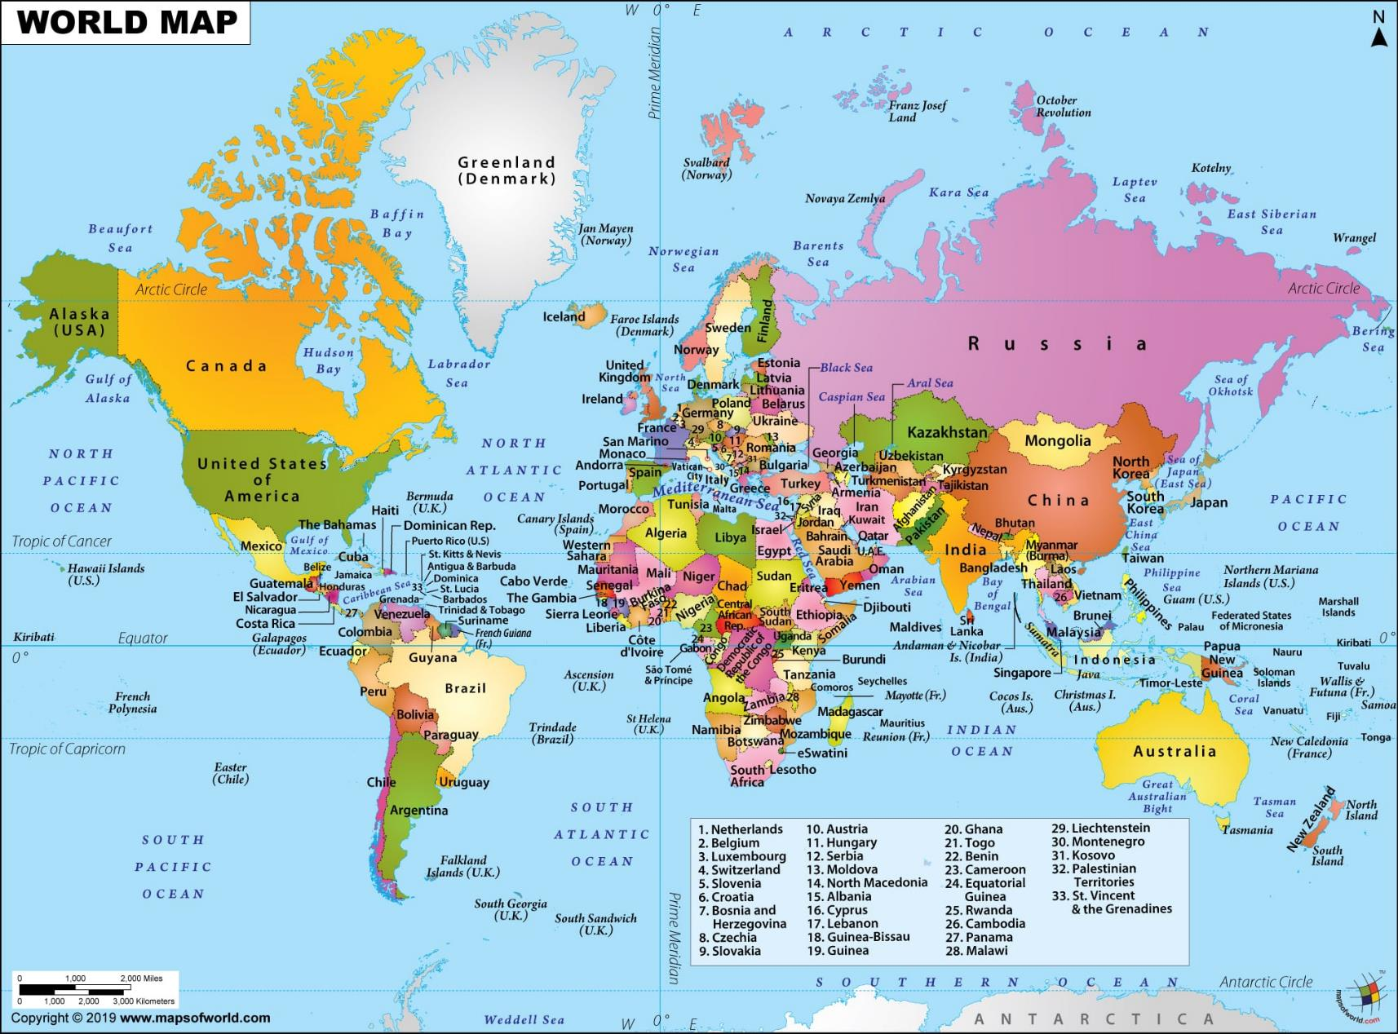
Louisville to Atlanta: 322 miles (1:25)
Atlanta to Narita, Japan: 6,832 miles (14:20)
Narita, Japan to Manila: 1,893 miles (5:20)
Total: 9,047 miles (21:05)
26:35 including Layovers
Left Louisville 2/4/20 6:00 am Arrived Manila 2/5/20 9:35pm

Slide 3
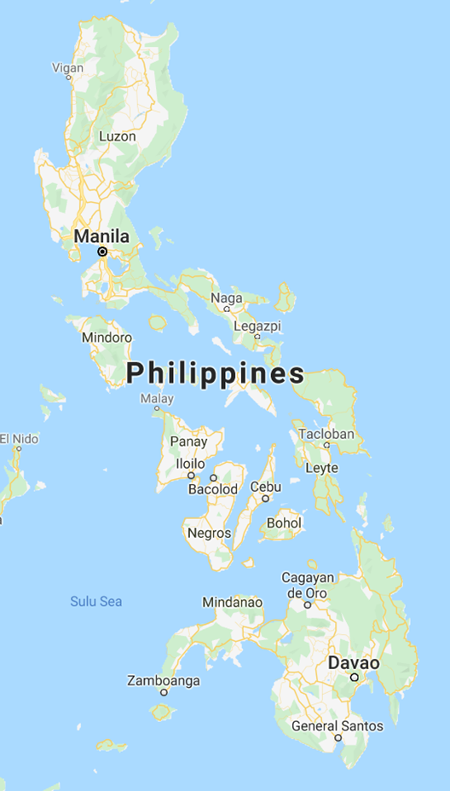
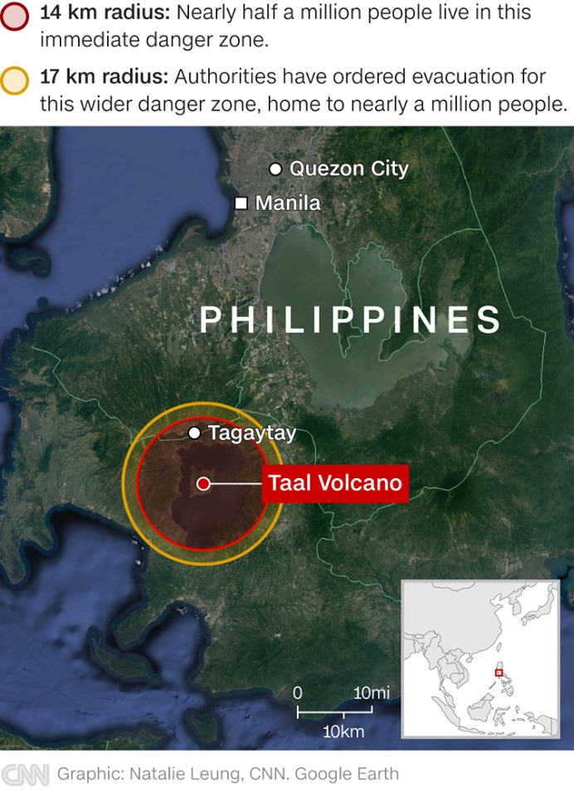
Luzon
Visayas
If it’s not a volcano… it’s a typhoon, earthquake, flooding or drought.
Mindanao

Slide 4
Public “Show”
Reality

Slide 5
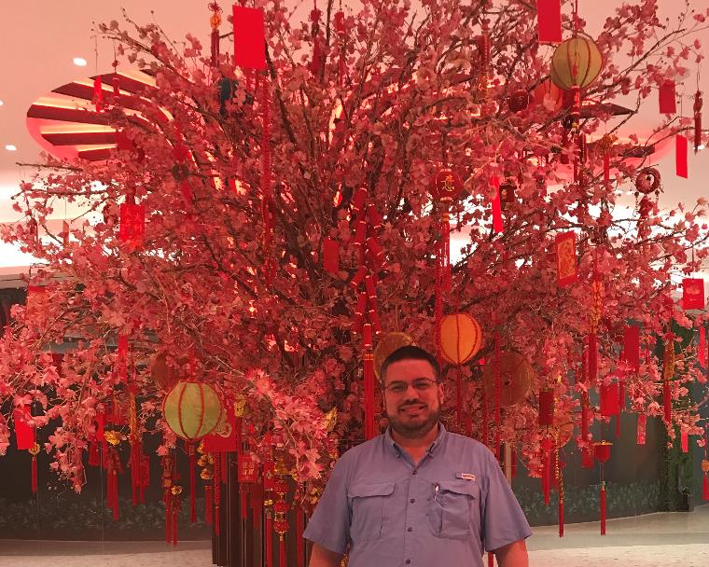
Chinese New Year
January 25, 2020
The Year of the Rat
Most Hotels, Malls & Stores in Metro Areas cater to China, Korea, Japan & Australia for rich vacationers (make you feel safe & secure… sometimes almost scary secure)

Slide 6
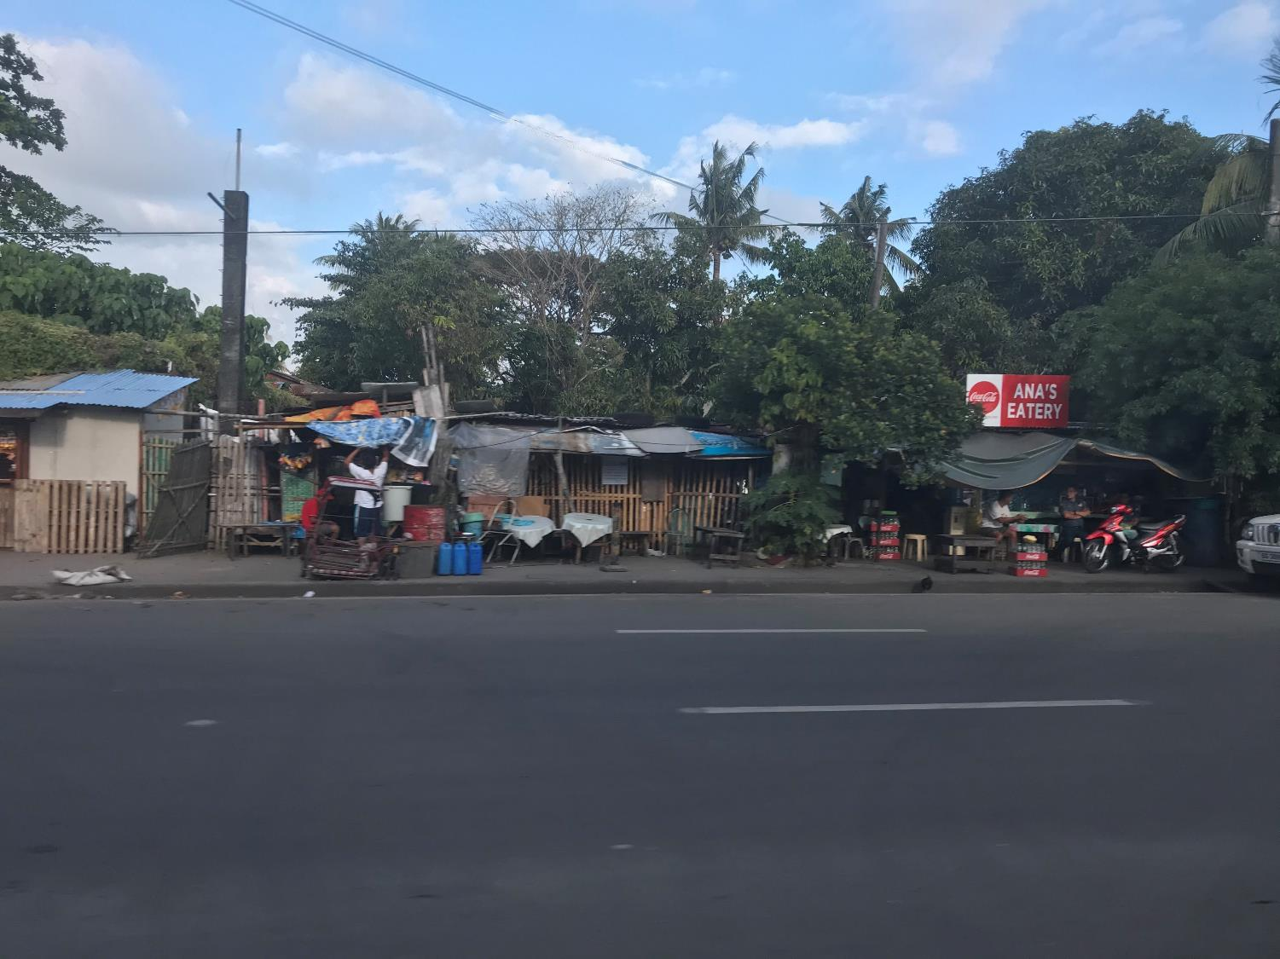
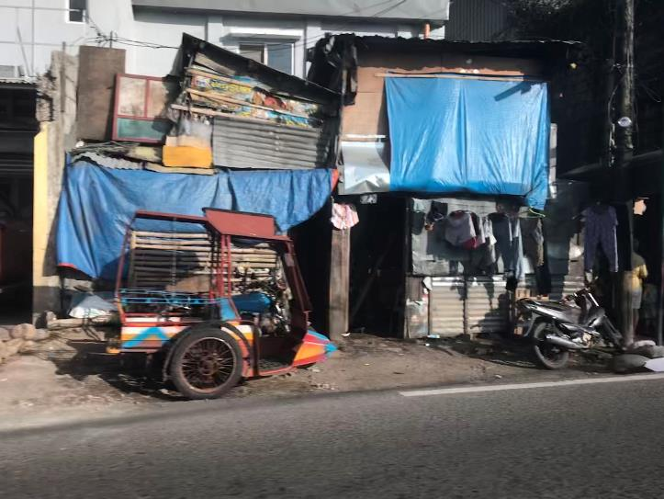
5m x 3m apartments

Slide 7
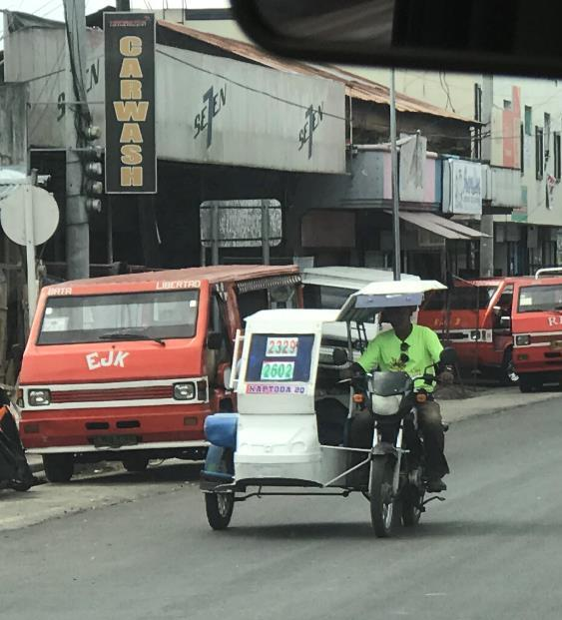
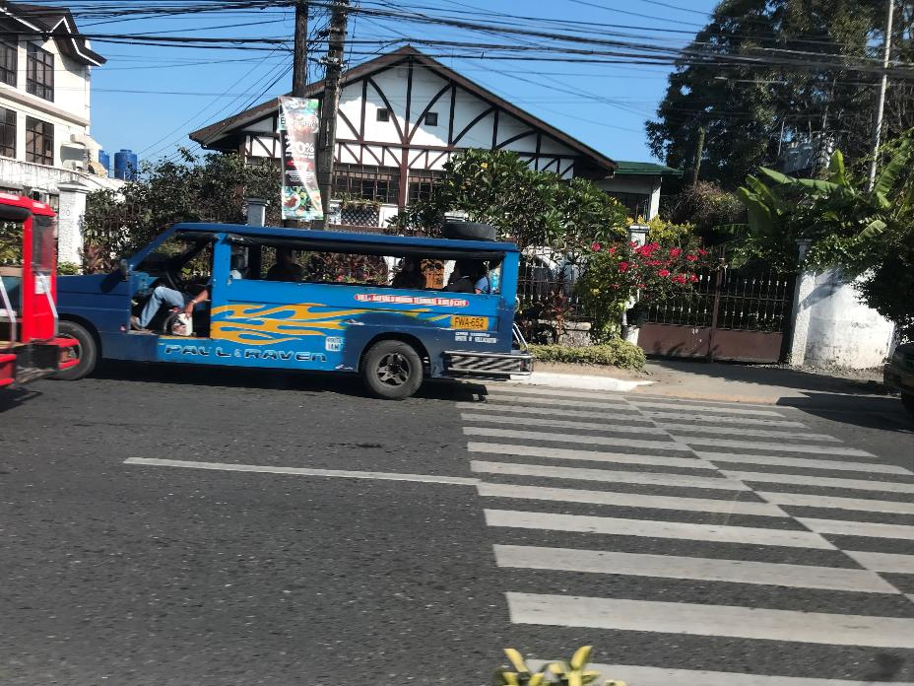
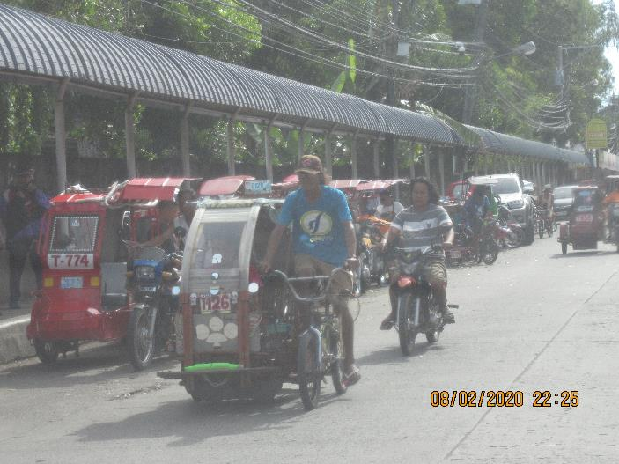
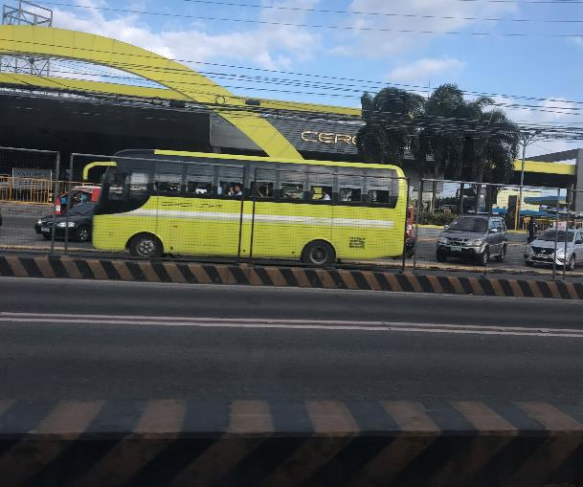
Travel in the Philippines Taxi (arr. by price) – Bike (Manual, Motorized), Trike (M/M), Jeepney, Bus (too dark to get a picture: Pinoy Ingenuity)
School Zone

Slide 8
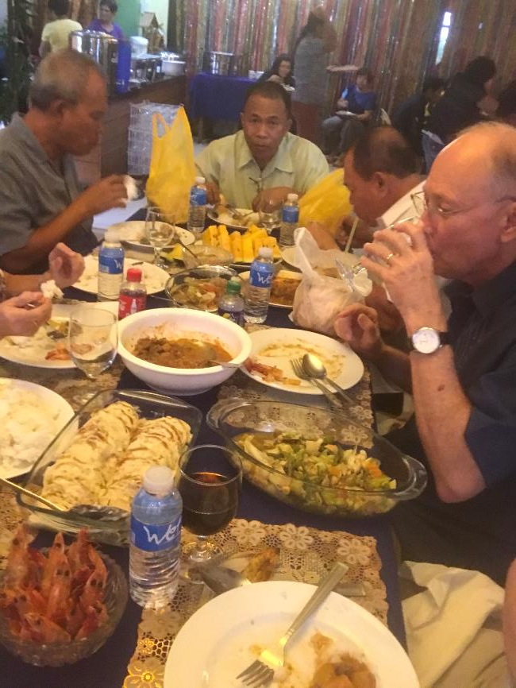
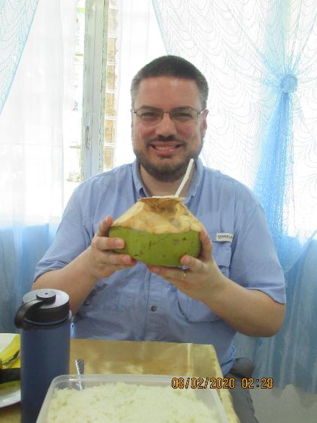
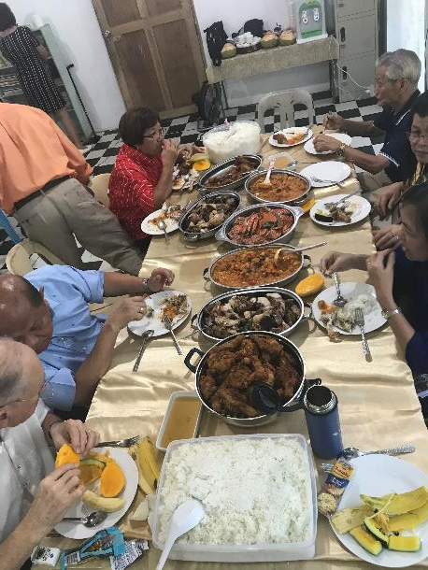
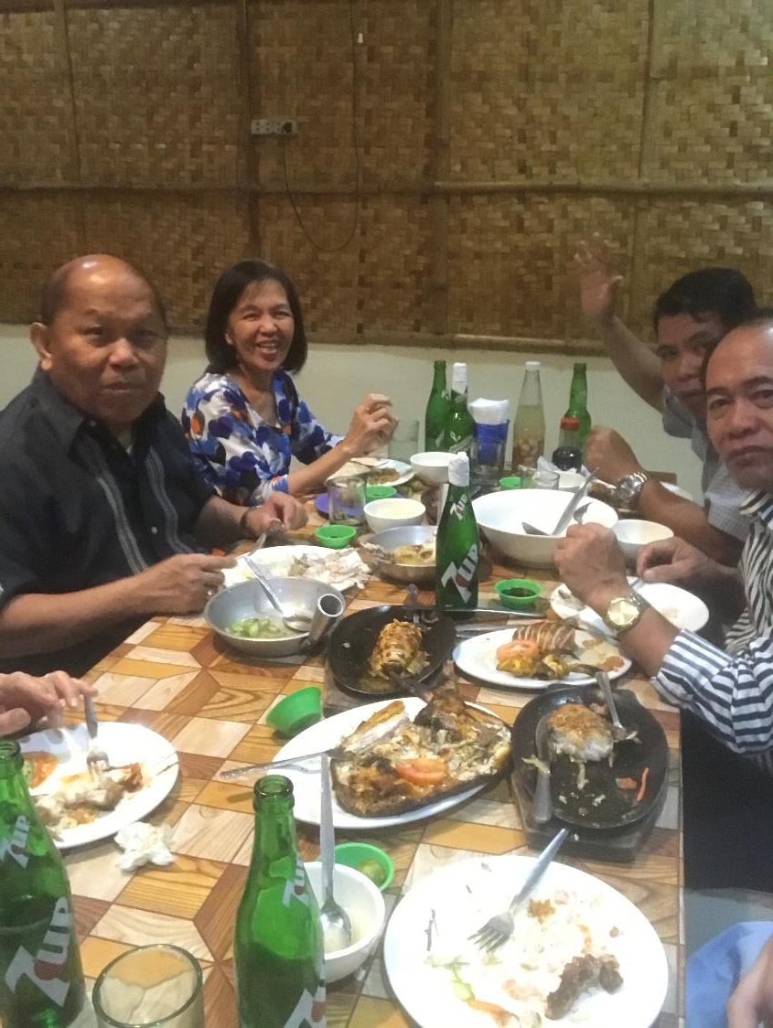
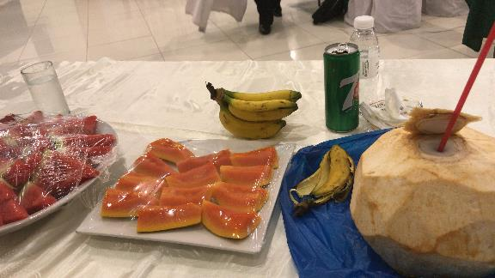
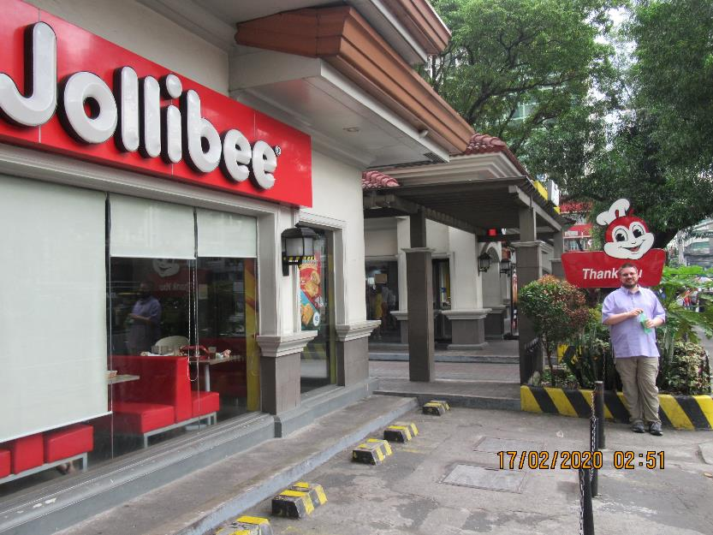
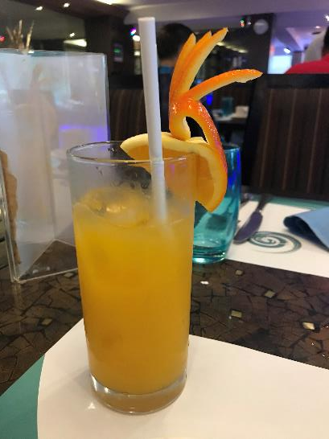
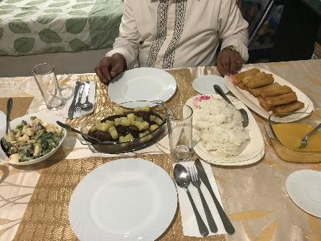
For all you foodies…

Slide 9
Feb 6 (Thur) Repack boxes for shipping with help of Elias Cruz, James Paet, & other brethren

Slide 10
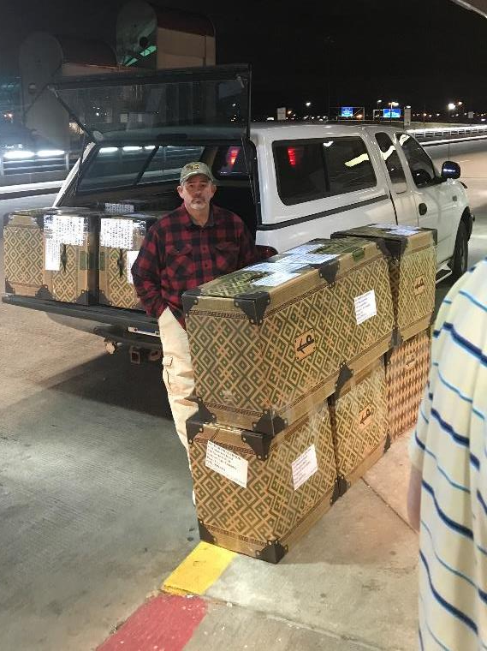
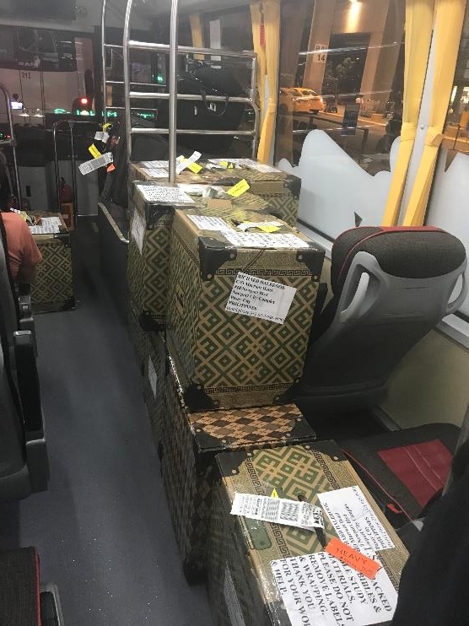
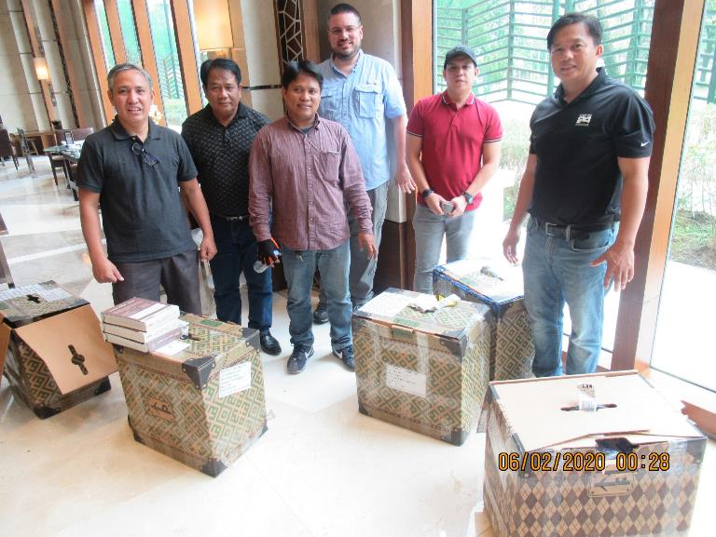
Doug Rush
Elias Cruz, Ely Ebuenga, Andrew Romero, Jhun Gumpad, James Paet

Slide 11
Feb 7 (Fri) Fly from Manila to Bacolod City, Negros Occidental Meet Jack Jaco & Jonathan Cariño

Slide 12
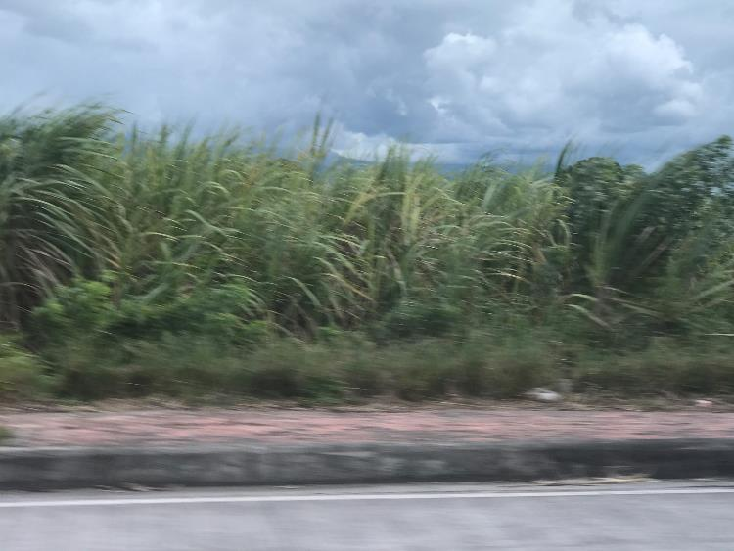
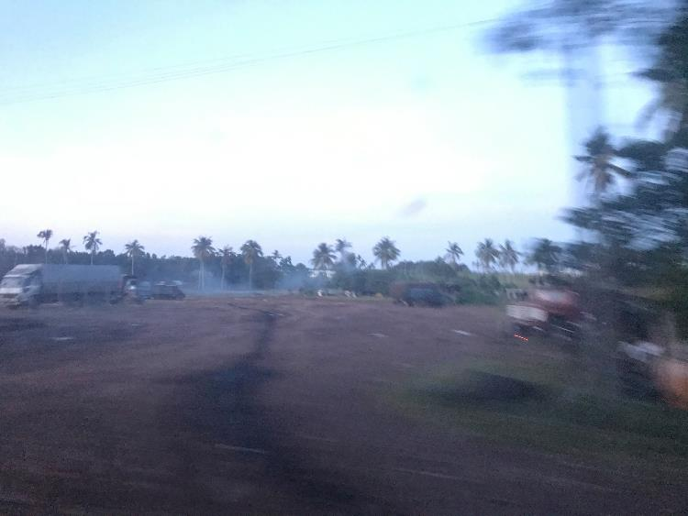
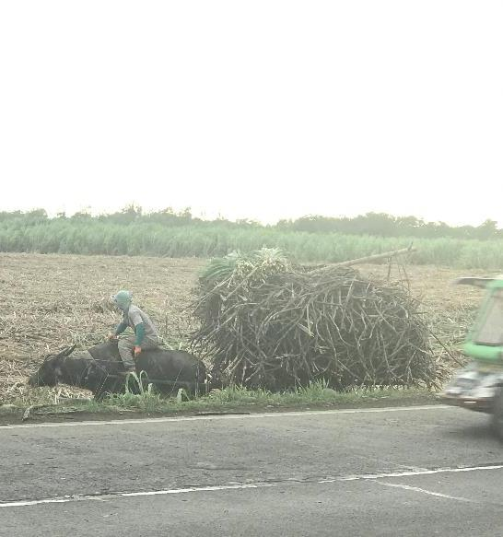
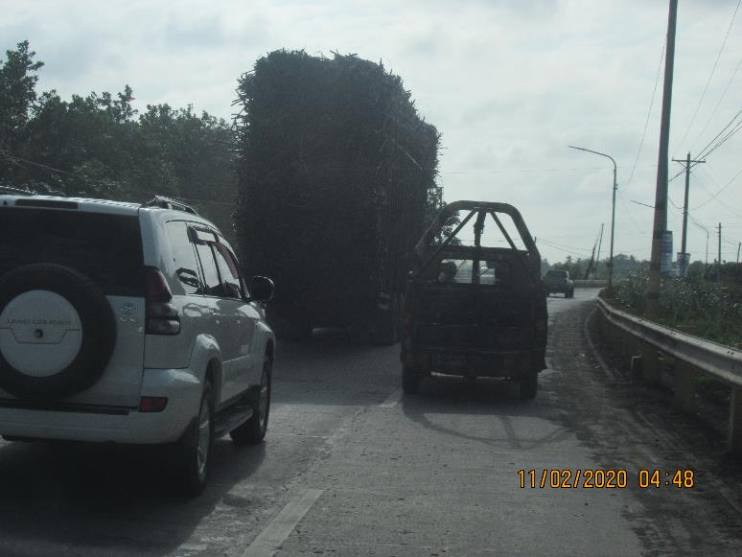
Bacolod City: The Sugar Cane Capital of the World

Slide 13
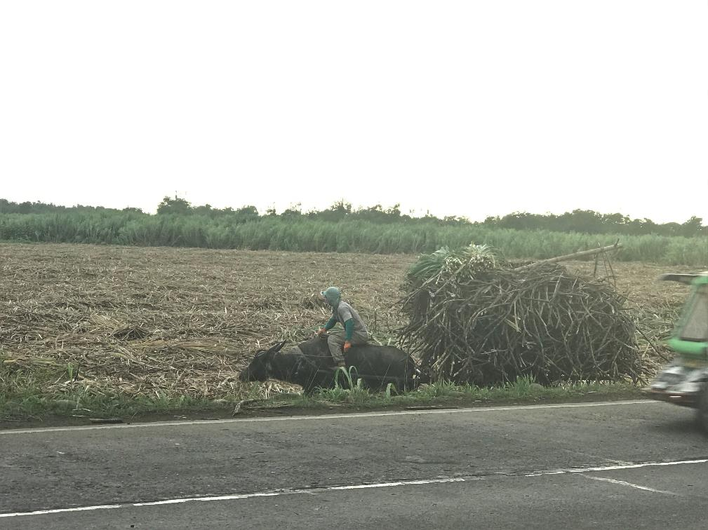
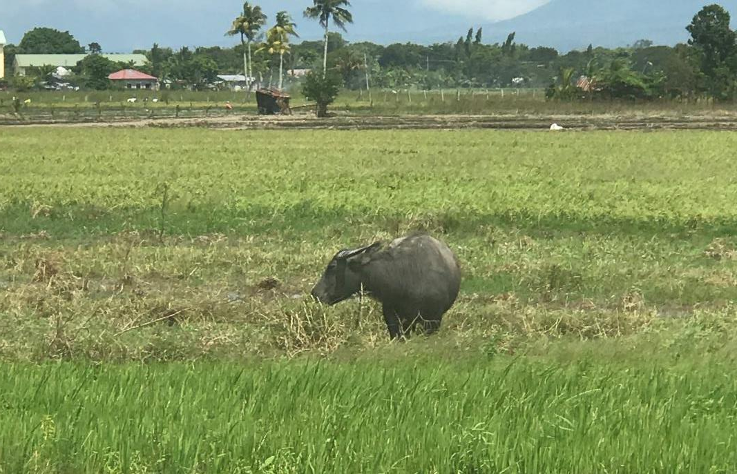
Carabao
Stock Photo:
Couldn’t get my camera out in time but saw 6-8 yr old girl riding a carabao down the road.

Slide 14
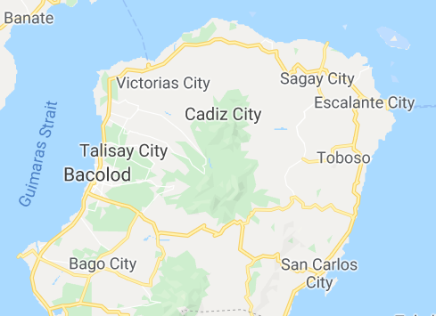
Feb 8 (Sat) Ron & Kevin Stilts preach at Escalante church of Christ, Negros Occidental with James Berden
I strongly believe the endurance of Filipinos to sit for hour long sermons on benches or plastic lawn chairs is strongly correlated to the length and condition of the roads they ride on.

Slide 15
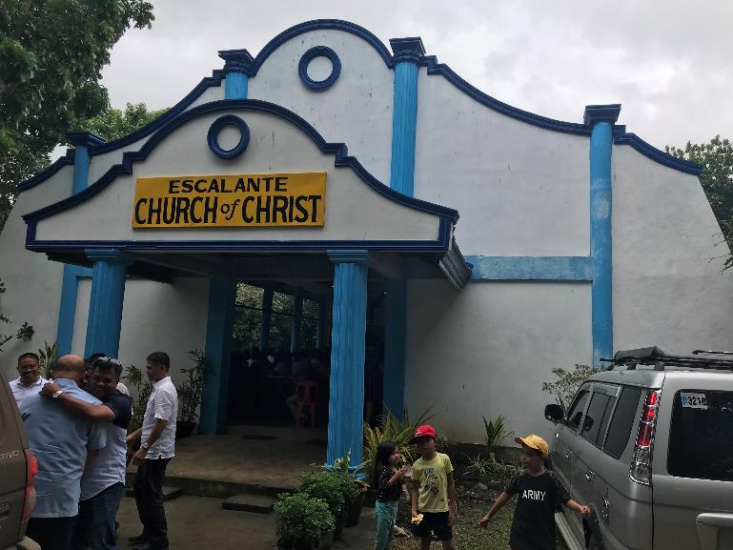
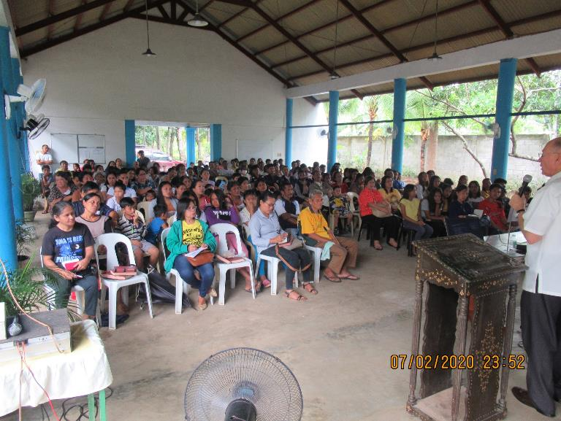
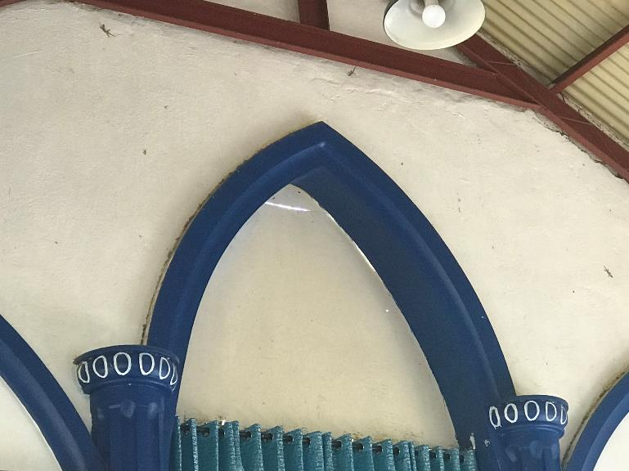
Lessons Taught:
God Created All Things – Ron
Homesick for Heaven
Does the Lord Know You?
Purpose of Life – Ron
Destiny of Man
Heaven Isn’t Fair
When Peter Confessed Christ – Ron
One True Church – Jonathan Cariño
220 in attendance (30 children)
3 baptized

Slide 16
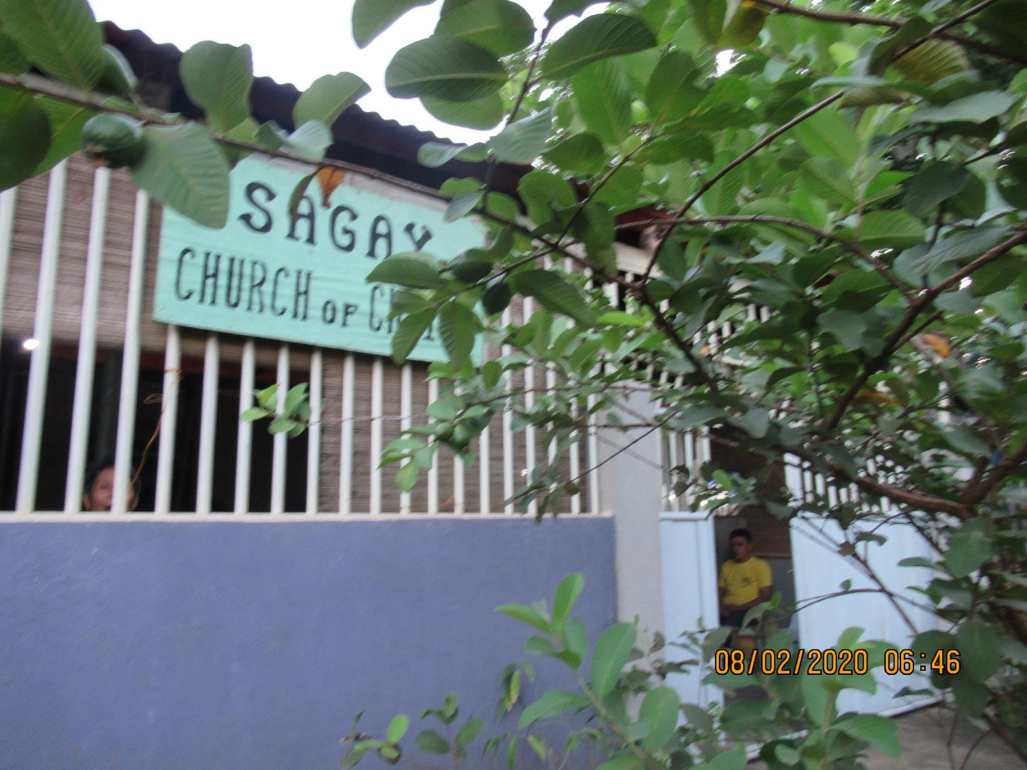
30 in attendance Waiting for 2 ½ hours
Just for encouragement & prayer.

Slide 17
Hardships in Philippines (met with 5 Visayan preachers while Jonathan extended invitation at Escalante)
Most visiting preachers to Philippines go to Luzon (Manila) and to Mindanao (Davao City) – avoid Visayas due to costs of travel
Travel to worship: Most ride taxis (i.e. Escalante – 220 in attendance from 4 congregations, 4 vehicles + 1 motorcycle in parking lot [1 vehicle was the CUV Jack rented to take Ron, Jonathan, and myself around])
Why feed lecture attendees? Can’t break for lunch and go home/restaurants.
Many ambitions but not enough funds
Would love to establish congregations in metropolitans - Bacolod City and Iloilo
250 studies in 2020 (52 worship services + lectures & gospel meetings)

Slide 18
Feb 9 (Sun) Kevin preach AM at Victorias City with Jack Jaco & PM at Cawayan church of Christ, Taluc, Bago City with Shem Tagapan

Slide 19
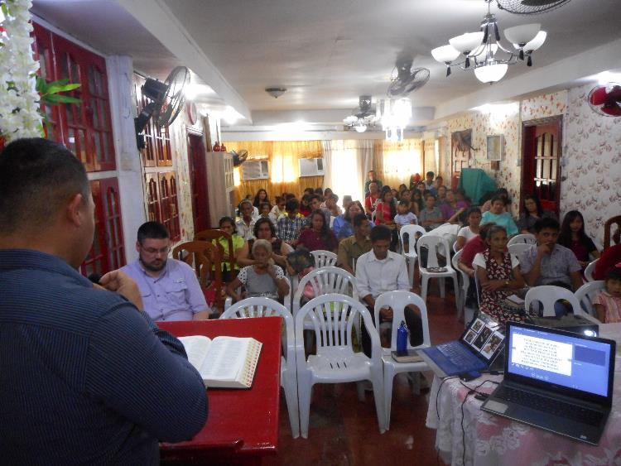
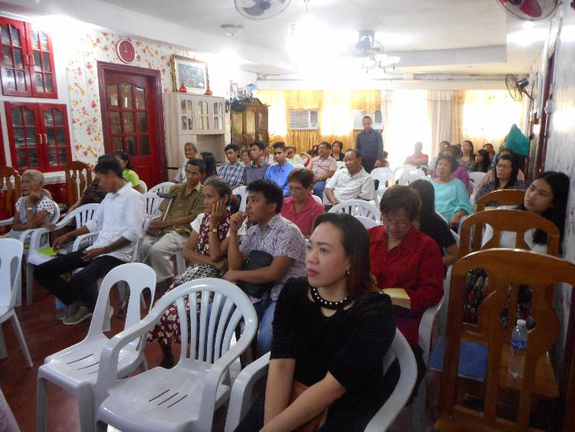
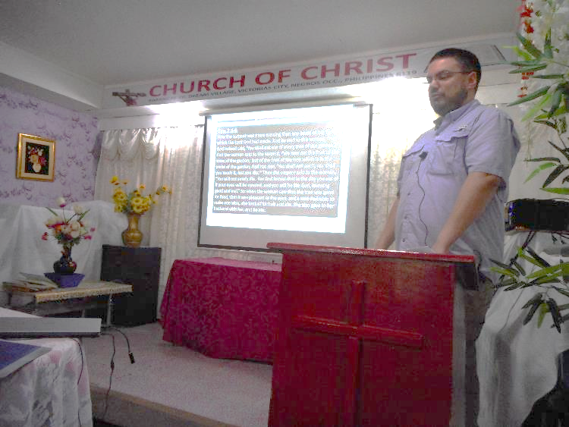
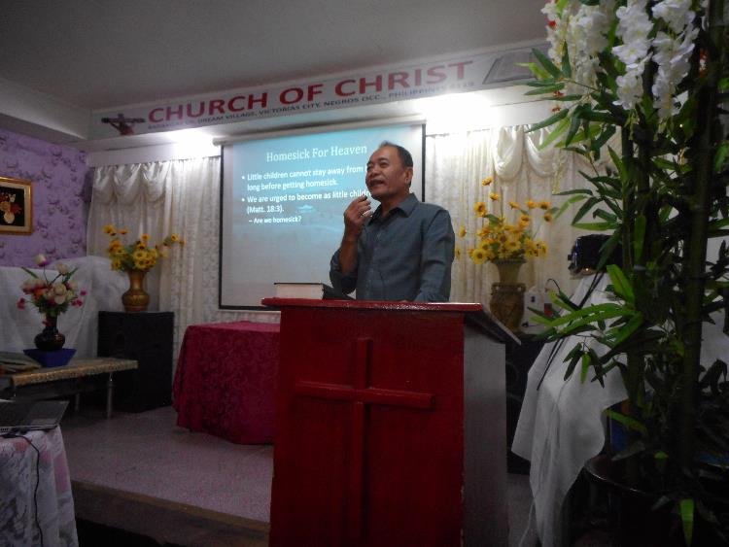
Lessons Taught:
How the Devil Works
Does the Lord Know You?
Homesick for Heaven
65 in attendance

Slide 20
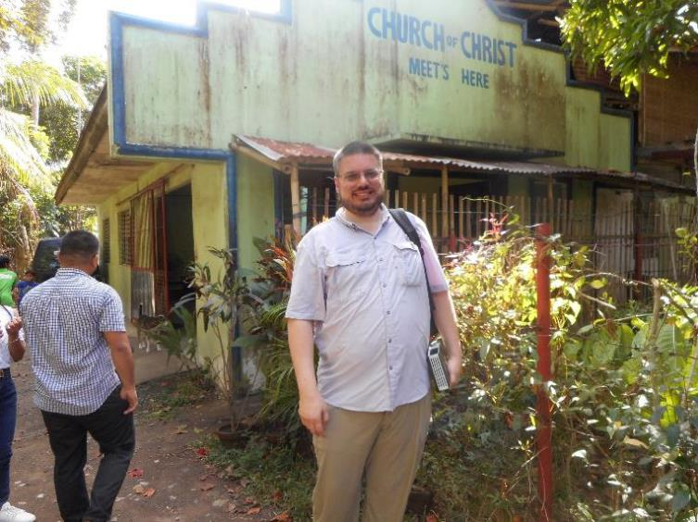
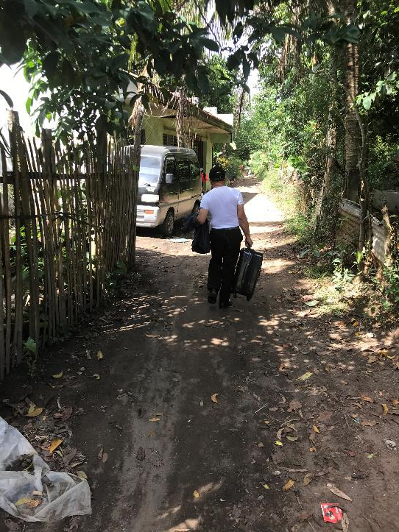
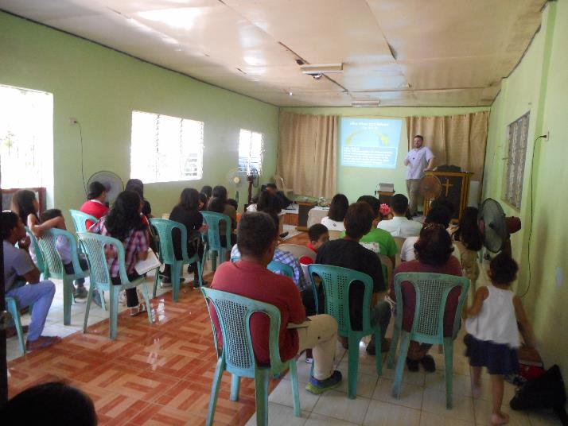
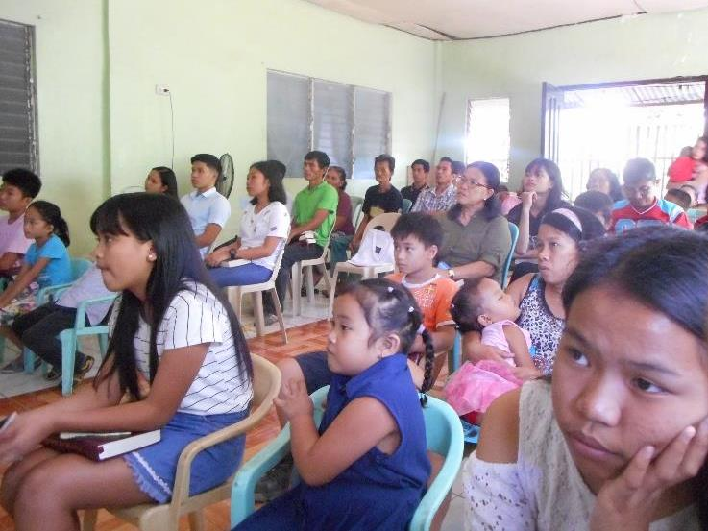
Lessons Taught:
Homesick for Heaven
Destiny of Man
48 in attendance
2 baptized

Slide 21
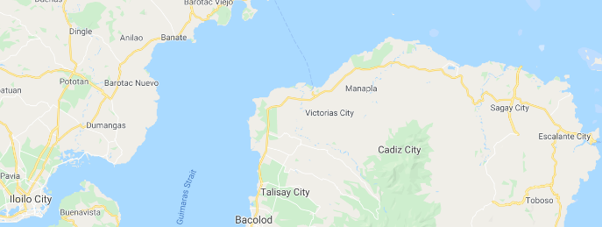
Feb 10-11 (Mon-Tues) Kevin, Ron, Jack Jaco, & Jonathan Cariño teach ‘How to Study the Bible’ (Lewis Willis) at Victorias City

Slide 22
“Be diligent (Study) to present yourself approved to God, a worker who does not need to be ashamed, rightly dividing the word of truth. (2 Tim. 2:15)
The Bible: A Book to Study
Can We Understand the Bible?
Reasons for Bible Study
Preparing the Heart
Improper Attitudes and Methods of Study
Rightly Dividing the Word
Nailed to the Cross
Context of a Passage
Read All the Bible Says
Word Studies and Translations
The Historical Context
When The Lord Says Nothing
Interpreting Figurative Language

Slide 23
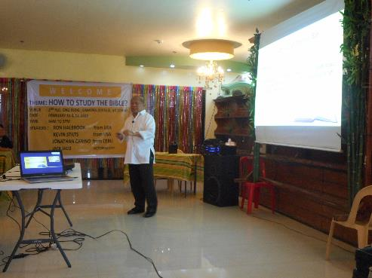
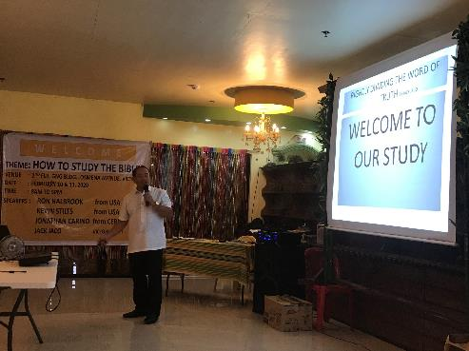
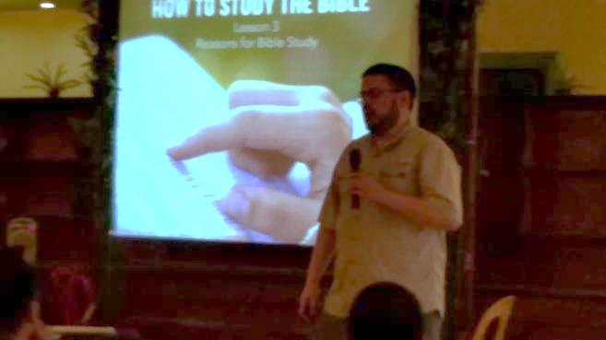
Jonathan Cariño
Sigualdo “Jack” Jaco
Kevin Stilts
Attendance:
Day 1 – 61 (many roads flooded)
Day 2 – 71
Ron Halbrook

Slide 24
How do they sing?
In English
Few Congregations have received donated song books
Sacred Selections
Songs of the Church
Always a need for more…
Other congregations, if fortunate enough, have old projector donated with song lyrics on overhead and sing

Slide 25
Feb 11 PM (Tues) Fastboat Ferry from Bacolod City to Iloilo

Slide 26
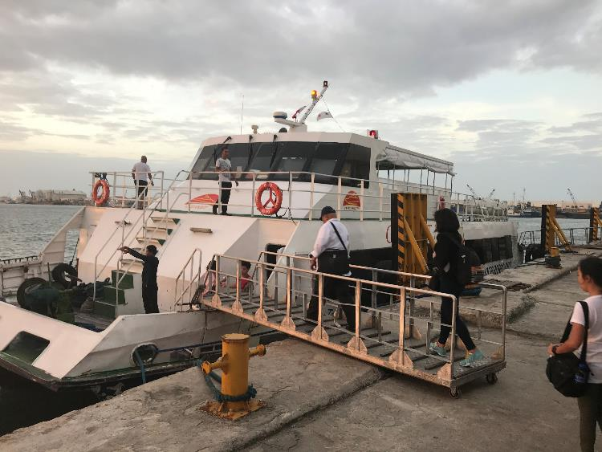
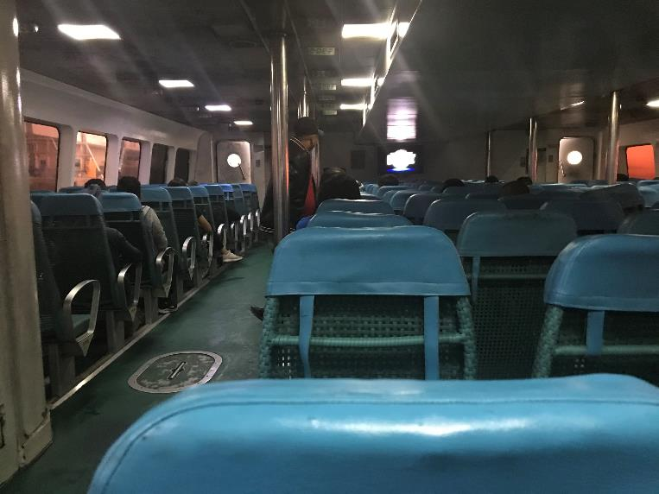
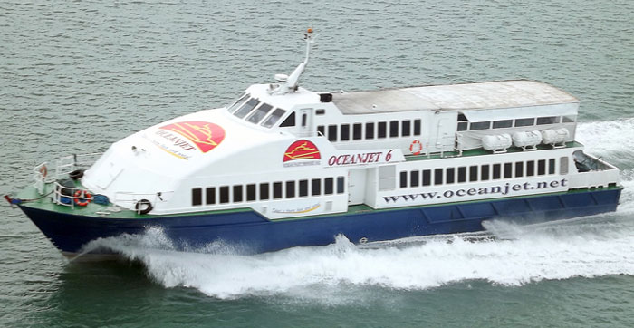

Slide 27
Feb 12-14 (Wed-Fri) Kevin, Ron, Jack Jaco, & Jonathan Cariño teach ‘How to Study the Bible’ & The Authority of Christ at Iloilo City

Slide 28
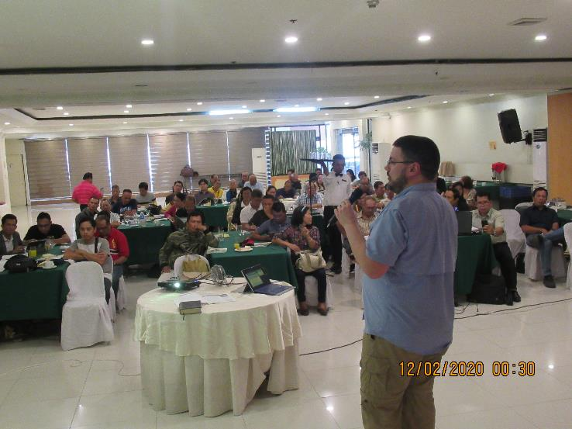
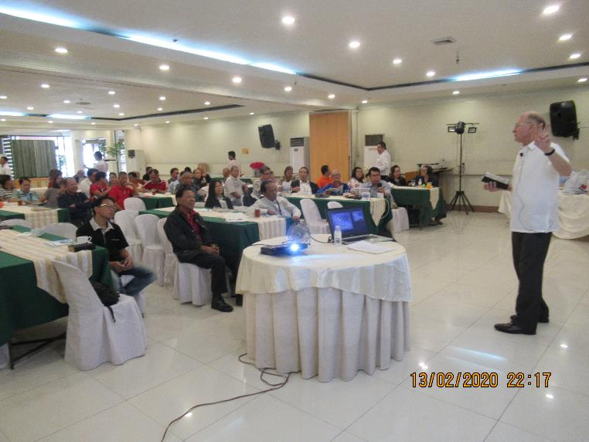
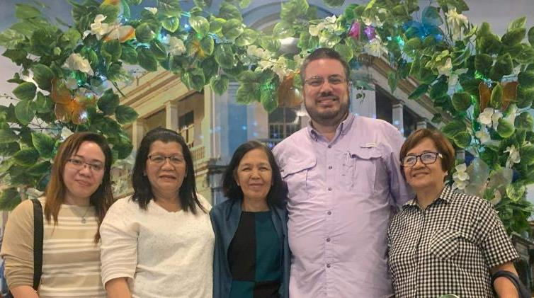
But I thought you said 150-200 denominational preachers?!?
Attendance:
Day 1 – 69
Day 2 – 64 (sick)
Day 3 – 63
3 baptized
Many requesting follow-up visit from Jack to Iloilo

Slide 29
Feb 15 (Sat) Kevin & Ron travel from Iloilo City to Manila

Slide 31
Feb 16 (Sun) Kevin preach at Edsa-Pasay with Jhun Gumpad in AM Kevin & Ron preach at Paranaque City with Jimmy Battung in PM

Slide 32
Lessons Taught:
A Christian Should Not – Rody Gumpad
Homesick for Heaven
57 in attendance

Slide 33
Current Edsa-Pasay Services:
Bible Study: 9:30 AM
Worship: 10:00 – 11:30 AM (start singing at 9:30)
2nd Service: 1:30 – 3:00 PM (start singing at 1:00)
Assembly for Deaf Mute: 3:00-5:00 PM

Slide 34
Current Edsa-Pasay Services:
Bible Study: 9:30 AM
Worship: 10:00 – 11:30 AM (start singing at 9:30)
2nd Service: 1:30 – 3:00 PM (start singing at 1:00)
Assembly for Deaf Mute: 1:30-3:00 PM

Slide 35
Lessons Taught:
Does the Lord Know You?
Shore Lights – Ron
18 in attendance

Slide 36
Feb 17 (Mon) Kevin prepares for trip home Sight-seeing with Ron, James Paet & Jhun Gumpad Supper with Jerry & Teresa Toreja

Slide 37
Manila American Cemetery
17,097 Headstones 36,286 Walls of the Missing

Slide 38
Rizal Park
City Wall
Cathedral of Manila
Fort Santiago

Slide 40
Manila to Narita, Japan: 1,894 miles (4:35)
Narita, Japan to Detroit: 6,428 miles (11:45)
Detroit to Louisville: 306 miles (1:32)
Total: 8,628 miles (17:52)
20:20 including Layovers
Left Manila 2/18/20 9:55 am Arrived Louisville 2/18/20 5:37pm

Slide 42
Plans to return?
Lord-willing!
Edsa-Pasay
Tuguegarao
Rural congregations

Slide 43
Keep our Filipino brethren in your prayers! Door may be closing soon... (Spratly Islands dispute, Visiting Forces Agreement)

Slide 44
Shine As Shore Lights
Christians are to shine as lights in a dark world (Phil. 2:14-16)
Shore lights bring storm-tossed ships to the lighthouse: we guide souls to Christ
God Promised the Divine Light of Salvation
God Guided History to Send Christ (Isa. 30:26; Jn. 8:12)
God Sends the Light of Truth to Save Our Souls
Christ Is the Truth & Teaches Truth to Save Us (Jn. 3:16-21; 1 Thess. 5:1-5)
Saints Are Lights Pointing Men to the True Light
Our Light Must Shine Crystal Clear (Matt. 5:14-16; Phil. 2:14-16)
The Light of Christ Shines Forever in Heaven
Faithful Saints Enter the Glories of Heaven (Rev. 21:23-26)

