Slide 1
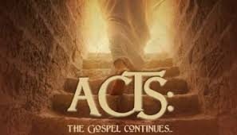
Lesson 4

Slide 2
Introduction
In order to have growth, locally and worldwide, all Christians will have to fulfill their responsibilities.
These responsibilities differ from each other. You may have one responsibility and I another.
But ALL are equally important to the growth of the Lord’s church!
Chapter 9 stands as an example of the above fact. Without certain Christians mentioned in chapter 9, the growth of the early church would have been hindered seriously.

Slide 3
Question 1 (9:10-17)
Vs 1-9 – An enemy is converted, the gospel is for all
Interesting to see the attitude of Ananias in V 9 as he says basically, “Here am I Lord, send me.”
Then, he hears what the Lord wants him to do and where He is sending Ananias.
What is his attitude then? (Vs 13,14)
What might have YOUR attitude been????

Slide 4
Question 1 (9:10-17)
To me, verse 17 is pretty impressive as it is just straightforwardly stated:
And he does what the Lord has asked him to do.
How important is Ananias to the growth of the church?
“And Ananias went his way, and entered into the house, . . .”

