Slide 1
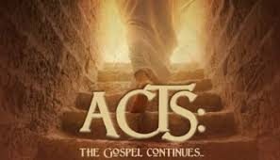
Introduction

Slide 2
Importance of Acts
Some claim that Acts is THE most important book in the Bible. What would we NOT know if not for Acts:
The kingdom? Spiritual in nature? The church?
Who is Paul?
Gentiles?
Elders?
How did we get to Rome?
First day of the week?
Where did all these churches come from?

Slide 3
Introduction Materials
Purpose of the Book
Second book in the series of Luke
First book, Luke, was written to give Theopolis the certainty concerning the gospel facts, what Jesus began to do and to teach until He ascended to heaven.
What is Luke trying to do in this book then?

Slide 4
Purpose
NOT a history of the early church
He tells nothing of the church of Galilee (9:31)
Or evangelism of Egypt and other areas
NOT an account of the apostles
ONLY four apostles are mentioned – Peter, James, John and Paul
Really, only two apostles are talked about – Paul and Peter

Slide 5
Purpose
Other historical matters NOT discussed in Acts:
Rise of elders – 11:30
James in Jerusalem church – 15:13
What did Paul do in Tarsus for three years – 9:30 and 11:25

Slide 6
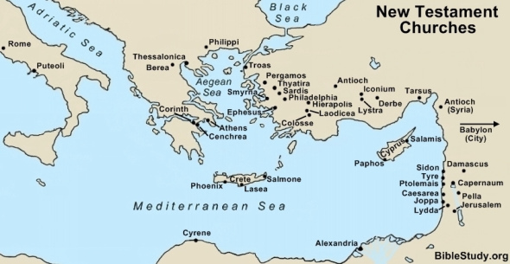
Expansion of the church in Acts

Slide 7
So then, what is Luke doing?
Luke is telling a story, not a history
He is telling of how the church expanded to Rome
Why?
Most Noble or Excellent is used as a term reserved for Roman officials – Acts 24:3; 26:25
How did God get the gospel to Rome for Theopolis? Acts answers this question for Theopolis.

Slide 8
Lessons?
The importance of ONE person to God
Cornelius
Ethiopian Eunuch
Others? Other passages?
Lessons for us????
How can this comfort us today?

Slide 9
Acts Outlined
Can be divided up in many many ways
1:8 – “You shall be my witnesses both in Jerusalem, and in all Judea and Samaria, and unto the uttermost parts of the earth.”
Personalities/Men
Peter – 1-5
Stephen – 6,7
Barnabas, Philip, and Saul of Tarsus – 8-12
Paul – 13-end of book

Slide 10
Acts Outlined
Organized by its movement and growth to Rome:
Notice how we grow from Jerusalem to Rome – 2:47, 5:14; 6:7; 9:31; 12:24; 16:5; 19:20 and 28

Slide 11
Two Men of Acts – Why? Thoughts?
Peter
Paul
Sermon in Full Chpt 2
Lame mean healed 3:1-10
Judgment brought 5:1-11
Freed from prison 5:19-21
Holy Spirit stressed 2:38
Resurrection Primary Purpose
Sermon in Full Chpt 13
Lame man healed 14:8-10
Judgment brought 13:6-11
Freed from prison 16:19-30
Holy Spirit stressed 19:2-6
Resurrection Primary Purpose

Slide 12
Topics Taught in Acts
Organization of the church
Church discipline
Remedies against false doctrine
Food for faith
Patience
Hope
Love for every work against all evils
Sound doctrine of all kinds

Slide 13
Purpose of Class
What did it take to get the gospel to Rome?
Difficulties faced
Hurdles overcome
What did it take to get the church to grow?/How did the church grow?
Questions will be handed out on January 5th and we will begin the class on January 8th.

