Slide 2
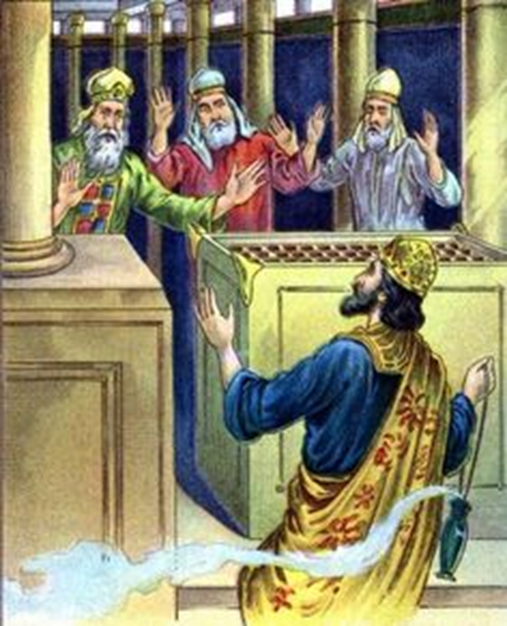
UZZIAH: Lessons from a King
2 Chronicles 26

Slide 3
Two names: Azariah – “He whose help is Yahweh” and Uzziah – “He whose strength is Yahweh” (James Smith, The Books of History, p. 601)
Became Judah’s king at 16 and reigned 52 years
Under his rule, Judah prospered economically and militarily
UZZIAH
Background Info

Slide 4
Amaziah’s son
Amaziah “did right in the sight of the Lord, yet not like David his father” (2 Kings 14:3); he didn’t serve the Lord “with a whole heart” (2 Chron. 25:2), nor did he remove the “high places” from the land (2 Kings 14:4)
Uzziah “did right in the sight of the Lord according to all that his father Amaziah had done” (2 Chron. 26:4)
However, he too left the “high places” as his father had (2 Kings 15:4), and later in his reign, became “unfaithful to the Lord his God” (2 Chron. 26:16)
UZZIAH
Background Info

Slide 5
Uzziah’s Character vv. 1-5
Generally, he did right in God’s sight (v. 4), although again, he left the high places for the people to worship idols (2 Kings 15:4)
“As long as he sought the Lord, God prospered him” (v. 5)
Early on, Uzziah was a good man who earnestly sought God and His will!
UZZIAH
The Text

Slide 6
Uzziah’s Success vv. 6-15
Rebuilt Eloth and restored it to Judah (v. 2)
Defeated the Philistines, dismantled their fortified cities and built his own cities there (v. 6)
Defeated the Arabians and Meunites (v. 7)
Ammonites paid him tribute (v. 8)
Became famous for his military might (vv. 8, 15)
UZZIAH
The Text

Slide 7
Uzziah’s Success vv. 6-15
Fortified Jerusalem’s walls; built watchtowers; installed cisterns; had many servants, crops and livestock (vv. 9-10)
Amassed a massive, well-trained, well-equipped army with advanced weapons (vv. 11-15)
What a successful king! Because he sought God, God prospered him!
UZZIAH
The Text

Slide 8
Uzziah’s Failure vv. 16-23
Pride got the best of him (v. 16)
He disregarded God’s laws concerning priestly duties (v. 16)
He became angry and took a censer in his hand, perhaps intending to do the priests harm, but at the very least intending to show he was king (vv. 18-19)
UZZIAH
The Text

Slide 9
Uzziah’s Failure vv. 16-23
God struck him with leprosy (vv. 19-20)
He was removed from the temple, his house, and as king, living as a leper the rest of his life (v. 21)
He was buried with his fathers, near the kings, but not with them, because he was a leper (v. 23)
What started out so promising ended in disaster, all because he stopped seeking God and sinned!
UZZIAH
The Text

