Slide 2
Gospel in India
Aug.14 to Sept. 17 (2019)
(4 Weeks)
John & Edna Humphries

Slide 3

“And the things that you have heard from me among many witnesses, commit these to faithful men who will be able to teach others also”
(2 Tim. 2:2).
To teach “faithful men who will be able to teach others also” is our motivation for going to India, and has been for a number of years.
This is a divinely given pattern for spreading the Word!

Slide 4
We had four different groups of Indian gospel preachers
in four different weeks of gospel teaching.
In total, for the four week long sessions, we had 140 preachers
We taught Hebrews, Galatians, Mark, Ephesians, Colossians, the Abrahamic Covenant, and the Davidic Covenant.
We studied all day and into the early evening.

Slide 5
We also preached at several local congregations on Sundays: Jadcherla, Addagutta, Kalavopalli, Opal,
and Shanthi Nagar.
We will show some of the class sessions and also a few pictures of the local assemblies of the brethren.
We have slides that give a bird’s eye view of the Indian culture.

Slide 6
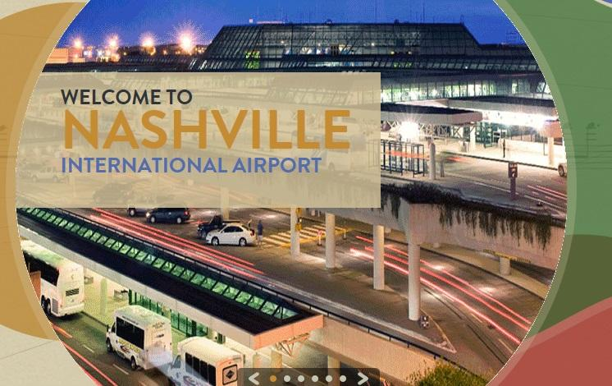
We drove to Nashville, Tn. from Calvert City, Ky.

Slide 7
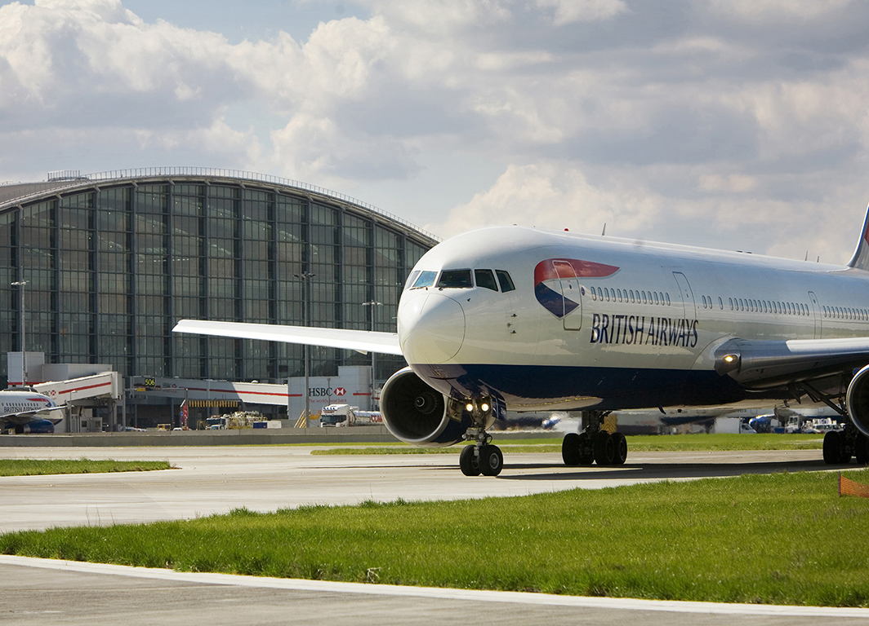
Heathrow, London, England

Slide 8
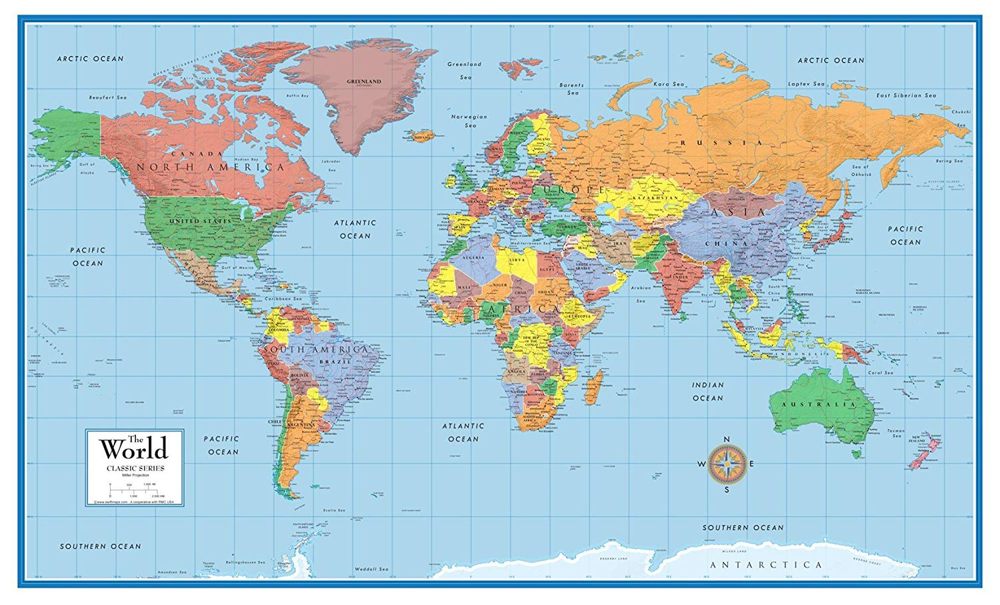

Slide 9
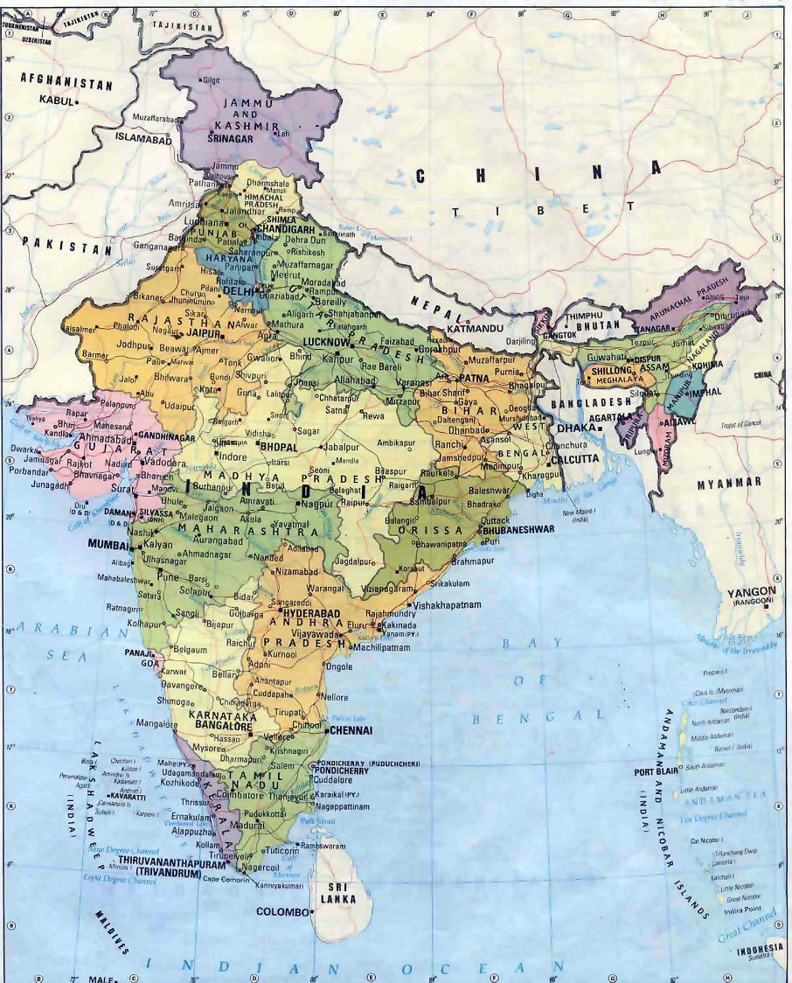
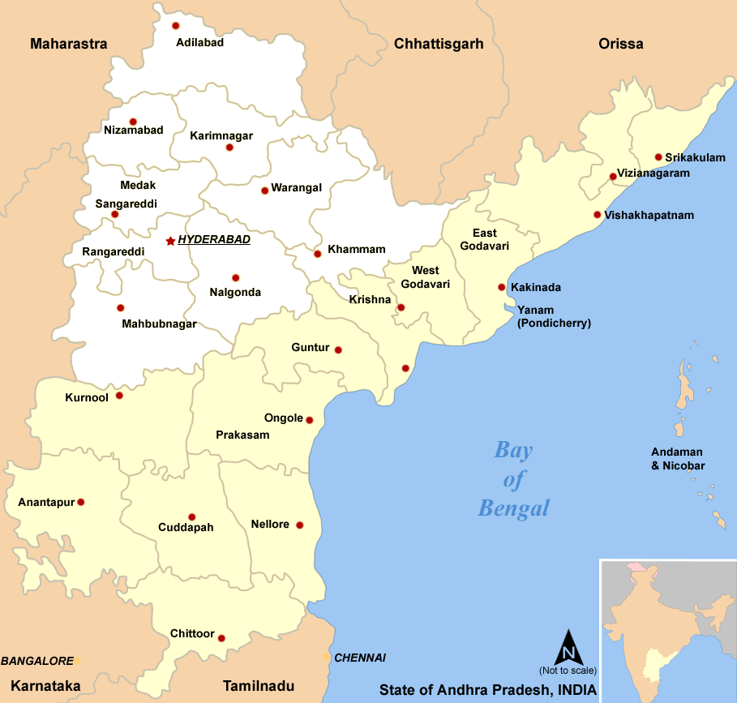

Slide 10
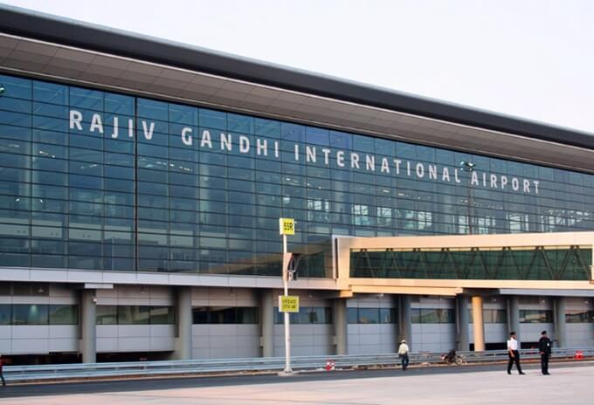
9,500 miles - 30 airport & flight hours later!

Slide 11
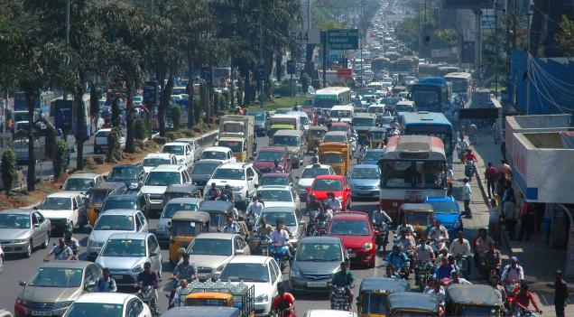

Slide 12
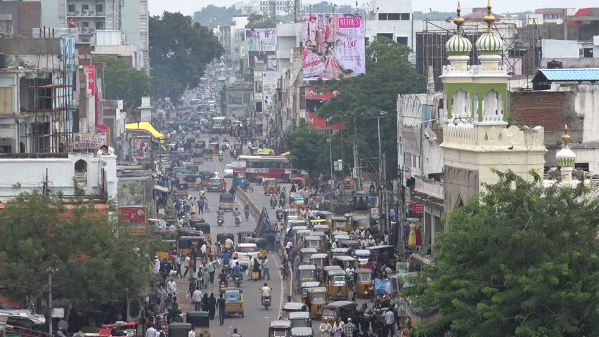

Slide 13
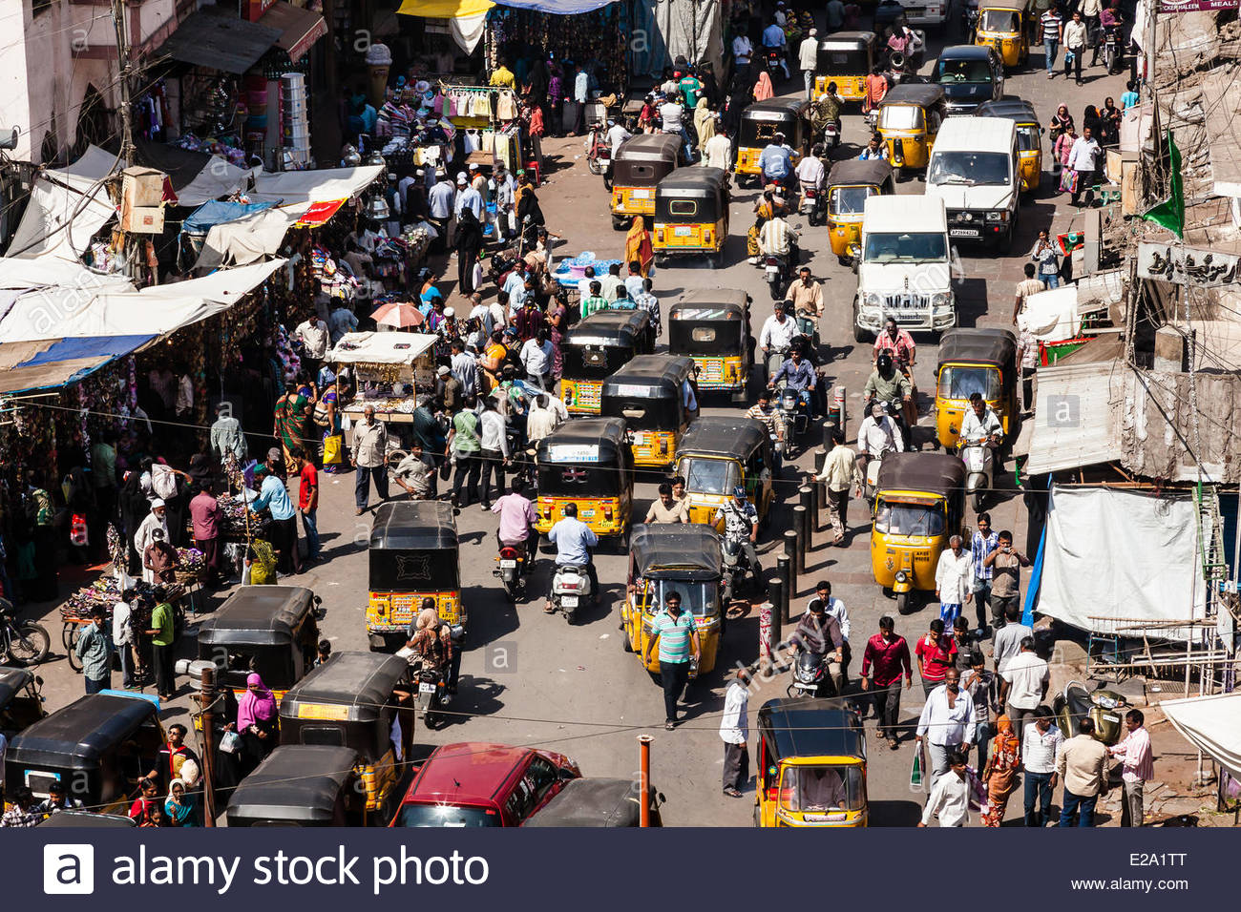

Slide 14
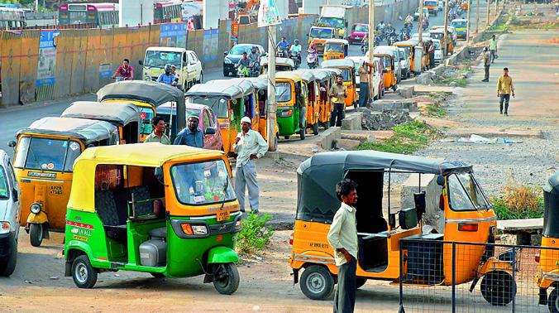

Slide 15
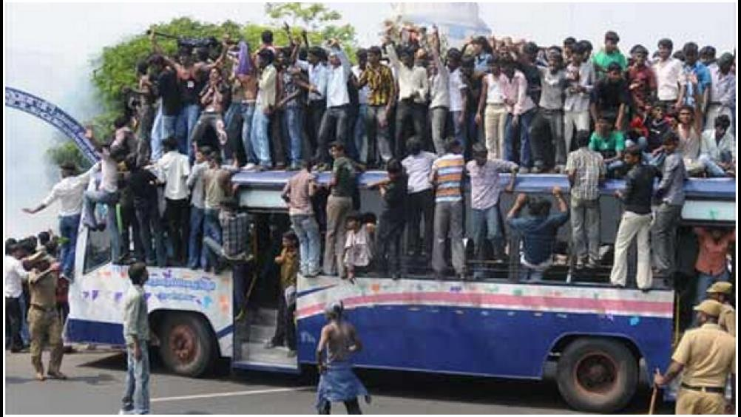

Slide 16
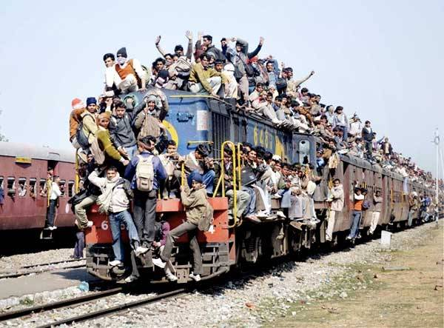

Slide 17
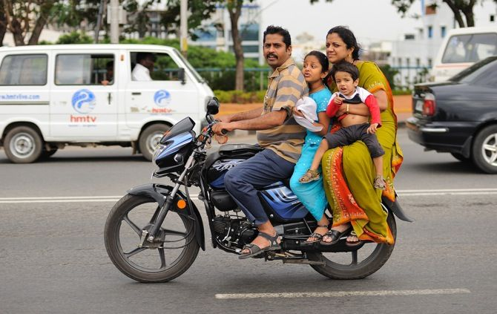

Slide 18
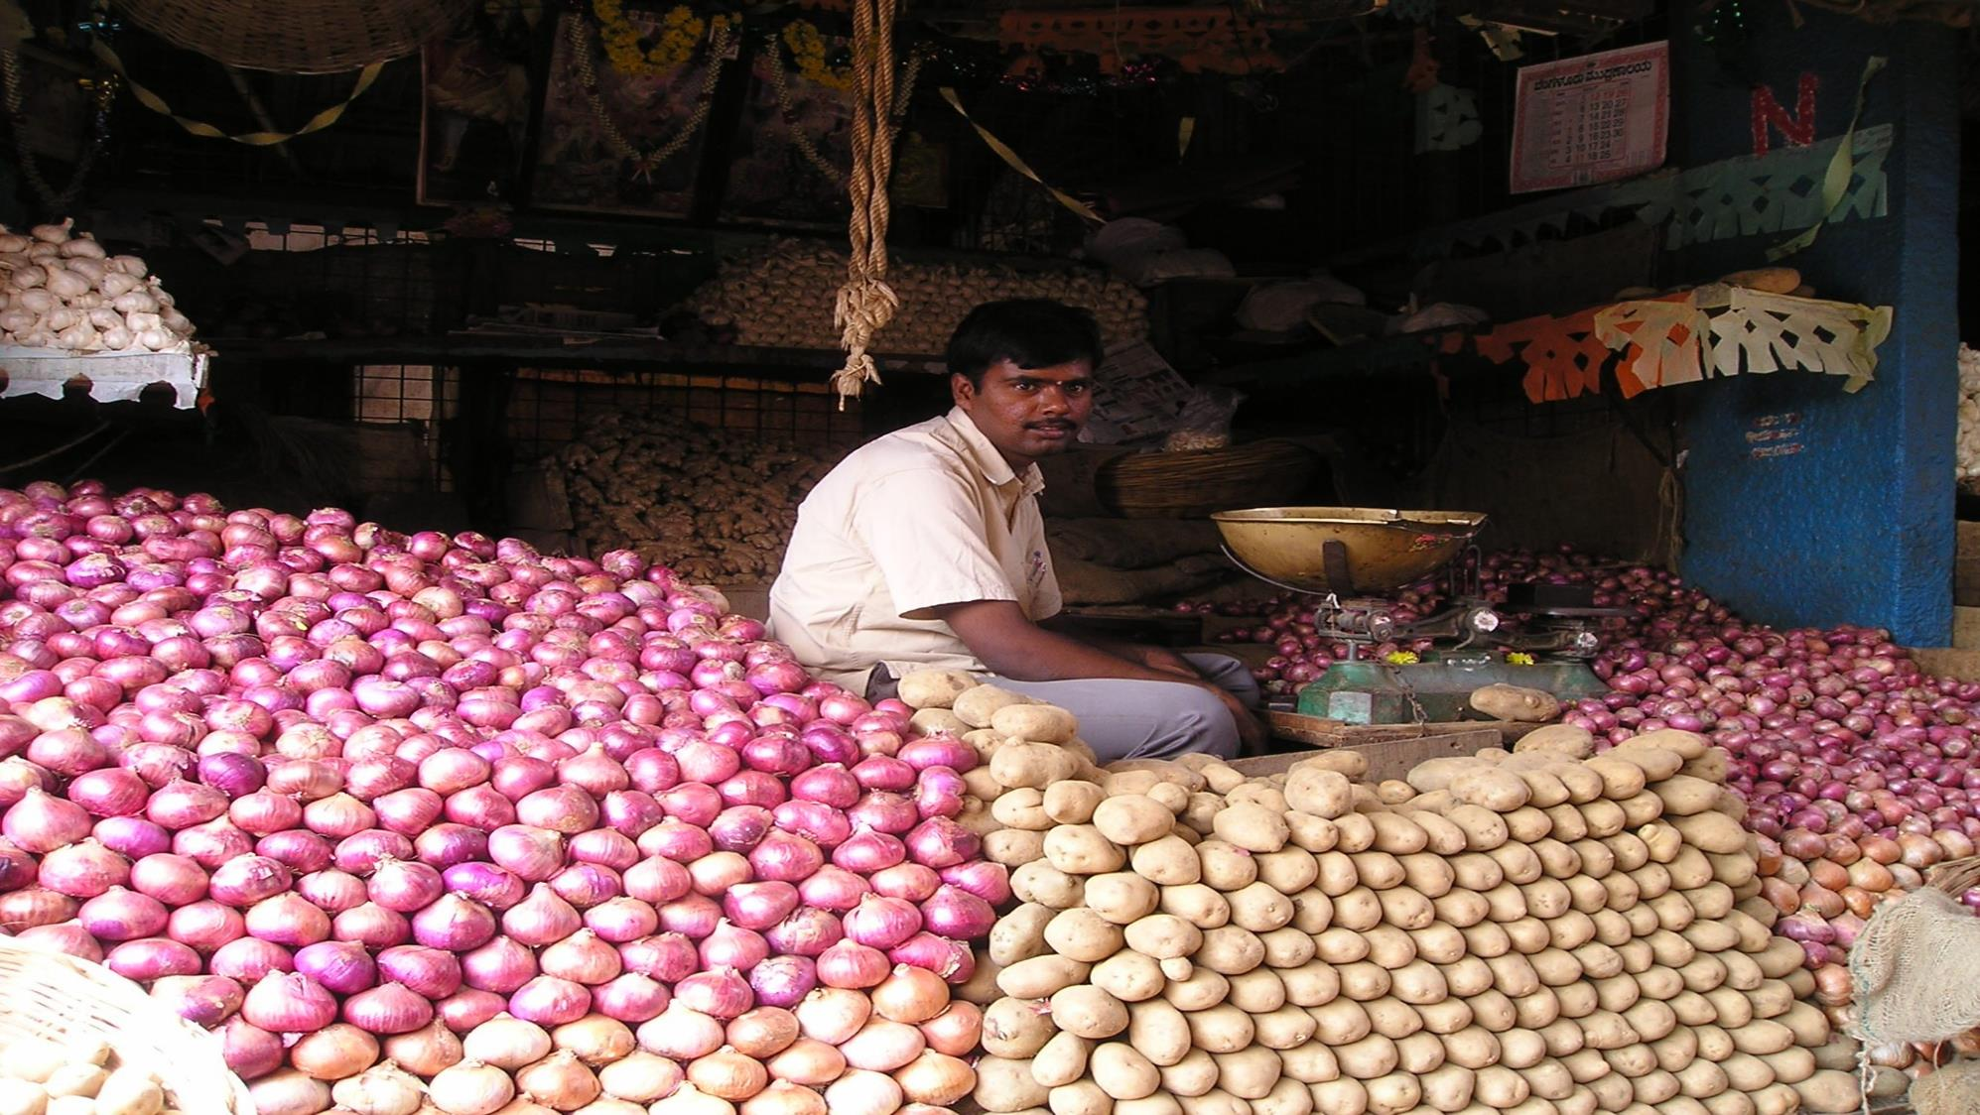

Slide 19
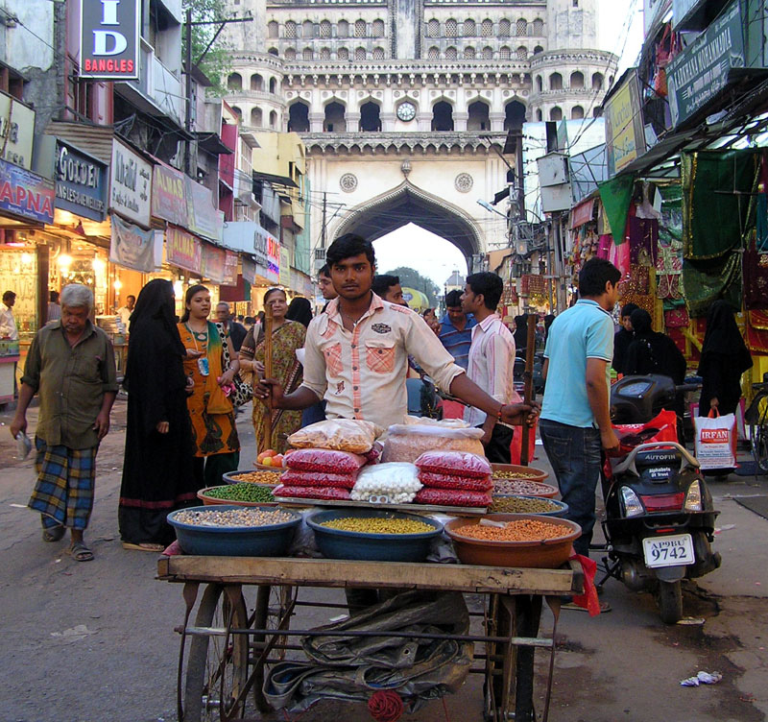

Slide 20
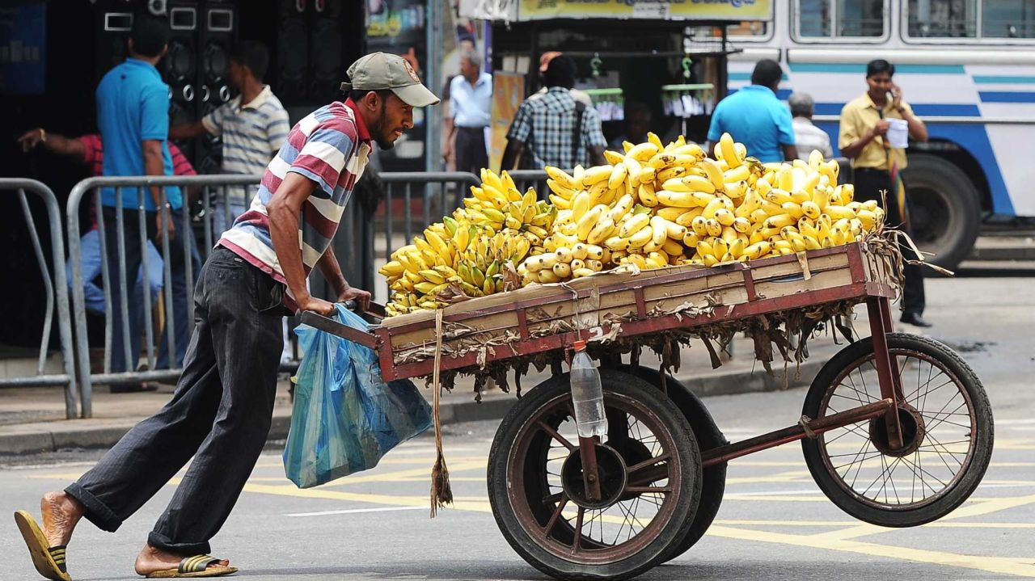

Slide 21
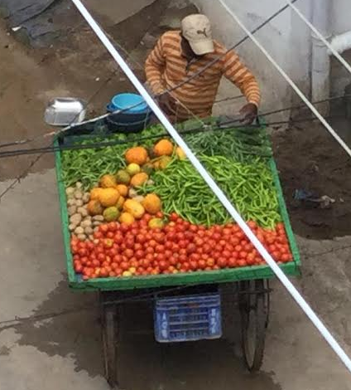

Slide 22
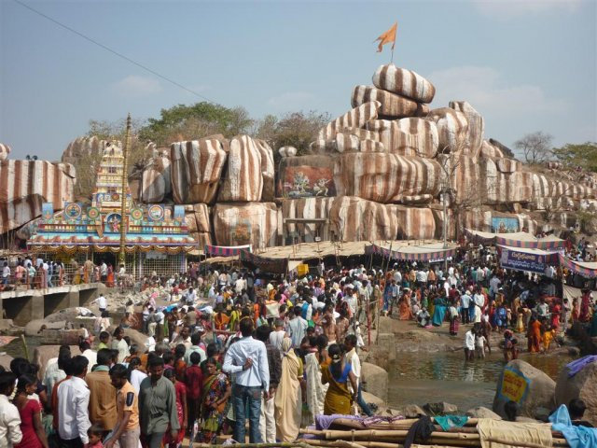
80% of India is Hindu

Slide 23
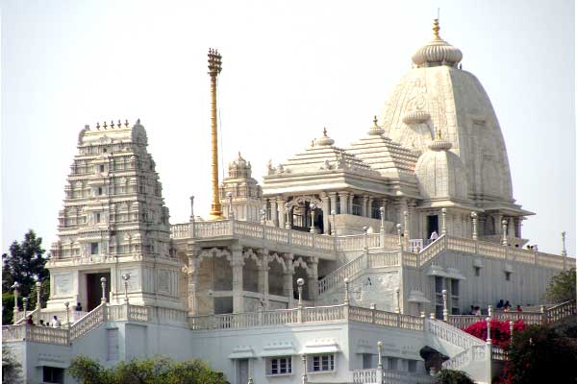
Birla Hindu Temple

Slide 24
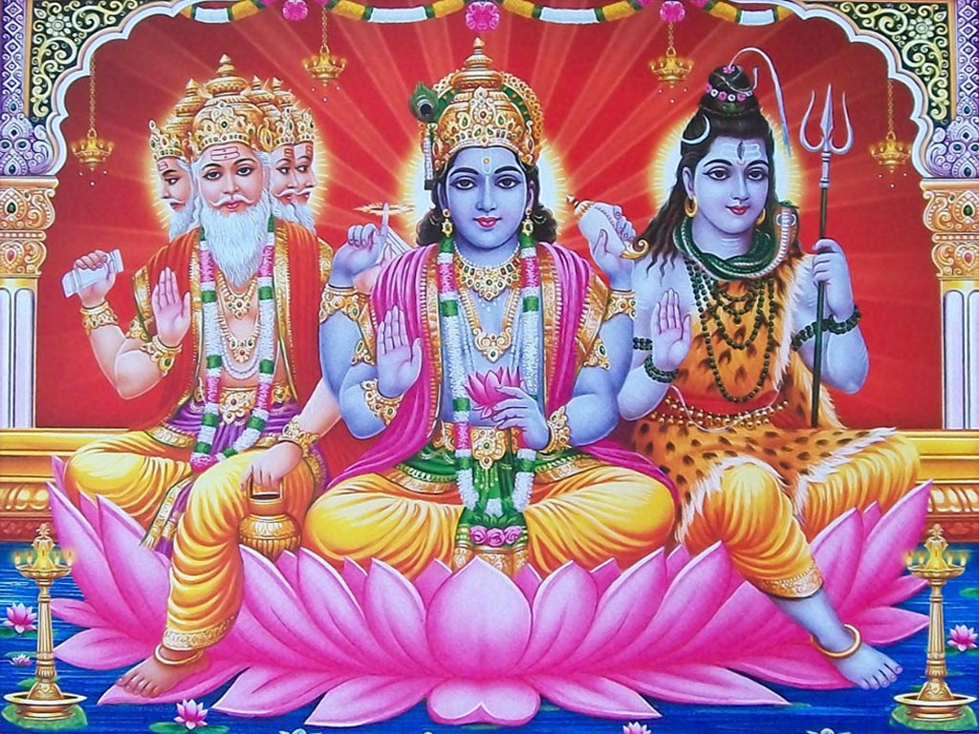
Brahma
Vishnu
Shiva

Slide 25
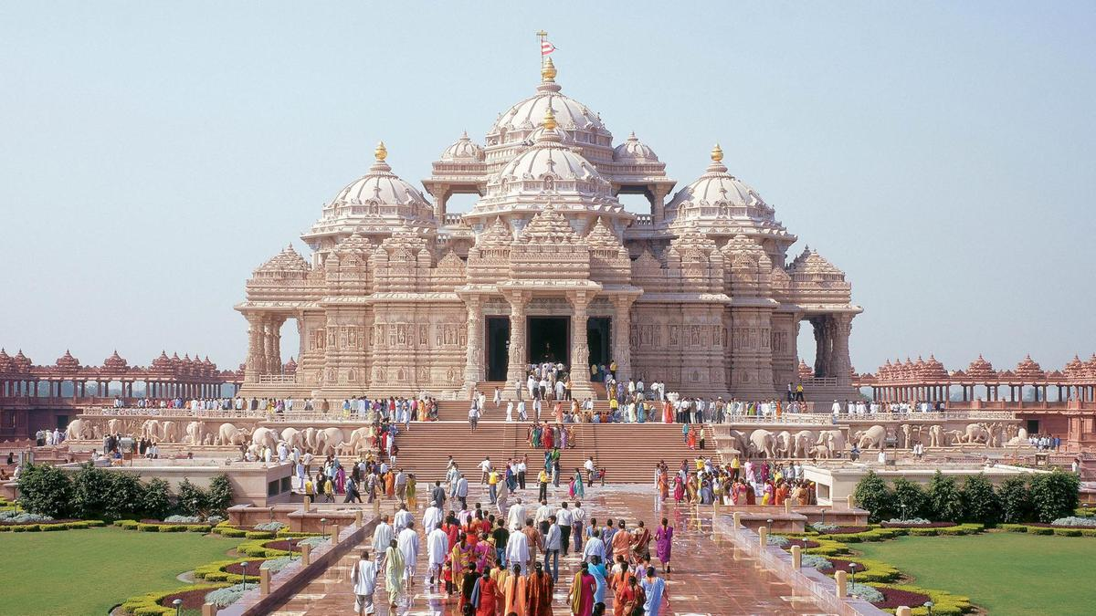

Slide 26
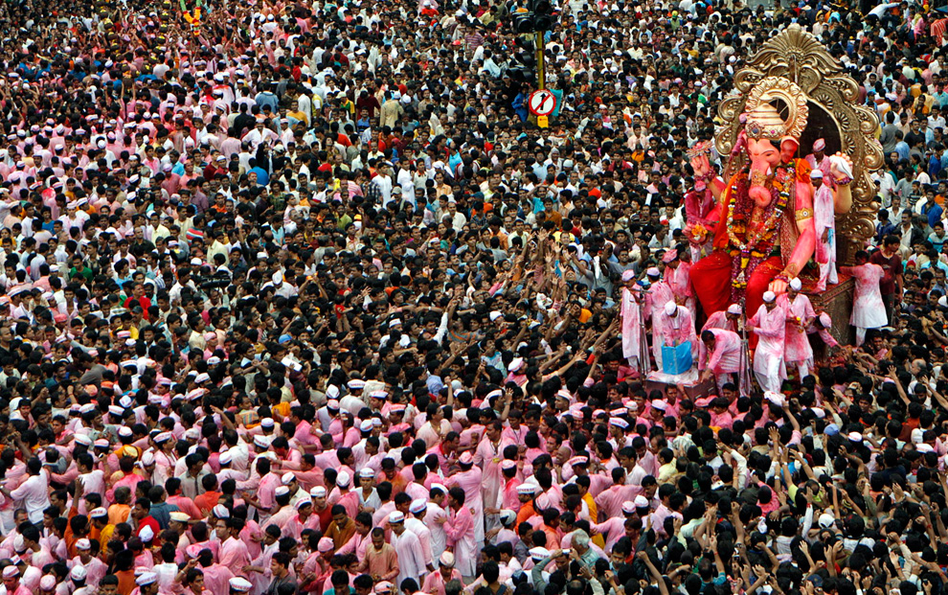

Slide 27
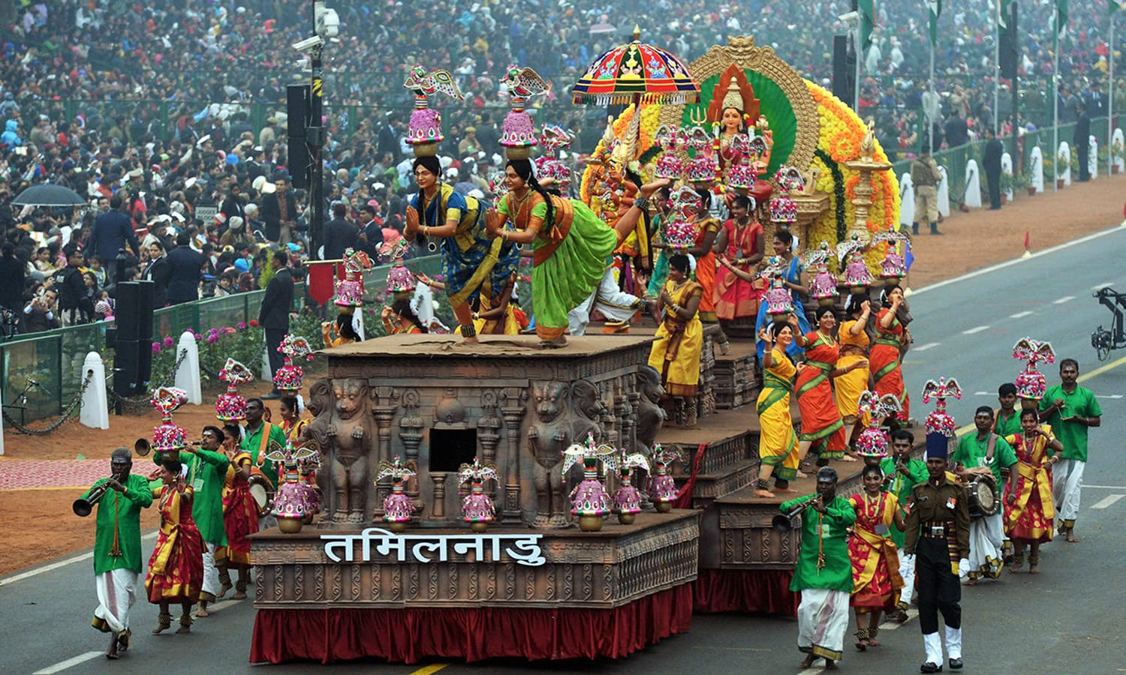

Slide 28
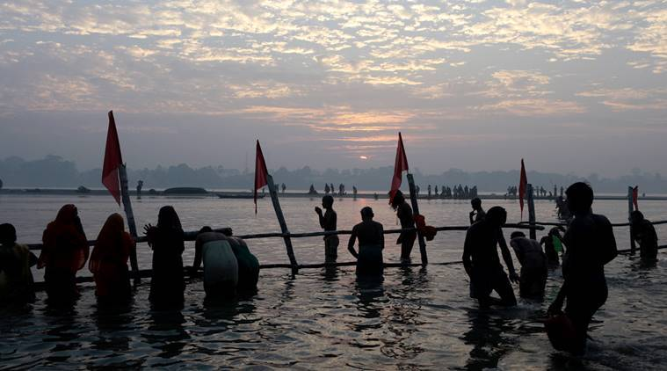

Slide 29
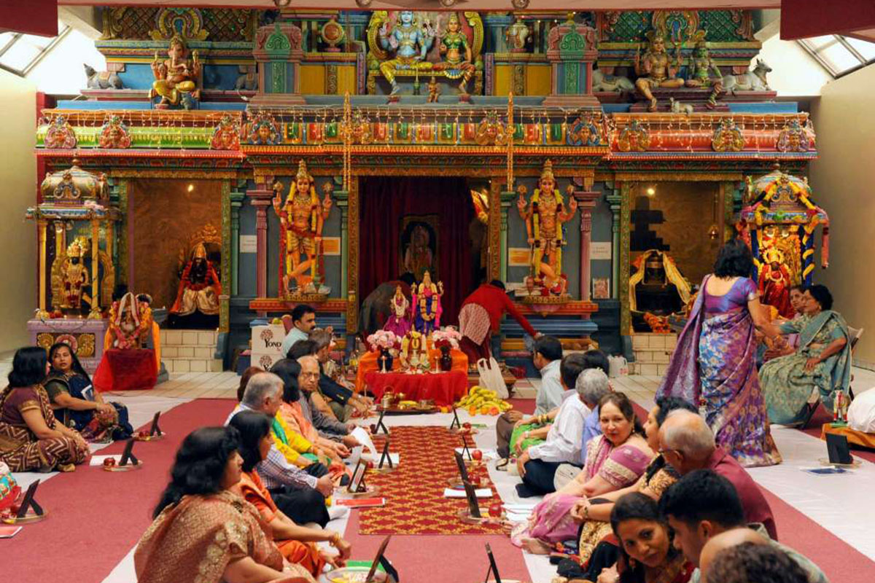

Slide 30
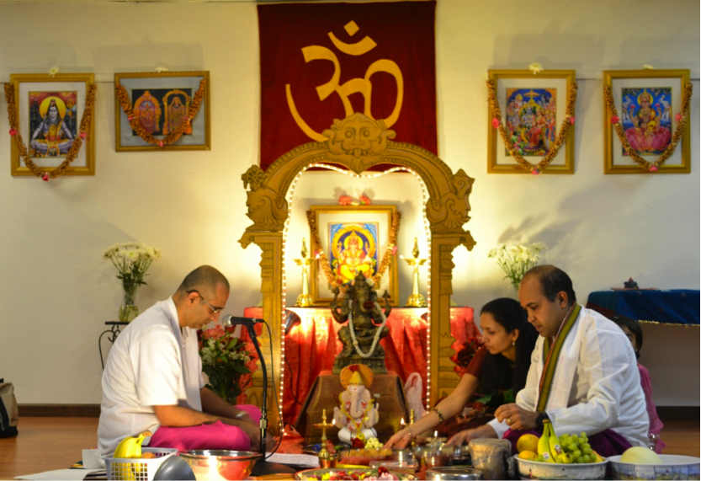

Slide 31
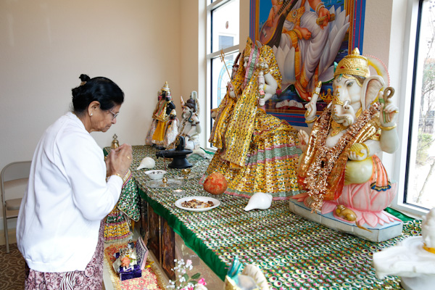

Slide 32
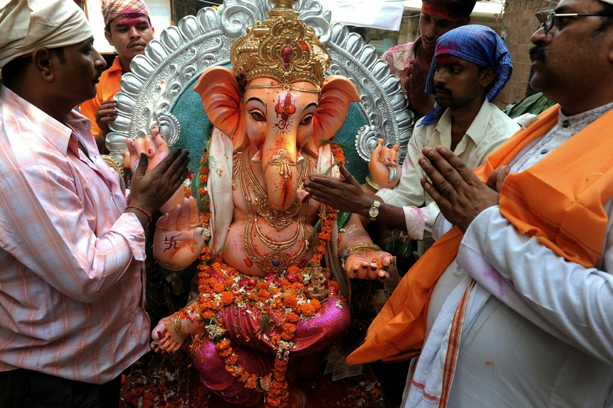

Slide 33
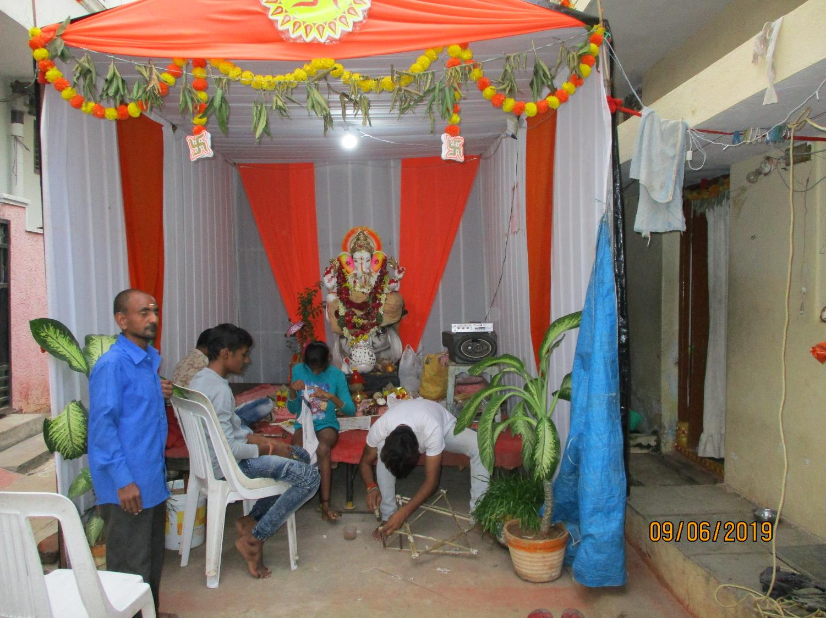
Ganesh:
Son of Shiva and Parvati
In the street near the house where we stayed in Shanthi Nagar

Slide 34
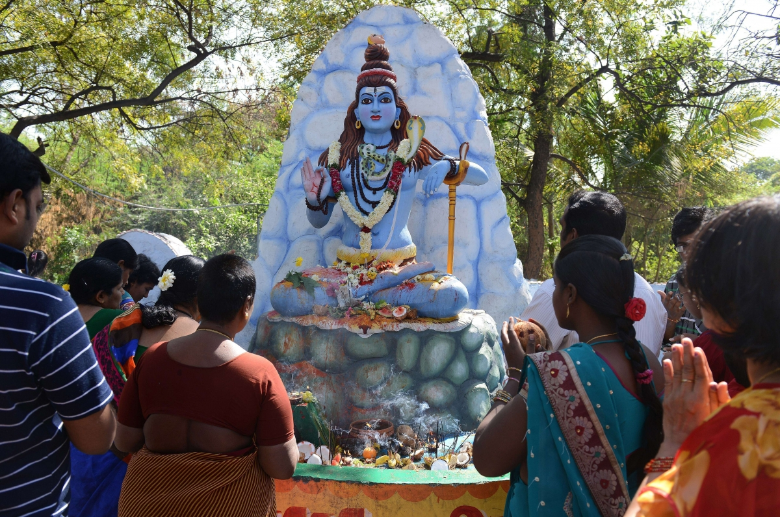

Slide 35
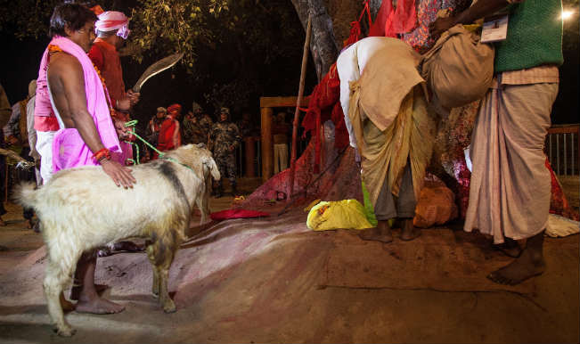

Slide 36
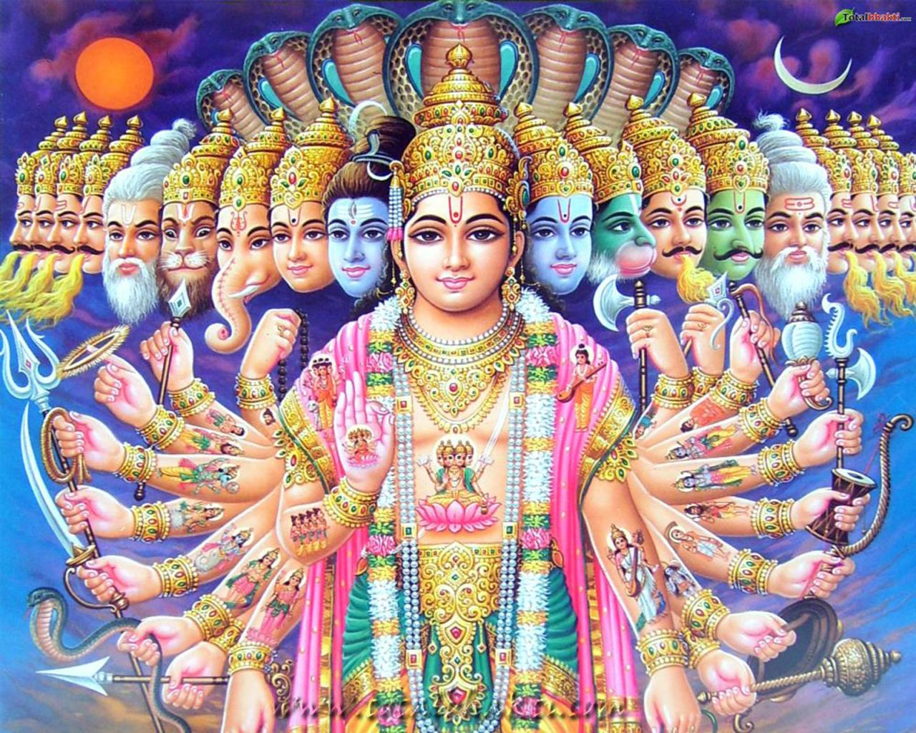

Slide 37
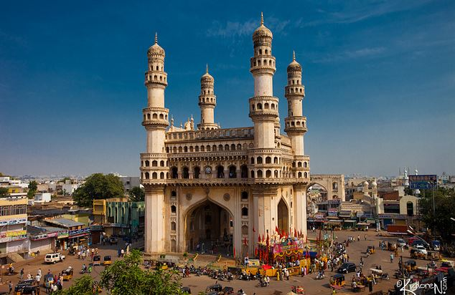
13% of India is Islam
Charminar
1591 A.D.
Islam

Slide 38
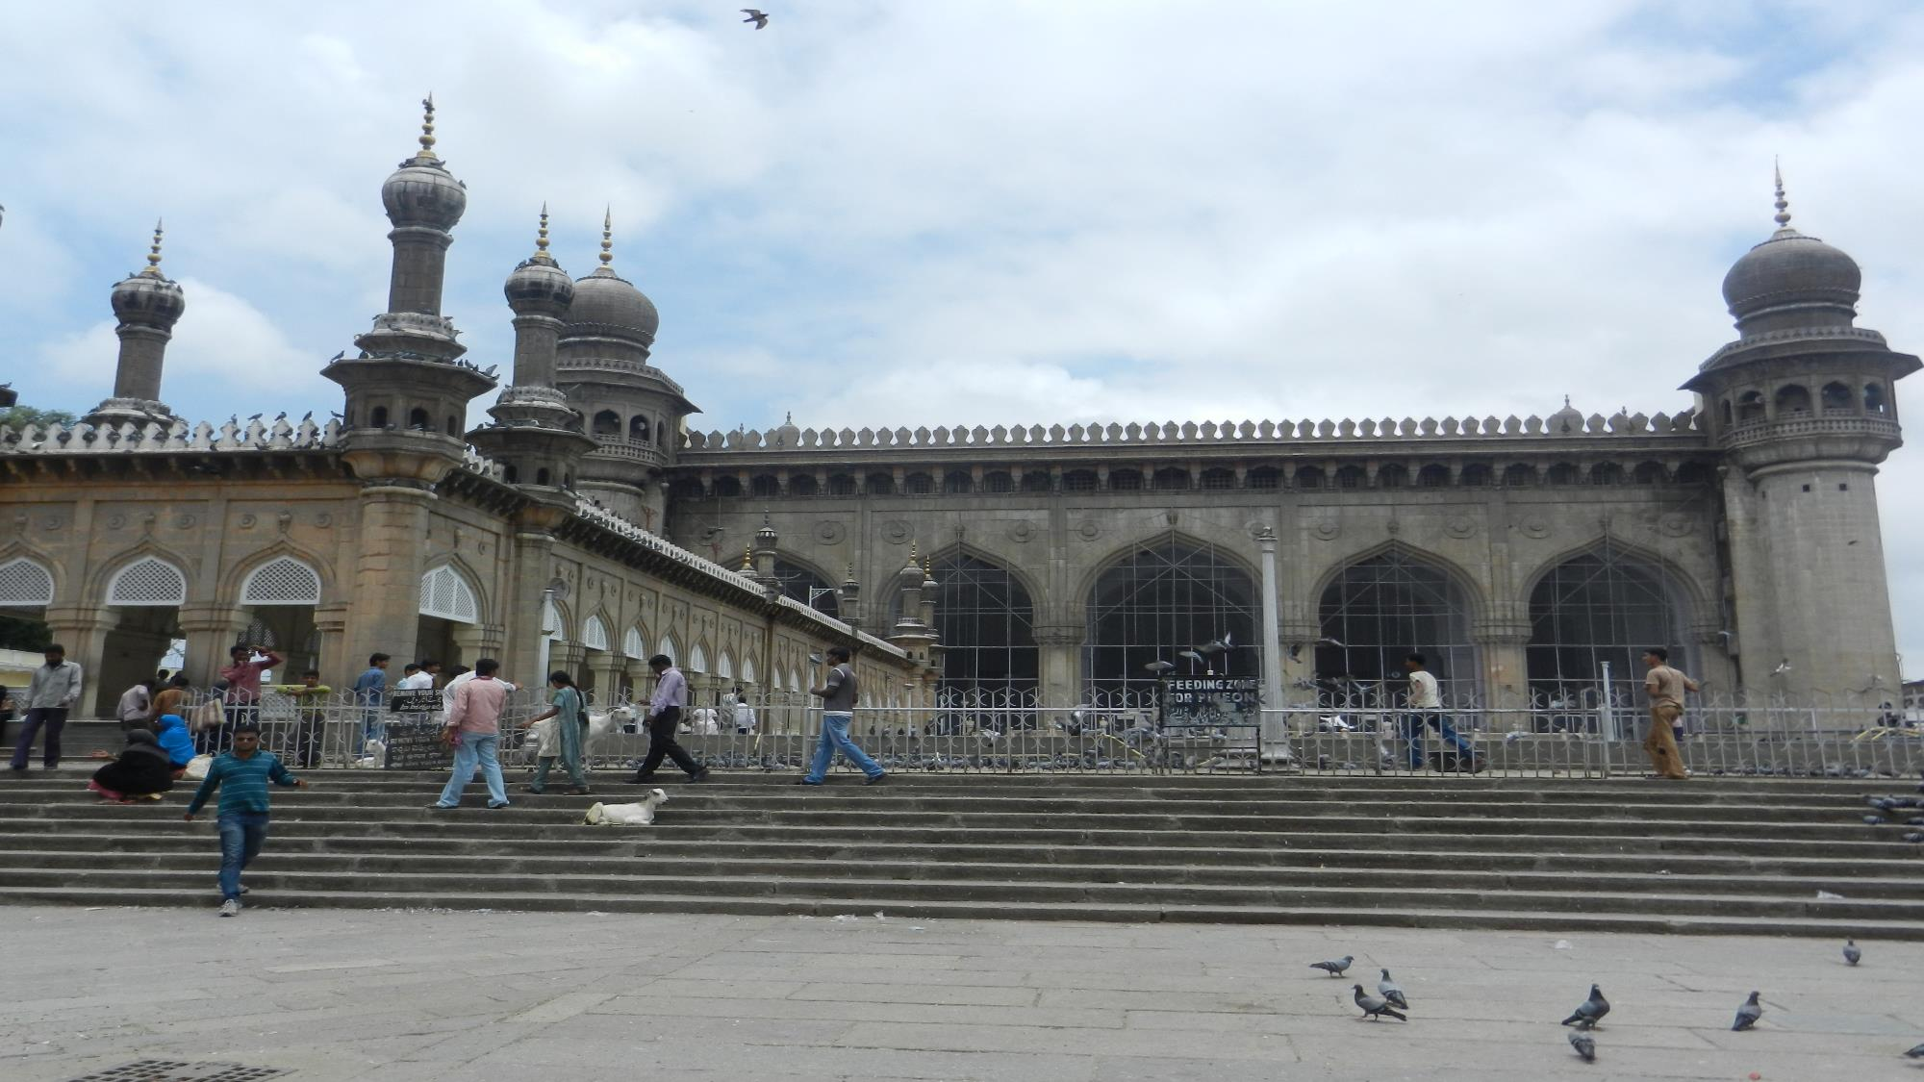
Mosque in Hyderabad

Slide 39
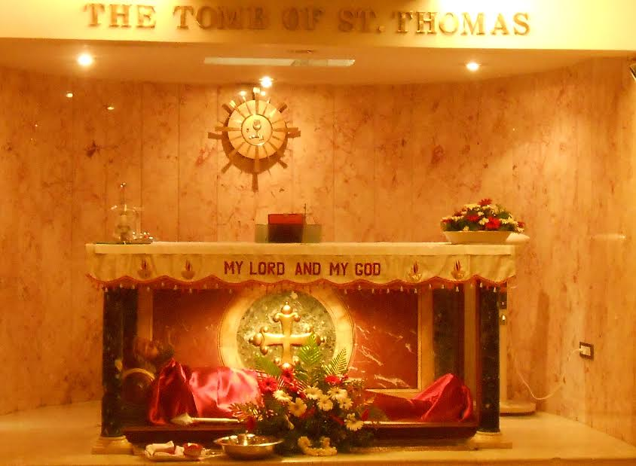
Chennai, Tamil Nadu, India

Slide 40
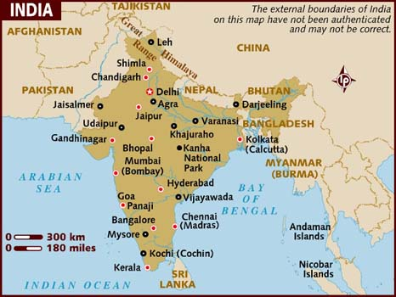

Slide 41
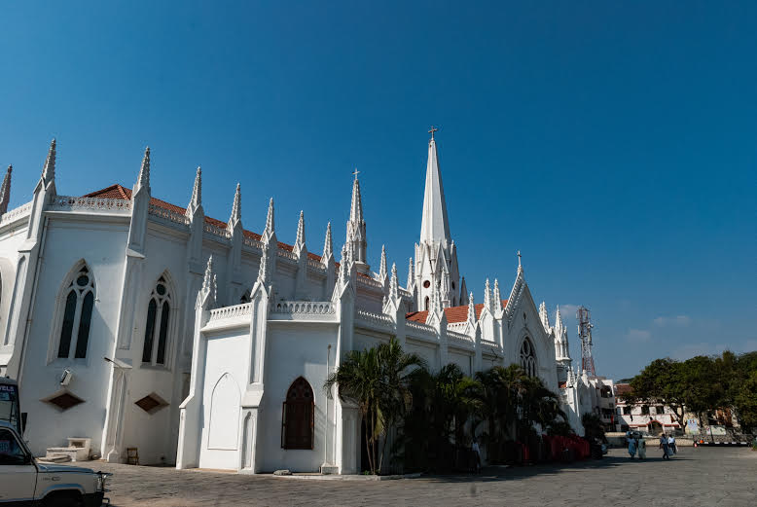

Slide 42
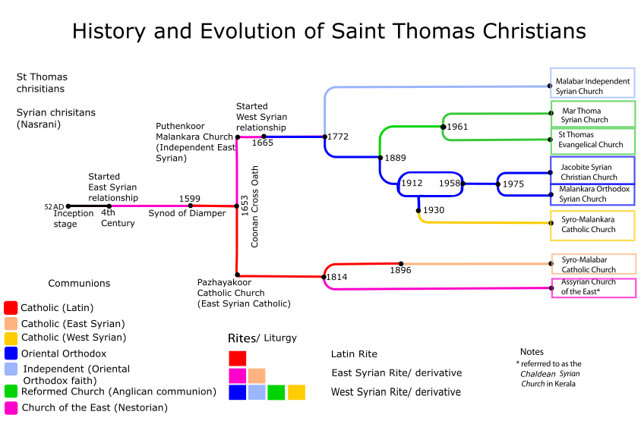

Slide 43
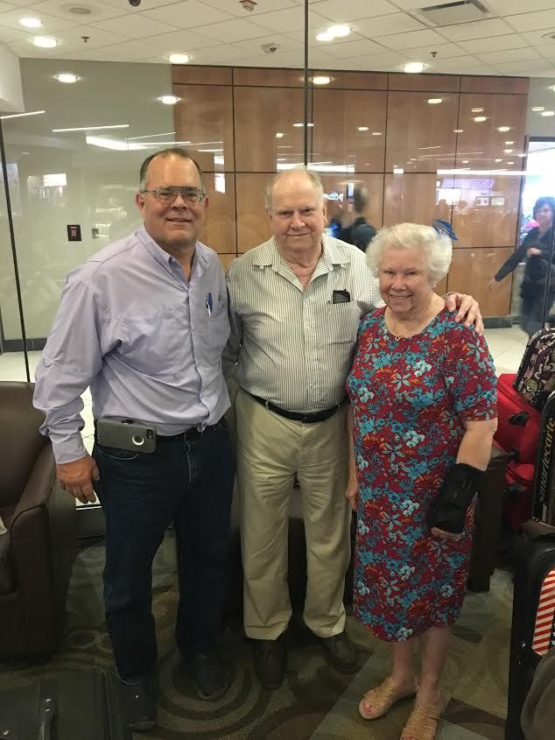
Our son in law, Marc Morris, also preached and taught in India – but in other locations. He is married to our elder daughter, Ruth.
Edna had broken her arm at the wrist …

Slide 44
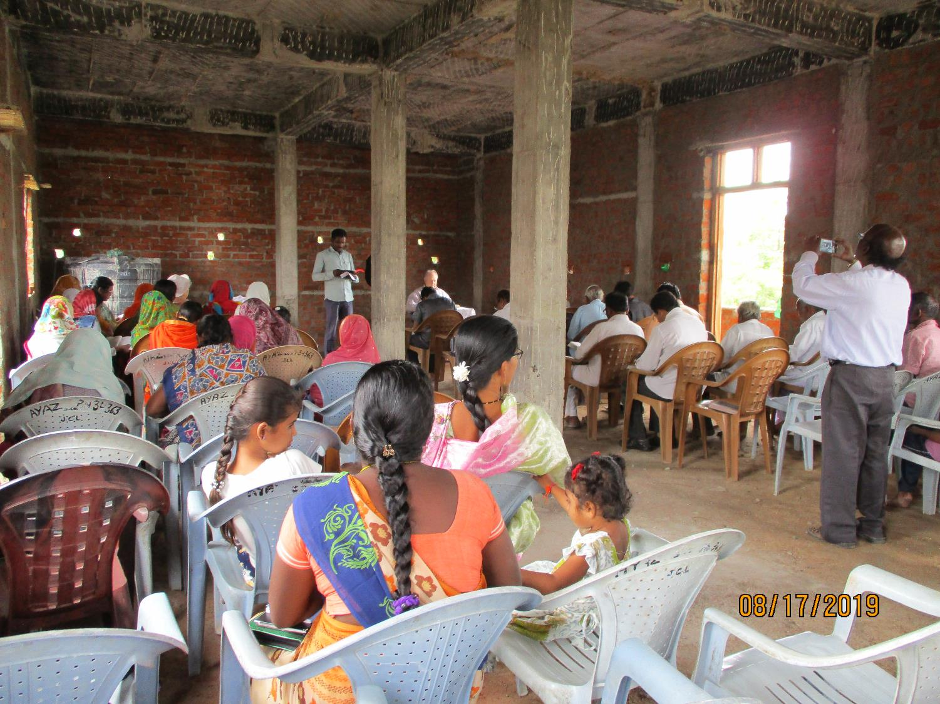
Our first Lord’s Day was with the church in Jadcherla -
Brother I.S. Deenadayal is the preacher

Slide 45
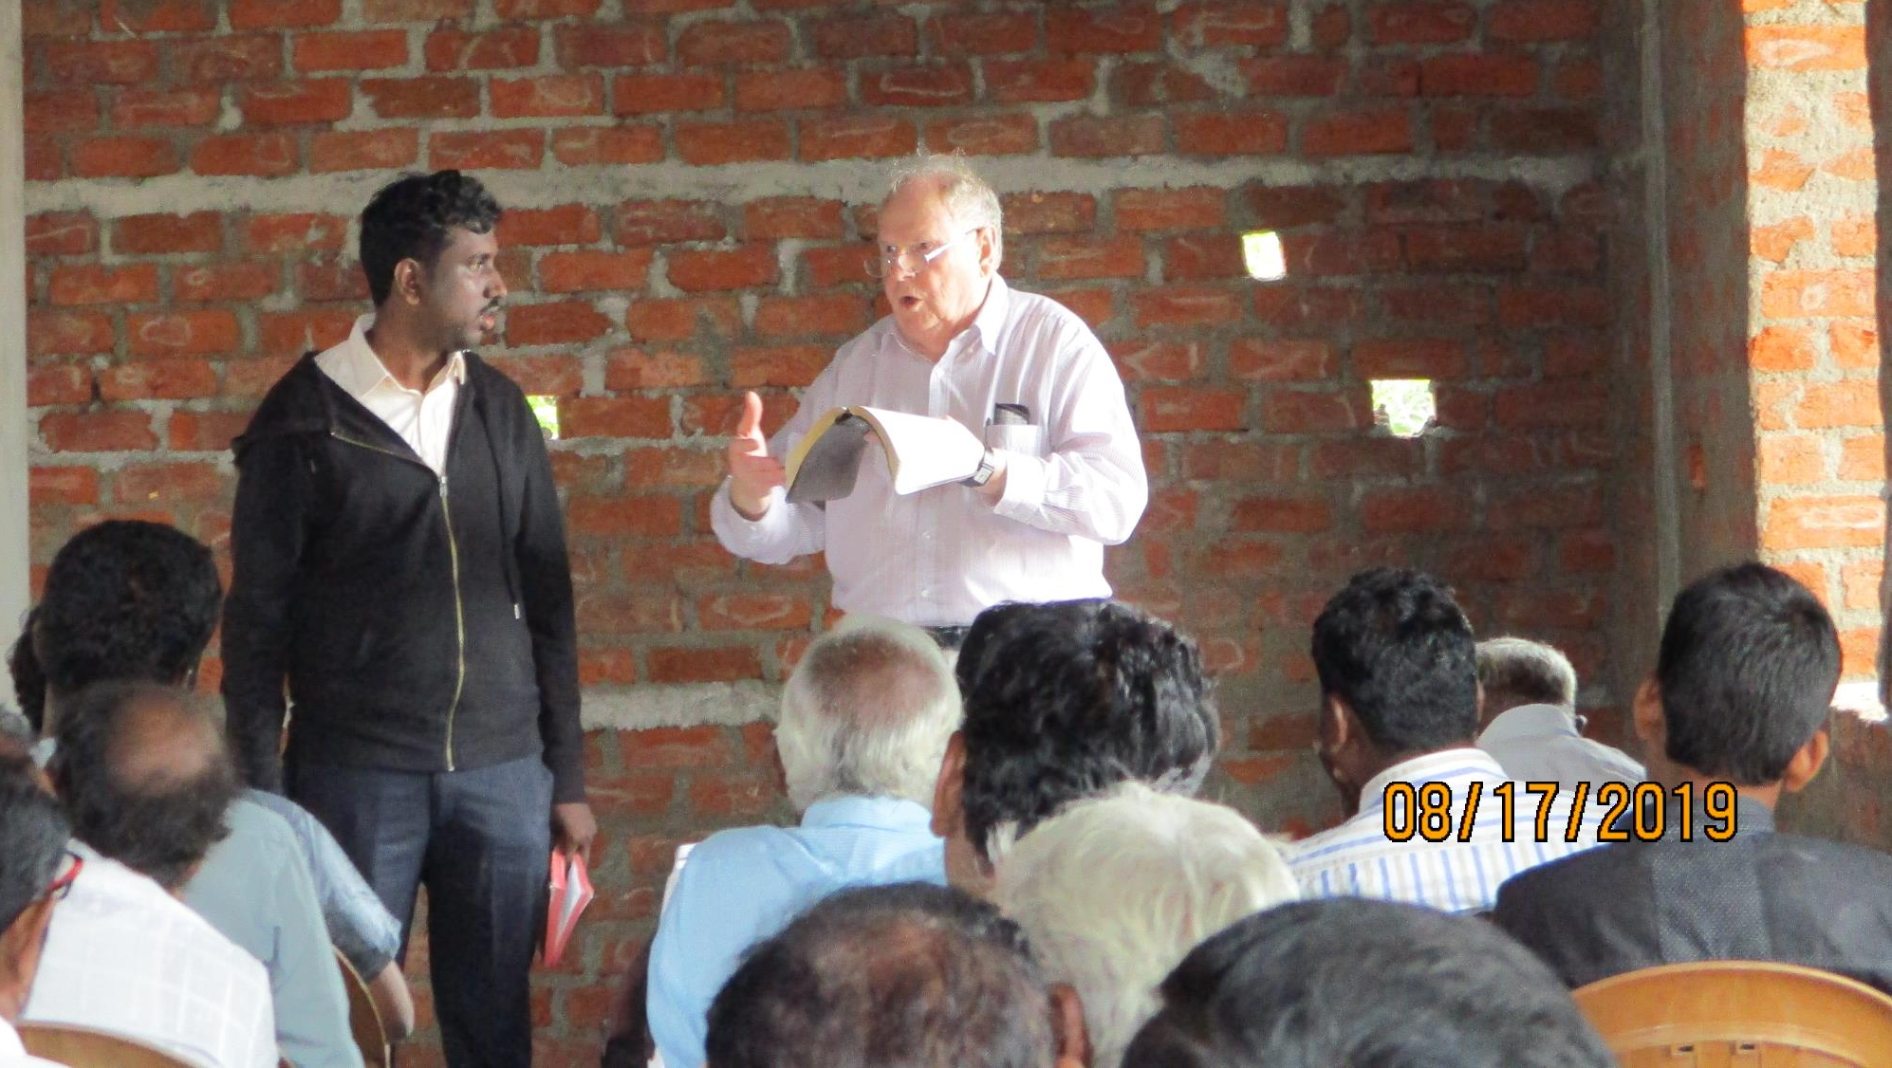
Brother Samuel (Sam) was fighting a bad cold – but he wanted to translate …

Slide 46
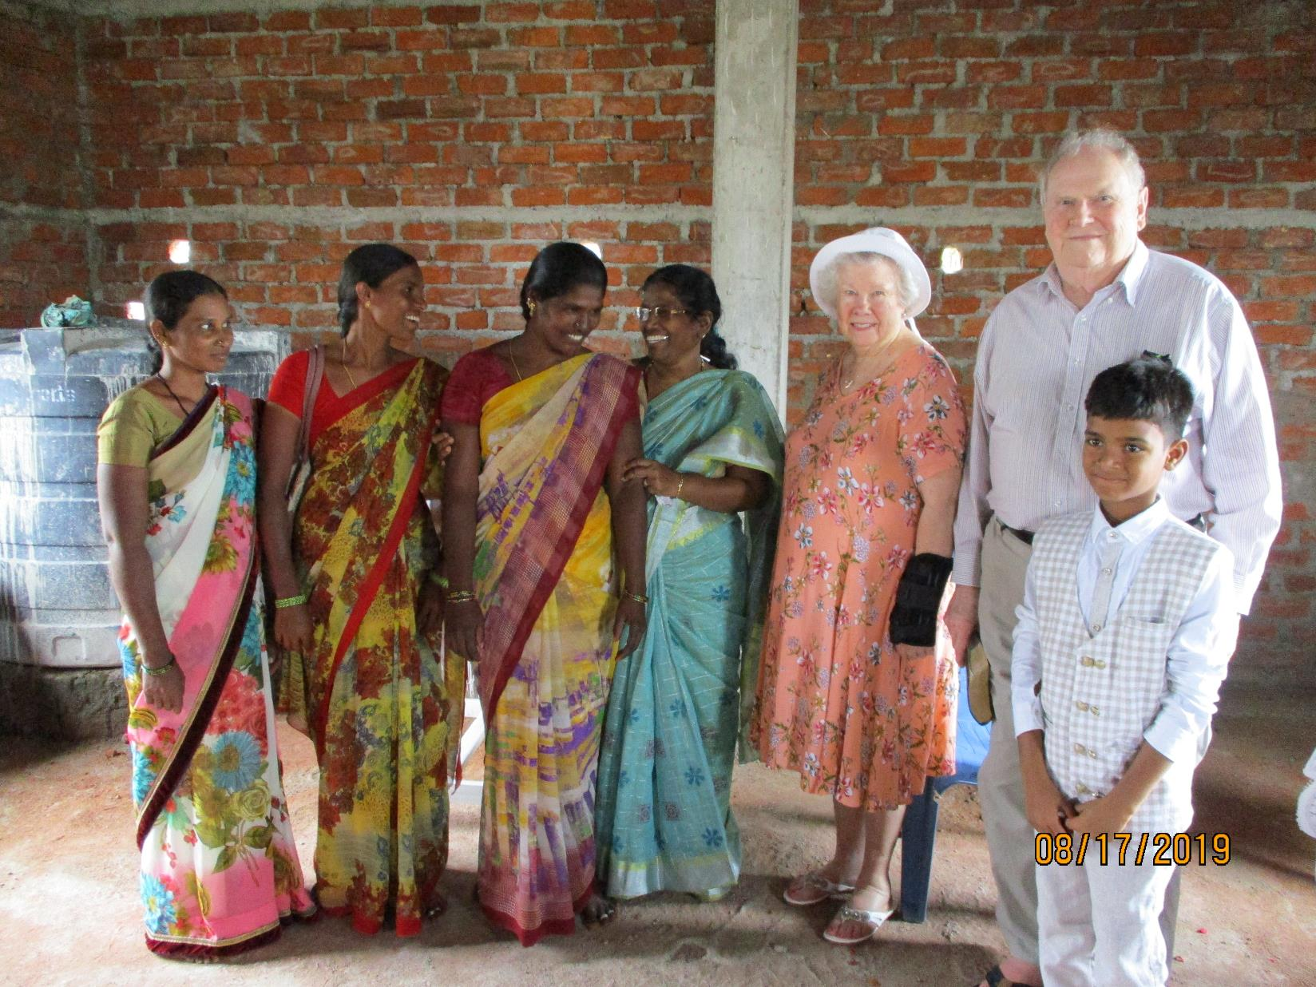
India is 10 ½ hours ahead of our Central Standard time here.
Edna and I are still jet laggy

Slide 47
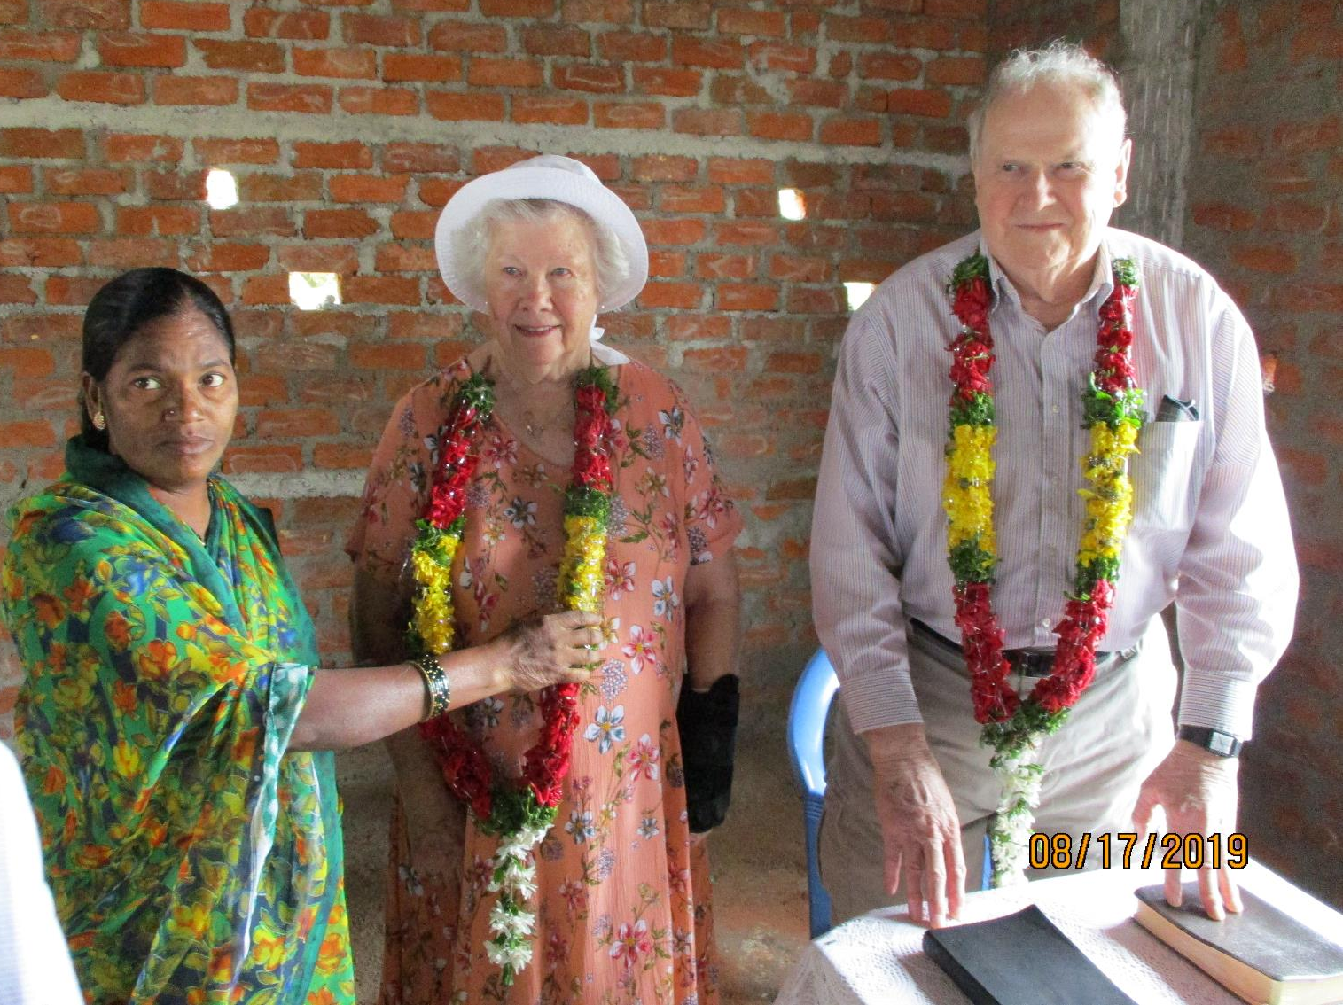
The brethren insist on giving us a welcome to India with a garland …

Slide 48
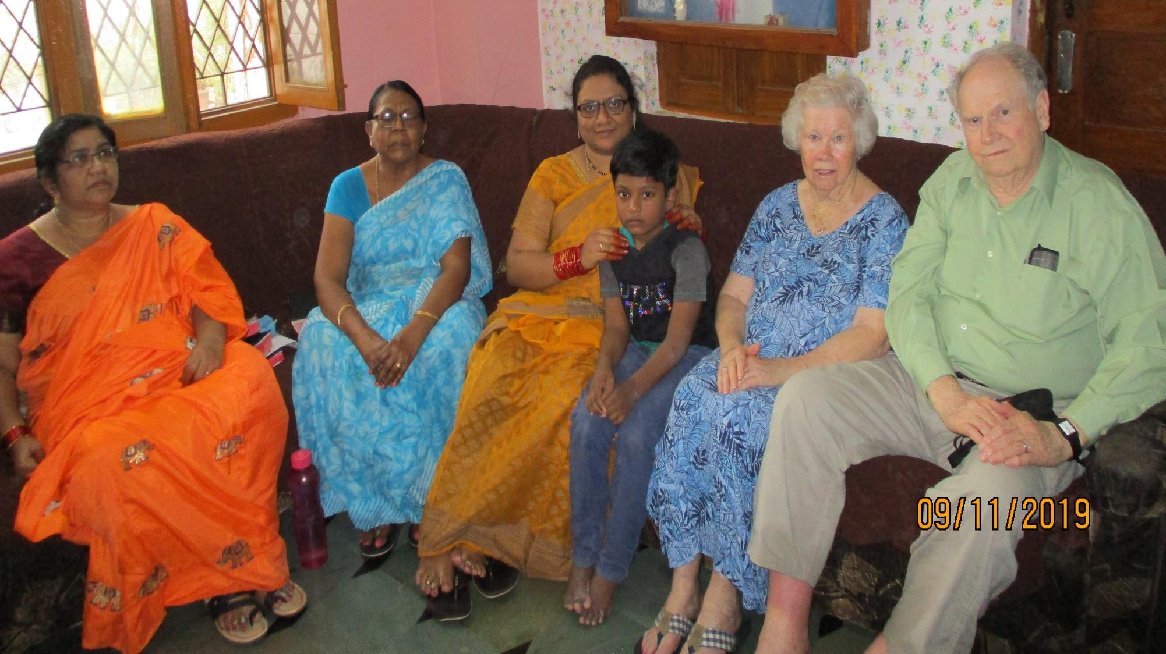

Slide 49
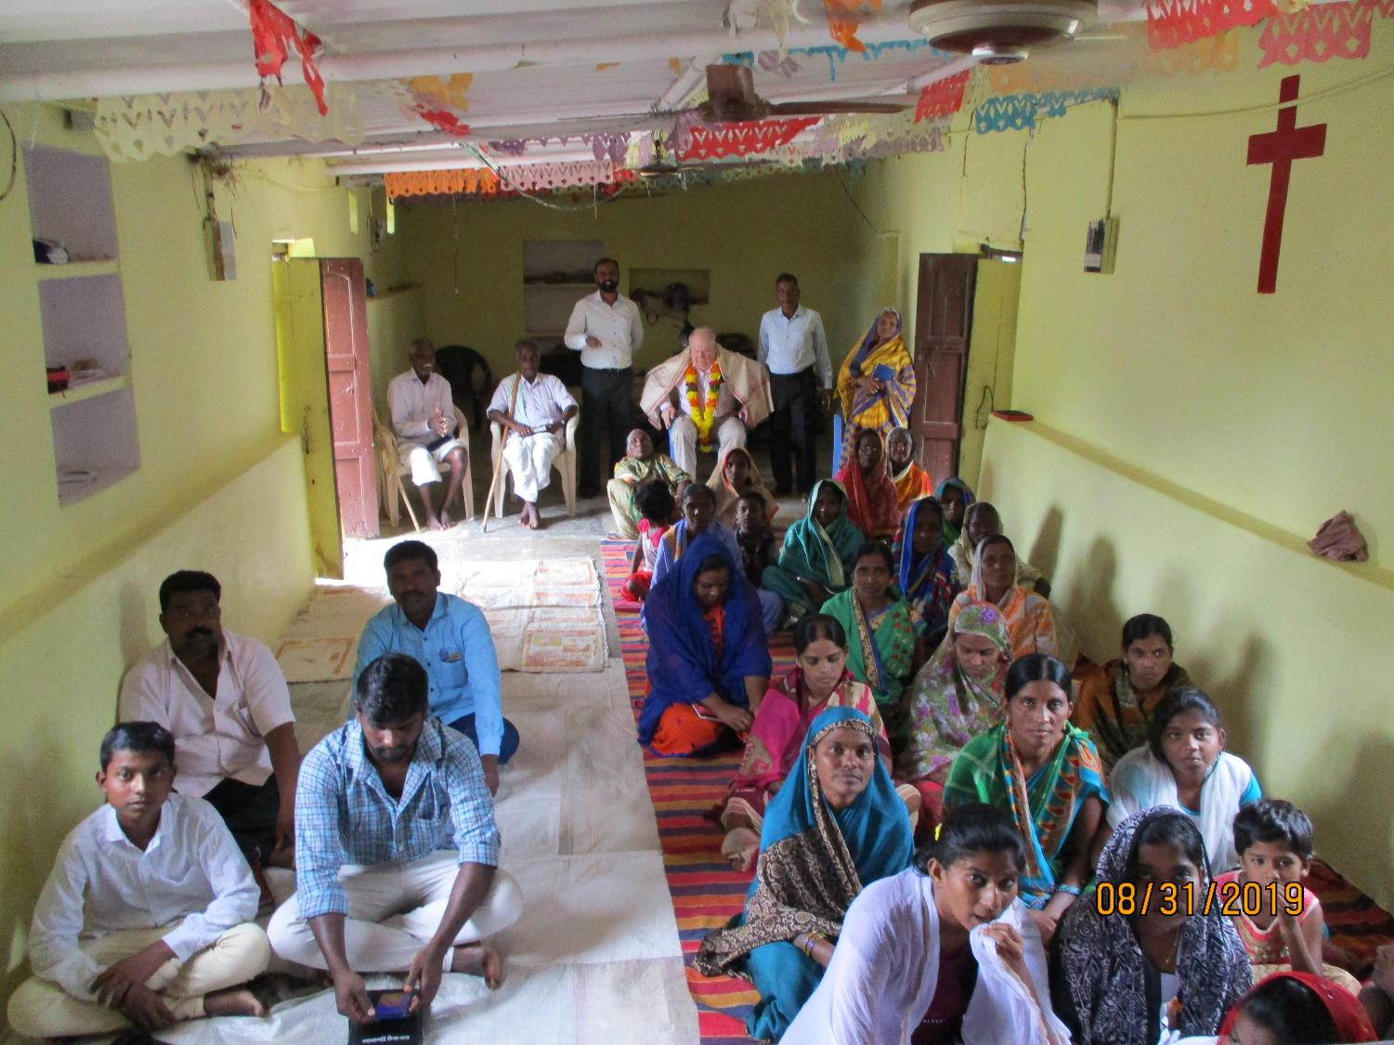
North east of Hyderabad

Slide 50
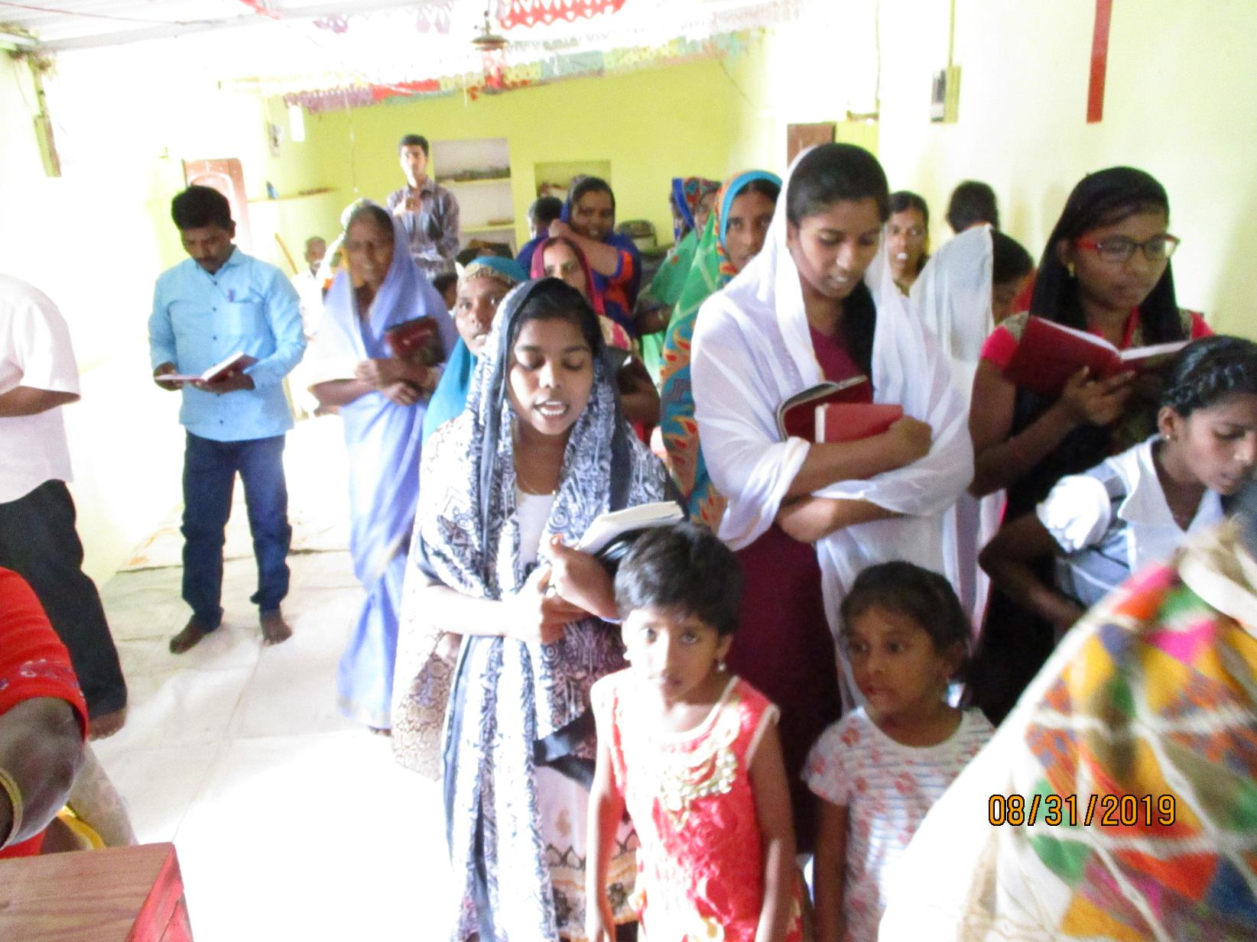

Slide 51
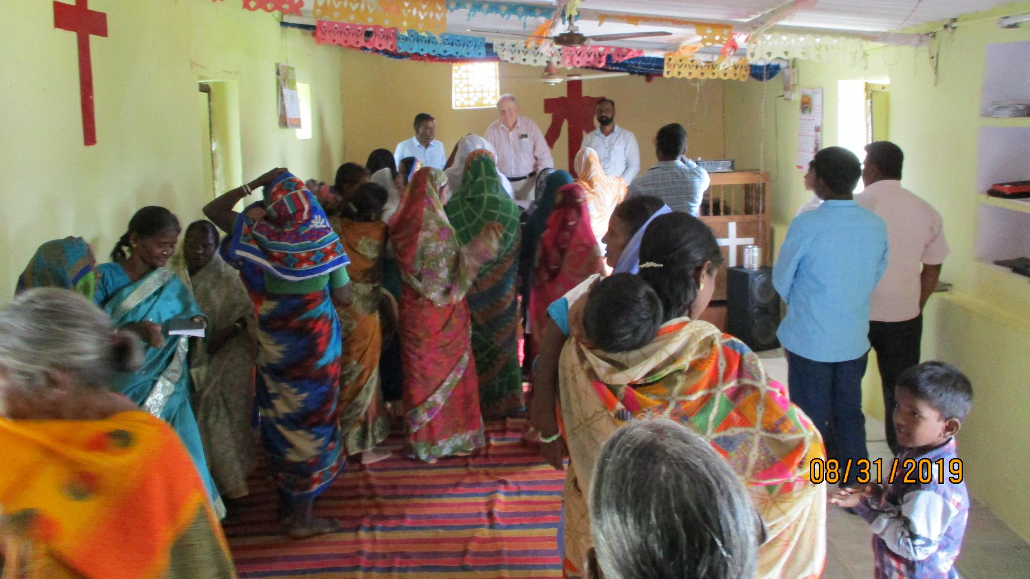

Slide 52
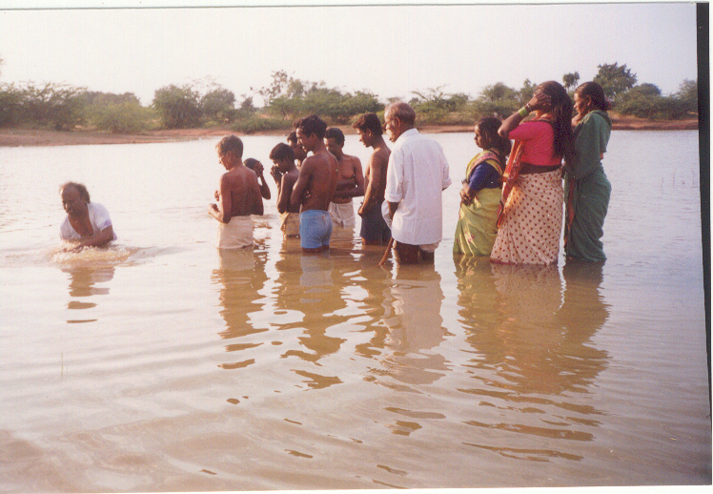
Buried with Christ …

Slide 53
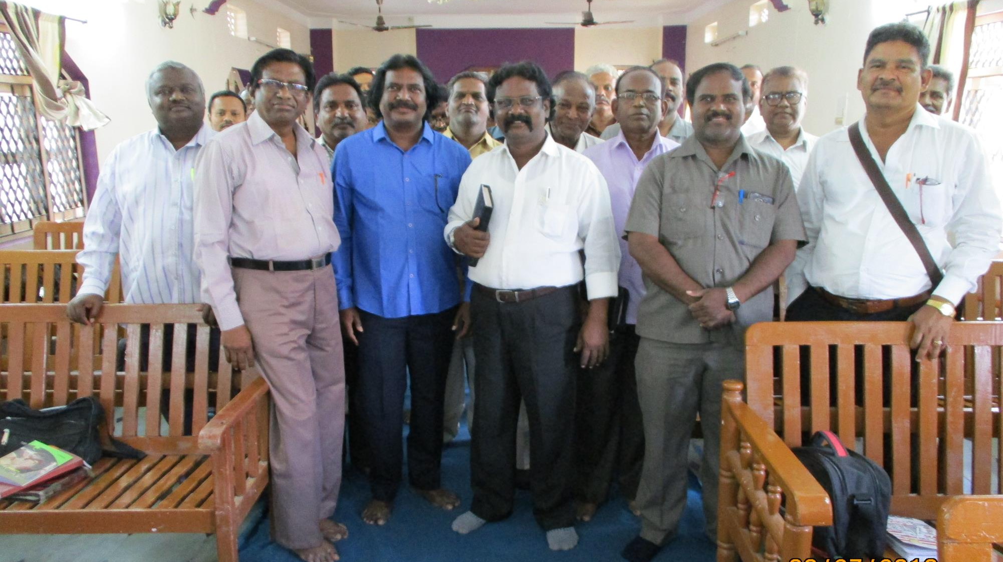

Slide 54
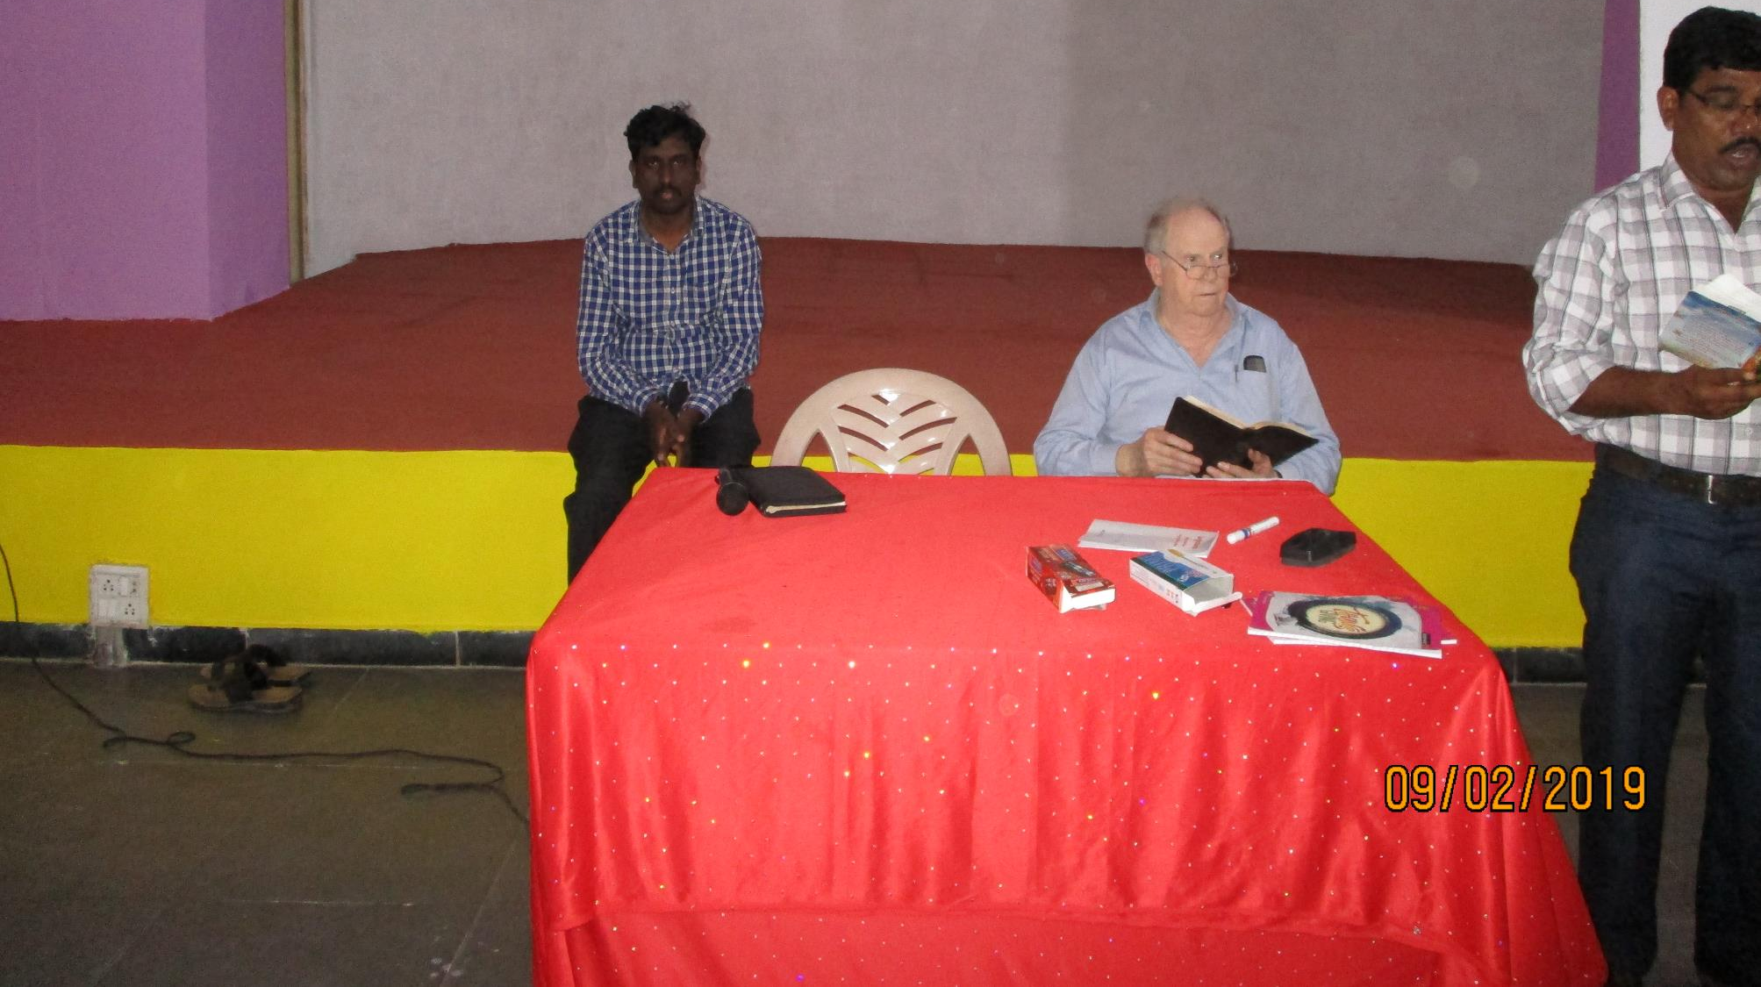
Sam is still fighting a bad cold
He eventually had to stay home in bed

Slide 55


Slide 56


Slide 57


Slide 58

Every group had to welcome us with a garland, flowers,
and a ”drape”

Slide 59


Slide 60


Slide 61


Slide 62


Slide 63


Slide 64


Slide 65


Slide 66


Slide 67


Slide 68


Slide 69


Slide 70


Slide 71


Slide 72


Slide 73


Slide 74


Slide 75

9400 miles to get back home …

Slide 76

London Heathrow International Airport

Slide 77


Slide 78


Slide 79

We live two miles south of Calvert City, Ky.,
just off of Kentucky 95

Slide 80

Back home again and thankful to our Father above …

Slide 81
We wish to humbly thank all who prayed for us, and also supported us, in this effort to preach and teach the gospel of Christ in India – we simply could not do this work without the blessings of the Lord along with your prayers and support!

